Slide 1
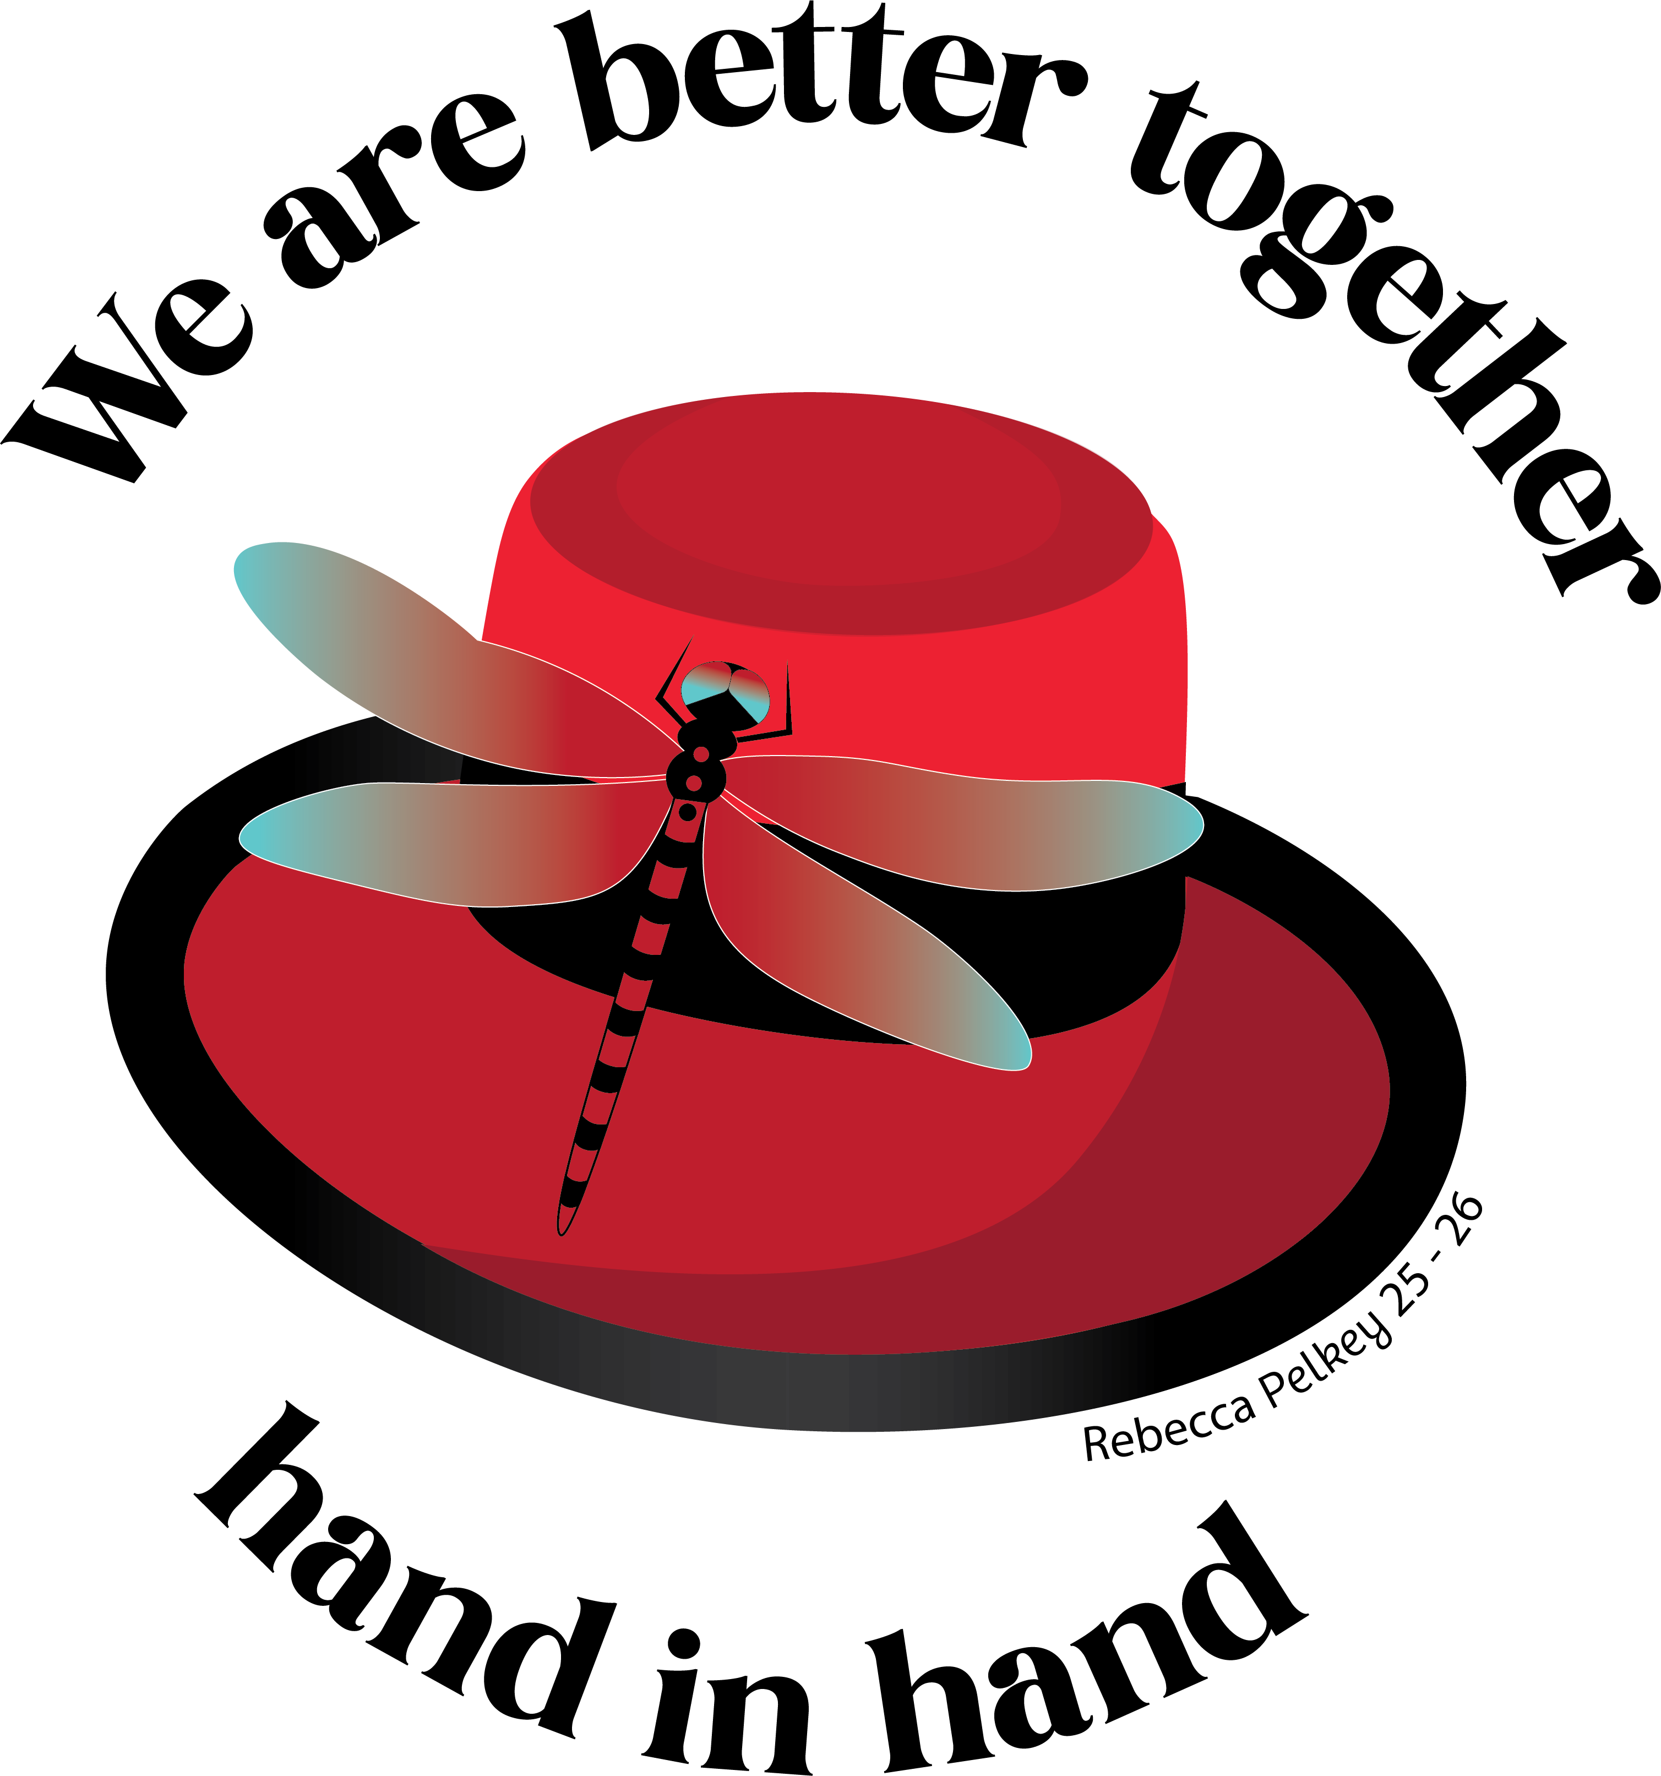
Volunteering

Slide 2
Volunteering
Our organization was built on the idea of “People Helping People.” Charity is the heart of what we do and what we stand for. Without it, we are simply a social room. We must keep charity at the forefront of our minds and hearts.

Slide 3
Volunteering
Eagles pitch in when others are in need. If an event chairman needs volunteers to help cook or serve dinner, sell tickets, set up, clean, etc., you should feel a responsibility to help out.
Whether or not you pitch in can make the difference between a successful event and a disappointing event.

Slide 4
Volunteering
If you are an Officer, Past President or hold some sort of leadership role in your Aerie/Auxiliary, your job is to lead by example.
The Membership follows your lead. If you act like you’re too good or too important to volunteer, so will your members.

Slide 5
Volunteering
When You Pitch In – Others feel obligated to help out as well. It sets a level of expectation that members want to meet.
When You Don’t Pitch In – Others feel like they don’t have to help. It creates a bad feeling in people if they see you slacking off but they’re expected to help.

Slide 6
Volunteering
We are a service organization. Our Aeries and Auxiliaries do not have the funds to have full-time staff to carry out events, cook, serve, clean up, etc. We cannot do what we are called to do without the help of volunteers who give their time and money to make our fundraising efforts a reality.

Slide 7
Volunteering
When you’re interviewing potential members, ask about volunteer work they may have done and try to get a sense of whether or not they will be willing to pitch in. Quality members won’t shy away from the idea of helping out when needed.

