Slide 1

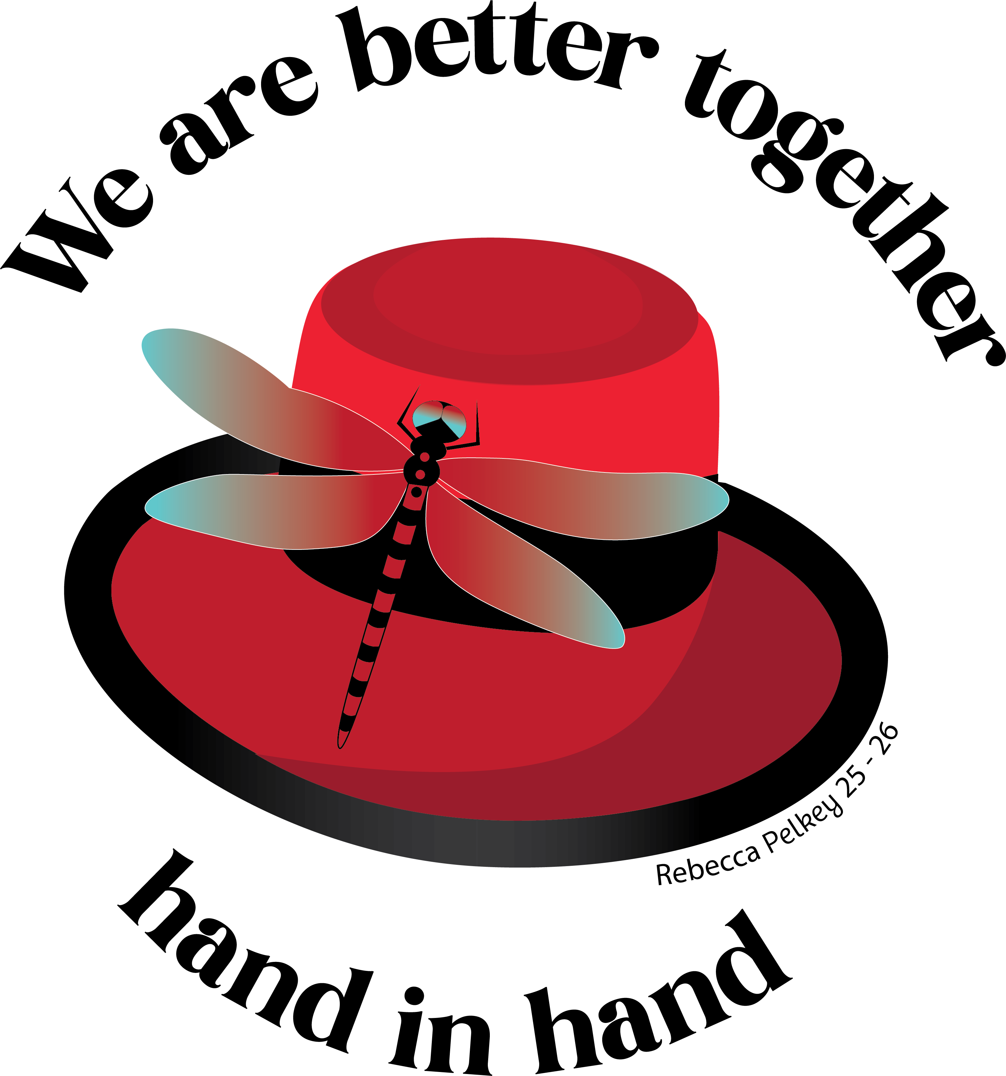
Work Together/Togetherness & Equality

Slide 2
Working Together
Every successful Aerie home shares one central quality – an Aerie and Auxiliary that work together. We are only as good as the togetherness and equality we show our Brothers and Sisters both on the National and Local levels.

Slide 3
Working Together
Ask any receiver you may know. When they go into a Troubled Aerie, one of the first things they’ll often notice is conflict between the Aerie and Auxiliary.
When the two sides fight, it creates tension in the social room and makes members want to avoid being inside the Aerie home.

Slide 4
Working Together
Keep your lines of communication open.
Hold joint meetings regularly to allow both sides to interact and offer input on major decisions and to plan events together.
Make sure the Auxiliary is properly informed of changes made in Aerie meetings which will affect their experience in the Aerie home.

Slide 5
Promote Equality
Make sure your Auxiliary sisters know they are equal partners and that their opinions are valued. When they feel equal, they will help contribute if the building needs repairs or if the Aerie needs extra help for events and fundraisers.

Slide 6
Lead By Example
If you are Aerie or Auxiliary officers, you should be working together to lead by example. If your membership sees Aerie or Auxiliary officers badmouthing one another, they will follow suit. If your membership sees two sides working together and lifting each other up, your members will do the same.
Leaders have an obligation to set the standard for what is and is not tolerated inside your Aerie home. Be a positive example – not a negative one.

Slide 7
Ways to Build Harmony
Joint Meetings
Having a Joint Charity for your Worthy and Madam President
Hold a Joint Installation of Officers annually
Encourage female prospects to join the Auxiliary

