Slide 1


State Receiver Training
Revised 3/25

Slide 2
Receiver Training

Slide 3
When you are commissioned to be an Aerie/Auxiliary Receiver, you will receive an email from Lucy Brillhart (lbrillhart@foe.com) as well as a mailed copy of your Commission and Executive Order. It’s important that the Worthy President/Madam President and Aerie Secretary/Madam Secretary receives a copy of the Executive Order as soon as possible. However, if you wish to make your first visit unannounced, contact Lesley Kovacs at lkovacs@foe.com and Lucy Brillhart at lbrillhart@foe.com and advise them you do not want the Suspension entered into MMS until you advise them. You will receive a separate email from Jackie Masters at jmasters@foe.com with a username and password for the MMS system of the Aerie/Auxiliary which you are assigned. When you receive your login credentials to the MMS, log in right away. The Grand Aerie does look at when you login and how often.
Receiver Commission from the Grand Aerie
“What to Expect”

Slide 4
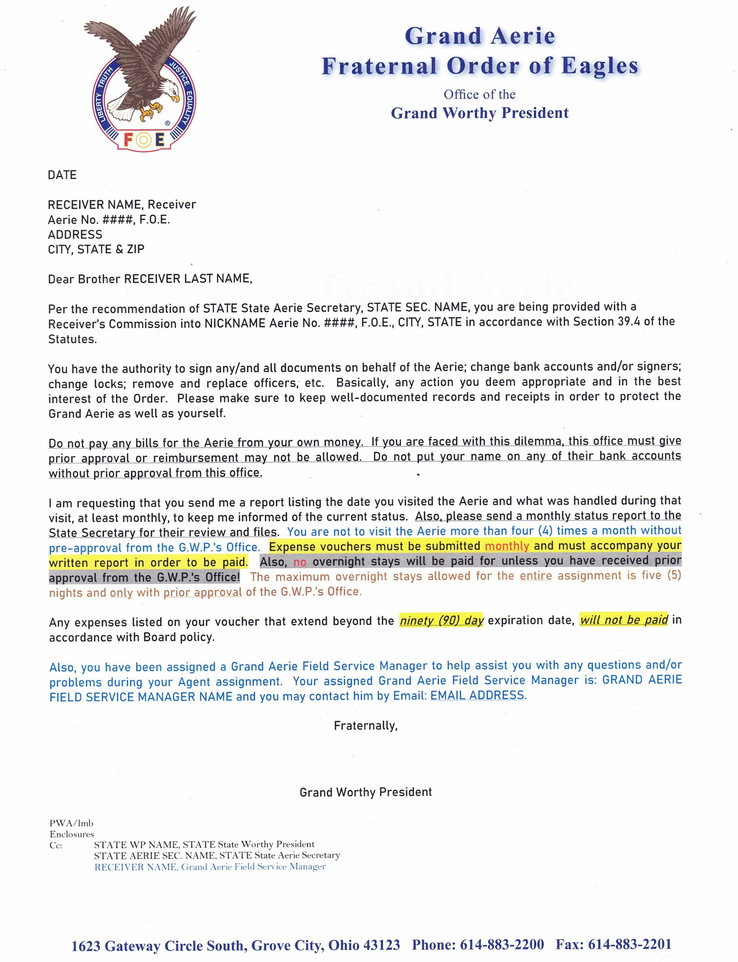
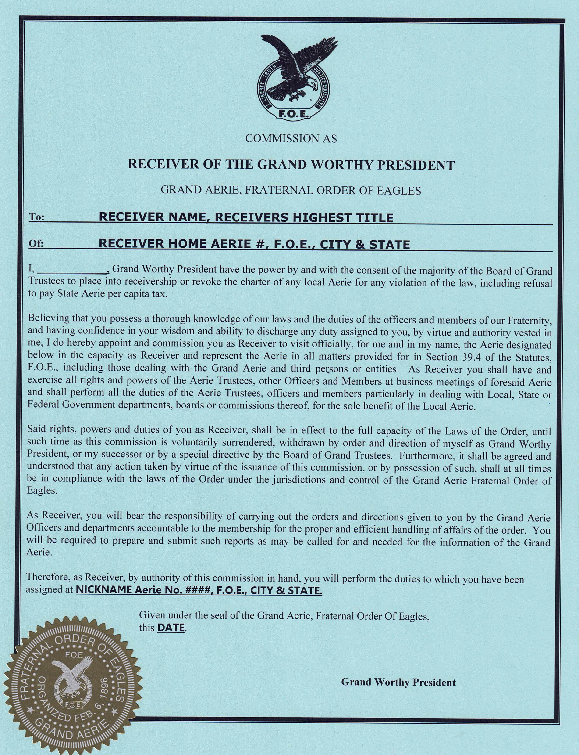

Slide 5
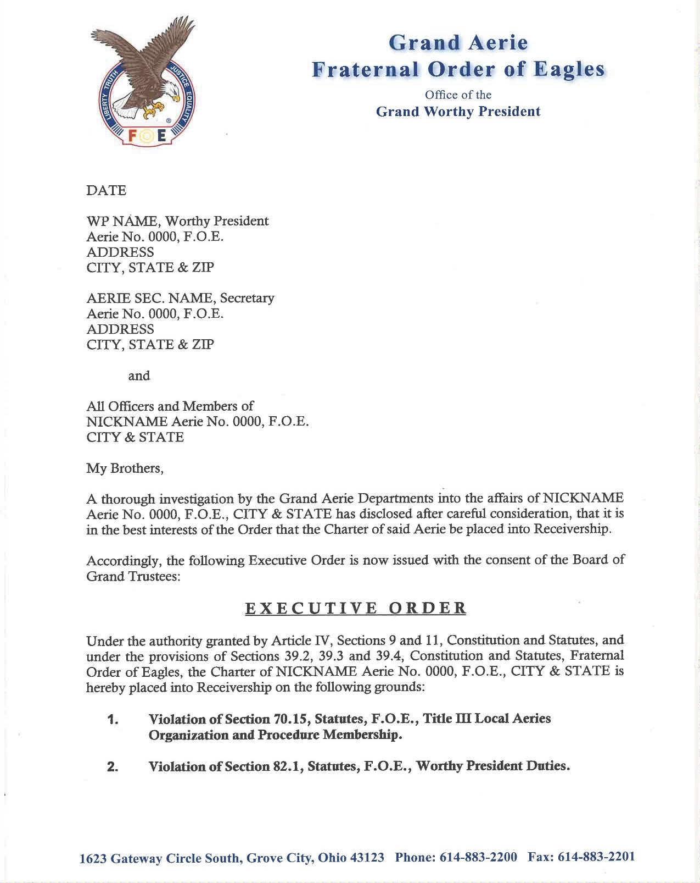
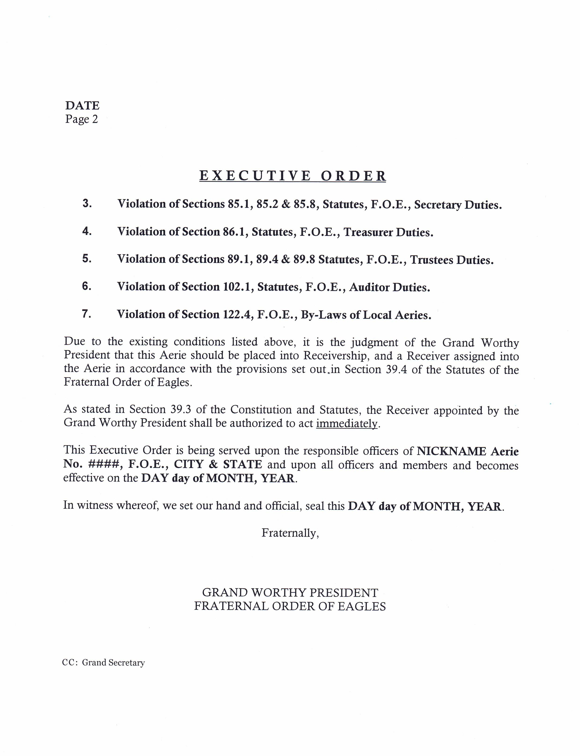

Slide 6
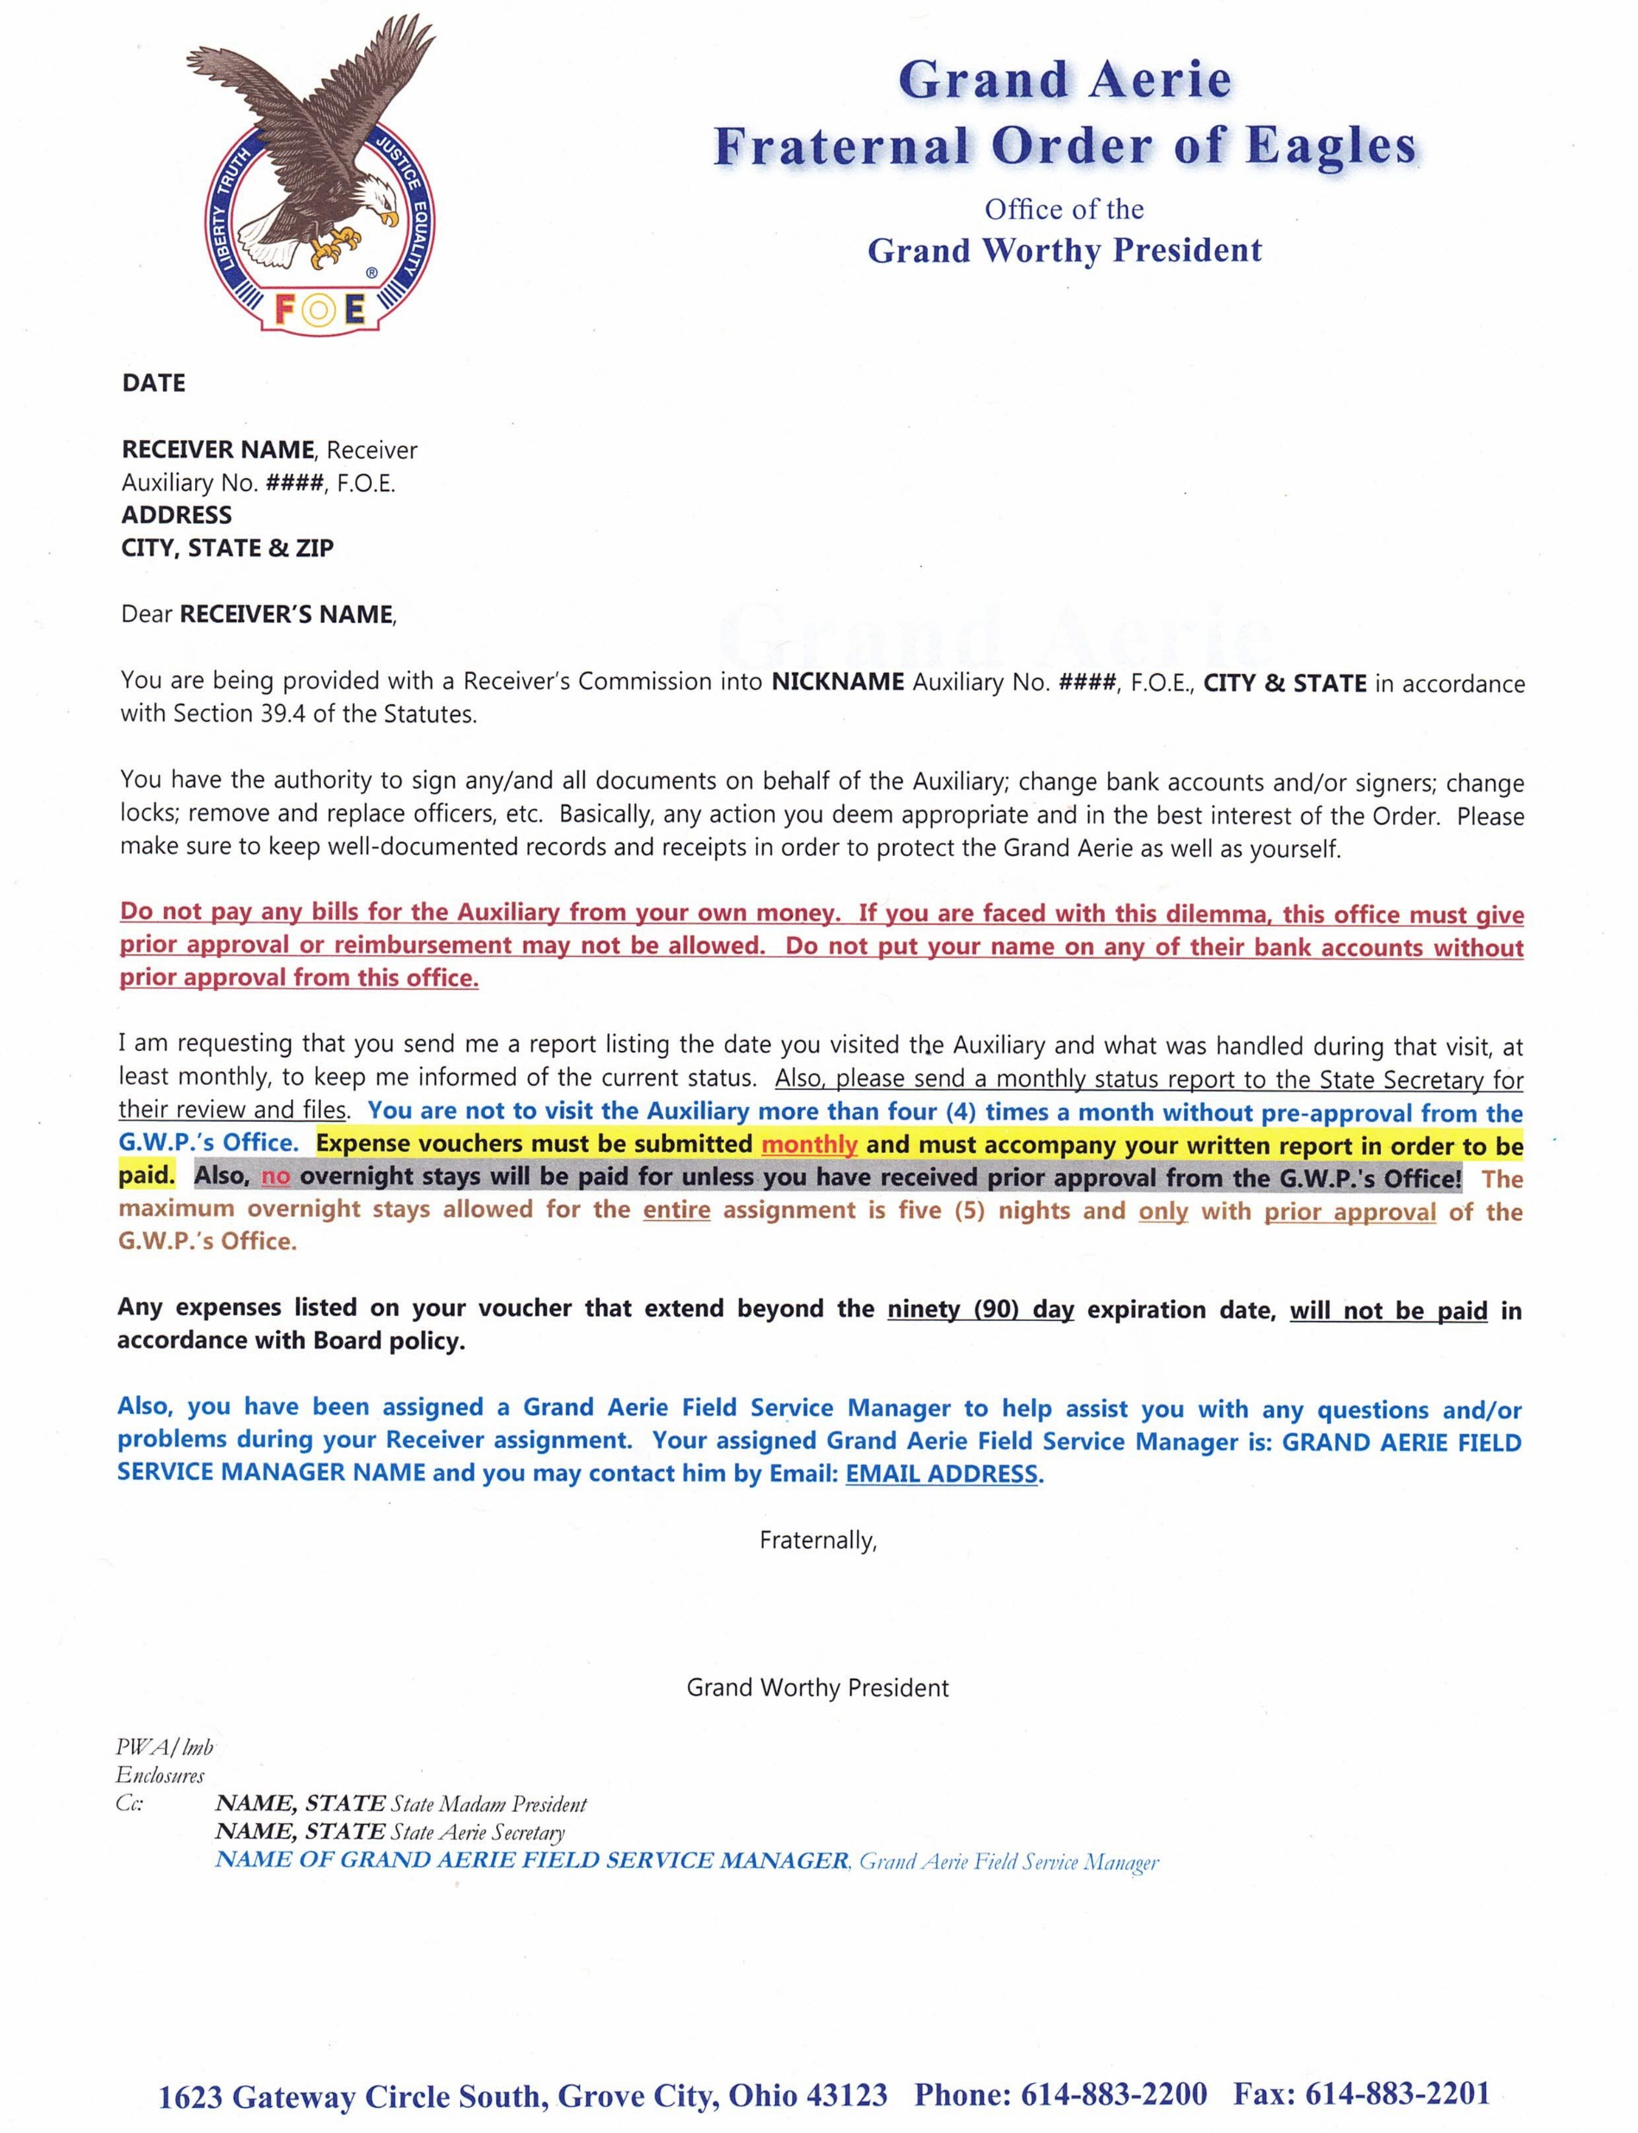
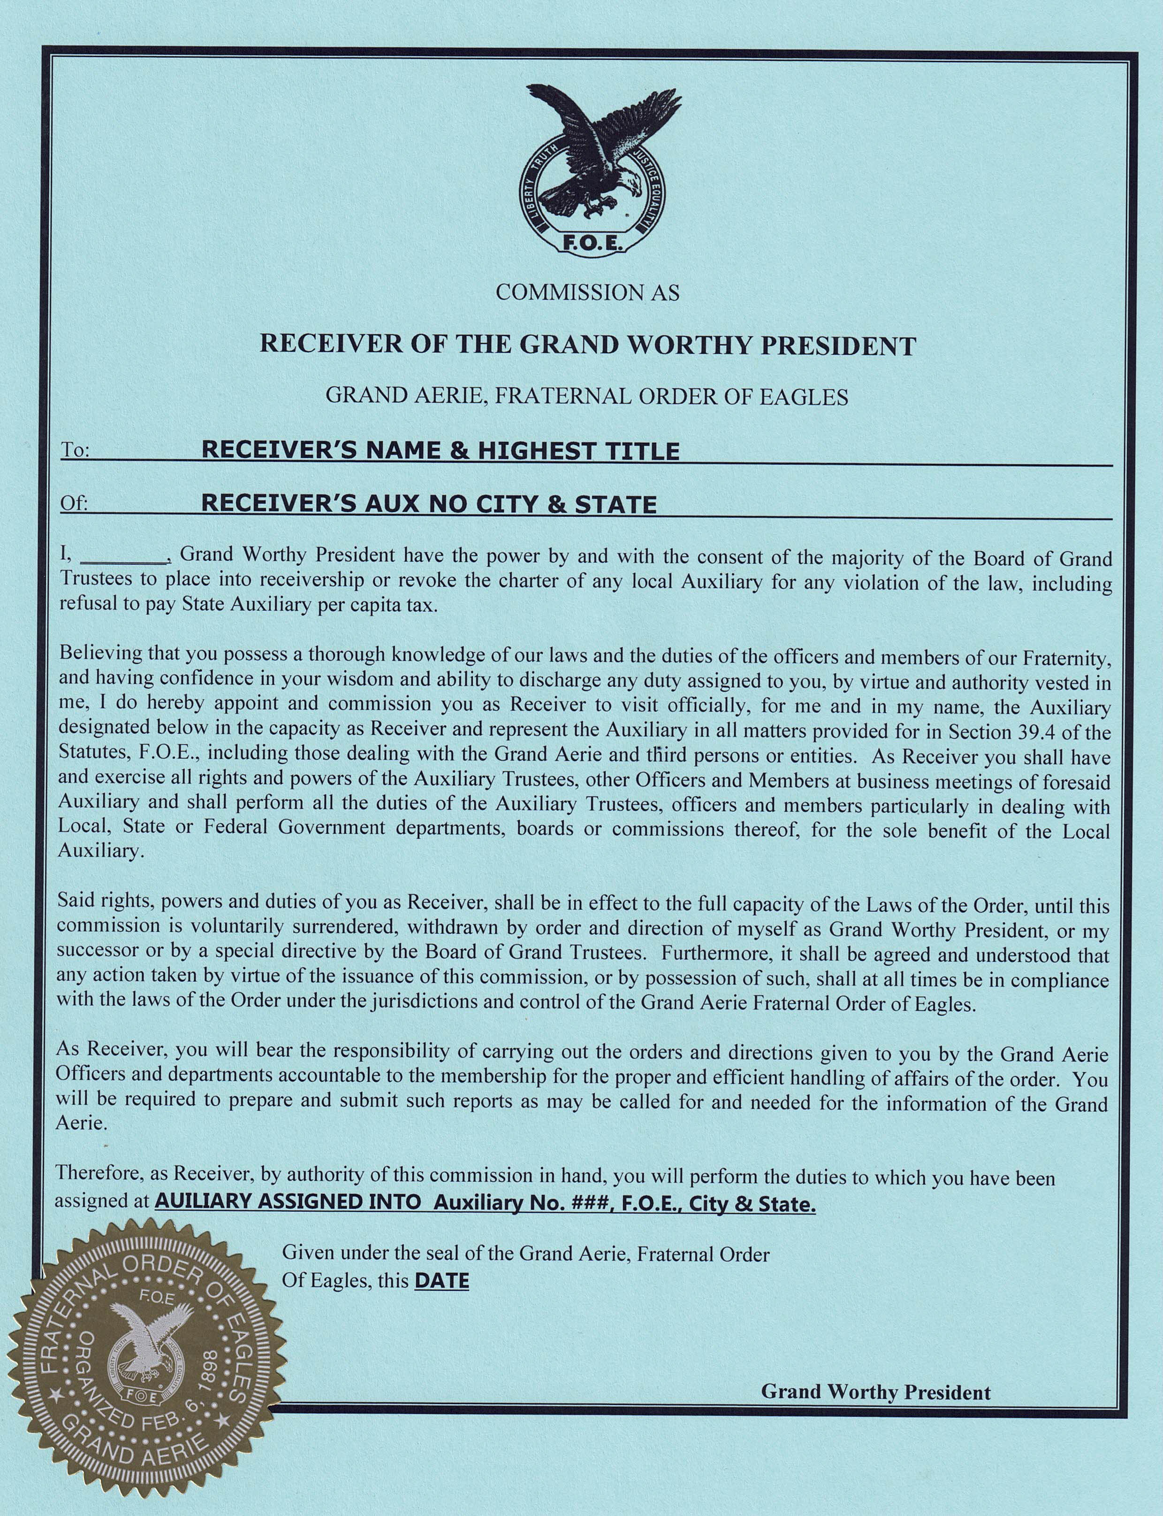

Slide 7
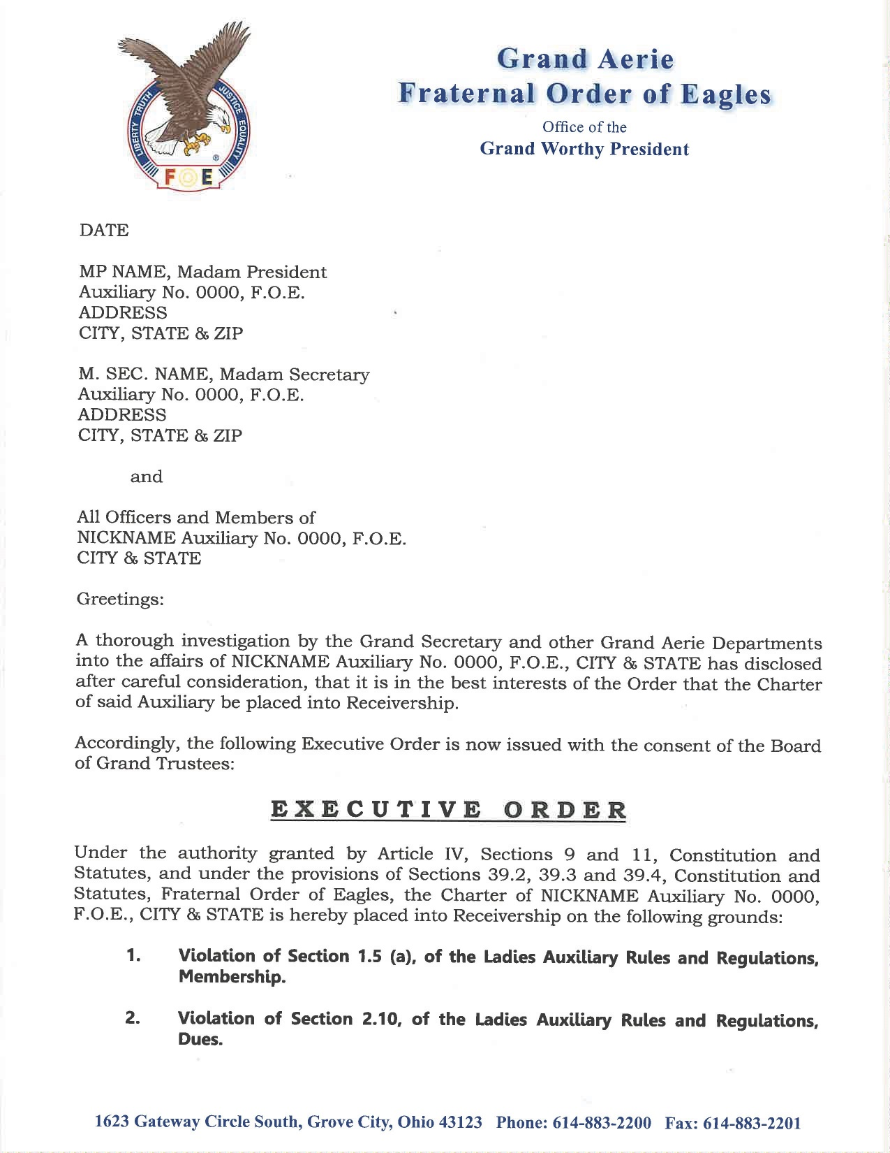
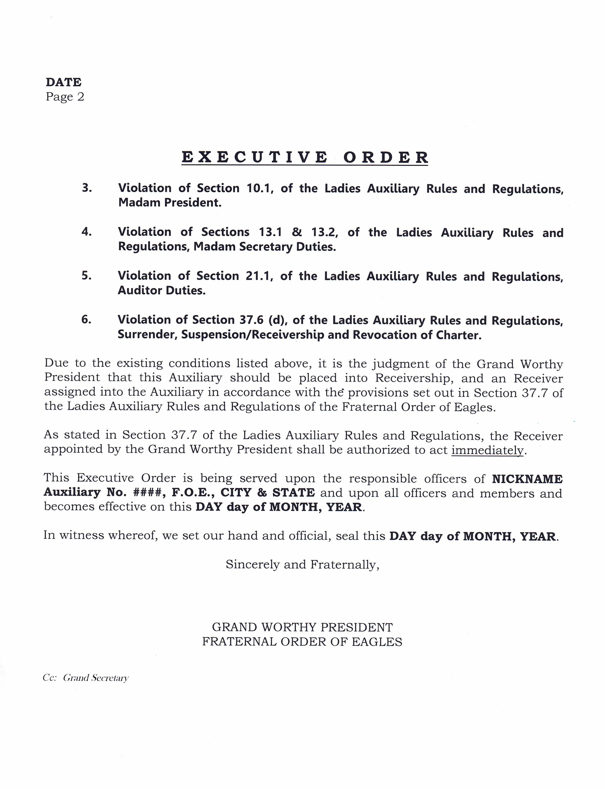

Slide 8
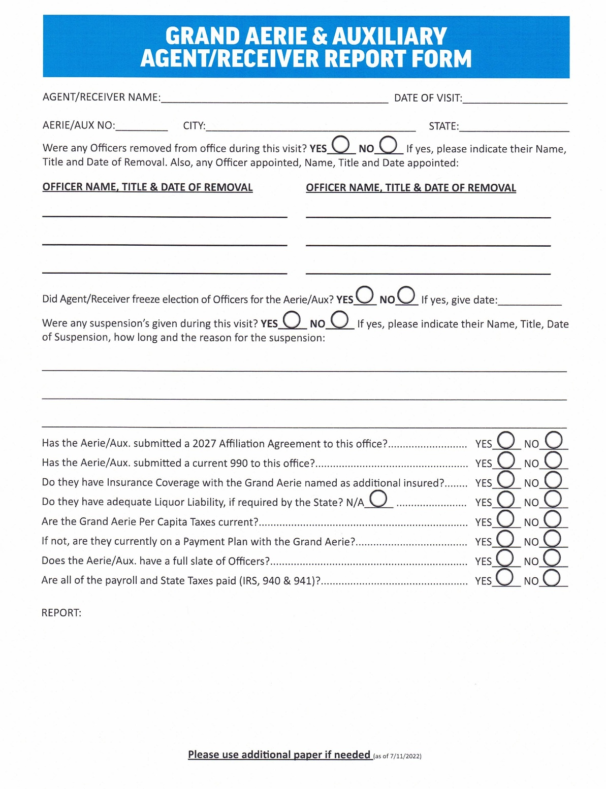
Grand Aerie & Auxiliary
Agent/Receiver Report Form is due within seven (7) days of your visit, email or phone conversation. Email it to lbrillhart@foe.com and your Field Service Manager

Slide 9
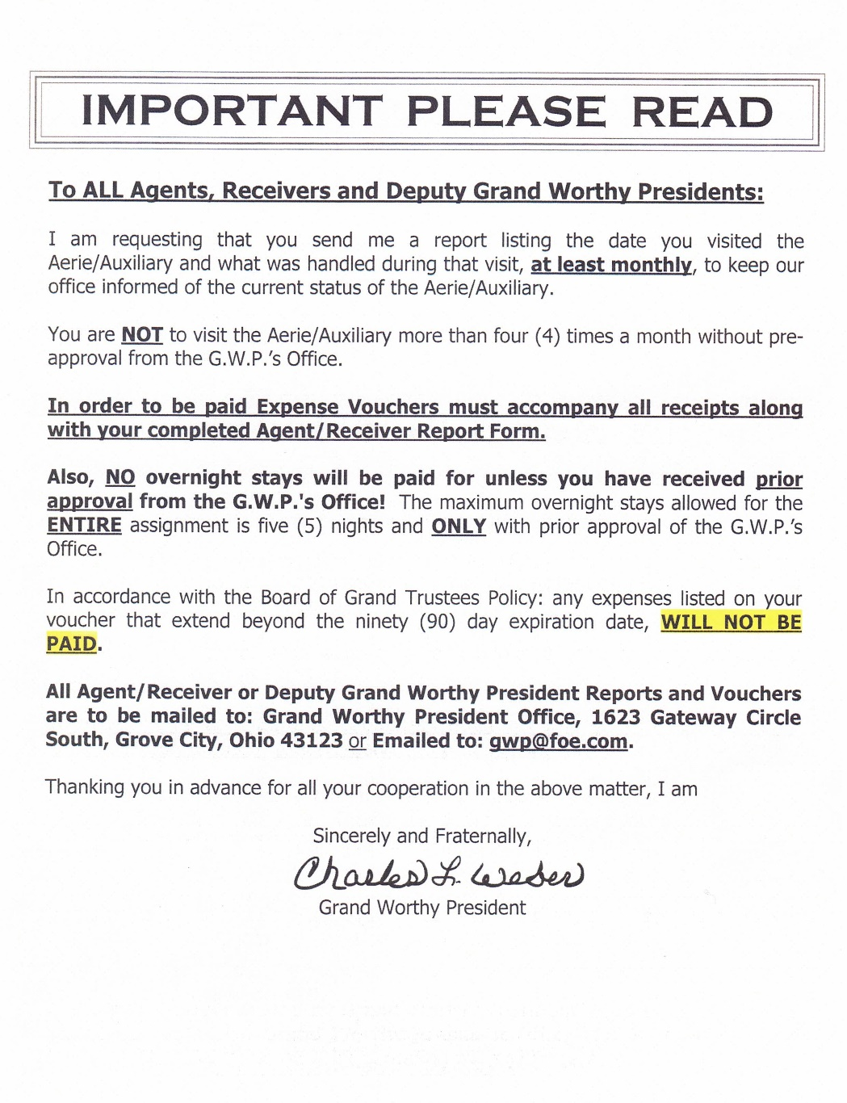
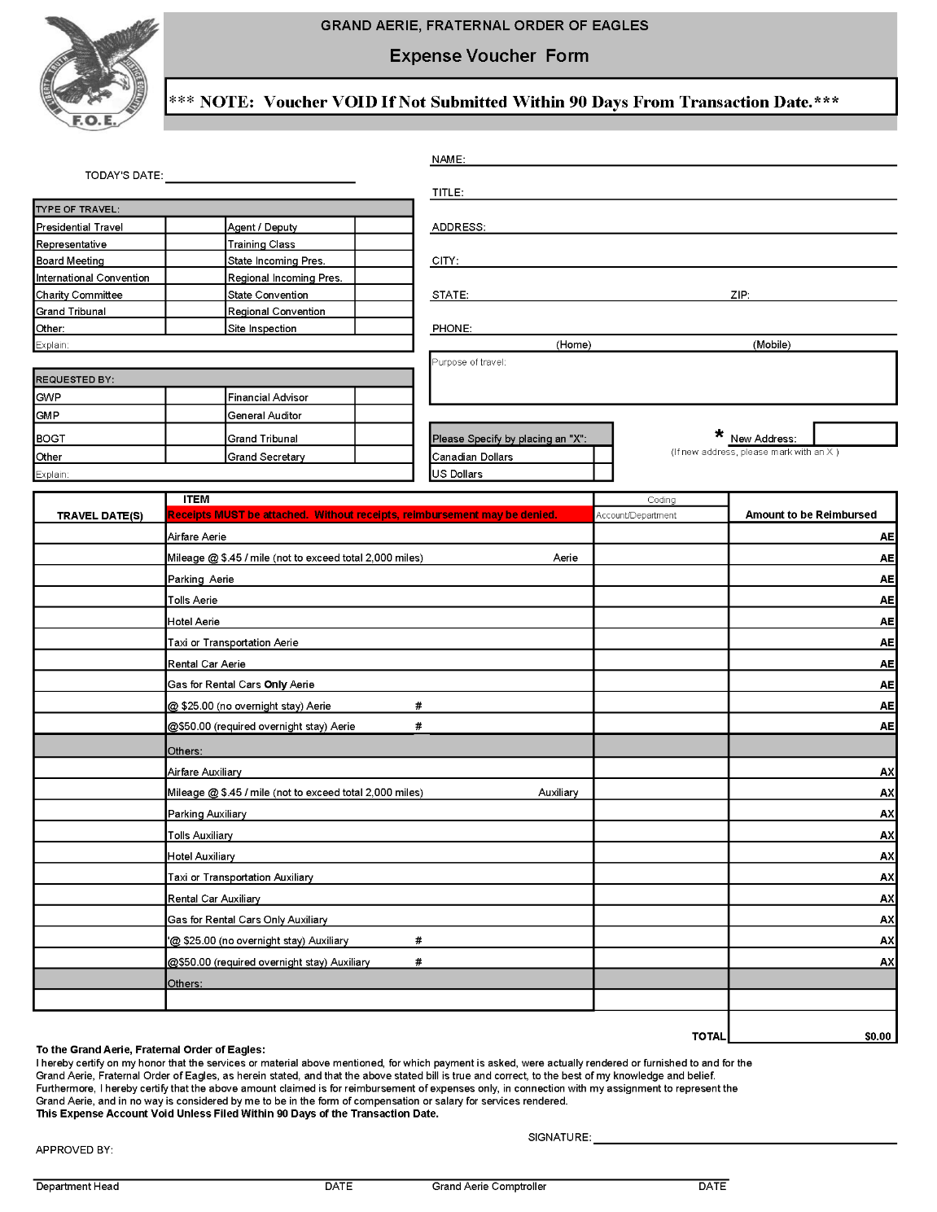
Grand Aerie Agent Expense Voucher

Slide 10
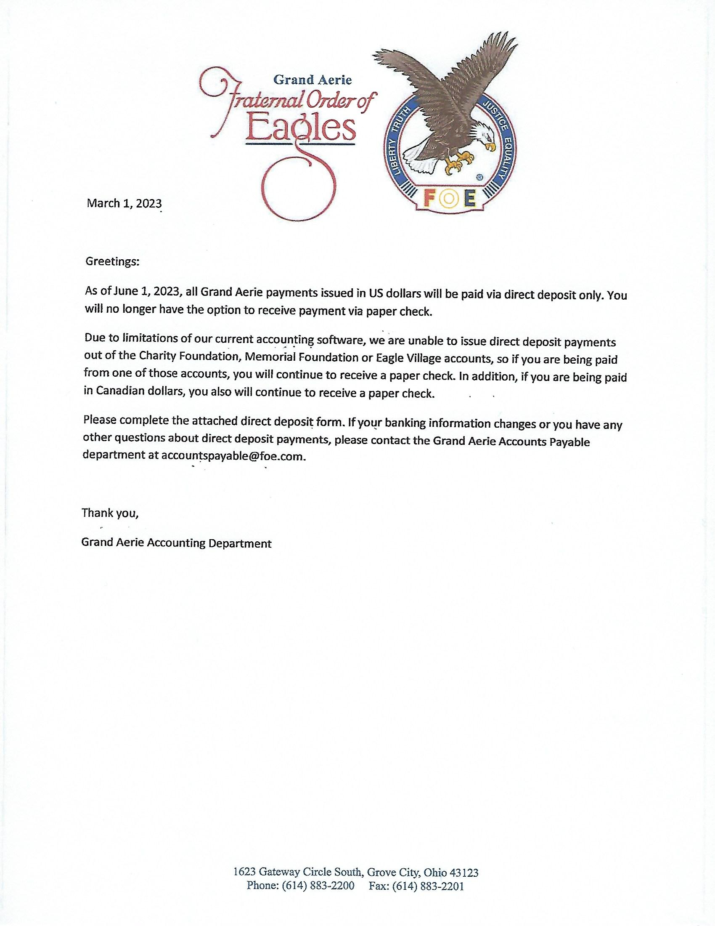
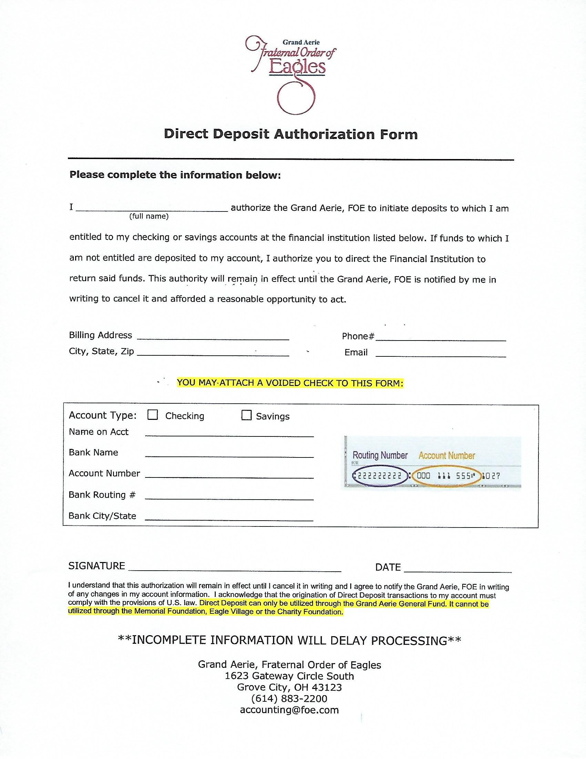

Slide 11
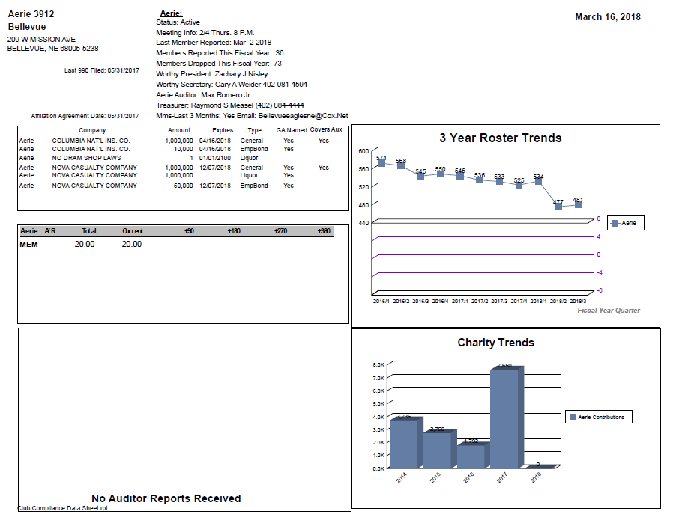
CLUB COMPLIANCE DATA SHEET Provides you with information regarding your status with the Grand Aerie Compliance Department such as 990, Insurance, Affiliation Agreement, etc. Click on Reports → Club Management → Club Compliance Data Sheet

Slide 12
Additional Items Included
List of PWP/PMP or TYS and Institution Date
Current Officers List
Compliance Data Sheet
Membership Roster
Account Statement of past due money owed to the Grand Aerie for supplies,
membership fees, misc. fees, and Per-Capita Tax
Current By-Laws
House Rules
The original letter of complaint or previous survey from the State Secretary office.

Slide 13
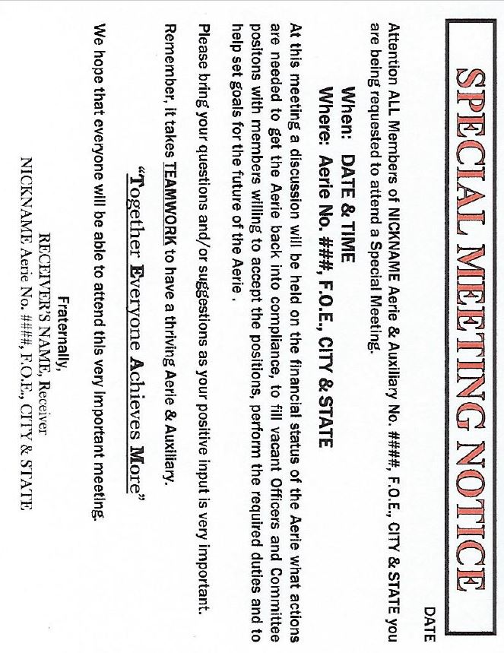
Special Meeting Notice
This may be necessary at the beginning of your Commission depending on violations of the Aerie/Auxiliary.
Lucy Brillhart, Secretary (614) 883-2167 or lbrillhart@foe.com
Lucy will assist you in creating the postcards and have them sent out to the General Membership of the Aerie/Auxiliary in which you are assigned.

Slide 14
Your Statutory Authority
Section 39.4. (a) pg. 46 The Grand Worthy President shall commission a member of the Fraternal Order of Eagles as an Agent/Receiver to represent a suspended Aerie. The Agent/Receiver is vested with all the powers of the Trustees and all other Aerie Officers and members, including but not limited to, the authority to act on behalf of the Aerie in all legal and governmental matters. The Agent/Receiver shall collect all dues, and pay all debts of the Aerie, including per capita tax. The Agent/Receiver shall file written reports and shall account for all funds in the manner prescribed by the Grand Worthy President. The Agent/Receiver shall have the authority to issue suspensions from membership for a period of up to ninety (90) calendar days.
The Agent/Receiver shall serve until his commission is withdrawn by the Grand Worthy President.

Slide 15
Just because you have the authority under Section 39.4(a) pg.46 to issue a Suspension from Membership for a period of up to 90 days, does not mean that it is mandatory to give the full 90 days. Use your discretion. Base it on the conduct the member displayed. Make sure you thoroughly explain your reasoning for issuing the suspension from membership in your report and the letter issued to the member.
Remember, until you are Commissioned by Grand Worthy President to a specific Aerie or Auxiliary, you are not a Receiver. Your attendance in this training class, does not make you a Receiver.

Slide 16
If By-Laws are at issue, an Agent/Receiver would first follow Sections 122.1, 122.2 and 122.3 pgs. 123 - 124. This allows the Aerie or Auxiliary to take the charge of their By-Laws to remedy any existing harmful By-Law or vote down any proposed By-Law that maybe potentially harmful. According to the Statutes, Section 39.4(a) pg 46, the Agent/Receiver is vested with all the powers of the Aerie or Auxiliary membership and its Officers. The Agent/Receiver cannot set aside or ignore the Statutes and the rights given therein to the membership. Nonetheless, if the Agent/Receiver believes that the Aerie or Auxiliary’s existing By-Law(s) or newly approved By-Law amendment is harmful and threatens the future existence of the Aerie or Auxiliary, the Agent/Receiver has statutory authority to overrule an Aerie or Auxiliary’s vote.”
The Agent/Receiver does not carry votes of absent members nor does the Agent/Receiver have to be present at a meeting of the Aerie to overrule an Aerie or Auxiliary’s vote. Opinion No. 891 and 967.

Slide 17
Section 39.4 (b) pg. 46. The Agent/Receiver shall have the authority to remove and replace any officers, committee members and internal unit officers of the suspended Aerie or Auxiliary. Any officers, committee members or internal unit officers so removed and not reinstated by the Agent/Receiver, is also removed from any Local office in the jurisdiction and/or Local Aerie committee prescribed by the Constitution and Statutes, which shall include the position of Auditor, and shall not be eligible to run for or be appointed to Auditor or any office or committee until three (3) regular elections have passed. The State/Provincial By-Laws may allow for the officer so removed by the Agent/Receiver to also be removed from any State/Provincial elected or appointed office and/or committee. Any officer so removed shall have no right of appeal.
Nominations and election pursuant to Section 91.1, Statutes may not occur until the Agent/Receiver believes it is in the best interest of the Aerie/Auxiliary to hold nominations and election or until the suspension/receivership is lifted.

Slide 18
Receiver of the Aerie
When assigned into an Aerie or Auxiliary there are several things that you should do prior to leaving home if possible. Try to get some history of the Aerie or Auxiliary officers and its members. There are different ways this can be accomplished.
The Grand Aerie has a reason for sending you in the first place. Request a copy of their history file from the Grand Aerie, if not included or to large.
Talk to some of the State Officers within the State to determine if they have any helpful information. Remember, their opinions may not be totally unbiased.
If possible, try to find out who requested your assistance, such as the State Aerie or State Auxiliary, an officer in the Aerie or Auxiliary or someone within the Aerie or Auxiliary. Try to interview them, but remember, they are going to tell you their version of the truth.

Slide 19
If you are an Auxiliary Receiver assigned in with an Aerie Receiver, find out who it is. Receivers working together will help in the direction that the Aerie and Auxiliary will proceed. The Aerie Receiver can fill you in on how the Aerie and Auxiliary are working together, or how they can improve. Communicate on a regular basis, issues may cross over but remember to stay in your lane.

Slide 20
If you haven’t received information in your commission packet that you think may be helpful, contact the Grand Aerie.
In reviewing the By-Laws, you can gain some insight into their operation. If they have not been reviewed lately, a lack of interest might be perceived.
With the officers list received, when you attend the meeting compare the officer’s list to the actual officers, you’ll determine if they are having problems getting and keeping officers. This may also tell you if they are having personality problems.
Not being current on per capita taxes or reports may tell you there could be a problem in the Secretaries office. If they have outstanding bills from the Grand Aerie, they more than likely have other outstanding bills. It seems that an Aerie or Auxiliary with problems will pay the Grand Aerie last, not first. It may also tell you that when dues are paid, they are not putting the money in the proper funds as required by their By-Laws, or that they are spending money out of the Benefit fund to pay normal bills.

Slide 21
After reviewing the materials and information, you should be ready to go to the Aerie or Auxiliary for your first visit.
(Note: You are representing the Aerie, and your actions will reflect on the Aerie.)
When you arrive at the Aerie or Auxiliary, look at the general appearance of the building inside and out. This will give you an idea if they have pride in their Aerie and Auxiliary.
Is the Social Room clean and is the appearance of the bartender presentable?
Is the staff friendly?

Slide 22
When you arrive at the Aerie or Auxiliary for the first time, ask to see the Secretary or the President. Introduce yourself and show them your credentials. Remember you’re there to help them, not to intimidate them or belittle them. An attitude of, “I am here to help you,” will get you further down the road to success than being verbally critical. Everyone interacts with members in different ways, what works with one Aerie or Auxiliary and/or individual may not work with another.
When assigned into an Aerie or Auxiliary, you are more than likely being assigned for one or two reasons; personality problems and/or financial problems, sometimes both.

Slide 23
Financial problems: What to check ?
Use the Grand Aerie or Auxiliary Survey as a guideline.
Is the Secretary’s cashbook up-to-date?
Are miscellaneous receipts being made out for all money transfers from one person to another?
Are funds being deposited in the proper accounts and in accordance with the by-laws.
Are the local, state/provincial and Grand Aerie PCT taxes being paid?
Is the Treasurer’s cashbook up-to-date and does it correspond or balance with the Secretary’s cashbook?

Slide 24
Is the Treasurer balancing their books with the checking account?
Are the bills being approved on their regular meeting floor by properly made motions?
Are the checks being written out of the Aerie or Auxiliary accounts being properly signed by the appropriate officers of the Aerie or Auxiliary? Note: The Statutes state proper procedure is the Secretary shall draw checks on the Treasurer against the proper funds of the Aerie or Auxiliary. Each check shall have 3 signatures, signed by the Secretary, President and the Treasurer. The Vice-President can sign if one of the above officers is absent.
Are the Trustees making out Trustee reports and reporting on the Aerie or Auxiliary floor?

Slide 25
Personality Problems: Generally speaking, when you have financial problems, you will end up with personality problems and vice-versa.
When dealing with personality problems, you will have to rely on your intuition, investigation and interviews with individuals. You will have some people tell you what they think you want to hear; others will tell you their version of the problems in the Aerie or Auxiliary. You will have those that are interpreting the Constitution and Statutes to their own good or to remain in power, so to speak. In each case, it will be up to you to speak with as many people as possible; then develop your own opinion as to what is really going on. Remember, each situation is different.

Slide 26
When you are assigned into an Aerie or Auxiliary, you are representing them and the best way to protect yourself and the Grand Aerie is to document, document and document!
As soon as possible, send a report to the Grand Aerie as directed in your commission paperwork. Remember, once you leave the Aerie or Auxiliary, you may have disgruntled members or officers' telephone or email the Grand Aerie to complain. If the Grand Aerie already has your report, insight is improved.
By the time you get to this point, nearly all the above has been accomplished. Now you have the authority to take whatever actions my be appropriate to get the Aerie or Auxiliary back in line. You must make your decisions as what to do to get started.

Slide 27
As an Agent/Receiver, there are things you may have to do to get things back in order as well as some things you shouldn’t do. The amount of time to accomplish your assignment will depend on your guidance and training.
If you are going to remove/replace/reposition officers and committee people, call a meeting with those involved and explain what you are going to do. It is recommended that when you remove an officer, you do it in a private meeting with the officer and a witness. It is not our place to embarrass or degrade any of our brothers or sisters. Our purpose is to get the Aerie or Auxiliary operating as it should, in accordance with the Constitution and Statutes. If an individual has given you a bad time or you just don’t trust them, keep your cool and don’t belittle the individual in public. If you are in a situation in which you must remove or replace someone, be careful how you do it.

Slide 28
When you appoint someone to replace or fill an empty position or committee, let the individuals know that you are appointing them to get the job done. Try to find someone with experience so you don’t set them up for failure.
In some Aeries or Auxiliaries, you will have to show them what to do and how to do it. If this is the case, don’t get caught in the trap of having to do it all for them. Let them know you will provide the needed training, but they are going to have to do the job themselves.
After you have provided the training, monitor their performance and give them the helping hand they may need. It is often hard for someone who knows the job to watch someone else trying to do it without jumping in….DON’T
When you get things set the way you think it should be, continue to watch their progress. You may have to adjust along the way.

Slide 29
Normally it shouldn’t take too long to get an Aerie or Auxiliary functioning properly again. At that point in time, it is time to reinstate their Charter.
When the Charter has been reinstated, attend their next meeting if possible and make a big deal of it. Give praise and recognition to those that helped to make this assignment successful and praise individuals that have been especially helpful. Thank them for the assignment; make them feel good about themselves. Don’t take all the credit because very honestly, if you didn’t have their help, you would be closing the Aerie or Auxiliary, not lifting the Charter Suspension.
Section 39.4 (c) pg. 46 Upon the recommendation of the Agent/Receiver or Deputy, the Grand Aerie, with the concurrence of the Board of Grand Trustees, will recover all or a portion, of the expenses incurred by the Grand Aerie during the time of the Aerie’s suspension/receivership or Deputy’s Commission. This expense, if any, must be resolved prior to the Charter of the Local Aerie being returned or the expiration of the Deputy’s Commission.

Slide 30
Once you are ready to reinstate their Charter, contact Lucy Brillhart (lbrillhart@foe.com) and she will verify that the Aerie or Auxiliary is compliant and does not owe any fees to the Grand Aerie. She will also verify what Agent/Receiver expenses have accumulated during your Commission. Lucy will send you an email stating the required fees and expenses due the Grand Aerie. This email only goes to the Agent/Receiver. It is your responsibility to forward the email on to the Aerie or Auxiliary Secretary for payment.
Again Remember, each Aerie or Auxiliary is different, but each of them have the same Constitution and Statutes or Rules and Regulations to follow. If you can get them to follow what is written, you have done your job.
If you must close an Aerie or Auxiliary entirely, contact your assigned Field Service Manager. Before you request a revocation or consolidation, you will need the State Aerie’s or State Auxiliaries concurrence as well.

Slide 31
Your presence into the Aerie or Auxiliary as a Grand Aerie Receiver will create many questions from the general membership of the Aerie and Auxiliary. You’ll find in many Aeries or Auxiliaries which you are assigned; everything is a big secret. A general membership meeting called by you will help in getting the Aerie or Auxiliary back in line as well as getting cooperation from the members. At that meeting, explain why you are there in the first place, what you have found and what actions are going to be taken in the future. Allow questions to be asked and get their input as to resolutions to the problems. It enables them to feel like part of the solution, rather than the thought of the Grand Aerie taking their Aerie or Auxiliary away from them.
DON’T be afraid to ask questions to those who have the answers. No question is a stupid question, the Grand Aerie wants you to succeed. Your contact person should be the Field Service Manager assigned to you. He will be able to answer your questions. If he can’t, he knows where to get the answer.

Slide 32
Aerie Suspension from Membership and Removal from Office Sample Letters

Slide 33
Auxiliary Suspension from Membership and Removal from Office Sample Letters

Slide 34
Receiver MMS Training

Slide 35
Once you have received your Receivership, you will receive your username and password for MMS via your email of record.
Aerie
Username: Agent0000
Password: Example
Auxiliary
Username: Auxagent 0000
Password: Example
“PLEASE UTILIZE IT”

Slide 36
If you’re not familiar with how to use MMS, the Grand Aerie has the MMS Training System. When logged into the training site, you are working with a mirror image of the actual site. All the content is the same, but while in the training site, any changes you make do not affect the actual MMS System for that Aerie or Auxiliary.
When learning, use only this site. https://mmstraining.foe.com, your agent username and password will work in this site for gaining access.
If you are familiar with how to properly use MMS, then go ahead and do your research.

Slide 38
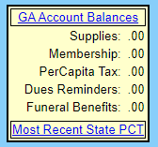
What to look for in the MMS
Upper left-hand corner
Money owed to the Grand Aerie
Supplies
Membership (Application fees)
PerCapita Tax
Dues Reminders
Funeral Benefits/Auxiliary
State PCT

Slide 39
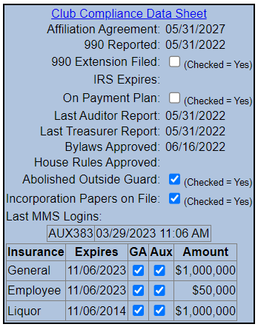
Upper right-hand corner
Compliance Checklist
Affiliation Agreement (due every 5 years –next is 2027)
990 Reported
Last Auditor Report
Last Treasurer Report
By-Laws Approved (should be reviewed every 2 years)
House Rules Approved per Sec.122.4
MMS Logins
General/Employee/Liquor

Slide 40
Do’s and Don’ts of a Agent/Receiver
Do’s
On your first visit, complete a Grand Aerie or Auxiliary Survey.
Make sure to re-address the negative responses to the survey.
Remain Impartial.
Treat officers and members with respect.
Keep both the Aerie and Auxiliary members informed.
Invite both Aerie and Auxiliary members to your Special Meetings.
Be consistent in your dealings with the officers and members.
Keep and maintain good records and notes.
All correspondence should be answered in writing.
Involve outside Law Enforcement Agencies if you expect there may be issues when first going to your assigned Aerie or Auxiliary. It is better to advise them of your presence prior to any issues.
Reports should be submitted in a timely manner after your visits.
Complete your reports to the Grand Worthy Presidents office at least monthly. GWP@foe.com
Regarding all correspondence to the Grand Aerie, make sure you cc your Field Service Manager.
You are required to have an email address and check it on a regular and consistent basis.

Slide 42
Contact Information
Field Service Coordinator Greg Hall - email ghall@foe.com – phone 1-614-883-2180
Secretary – Grand Worthy Presidents Office and Field Service Coordinators Office – lbrillhart@foe.com – phone 1-614-883-2167
FSM Jeff Hull for East Central Region– email jhull@foe.com – phone 517-712-6906
FSM David Locke for North Central, Four Corners, South Central & West Central Regions – email hondol@foe.com – phone 1-402-880-7635
FSM Mike Simonds for Pacific Northwest, Mountain & Western Regions – email msimonds@foe.com – phone 1-614-381-2985
FSM Tim Marler for Southeast, Southeast Central & Southwest Regions – email tmarler@foe.com – phone 1-636-465-4870
FSM Dennis Korn for Eastern, Mid-Atlantic, New England & Great Lakes Regions – dkorn@foe.com – phone 1-947-997-8701

Slide 43
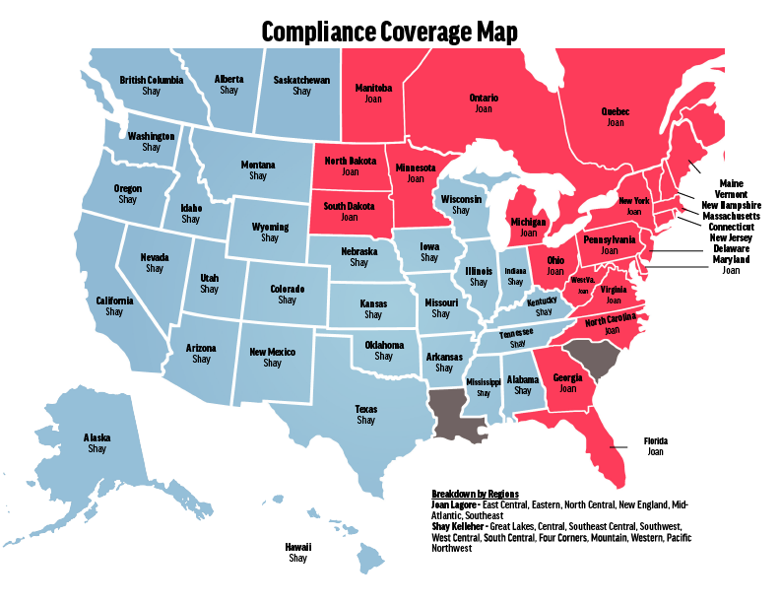

Slide 44
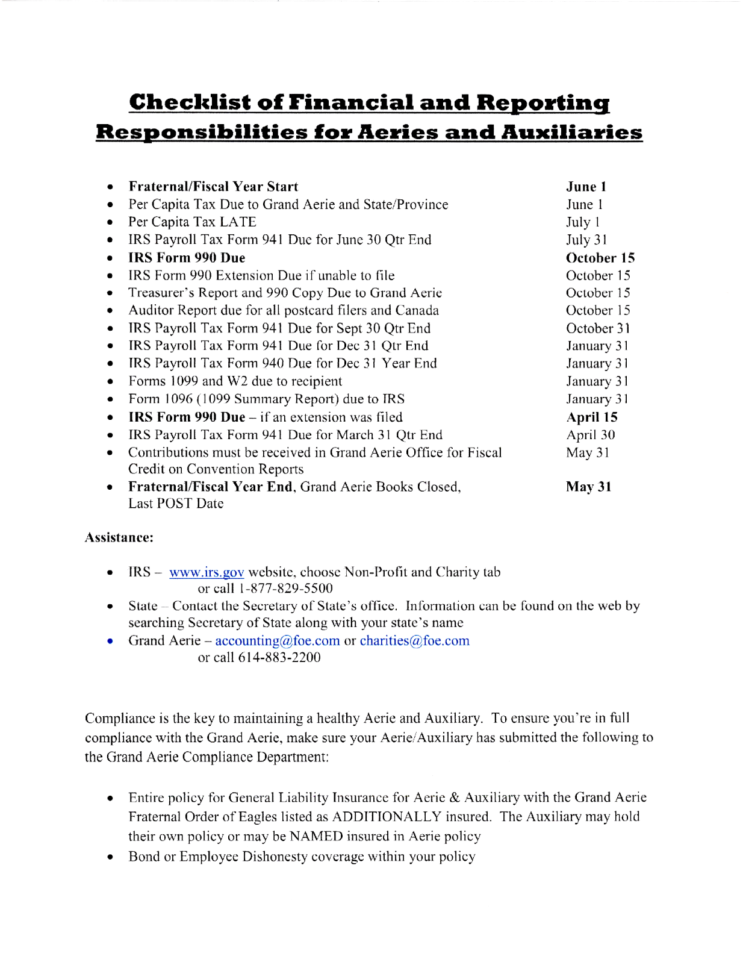

Slide 45
Questions ?

