Slide 1
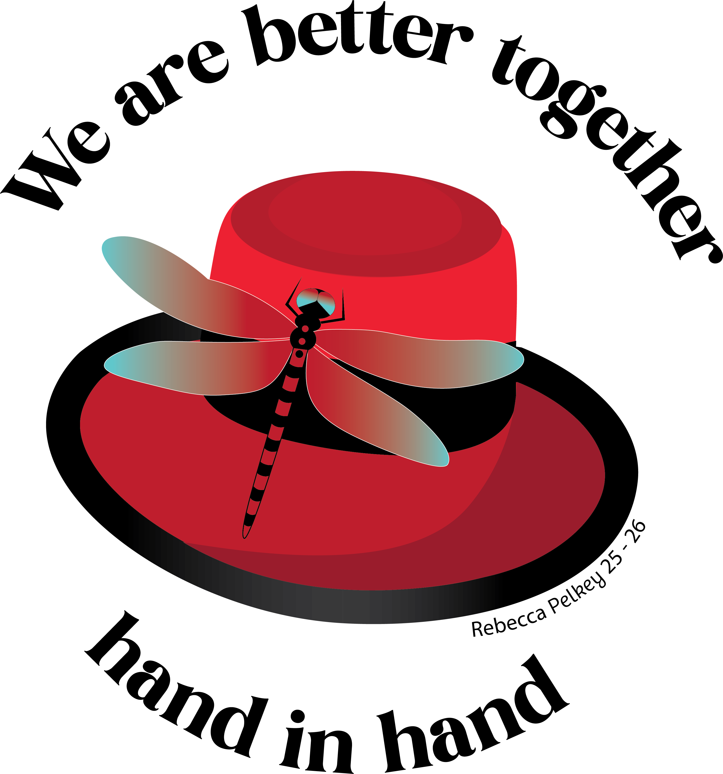
Obligation/Ritual

Slide 2
Honoring Our Obligation
As members, we all take an obligation to do our best in service to the Order. We promise that if we cannot speak well of an Eagle, we will not speak ill of him.
We have to hold ourselves accountable to these standards.

Slide 3
Preventing Problems
LIMIT FIGHTING WITHIN YOUR CLUBS!!
The evidence overwhelmingly proves that people are looking to enjoy themselves when they become members. They don’t want to be dragged into Aerie/Auxiliary politics. They don’t want to see a club that’s fractured or full of drama.
While most tend to view membership recruiting and Aerie/Auxiliary politics as separate issues, the facts are that one greatly affects the other.
The quickest way to kill your retention rate and hurt your recruitment efforts is by allowing internal issues to persist over time within your Aerie/Auxiliary.

Slide 4
Consequences
83% of our dropped members leave because of fighting in the Aerie/Auxiliary.
When you allow cracks to grow, you will lose members. When you lose members, you lose income. When you lose income, your Aerie/Auxiliary is at risk of closure.

Slide 5
Responsibilities
Your obligation isn’t just to avoid fights, it’s to help stop them.
If you see problems and you say nothing, you’re contributing to the problem and going against your obligation.

Slide 6
Lead By Example
Part of your obligation is to set a positive tone in the Aerie Home.
Listen to your members. Let them express their creativity through new ideas. Create an environment that fosters collaboration and teamwork.
Don’t sweep things under the rug. Small problems become big problems over time. When we don’t take the initiative to stop things early, we allow them to take over and hurt us in the long term. Show by example that you will not accept these issues by taking action early.

Slide 7
Teammates
At the end of the day, we’re all on the same team.
Remember that we are Brothers and Sisters and our obligation is to work together for the overall betterment of the Order.

Slide 8
Remembering the Ritual
The Ritual is the heart of the Fraternal Order of Eagles. It sets the tone for all members regarding expectations and requirements to be a great Eagle.

Slide 9
Common Misconceptions
There is NO short form of the Ritual!
If you were initiated via a short form Ritual, you are not legally a member of the Order
There are NO levels of membership that don’t require Ritual!
We don’t have a tier for social-only members. All members have to go through Ritual

Slide 10
Consequences
If you have not gone through the full Ritual, your family can be denied benefits through the Memorial Foundation in the event you were to perish while on the job.
Your Aerie/Auxiliary could face consequences from liquor or lottery commissions or face denial of insurance coverage if it is discovered your patrons are not legal members of the organization.

Slide 11
Ritual Books
The Grand Aerie Supply Department sells Ritual Books which can be used to read and perform the ceremony to your candidates.
We encourage clubs to have a Ritual team with the ceremony memorized, but if you don’t have access to that, you can use these books to carry out the ceremony properly.

Slide 12
Competitions
State/Provincial, Regional and International Conventions can provide individuals with the opportunity to compete for prizes.
At the International Level we have Team, Shotgun and SureShot competitions for those who want to compete.

Slide 13
How You Can Help
If your Aerie/Auxiliary has a dedicated Ritual team and you know others in your area don’t, offer to help with initiations and show their members how the ceremony should be performed and make yourself available for questions.
We’re People Helping People and we should be helping our own people become better, stronger Eagles!

