Slide 1

Membership

Slide 2
Proposer Responsibilities
Proposers are typically the first introduction new members have to the Fraternal Order of Eagles. As a proposer, you have a responsibility to welcome your new member into the organization and help them integrate themselves into the Order.
A good proposer should:
  Explain in detail who we are and what we do
  Make sure the candidate knows the eligibility requirements for membership
  Make them aware of the Membership Award Incentives and how they work
  Be at a meeting where their candidate is interviewed and voted on
  Be at the meeting when they are initiated
  Make sure they know when regular meetings are held and their obligation to attend
  Make them aware of House Rules, Bylaws and the Constitution & Statutes
  Keep them up to date about events at the Aerie
  Introduce them to new Brothers & Sisters
  Follow up when it’s time to renew their dues.

Slide 3
Promote The Aerie Outside the Home
Many of our Eagles do a great job promoting events and charitable works inside the walls of the Aerie home, but few do the work necessary to make the general public more aware.
This year, focus on ways to get your name out to the public including:
  Joining Your Chamber of Commerce
  Set up tables at farmer’s markets, fairs, Relay for Life, craft shows, etc.
  Sponsor youth sports teams
  Honor local first responders
  Set up a Scholarship Fund

Slide 4
How Do We Capture Attention?
Tell Your Story!

Slide 5
Tell Your Story
This year, we’re focusing on telling our stories.
92% of new members join because they know a current member who endorses the organization.

Slide 6
Why?
Your story is important because it can’t be replicated. Other groups may offer similar things, but your individual experience can’t be duplicated.
If being a member clearly means something to you, they’ll pick up on that and want to be a part of something that makes them feel the way you feel.

Slide 7
How We’re Helping
This year, we’re filming short videos as part of a new Why I Joined campaign, which will kick off at the start of the new fraternal year.
Our data shows that personal endorsements bring in 92% of new members, but many individuals either don’t know a current member or don’t realize that they know a current member, so they don’t have exposure to these stories.
By filming stories and sharing them via social media and targeted online advertising, we’re bringing your stories to individuals outside of our networks and sharing with them what it means to be an Eagle.

Slide 8
Your Work Doesn’t Stop There!
Selling the organization doesn’t stop when someone joins.
Our numbers show that you still need to market the organization to your new members throughout their first few years of membership.
How you continue to tell what being an Eagle means affects your Aerie or Auxiliary’s retention efforts.

Slide 9
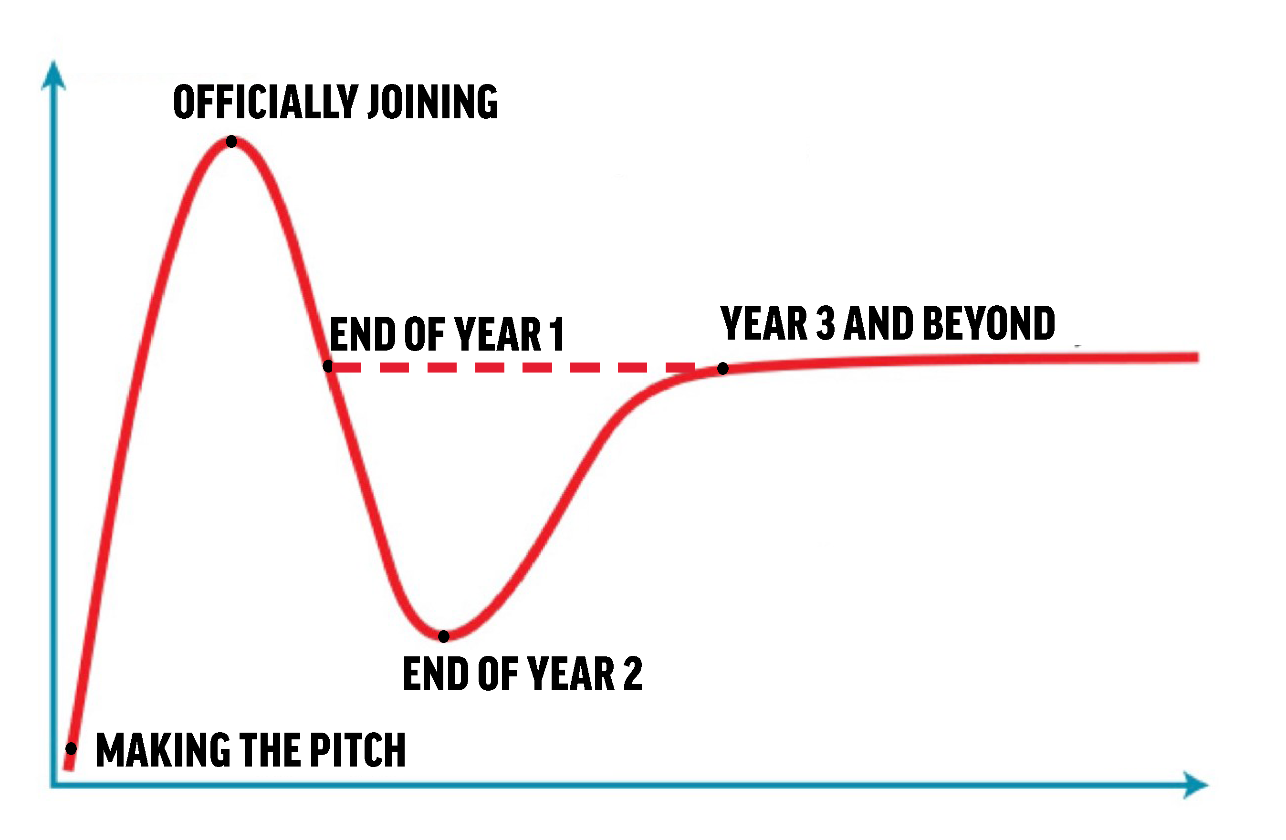
Eagles Hype Scale
As
Right now, most new members are left to fend for themselves after joining, causing their satisfaction with their membership to decrease from initiation to the end of year two, when most are leaving.
Members who make it to Year 3 usually stick around for good.
This year, Incoming Presidents Ron and Gloria are focusing on bridging the gap to eliminate these losses.

Slide 10
Eagles Hype Scale
As
The dashed line represents an increased focus on proposer duties. By re-focusing on what a proposer should do, we can help eliminate some of those year 1 and 2 losses and increase the speed with which new members become integrated into the F.O.E.
By continuing your efforts to get them in the door and involved, you’ll leave them with a great experience and leave your Aerie/Auxiliary in a healthier position longterm.

Slide 11
Get The Word Out
Explore beyond your four walls.
Many Aeries/Auxiliaries do a great job advertising themselves to individuals inside the Aerie home, but most don’t branch out to effectively reach the community.
We want everyone to find ways to get involved in the community outside of the Aerie home to shine more light on the Eagles and what the organization does to benefit others.

Slide 12
How?
Join your Chamber of Commerce
Set up a table at farmers markets, fairs, Relay for Life, craft shows, etc.
Sponsor youth sports teams
Start a scholarship fund for area high schoolers
Take bagels/donuts to the fire station/police station along with Eagles literature
When you make the extra effort, people take notice!

Slide 13
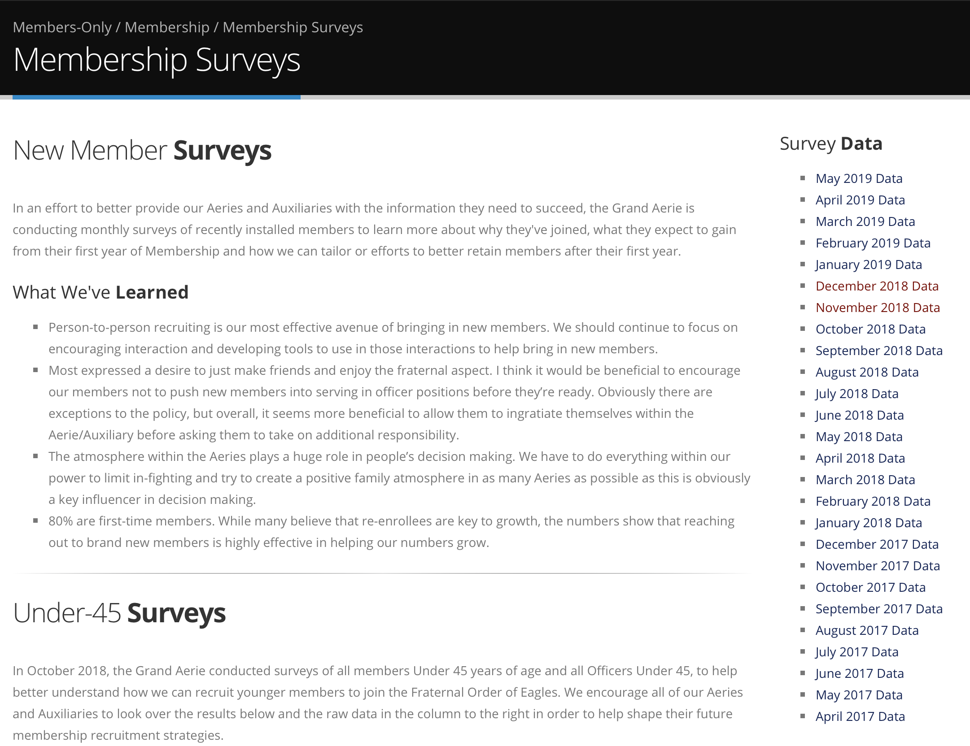
Membership Surveys
Each month, we send surveys to all new members, finding out more about why they joined and what they expect to gain from their membership.
Those results are posted monthly on the Membership Surveys page at foe.com.

Slide 14
What We Do With That Information
We use the survey results to target populations of people most likely to join the organizations and to tailor our future membership efforts to maximize our membership success and make sure our new members continue to want to be a part of the organization after their initial year of membership.
It is vital to our success that we listen to the men and women joining our organization. These surveys let us know how to shape what we do to better maximize our membership efforts.
The Grand Aerie conducts targeted social media advertising using this information which directs prospective members to the Join form at foe.com, which in turn generates membership leads you can use to recruit individuals interested in being a part of the Fraternal Order of Eagles.

Slide 15
If It’s Not Broke, Don’t Fix It
Many times, people have a tendency to change things that are still effective because we’re bored with them. If your annual events are still generating new members and charity donations, then it means they’re still working!
Don’t change your strategies when you’re bored with them. Change when your prospective members stop responding to them.
If it’s bringing you success, don’t change it just to change it.

Slide 16
Membership Poster
Each attendee received one in their bags.
Keep track of proposed members on the wall.
Create competition in your Aerie/Auxiliary and bring attention to those who don’t contribute.

Slide 17
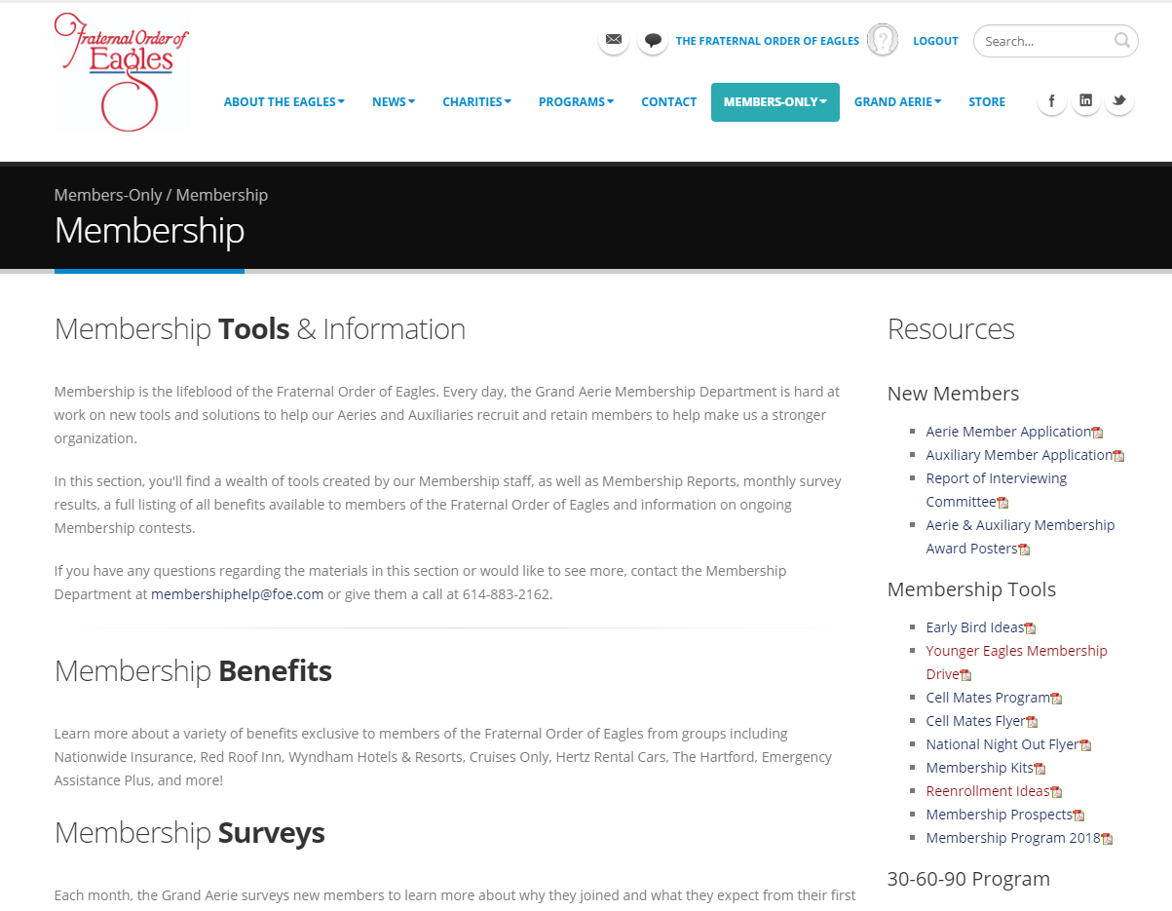
Web Updates
Membership Home Page
  Contest Flyers
  Early Bird Ideas
  Applications
  Awards Posters

