Slide 1
Marketing & Communications
Promoting your Aerie/Auxiliary

Slide 2
Zack Timmons
Marketing & Communications Director

Slide 3
Building Our Brand
Taking our historic logos, mission statement and overall purpose to create a unified F.O.E. Brand.
Upcoming Brand Updates:
  New Materials
    Grant Guide
    Social Media Guide
    Training Materials page on foe.com

Slide 4
Building Our Brand
Why?
  Simply put, establishing a set style and brand allows both members and non-members to immediately associate our communications with the F.O.E

Slide 5
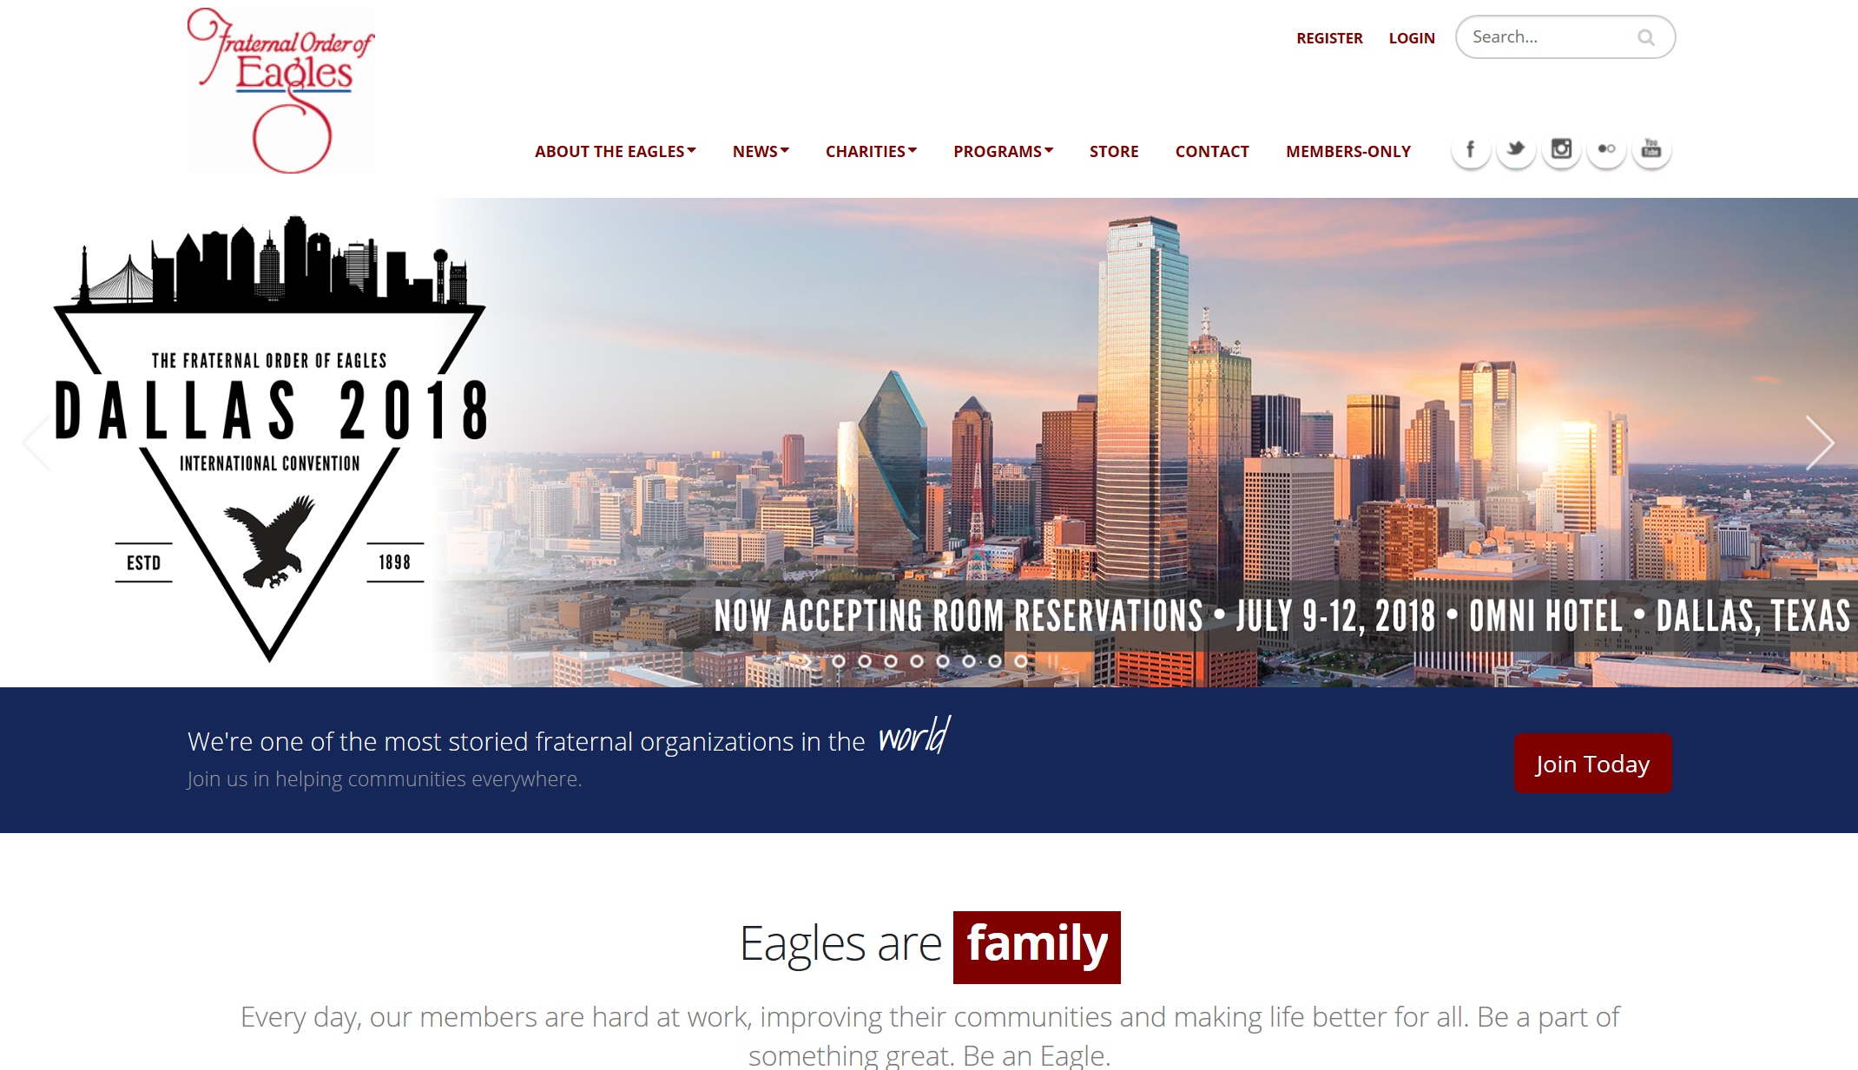
FOE.com

Slide 6
FOE.com Features
Easier Navigation
Smarter Search Function
Improved News Page
Grand Presidents Page
Compliance Page
People Helping People Page
Training Section (Coming Soon!)

Slide 7
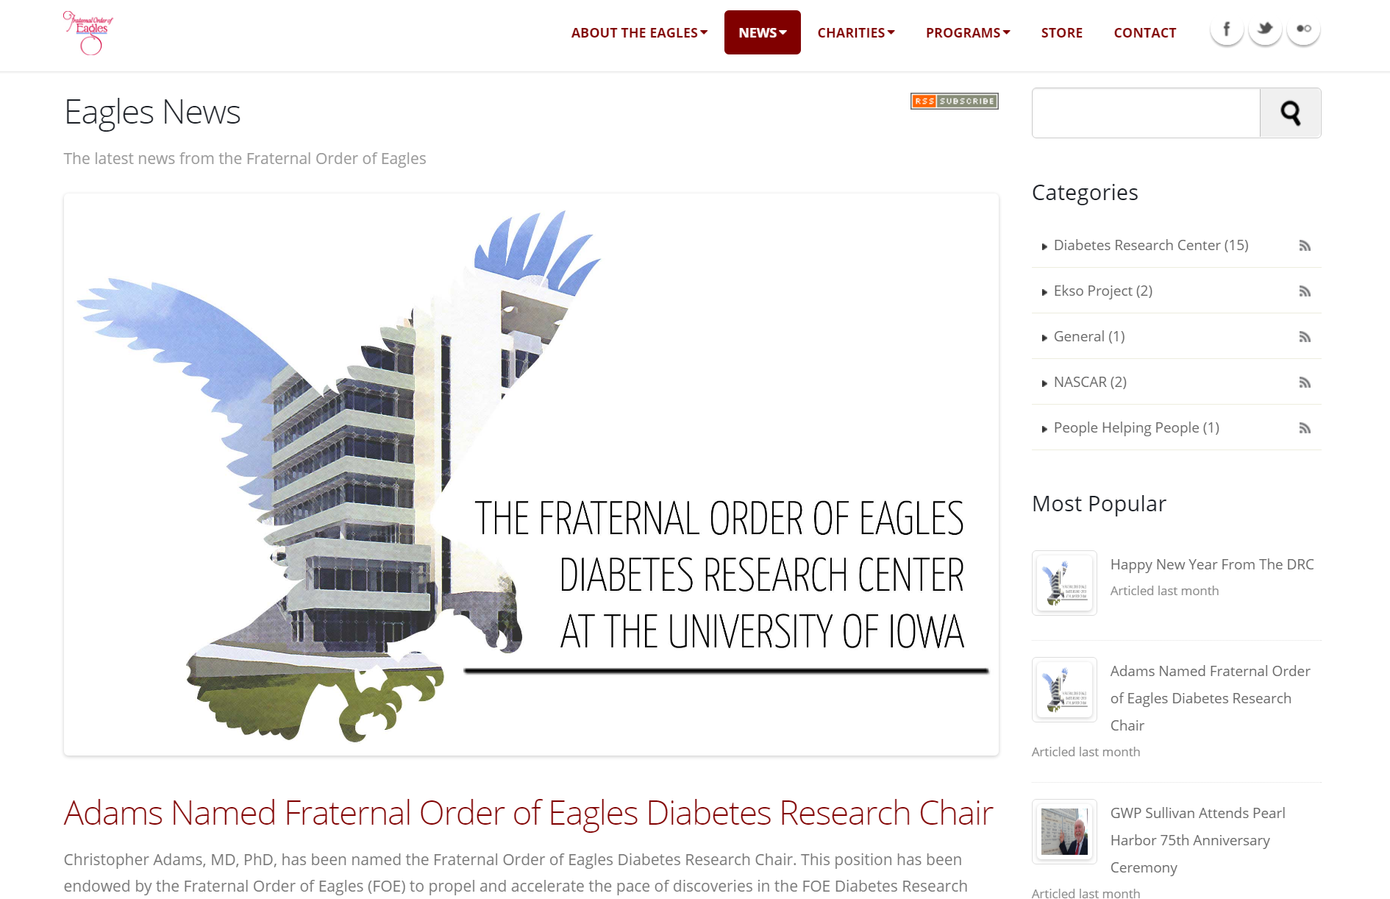
News Page

Slide 8
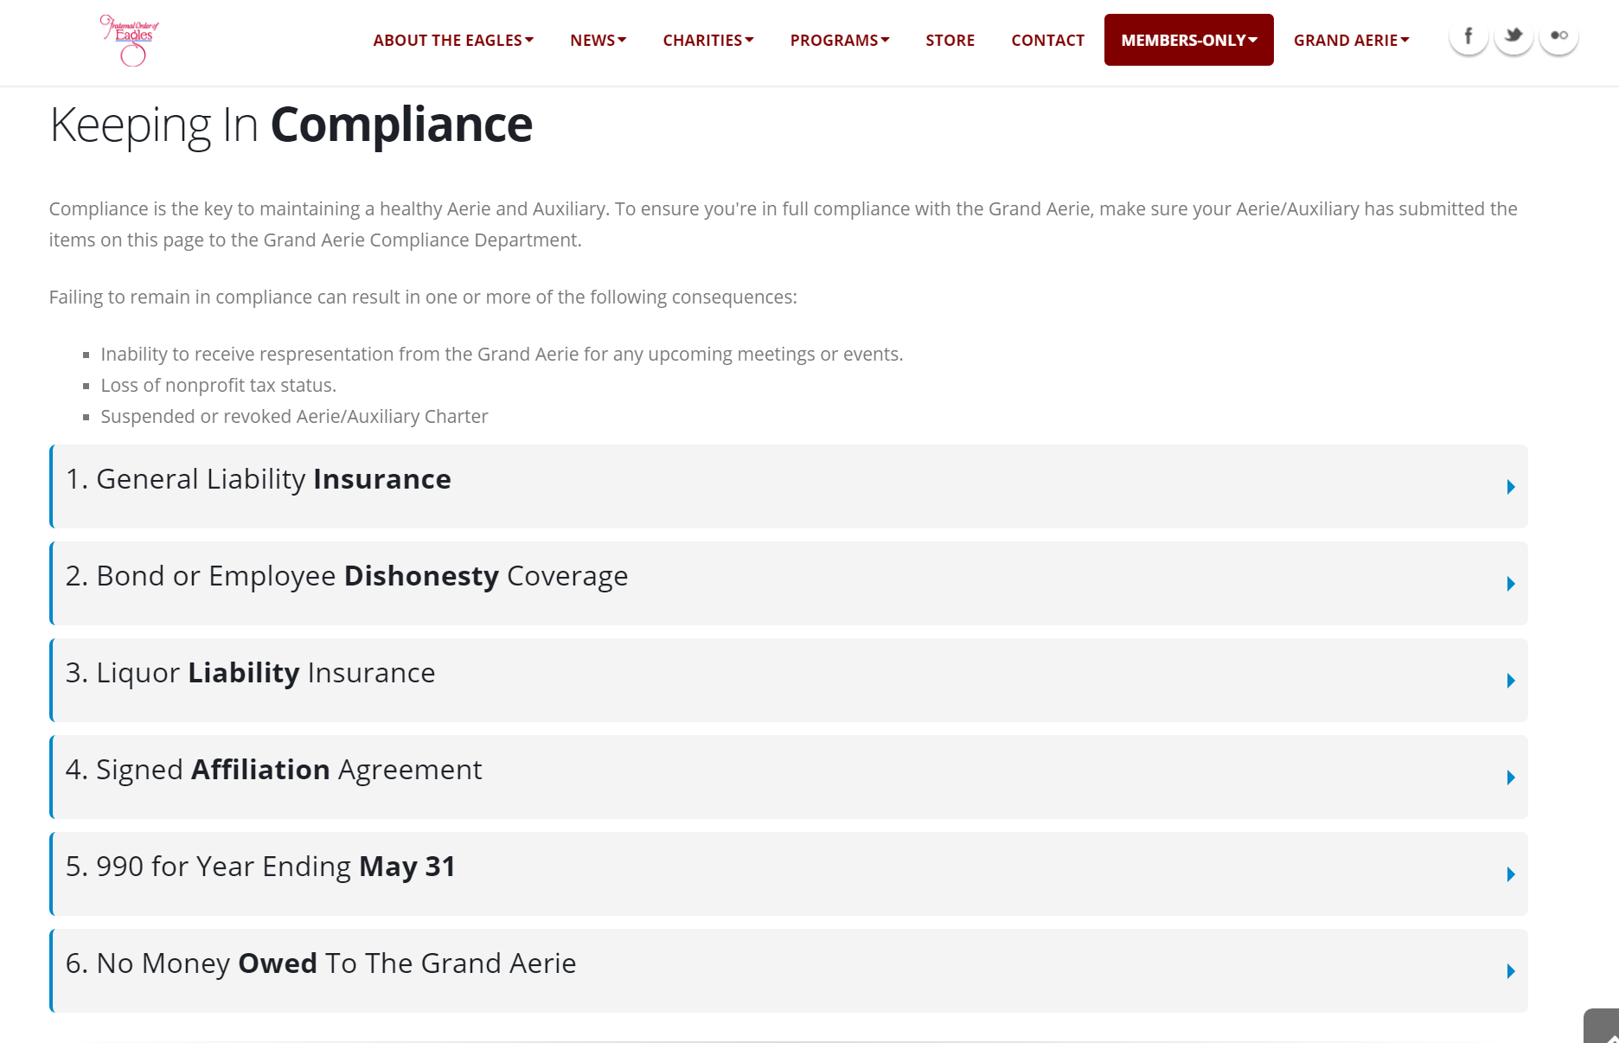
Compliance Page

Slide 9
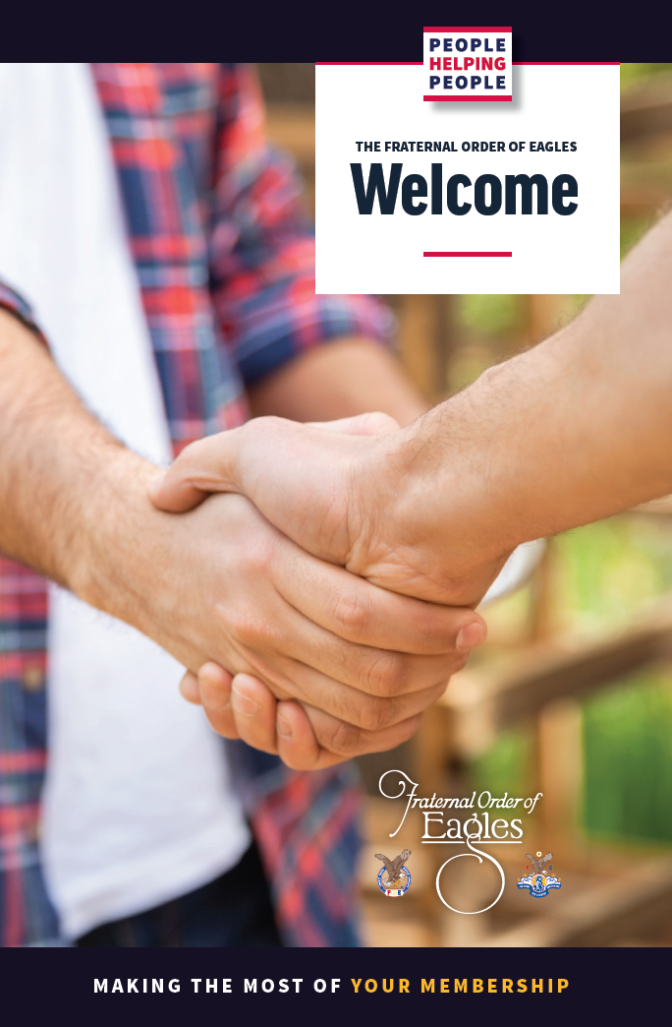
Welcome Brochure
Includes:
  Grand Aerie Contact Information
  Member Benefits Listing
  Charity Foundation Info
  How to Sign Up For Members-Only
  How to Change Personal Info Online

Slide 10
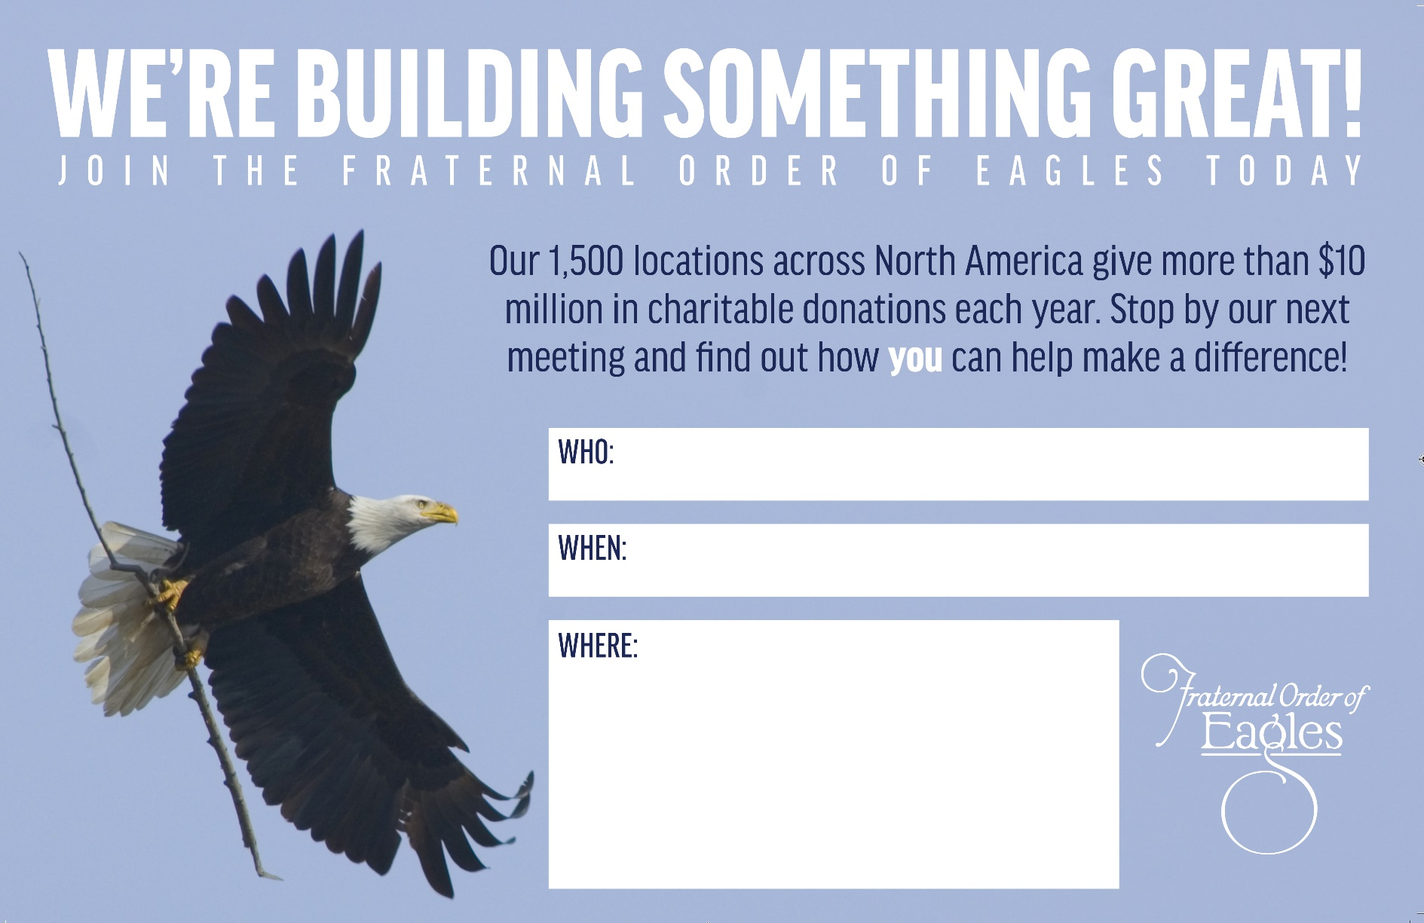
Posters – Available now through Membership

Slide 11
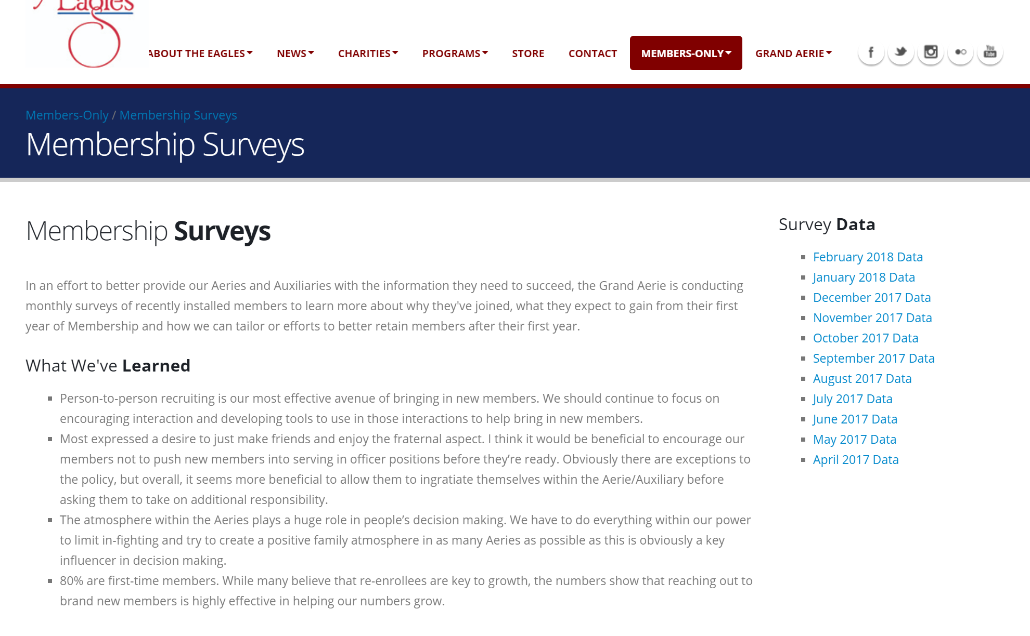
Surveys

Slide 12
Surveys
We’ve learned…
  9 of every 10 new members join because they already know someone who is a member.
  Most want to spend their first year getting to know people and fitting in as opposed to immediately serving in officer positions.
  More than 2/3 want to help with our charitable efforts.

Slide 13

Mike Goldsmith
Marketing/Programs Coordinator
Leveraging General Programs within your aerie
Children’s Programs and your community
Convention Program Book

Slide 14
General Programs
Operation Eagle
Donation program designed to help troops serving overseas during the Holiday season.
Bulletin Contest
Newsletter contest judging the best communications amongst local and state Aeries and Auxiliaries.
International Sports
Eagles competing against Eagles in a variety of international sports tournaments.

Slide 15
Children’s Programs
Children’s Day
Hold an event for children any time during the year and send in a summary for a chance to win a $3000 grant from the Jimmy Durante Children’s Fund.
Children’s Art Contest
Aeries and Auxiliaries are encouraged to meet with local schools to encourage 3-6 grade students to create art pieces and compete for cash prizes.
God, Flag, and Country
Oratory competition held each year at International Convention for children
aged 10-15 with a chance to win cash prizes. Local and State Aeries and
Auxiliaries are encouraged to hold preliminary competitions.

Slide 16
Convention Program Book
Early Bird Period ends March 31
Save $25 by submitting your ad before March 31
All Ads due April 30
Ads are due by April 30th to meet the demands of mass printing.
We will redesign your ad
Next Year there will be a box to check if you do not want the Grand Aerie
Marketing Department to Enhance Your ad. This will allow us to improve the
look and feel of the program book from year to year.

Slide 17
Sofia Syed
Communications Specialist

Slide 18
Social Media Tips & Best Practices
Social Media Platforms
Do’s & Don'ts + How to Handle Bad Posts
Creative Ways to Mix up your Posts

Slide 19
Social Media Platforms
Facebook –
Good for sharing Events, Updates about the Aerie, Photos, etc.
Twitter-
Good for sharing Quick Updates and Local Events
Instagram-
Good for sharing Photos of Good Deeds, Fundraisers, Members

Slide 20
Do’s & Don’ts of Posting Online
+ How to Handle Bad Posts
Do’s
- Post about Events | Fundraisers | Dinners | Etc.
- Take it one step further; after posting about an upcoming event,
be sure to post Follow Up Pictures and Updates of how the Event went ( + tag us so we can see!)
- Encourage Conversation;
Host Polls and Ask Questions on your Social Media to get feedback from fellow members
Don’ts
- Post anything inappropriate; alcohol / drinking, etc.
- Talk badly about Members on Social Media (delete & address privately)
- Delete posts that contain bad reviews (address the problem)

Slide 21
Tips: Creative Ways to Mix up Posts
Use CANVA.com to create: Social Media Posts | Flyers | Business Cards | etc. – FREE!
Professional and Free Image Websites:
PEXELS.com
FREEIMAGES.com
PIXABAY.com
Encourage your members to follow your Aerie on Social Media
Try and post a few times a week to stay active on the different platforms
Have members post to the page

Slide 22
People Helping People
What To Submit
How To Submit
Tips

Slide 23
What to Include in your Submission
Anything relating to:
Good Deeds | Fundraisers | Donations | Helping someone in the Community | etc.
How much was Donated / Given – whether it’s money, items, etc.
Aerie # and Location
Who raised the Money – Aerie | Auxiliary | Eagle Riders
Photos
Not mandatory but its always better to include photos if you can

Slide 24
How to Submit
Email us your submission at: Marketing@FOE.com
Tag us on social media: @FOEGRANDAERIE

Slide 25
People Helping People Tips
For Photos:
Try taking ‘action shots’ rather than the standard group / person holding a check

