Slide 1

Keeping in Compliance
Compliance is the key to maintaining a healthy Aerie and Auxiliary. To ensure you're in full compliance with the Grand Aerie, make sure your Aerie/Auxiliary has submitted the items in this presentation to the Grand Aerie Compliance Department.
Failing to remain in compliance can result in one or more of the following consequences:
Inability to receive representation from the Grand Aerie for any upcoming meetings or events.
Loss of nonprofit tax status.
Suspended or revoked Aerie/Auxiliary Charter

Slide 2
General Liability Insurance
You must submit the “entire” General Liability Insurance policy for the Aerie and Auxiliary with the Grand Aerie Fraternal Order of Eagles named as Additionally Insured. Auxiliary must either be a “policy owner” on the Aerie's policy or “have their own separate policy.”

Slide 3
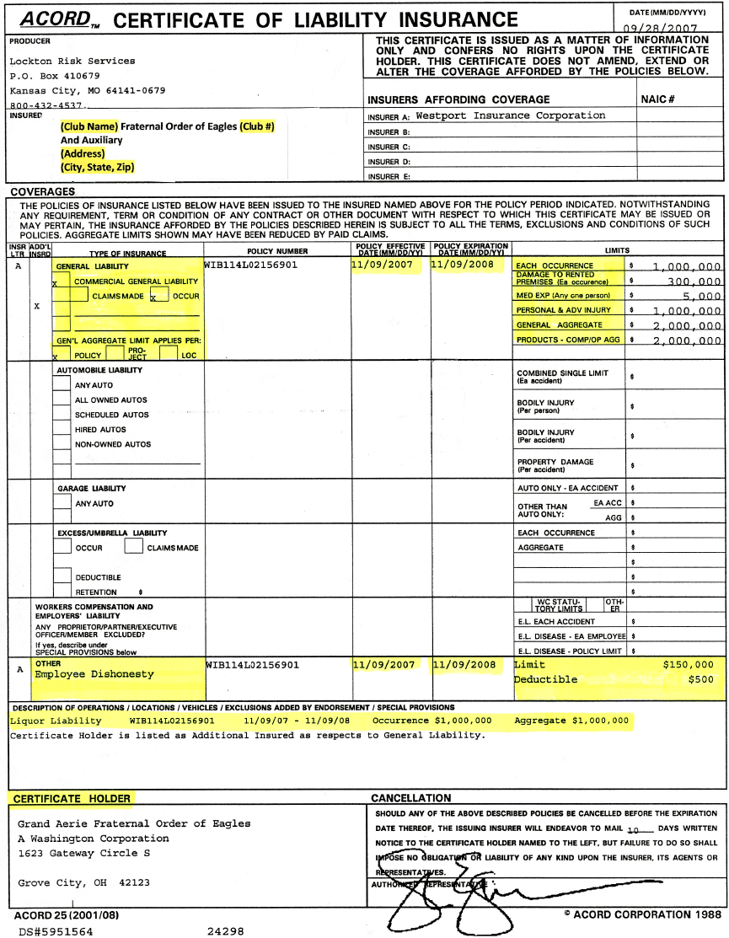
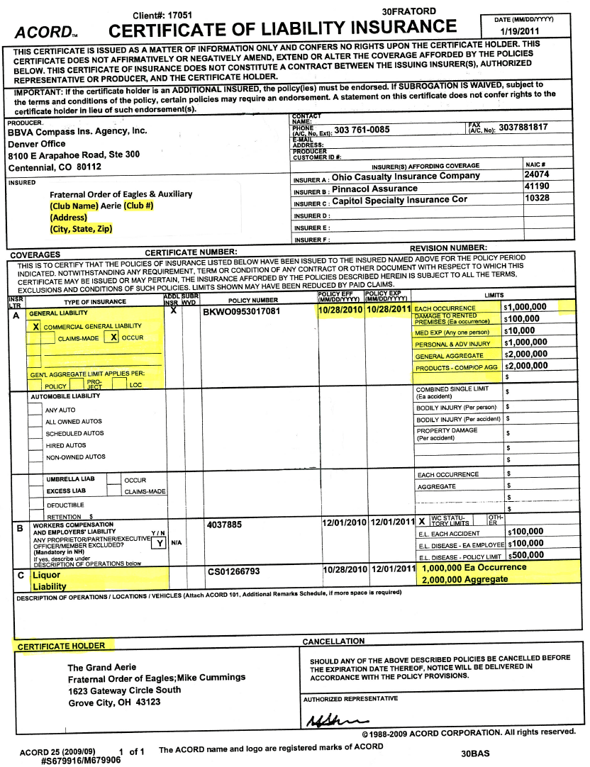
Certificate of Liability Insurance
“This example is not valid Proof of Insurance for Compliance purposes”

Slide 4
Bond or Employee Dishonesty Coverage
Your policy MUST include bond or employee dishonesty coverage in order to be considered in compliance with the Grand Aerie.

Slide 5
Liquor Liability Insurance
Obtaining Liquor Liability Coverage protects you in the event a patron causes property damage, physical damage to another individual or causes harm via a motor vehicle after being served at your establishment. A select number of states do not have dram shop laws, which means the establishment cannot be held responsible for the actions of an individual served there. In these states (Delaware, Kansas, Louisiana, Maryland, Nebraska, Nevada, South Dakota and Virginia) it is not required for an Aerie to obtain Liquor Liability Insurance.

Slide 6
Signed Affiliation Agreement
As some of you may know, the Grand Aerie and some local Aeries have been found liable in recent lawsuits, costing the organization in dollars, valuable membership and leadership and adding additional stress and frustration which inhibits our ability to grow. With these situations and the protection of our members in mind, our legal team drafted the Affiliation Agreement. The Agreement provides protection to local members, officers, their buildings and property, as well as the Grand Aerie, and provides us with a valuable resource to guide decision-making on all levels.
The Worthy President and Secretary of the Aerie are required to sign the Affiliation Agreement and send it back to the Grand Aerie Office to the attention of the Compliance Administrator. Once received, a Grand Aerie official will also sign the agreement and send a copy back to your Aerie for record keeping purposes. The Affiliation Agreement is located in the MMS Admin section of the Member Management System (MMS) for your review and signature.
Further, the Affiliation Agreement requires each Aerie to enter into a similar agreement with each of its Auxiliaries, clubs within a club (such as REAC, Eagle Riders, etc.), and any other subordinate groups. A sample agreement has also been placed in the reports section of MMS for your reference. Please note the waiver on the first page of the agreement. Due to the variations in the laws across the United States, we cannot give each Aerie a finalized form to use, but we wanted to at least give an example of what the agreement between your Aerie and its associated groups could look like.
2017 Aerie Affiliation Agreement
2017 Auxiliary Affiliation Agreement

Slide 7
Incorporation
Section 123.1. (b) An Aerie must be incorporated under Section 123 but cannot form sepa­rate corporations for the purpose of one (1) corporation holding the liquor license and another holding the real estate and other assets of the Aerie. Any corporate structure above and beyond the simple "incorporation of the Aerie" is in violation of Sec. 123.1.

Slide 8
990 for Year Ending May 31
You must have a 990 filed for the most recent fraternal year ending May 31. If all extensions were filed, deadline is April 15. All extensions must be submitted to the Grand Aerie Compliance Department.
The local Aerie and Auxiliary 990's are due October 15 with the IRS. The IRS does not have the Grand Aerie classification updated at all of their tax return centers. The Grand Aerie classification was changed from a 501(c)10 to a 501(c)8 in 2007.
All 990 returns should include a copy of the April 5, 2007 IRS Determination Letter with the Group Exemption Number of 0102. This will avoid local returns being rejected.
A copy of the IRS determination letter can be obtained in the Members Only section of www.foe.com under forms and logos.

Slide 9
Auditor
Annually the Auditor shall make a thorough and complete audit of the books of the Secretary, the Treasurer, the Board of Trustees, and any other officer, internal unit and committee by whom any of the financial transactions of the Aerie have been conducted. The audit shall be in conformity with the instructions to the Au­ditor given in the printed forms or instruction sheets contained in the Auditor's Annual Report Record. The Auditor shall promptly render a report on the audit so made to the Aerie and to the Grand Aerie. The Local Aerie Secretary shall include a copy of the previous year’s IRS Form 990, or its equivalent.
If the Aerie files an IRS Form 990 or 990EZ and provides a copy to the Grand Aerie, the Auditor is not required to provide an Auditor’s Annual Report pursuant to Section 102 (b). Otherwise the Aerie Auditor must comply with Section 102 (b) filing requirements.

Slide 10
TREASURER'S ANNUAL REPORT
The fiscal year of the Grand and Local Aeries of the Fraternal Order of Eagles ends on May 31 of each year, and the Aerie Treasurer is required to complete an annual report for the 12 months ending May 31. This annual report furnishes important information to the Grand Aerie. The Treasurers Annual Report to the Grand Aerie is due in the Grand Aerie office on July 1 of each year.

Slide 11
Fraternal Order of Eagles Fiscal Year
Section 35.7 (c) June 1st through May 31st of the following year shall be the fraternal and fiscal year for all Aeries and Auxiliaries. All Aeries and Auxiliaries, where applicable, shall use this date for the Internal Revenue Service (IRS) filings.

Slide 12
Charitable Gaming Reporting Information
Gaming Reporting on Form 990 for Non-Profits
IRS Publication 3079: Tax-Exempt Organizations and Gaming
IRS Form 990:Schedule G
IRS Form 990: Schedule G - Instructions

Slide 13
No Money Owed To The Grand Aerie
All outstanding Per-Capita Tax, Membership Fees and Supply Invoices must be paid in full to date to be considered in compliance.

Slide 14
House Rules Approved By Grand Aerie
All Aeries & Auxiliaries, per Section 122.4 of the Grand Aerie Constitution & Statutes and Rules & Regulations, must have their House Rules submitted to the Grand Secretary's Office for approval. Those who have yet to submit their House Rules or whose House Rules have been rejected will be considered out of compliance until their House Rules are properly approved.

Slide 15
Compliance Checklist
Has the Affiliation Agreement been signed and sent to the Grand Aerie?
Has the Aerie filed their Incorporation documents? Required
Last IRS 990 or equivalent has been filed?
A current copy of the Insurance Policy on file with the Grand Aerie?
Are the Grand Aerie Per Capita Taxes, Membership Fees and Supply Invoices Current?
Are the State/Provincial Aerie Per Capita Taxes Current?
Are all the payroll and State Taxes paid? (IRS 940 & 941)
8. Auditors and Treasurers annual reports sent to the Grand Aerie?
Revise 8/17/20

Slide 16
Section 85.17. The Secretary shall receive such compensation for the per­formance of his duties as may be prescribed by the By-Laws of the Aerie. Such compensation shall be a per capita compensation, and shall be based upon the number of members who are in good standing or who are no more than one (1) month in arrears. Such compensation shall not be paid to the Secretary however, until Grand Aerie and State/Provincial per capita tax and fees have been paid in full, and all reports then due as required by the Laws of the Order shall have been completed and transmitted to those entitled to receive the same.
The Secretary is an elected official who is paid according to the Aerie By-Laws. As the Secretary is elected, he is not an hourly employee paid on an hourly basis, so the minimum wage laws do not apply. The Secretary is to be paid on a per capita tax basis. (Opinion No. 556)
Revised 8-17-20

