Slide 1
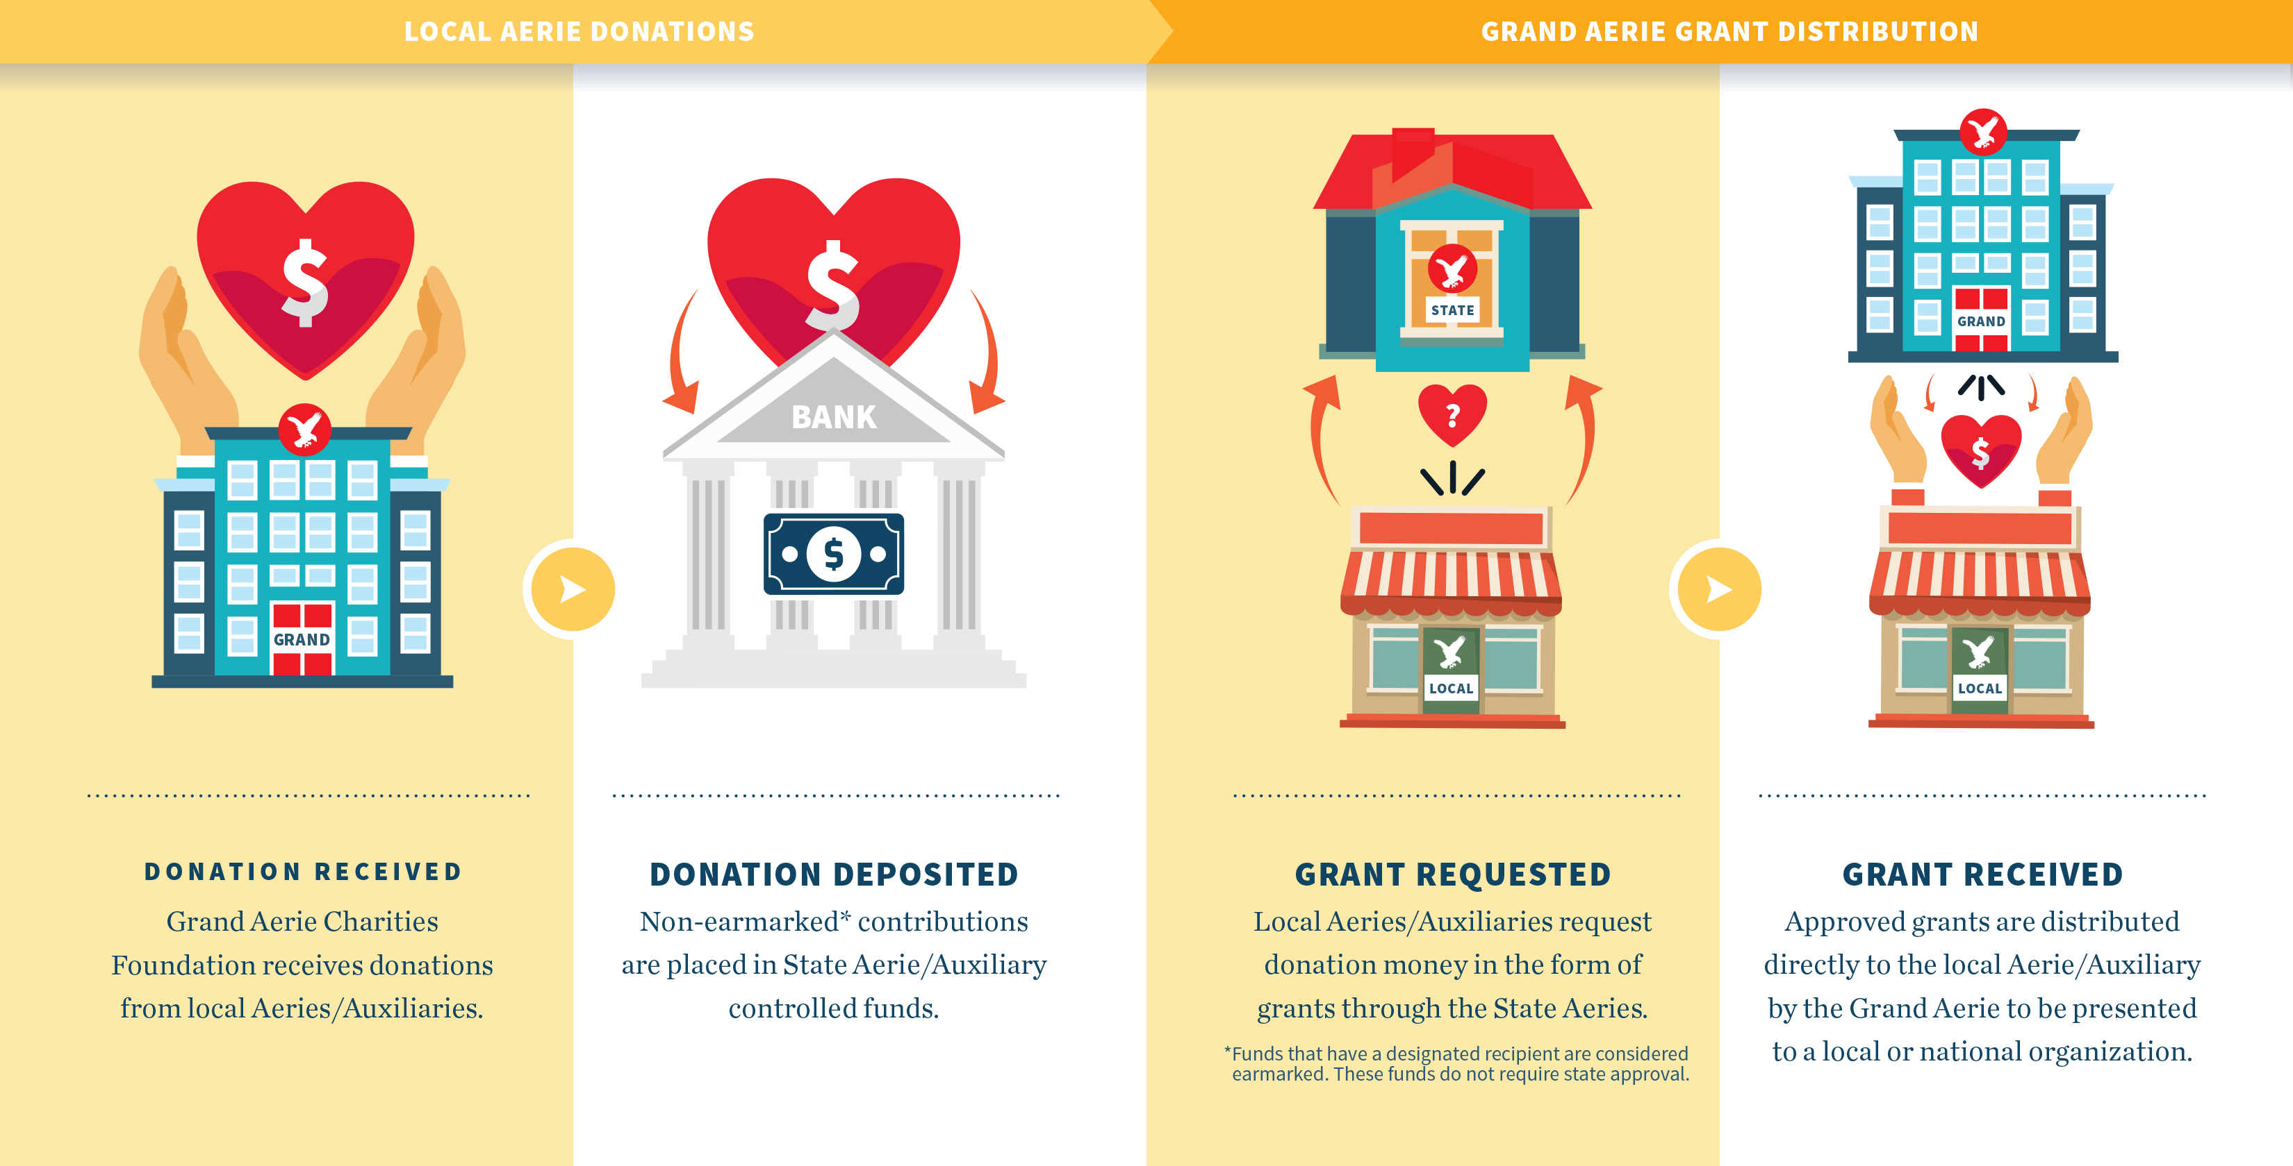
Contributions and Grants

Slide 2

Contributions vs Grants
Contributions
Collected Funds
Charities
charities@foe.com
Given (Distributed)
Granted
Grants
grants@foe.com
FOE

Slide 3
Why should we send contributions to the FOE Foundation?
Local level received credit for the amount raised
Organizations/Individuals receive credit for contributions received at the local level
Tax letter – for tax credit is issued for all contributions
The Grand Aerie ensures all requirements are met
Helps the Fraternal Order of Eagles organization as a whole receive national recognition and reflect the impact made by your efforts
Win/Win/Win
For the Locals – The Grand Aerie – And the Foundation!

Slide 4
FOE Charity Foundation Fund Name Revisions
Effective June 1, 2019, there is only one, comprehensive Children’s Fund.
Grants may still be given for the purposes of Child Abuse Prevention and Children’s AIDS Awareness.
All fund names now begin with “FOE Charity Foundation” and will be followed by the specific designation.
For example: The Jimmy Durante Children’s Fund has been revised to be the FOE Charity Foundation Children’s Fund.

Slide 5
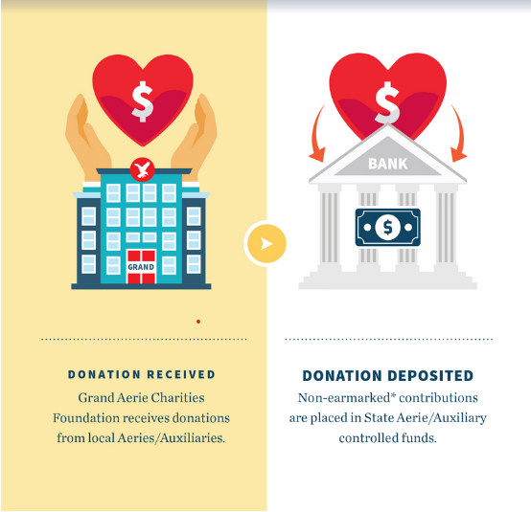
Contributions Overview

Slide 6
Contributions
Non-Earmarked: Contributions which reside in the State/Provincial funds and are available for grant submissions
Earmarked: Contributions which can only be given to the organization for which it was raised

Slide 7


For Non-Earmarked (General) contributions to all FOE Charity Foundation Funds:
Heart, Cancer, Muscular Dystrophy, Diabetes, Kidney, Children’s, Golden Age, Parkinson’s, Alzheimer’s & Neurological and Spinal Cord Injury
Payable to: FOE Charity Foundation
Specify in Memo: FUND (Heart, Cancer, etc.)

Slide 8





Non-Earmarked (General) Contributions
Local Aerie/Auxiliary
FOE Charity Foundation
State/Provincial Fund
Local
State/Province
Non-Earmarked: Contributions which are held within the FOE Charity Foundation for each State/Province. These contributions are available for grant submissions the following fiscal year.
Notes:
Contributions are sent from the local Aerie/Auxiliaries to the Grand Aerie. The funds are held within the FOE Charity Foundation and are available for grant submissions. The State/Provincial Aerie approves all grant submissions requesting State/Provincial Funds.

Slide 9


75%
How are Non-Earmarked Contributions Used?
25%
Used to fund grant submissions by Local, State and Provincial Aeries/Auxiliaries
Used by the Foundation for:
Convention Grants
Regional Grants
New Aerie/Auxiliary Grants

Slide 10

Earmarked Contributions
Earmarked:
Contributions which can only be given to the organization for which it was raised
Notes:
We will cover this more thoroughly within the Grant section of the presentation

Slide 11


Contributions
NO PORTION of any of the contributions received from local or State/Provincial Aeries/Auxiliaries is utilized to pay any administrative expenses

Slide 12
Contributions
Administrative Expenses of the Charity Foundation are paid by the Grand Aerie using:
Membership dues
Support from the Memorial Foundation
Interest earned from the investments

Slide 13
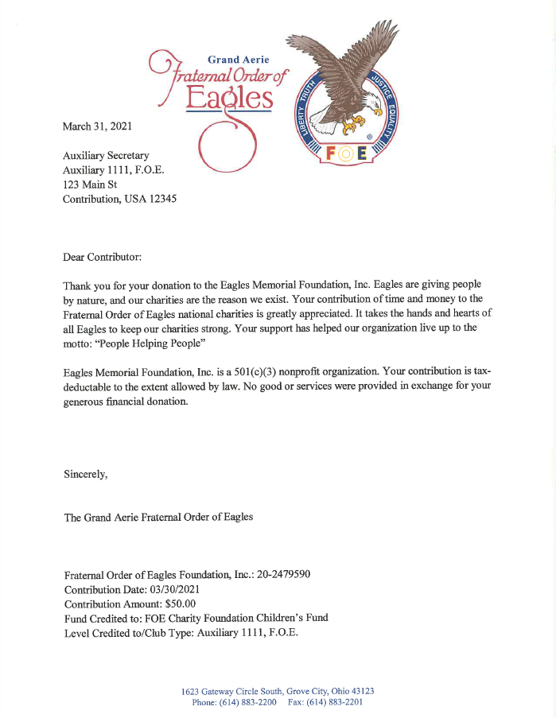
Tax Letter (Acknowledgement)
When you send a check to the Grand Aerie for one of the established charities you are technically donating to one of the FOE Charity Foundations (Charity Fund, Memorial Fund or Eagle Village)
Charitable Foundations are required by law to issue a letter to the contributor detailing the contribution.
This letter should be filed with your tax papers and given to your accountant when they are completing your yearly taxes.
(If the contribution is earmarked for a grant, the acknowledgement letter will most likely arrive before the grant check)

Slide 14
ALL contributions received are distributed in the form of a GRANT
Contributions Received
=
Grants Funded

Slide 15

Grants

Slide 16
Grants
ALL types of grants require a full grant package upon submission

Slide 17





4 Types of Grants
State/Provincial Funded Grant | Earmarked Grant
Turn-Around Grant | HOME Grant
State/Province
State/Province
Notes:
General Grant: Funds are approved exclusively from State/Province, Earmarked Grant: Funds are provided in part by Aerie/Auxiliary and in part by State/Provincial Funds, Turn-Around Grant: Funds are provided exclusively from the Aerie/Auxiliary, HOME Grant: Funds are provided exclusively from the Aerie/Auxiliary.

Slide 18

State/Provincial Funded and Earmarked Grants
These two types of grants:
Always require the grant package to be sent to the State/Provincial Aerie
May include State/Provincial funds

Slide 19

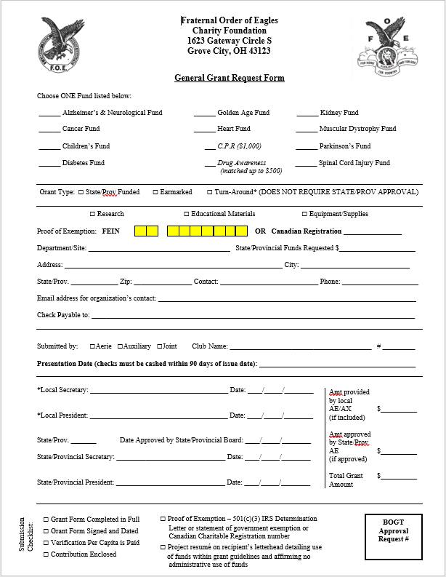
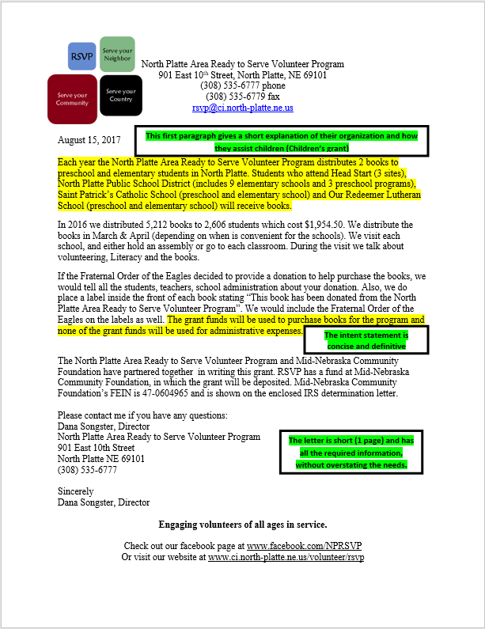
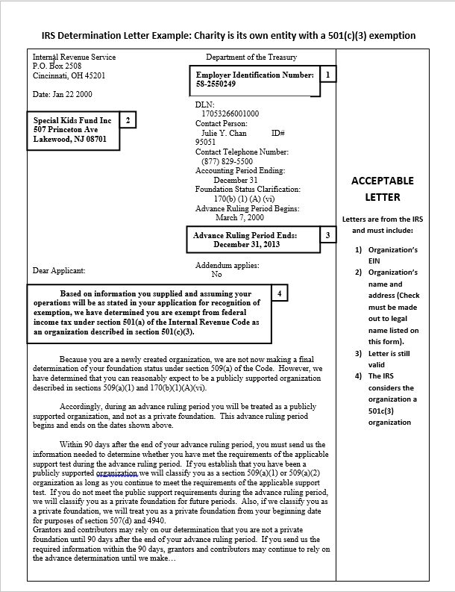
State/Provincial Funded Grant
Grant amount requested is supplied entirely by the STATE/PROVINCE Grant package is sent to the STATE/PROVINCIAL Aerie for approval

Slide 20


Earmarked Grant
Grant amount consists of funds raised by the Aerie/Auxiliary and any additional funds requested from and approved by the STATE/PROVINCE Grant package, including the funds raised by the Aerie/Auxiliary, is sent to the STATE/PROVINCIAL Aerie for approval
Check made payable to: FOE Charity Foundation
Notes:
Check with your STATE/PROVINCE for their guidelines regarding grant submissions.

Slide 21

Earmarked Grant
DO NOT send the check to the Grand Aerie separately from the grant package. It must accompany the package sent to the STATE/PROVINCE The STATE/PROVINCE will forward the approved package to the Grand Aerie for processing.
Check made payable to: FOE Charity Foundation
Notes:
Check can not be processed without the approved grant package. Check must be made payable to the FOE Charity Foundation.

Slide 22

Turn-Around and HOME Grants
These two types of grants:
Will only include funds raised by the local

Slide 23
Turn-Around Grant
Grant amount consists exclusively of funds raised by the Aerie/Auxiliary (no State/Provincial funds being requested) Grant package, including the funds raised by the Aerie/Auxiliary, is sent directly to the Grand Aerie for processing
Check made payable to: FOE Charity Foundation
Notes:
Check must be made payable to the FOE Charity Foundation. No State/Provincial approval is needed as no State/Provincial funds are being requested.

Slide 24

HOME Grant
Aerie/Auxiliary has raised funds for a specific organization which meet all of the grant criteria, but does not fit within one of the established FOE Charity Foundation Funds (ie: Heart Fund)

Slide 25
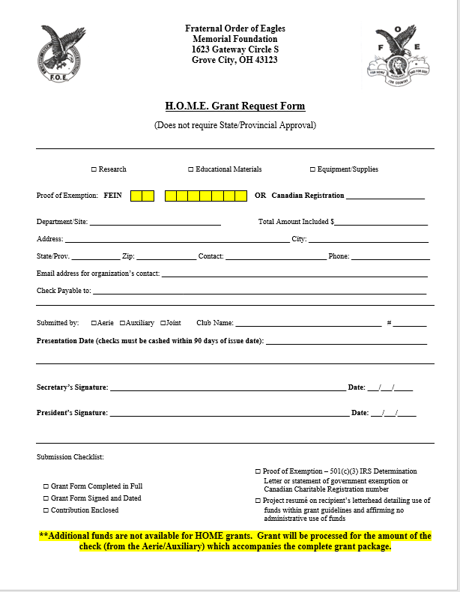
HOME Grant
Grant amount consists exclusively of funds raised by the Aerie/Auxiliary Grant package, including the funds raised by the Aerie/Auxiliary, is sent directly to the Grand Aerie for processing
Check made payable to: Memorial Fund
Notes:
Check must be made payable to the HOME Fund or Memorial Foundation. No State/Provincial approval is needed as no State/Provincial funds are available.

Slide 26
HOME Grant Organizations: Examples
Food pantries which serve the entire community (all ages) – not only children (aged 17 and under) or seniors (aged 55 and over)
Shelters/Crisis centers which serve men, women or entire families (all ages) - not specifically children or seniors
Veteran’s organizations which do not specifically serve seniors or treat PTSD
Humane Societies or dog training facilities
Organizations which treat/assist persons with disabilities of all ages
Disaster relief organizations
Notes:
You may contact the grant department for assistance with determining where an organization fits.

Slide 27


Grant Package Components - 1
Completed Grant Request Form
OR
General
Earmarked
Turn-Around
HOME

Slide 28

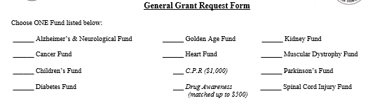
Grant Package Components – 1
Grant Request Form:
Completed by the Aerie/Auxiliary
Ensure the proper FOE Charity Foundation Fund has been chosen, if applicable
Notes:
No fund will be chosen for HOME as no additional funds are available.

Slide 29


Grant Package Components – 1
Grant Request Form:
Ensure all information is complete, legible and correct
Ensure grant form is signed by the proper officers
Notes:
Grant forms of all types must always be signed by the local Aerie/Auxiliary Secretary and President. General Grants and Earmarked Grants must also be signed by the State/Provincial Aerie Secretary and State/Provincial Aerie President.

Slide 30

Grant Package Components - 2
Resumé Letter from the Receiving Organization on their Letterhead

Slide 31


Grant Package Components – 2
Resumé Letter
Must be on the receiving organization’s letterhead
Must include a brief explanation of their charitable purpose
1-2 pages is sufficient
Detailed explanation of purchases or costs is not necessary

Slide 32








Grant Package Components – 2
Resumé letter must include:
Statement containing “grant funds will not be used for administrative expenses”.
Grant funds may not be used for financial assistance, gift cards, continuing education or any overhead costs.

Slide 33
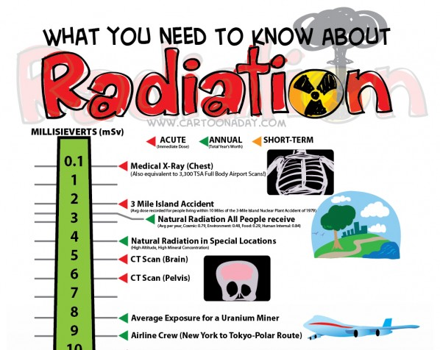


Grant Package Components – 2
Resumé letter must include a concise intent statement:
Grant funds will be used exclusively for… or Grant funds will be used to purchase…
Educational Materials
Research
Equipment and Supplies

Slide 34
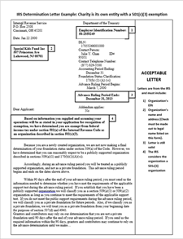
Grant Package Components - 3
Proof of Exemption:
IRS Determination Letter
Exempt Statement
OR
Canadian Charitable Registration Number

Slide 35
Grant Package Components - 3
IRS Determination Letter or statement of exemption
Federal exemption letter which states the organization is exempt as a 501(c)3 charity
Not a State sales tax exemption certificate
Statement of exemption: “The Standard Police Department is exempt through the City of Standard. The City of Standard’s FEIN is 12-3456789.”

Slide 36

Notable Points
Ensure the receiving organization and their planned use of the grant funds meet all of the grant guidelines BEFORE committing the funds to the organization
Grant funds are not given to organizations which are solely fund raising organizations. The receiving organization must actually be using the equipment and supplies, distributing the educational materials or performing the actual research. They may not be passing the funds, as a cash transaction, to another organization. (Susan G. Komen, American Heart Association, American Cancer Society).

Slide 37

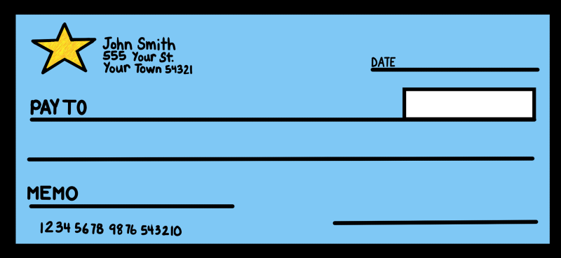
Notable Points
Grant checks must be cashed by the receiving organization within 90 days – ensure you notate the date needed on the grant form
Within 90 Days
Presentation checks are available through the marketing department
Notes:
Within 90 days o

Slide 38

Benefits of the Grant Process
Recognition: Each contribution/grant sent to the Grand Aerie is tracked so recognition can be given each year at the International Convention. The Grand Aerie cannot track or recognize contributions given by Aeries/Auxiliaries directly to other entities.
Credit: (Charitable Tax Deductions) All donors receive an acknowledgement letter acceptable for tax purposes. These letters should be given to your accountant each year. This only applies to contributions given to one of the FOE Foundations (Charity – Memorial – Eagle Village), which are designated by the IRS as exempt as 501(c)3 charities. This does not apply to any contributions given directly to any individual Aeries/Auxiliaries as they are designated as non-profit, 501(c)8 entities, not charitable.

Slide 39


Benefits of the Grant Process
In order for the Fraternal Order of Eagles Charity Foundation, The Memorial Foundation and Eagle Village to maintain their charitable status, proof of charitable activities within the issued guidelines must be provided. Contributions to the FOE established charities and grants awarded are reported in the yearly financial statements.

Slide 40
State/Provincial President’s Fund
State/Provincial Presidents may contact the Grand Aerie to establish a fund for their charity.
Email charities@foe.com and include:
Your name
Your State/Province
Aerie or Auxiliary
Your Presidential year (ex: 2021-2022)
Name of receiving organization and required documents to verify eligibility
Verify your chosen charity meets the grant requirements
The organization may submit their resumé letter to the grant department in
advance to verify their use of funds. The resumé letter and proof of exemption may be emailed to grants@foe.com

Slide 41
State/Provincial President’s Fund
To process Contributions for State/Provincial Presidents’ Funds:
Contributions may be sent directly to the Grand Aerie
Make checks payable to: FOE Charity Foundation
Note on the memo line:
Aerie or Auxiliary State/Provincial President Name
Indicate the State/Province (ex: Iowa)
Indicate the Presidential year (ex: 2021-2022)
One grant will be processed for the total amount in the fund at the end of the President’s term

Slide 42
State/Provincial President’s Fund
If the State/Provincial President or the State/Province is collecting funds from individual Aeries/Auxiliary and sending to the Grand Aerie as one sum, they must include a detailed list of which Aerie/Auxiliary contributed what amount.
Otherwise, when the contribution is received, it will be credited to the State/Province as one large sum.
The Aeries/Auxiliaries which donated the funds will not receive credit/recognition through the FOE Charity Foundation.

Slide 43


Regional Grants (For Regional Presidents ONLY)
Together, the Aerie and Auxiliary Regional Presidents will decide how the $5,000 grant is dispersed
They may present one joint $5,000 grant or each present a $2,500 grant for the charity they have chosen
The grant funds may not be used for Aerie or Auxiliary State/Provincial Presidents’ projects, Grand Worthy President/Grand Madam Presidents’ projects or redirected to any of the FOE Foundations (Charity Foundation, Memorial Foundation or Eagle Village)

Slide 44


Regional Grants
Completed grant packages must be received at the Grand Aerie no later than June 15th
Grant checks will be mailed 2 weeks before the start date of the Regional Conference
The grant check MUST be presented at the Regional Conference

Slide 45
Copies of the Grant Request Form and HOME Grant Form have been included for your use
Should you have any questions or need assistance, please contact Kim Fifer: 614-883-2207 or charities@foe.com OR
Kristine Preskar: 614-883-2196 or grants@foe.com

