Slide 1
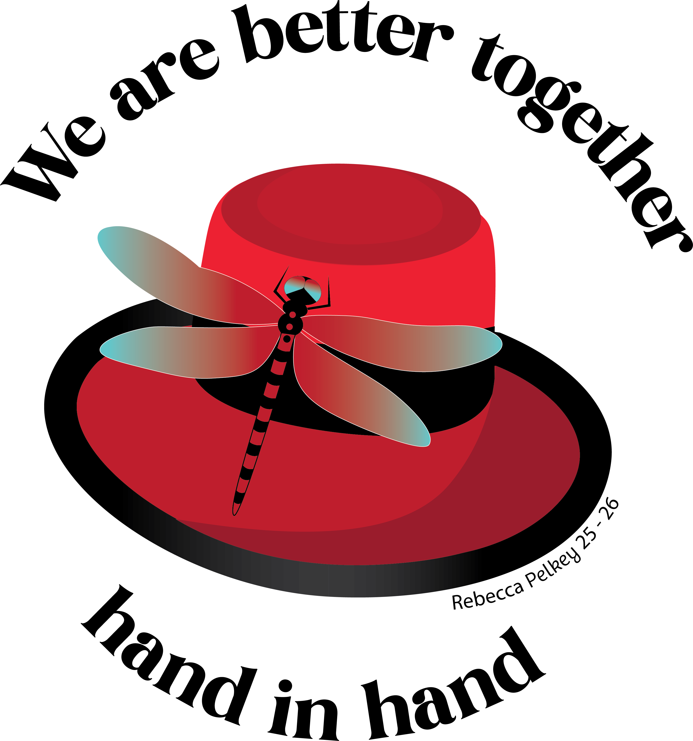
Governing

Slide 2
Rules & Regulations
The Constitution & Statutes and Rules & Regulations are the guiding governing documents for our Order. Every member should have a copy. You can order them through the Supply Department at supplies@foe.com or via the Grand Aerie’s Online Store.

Slide 3
Rules & Regulations
Inside the R&R, you will find the requirements each Auxiliary must follow, the duties of the Auxiliary’s officers and committees and procedures to follow for the various business aspects of the Order.
Even if you aren’t an officer, you should feel an obligation to have a copy so you can properly ensure your officers are following the rules and that nothing is being forgotten or neglected.

Slide 4
Local By-Laws
Your Local By-Laws are the governing document for your Auxiliary. It sets the cost of your dues, the rules specific to your Auxiliary and the expectations for your membership.
All Local By-Laws have to be submitted to the Grand Aerie and approved to ensure they’re in compliance with the Constitution & Statutes and Rules & Regulations.

Slide 5
House Rules
House Rules govern the social room in your Aerie home and provide rules and expectations for members while socializing. These should be posted in a prominent place in the Aerie home so that all members know the expectations. Aerie Trustees have the right to issue social room suspensions

Slide 6
Taking Action
Section 63.1. (a) Any member in good standing in an Aerie or Auxiliary may file charges against any other member of any Aerie or Auxiliary for an offense committed against the Laws of the Order.
If someone violates the Laws of the Order, you have the right to bring them up on charges. Holding people responsible for their actions is part of the governing process. When we fail to hold them accountable, we allow rules to be broken, which causes further problems.

Slide 7
Consequences
When you don’t hold members accountable you risk:
Losing members due to conflict
Other members following suit and breaking rules because they feel there’s no consequences
Potential loss of Liquor License, Gaming License, Non-Profit Status, etc., for violations

