Slide 1
Conciliation Committee
Ladies auxiliary rules & regulations
Rev 06/2025

Slide 2
Section 20.5
Immediately after her installation, the Madam President of each Local Auxiliary shall appoint a Conciliation Committee, which shall consist of five (5) members, all of whom shall be Past Madam Presidents of the Auxiliary, if Past Madam Presidents are available, and who shall serve during the Madam President’s term of office.

Slide 3
Appointment of the Conciliation Committee
The Madam President appoints five (5) Conciliation Committee Members
All Conciliation Committee Members should be Past Madam Presidents of the Auxiliary if available. Otherwise, any member in good standing of the Auxiliary may be appointed
Dual members of the Auxiliary may serve on the Conciliation Committee
Conciliation Committee Members serve during the Madam President’s term of office and cannot be replaced unless a vacancy occurs

Slide 4
Section 20.5
(continued)
Purpose of the Conciliation Committee

Slide 5
Purpose of the Conciliation Committee
The purpose of the Conciliation Committee is to provide a means for resolving disputes between members of the Auxiliary
Said dispute must have occurred within the past thirty (30) days
The Conciliation Committee may make recommendations for resolving the dispute; however, both parties must agree to the resolution
The Conciliation Committee does NOT have the authority to impose penalties

Slide 6
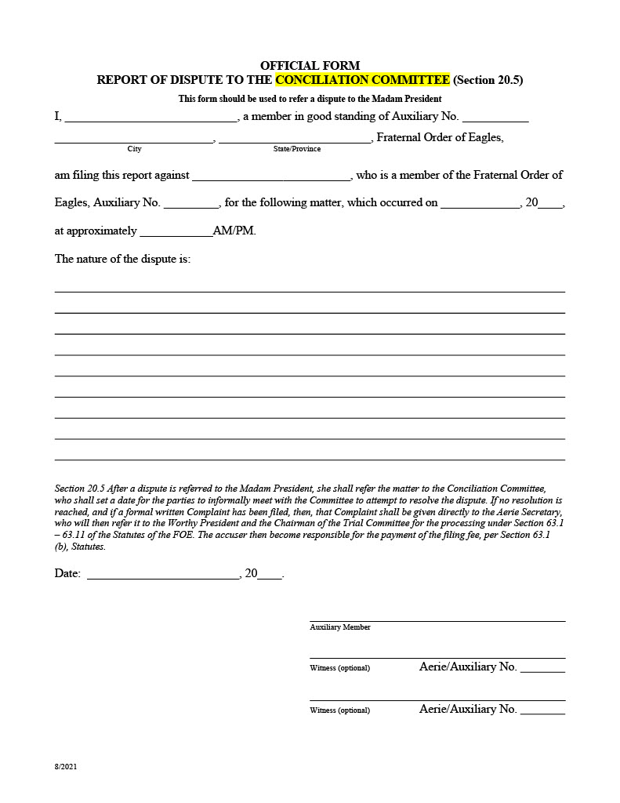
Conciliation Dispute Form

Slide 7
Conciliation Dispute Form
The Conciliation Dispute form is to be completed within thirty (30) days of the occurrence of the dispute and given to the Madam President
The Madam President then refers the matter to the Conciliation Committee
The Conciliation Committee sets a date for the parties to meet to attempt to resolve the dispute

Slide 8
If Conciliation is successful:
The Conciliation Committee completes and signs the Conciliation Dispute Resolution form, noting the terms of the settlement
The parties to the dispute must also sign the Conciliation Dispute Resolution form
The Conciliation Dispute Resolution form is filed with the Madam Secretary

Slide 9
If Conciliation is not successful:
If no resolution is reached, the party filing the dispute has the option of filing an Official Complaint with the Aerie Secretary under Section 63.1, Statutes, and the matter will proceed to trial
The Conciliation Dispute Resolution form is to be completed and signed by the Conciliation Committee indicating the matter is dismissed or a formal Complaint has been filed directly with the Aerie Secretary for processing under Section 63.1, Statutes
The parties to the dispute must also sign the Conciliation Dispute Resolution form
The Conciliation Dispute Resolution form is filed with the Madam Secretary

Slide 10
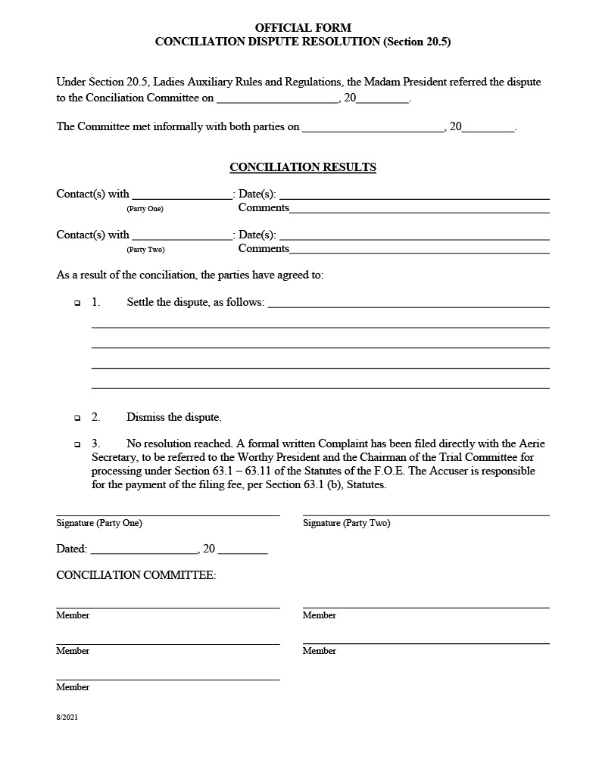
Conciliation Dispute Resolution Form

Slide 11
Jolie Stauffer
Secretary of the Grand Tribunal grandtribunal@foe.com
614-883-2175
All forms may be found at the back of the statutes and at www.foe.com under the Member’s Only section.

