Slide 1

AUXILIARY SECRETARY DUTIES
July 2022

Slide 2
SECRETARY
DUTIES
1. Keep a full and complete record of the proceedings of the Auxiliary in a book provided for that purpose by the Grand Aerie or if the records are kept electronically, they shall be printed and read at each meeting and, once approved by the membership and signed by the Madam President and Secretary, copies shall be kept and protected in a three (3) ring binder or book for that purpose.
2. Open & Read to the Auxiliary all Auxiliary mail (unless it is addressed to another Officer or member) - reports, bills and communications which may be presented, including all official communications received from the Grand Aerie, which shall be read in their entirety unless otherwise specifically directed.
3. Shall assist in the transaction of the business of the Auxiliary; write all communications; fill out all certificates and cards granted by the Auxiliary.
4. Keep and maintain at all times a full, complete and up-to-date roster of the membership, Committees and Officers of the Auxiliary, as required by the Membership Management System (MMS) with the latest up-to-date residence, mailing address, Phone or cell numbers and email address.
5. Shall notify the Grand Secretary forthwith of the expulsion by the Trial Committee of any member or Officer removed from office.

Slide 3
6. Shall maintain such systems of records, books and accounts, and shall issue such notices and make such reports as the Grand Aerie shall prescribe.
7. The mailing list or roster is an official record of the Local Auxiliary for which the Madam Secretary is responsible. Every member whose name is on the roster list of the Local Auxiliary is entitled to full protection from any misuse of such roster list. Neither the Madam Secretary nor any other officer of the Local Auxiliary may use or authorize the use of the Auxiliary roster list. NAMES ONLY may be given for official Auxiliary business.
8. If the Auxiliary has an office in the Aerie Home and it is an office shared by the Auxiliary officers, the Auxiliary membership controls who is to have a key to that office.
If the office is under the control of the Secretary, she controls who has keys to the office, with the exception that a key must be given to the Aerie Trustees for security and emergency purposes only.
9. Local Auxiliary By-Laws of a current status shall be posted at all times on the Auxiliary Bulletin Board so as to be available to all members of the Auxiliary.

Slide 4
10. The Madam Secretary shall segregate and enter amounts of all monies received upon her records to the credit of the respective funds of the Auxiliary, as required by the Laws of the Order, and shall pay such money to the Madam Treasurer at the close of each meeting, or on the succeeding day and demand the signature of the Madam Treasurer in the Secretary’s Cash Book, for money received by the Madam Treasurer.
11. The Madam Secretary shall demand, receive and immediately receipt for all money and/or property belonging to the Auxiliary and receive from every source, including any committee, Marching Club, Degree or Drill Team or other Internal Unit.
12. May appoint an assistant to efficiently carry on the duties of her office. The assistants so appointed shall give bond for the faithful performance of such duties, the premiums to be paid for by the Auxiliary. The Secretary shall also be responsible for her bond, for the faithful performance of the duties assigned to such assistants. The assistants’ compensation shall be paid by regular Auxiliary check from the treasury of the Auxiliary if compensation is provided for in the By-Laws of the Local Auxiliary, and in that event, the compensation to the assistant shall not be charged against, and regularly deducted from, the compensation of the Secretary.
13. Shall read at every meeting:
An itemized account of the receipts to and the disbursements from each fund of the Auxiliary since the last regular meeting.
At the last regular meeting of each month she shall read an itemized list of all, approved unpaid bills of the Auxiliary on hand, and the date such bills were due and payable.

Slide 5
14. Shall, on request, deliver all books, papers and property of the Auxiliary to the Auditor or to such officer or officers as the Grand Worthy President or the Grand Secretary shall direct.
15. Shall receive compensation for the performance of her duties as may be prescribed by the By-Laws of the Auxiliary.
Such compensation shall be a per capita compensation
Shall be based upon the number of members who are in good standing or who are not more than (1) month in arrears.
Shall not be paid until all required reports have been completed and transmitted.

Slide 6
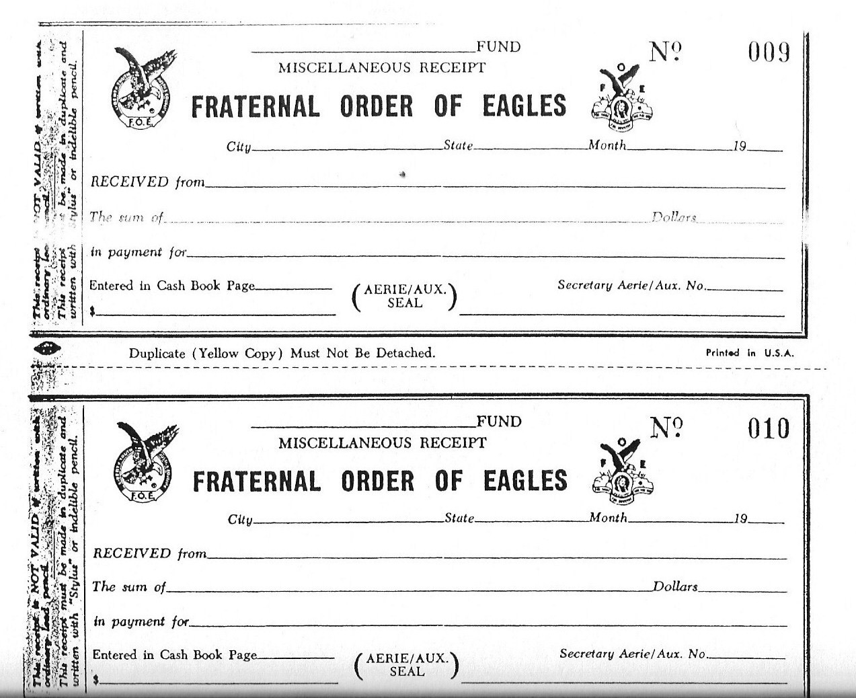
17. Temporary Receipts - to immediately acknowledge receipt of dues and application fees.
Miscellaneous Receipts - a duplicate carbon receipt for all other monies received
- original to be given to the person you received money from
- Receipts are in numerical order.
Both receipts provided by the Grand Aerie.

Slide 7
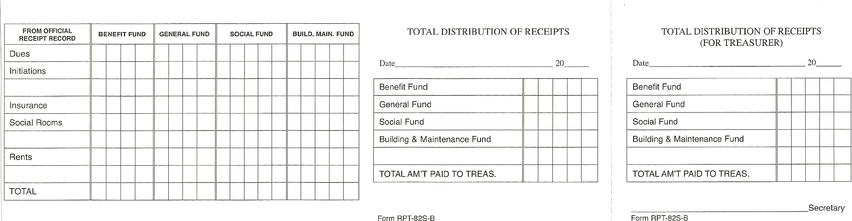
18. DISTRIBUTION OF RECEIPT FORMS
Can be obtained from the Grand Aerie Supply Department.
A valuable tool for making the turnover of money to the Treasurer and making your report to the membership.
Not to be used as a receipt from the Treasurer.
Indicates how your deposits are made to the different funds.
Perforated for tearing off part for the Treasurer.

Slide 8
19. SECRETARY’S MINUTE BOOK
Secretary’s must keep a complete and full record of the proceedings of the Auxiliary.
DO NOT attempt to write out completed minutes of the meeting during the meeting. Take notes and/or record the meeting.
(A Local Auxiliary may, by a proper By-Law, prohibit the tape recording of any of its meetings other than that done by the Secretary or designated recorder for those proceedings or meetings. Opinion No. 703.)
Create an outline of standard minutes required so you have it available for each meeting:
Roll Call of Officers
Reading of the Minutes of the previous meeting
Treasurer’s Report
Old Business
New Business
Reading of new applicants
Reading of re-enrolled applicants
Etc.

Slide 9
5. Minutes can be typed and glued to the Secretary’s minute book pages or maintained in a three ring binder.
6. It is VERY important to include the following in the Minutes book:
Visiting Members
Officers absent and if they were excused
Applications received for New/Reenrolls/Dual/Transfer
Applications voted upon
Applications that were rejected
Applicants who were initiated
Members on the sick list
Short resume on all communications received and read
Action taken on reports of all committees
Excuses of absentees
Old Business – Motions, etc.
New Business – Motions, etc.
Good of the Order

Slide 10
20. SECRETARY’S MINUTE BOOK PART 2
Part two of the minute books is a record of all Special Committees.
Part three is for a record of all Standing Committees.
Part four is for recording attendance of all Officers.
Fraternal and Fiscal Year – June 1st to May 31st.
There are 2 authorized funds:
General Fund
Benefit Fund
Local Auxiliaries may, by their By-Laws, provide for special funds for any purpose not prohibited by the Laws of the Order, upon obtaining the approval of the Grand Aerie Financial Advisor.
The Secretary Cash Book is available through the Grand Aerie Supply Department or you may use the Quicken Quickbooks or similar program.

Slide 11
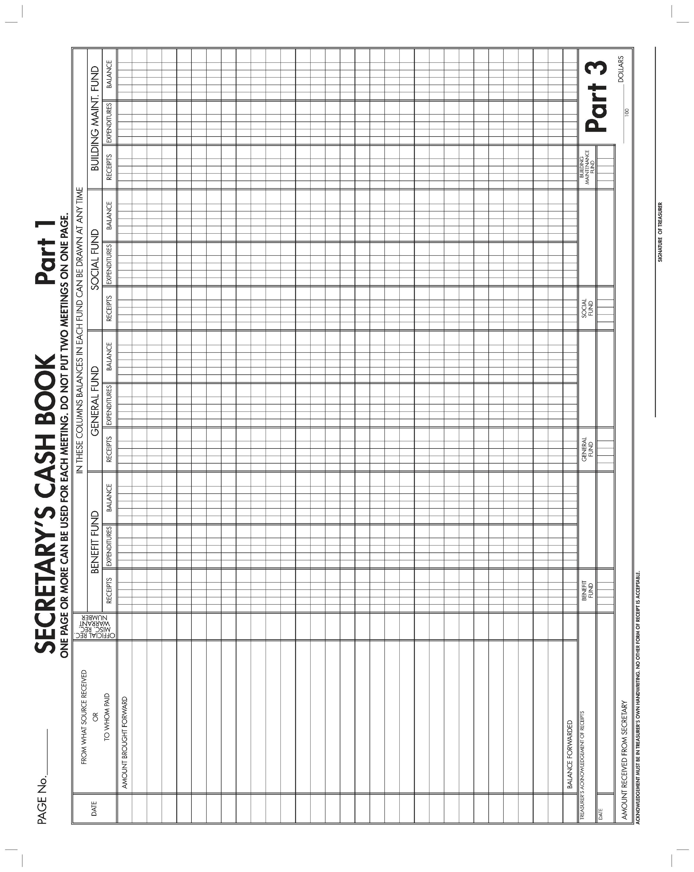
21.

Slide 12
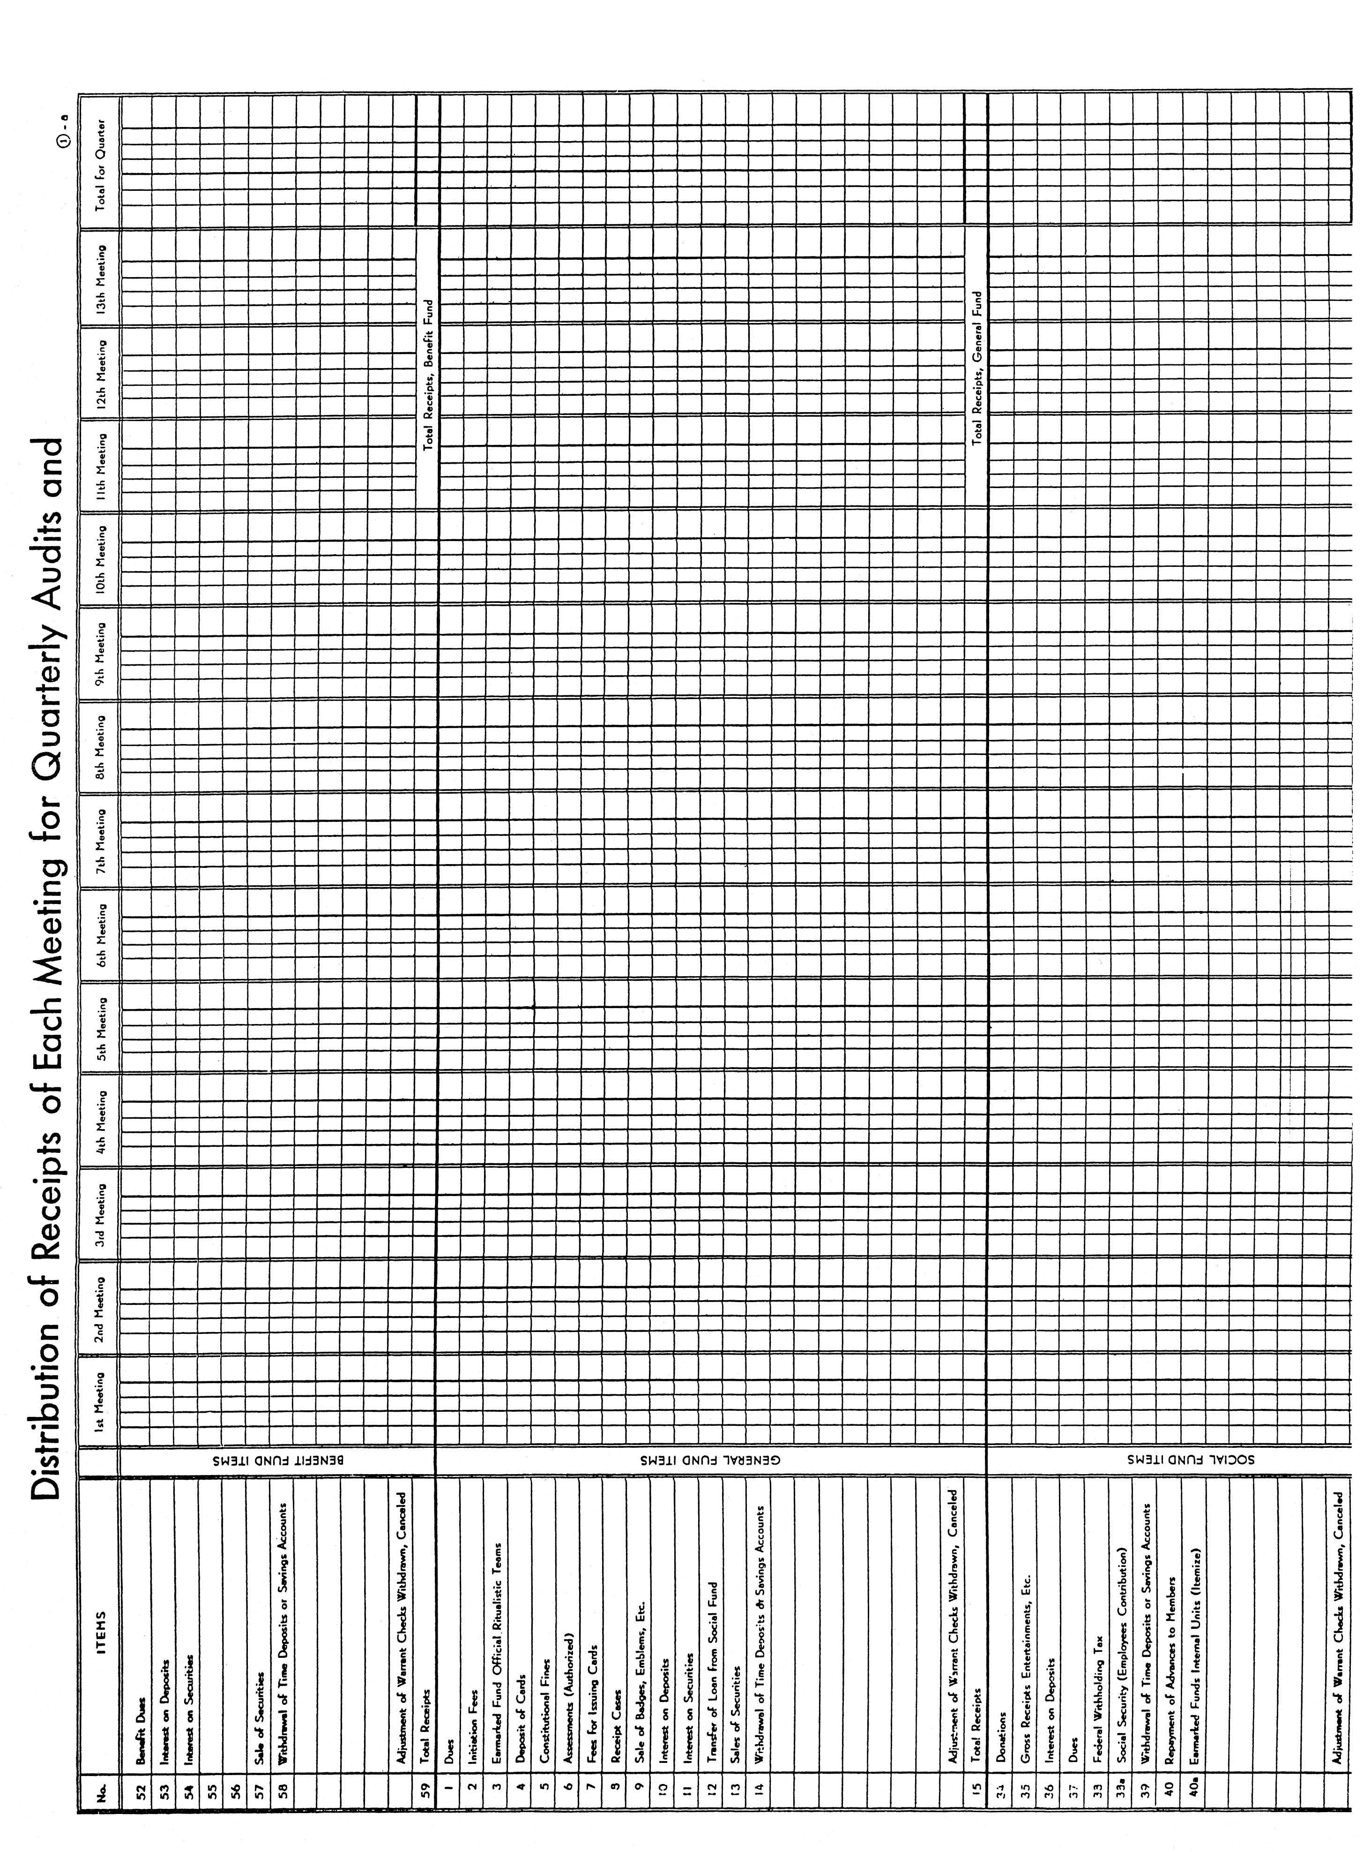
21. a

Slide 13
22. Secretary’s Annual Report – Per Capita Tax
Each Local Auxiliary shall pay to the Grand Aerie an annual Per Capita Tax of twelve ($12.00).
Invoice will appear on the Membership Management System home page
Paid from the Benefit Fund
Due and payable by June 30th

Slide 14
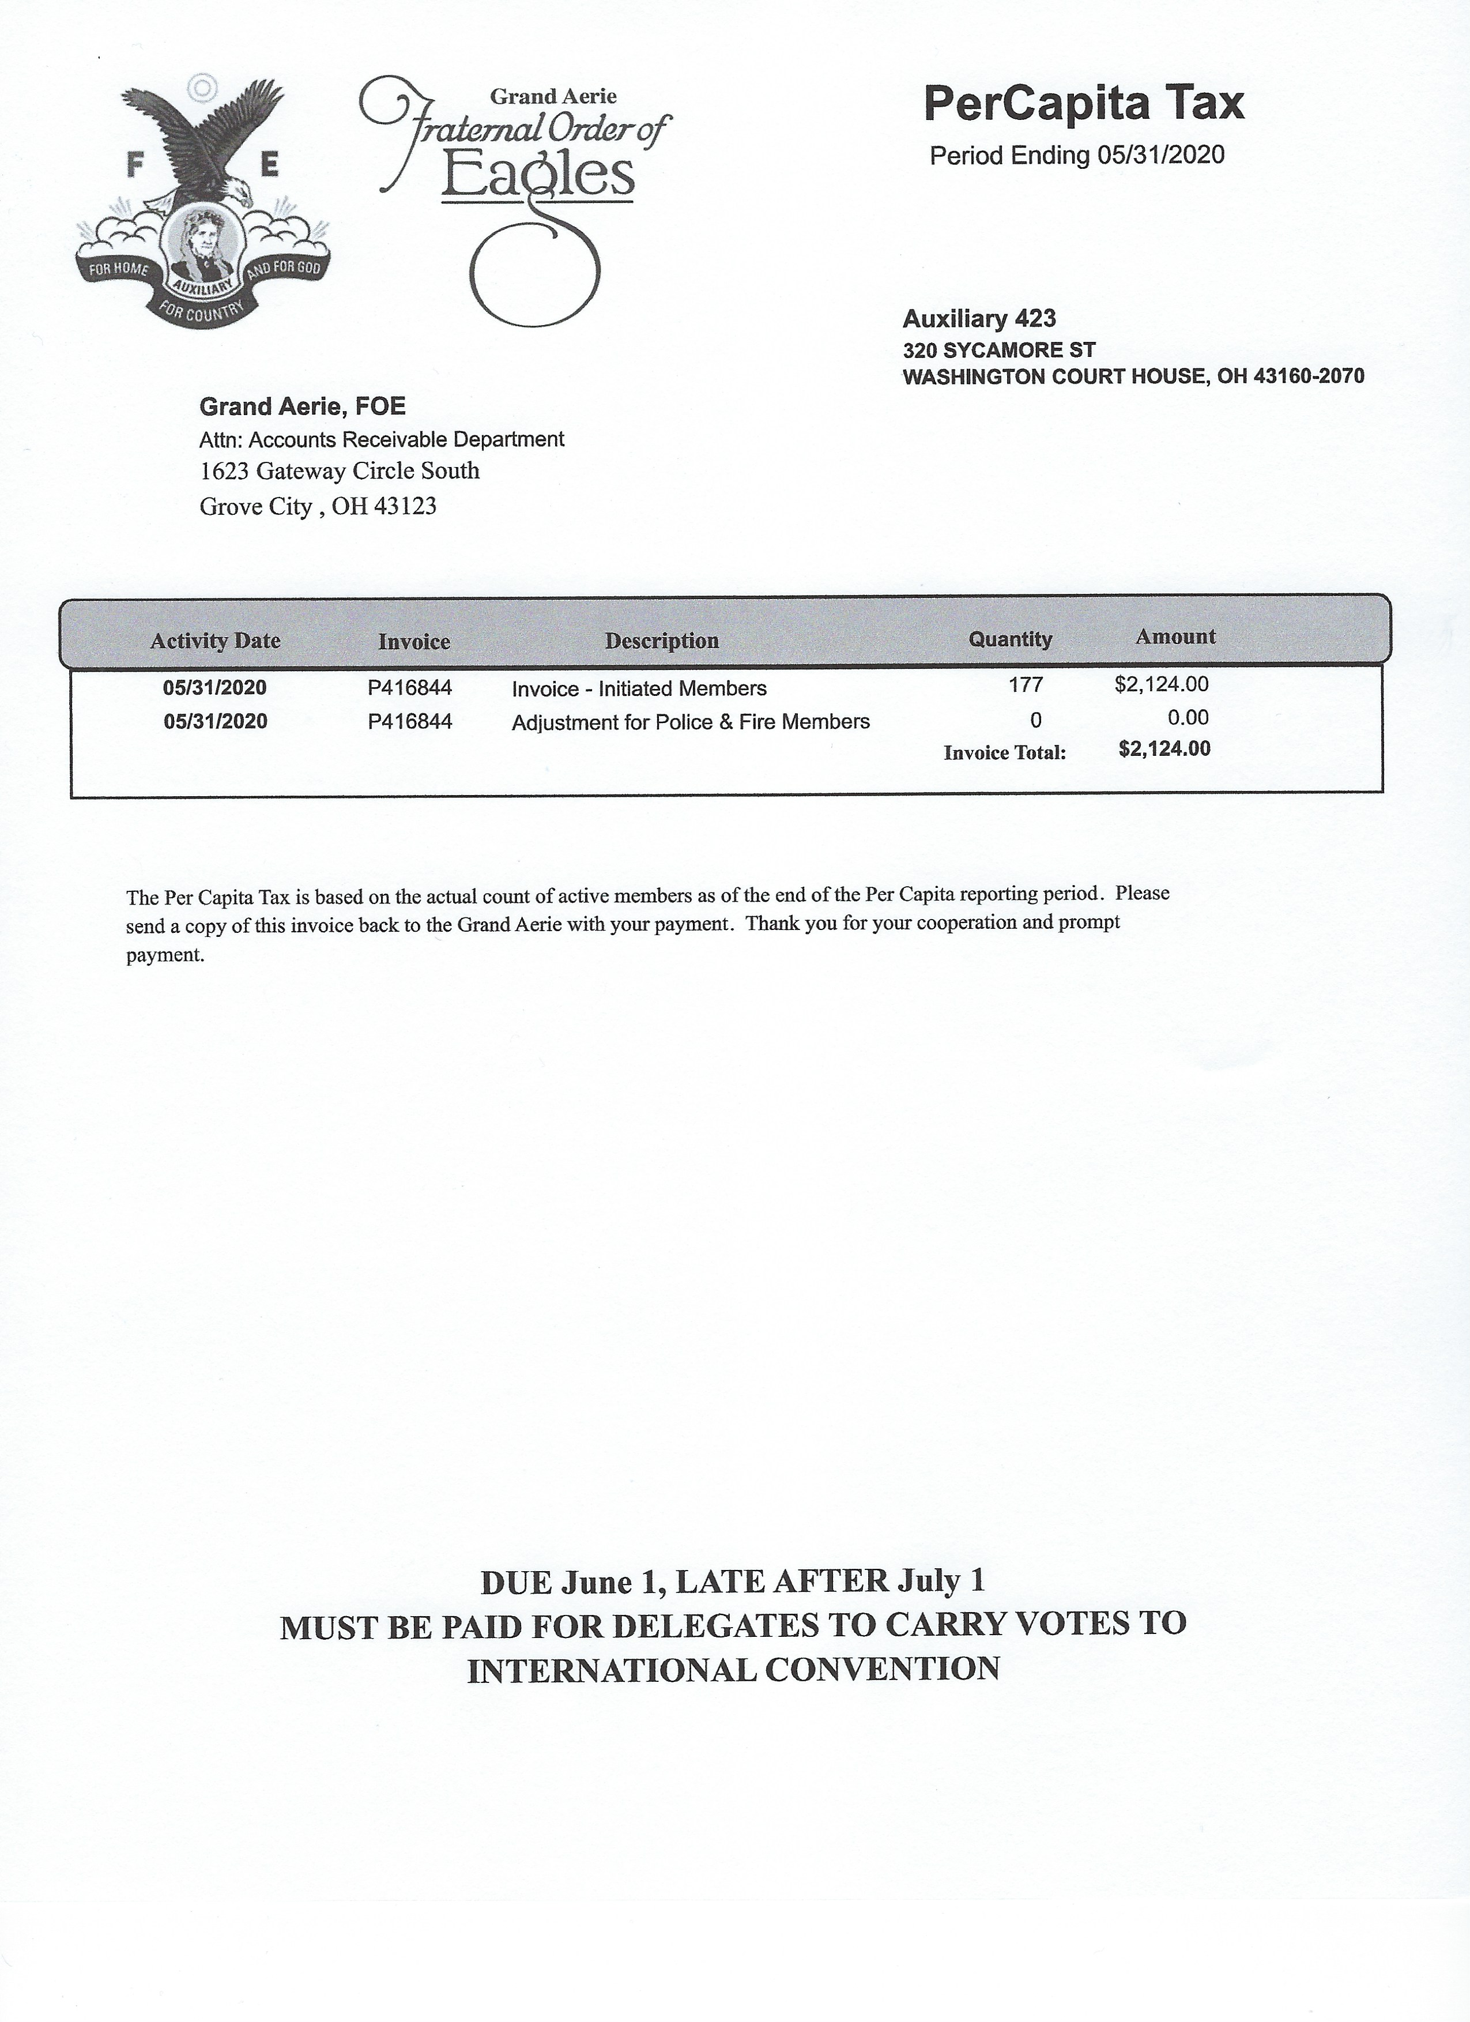
23. Sample of Local Auxiliary Per Capita Tax Statement

Slide 15
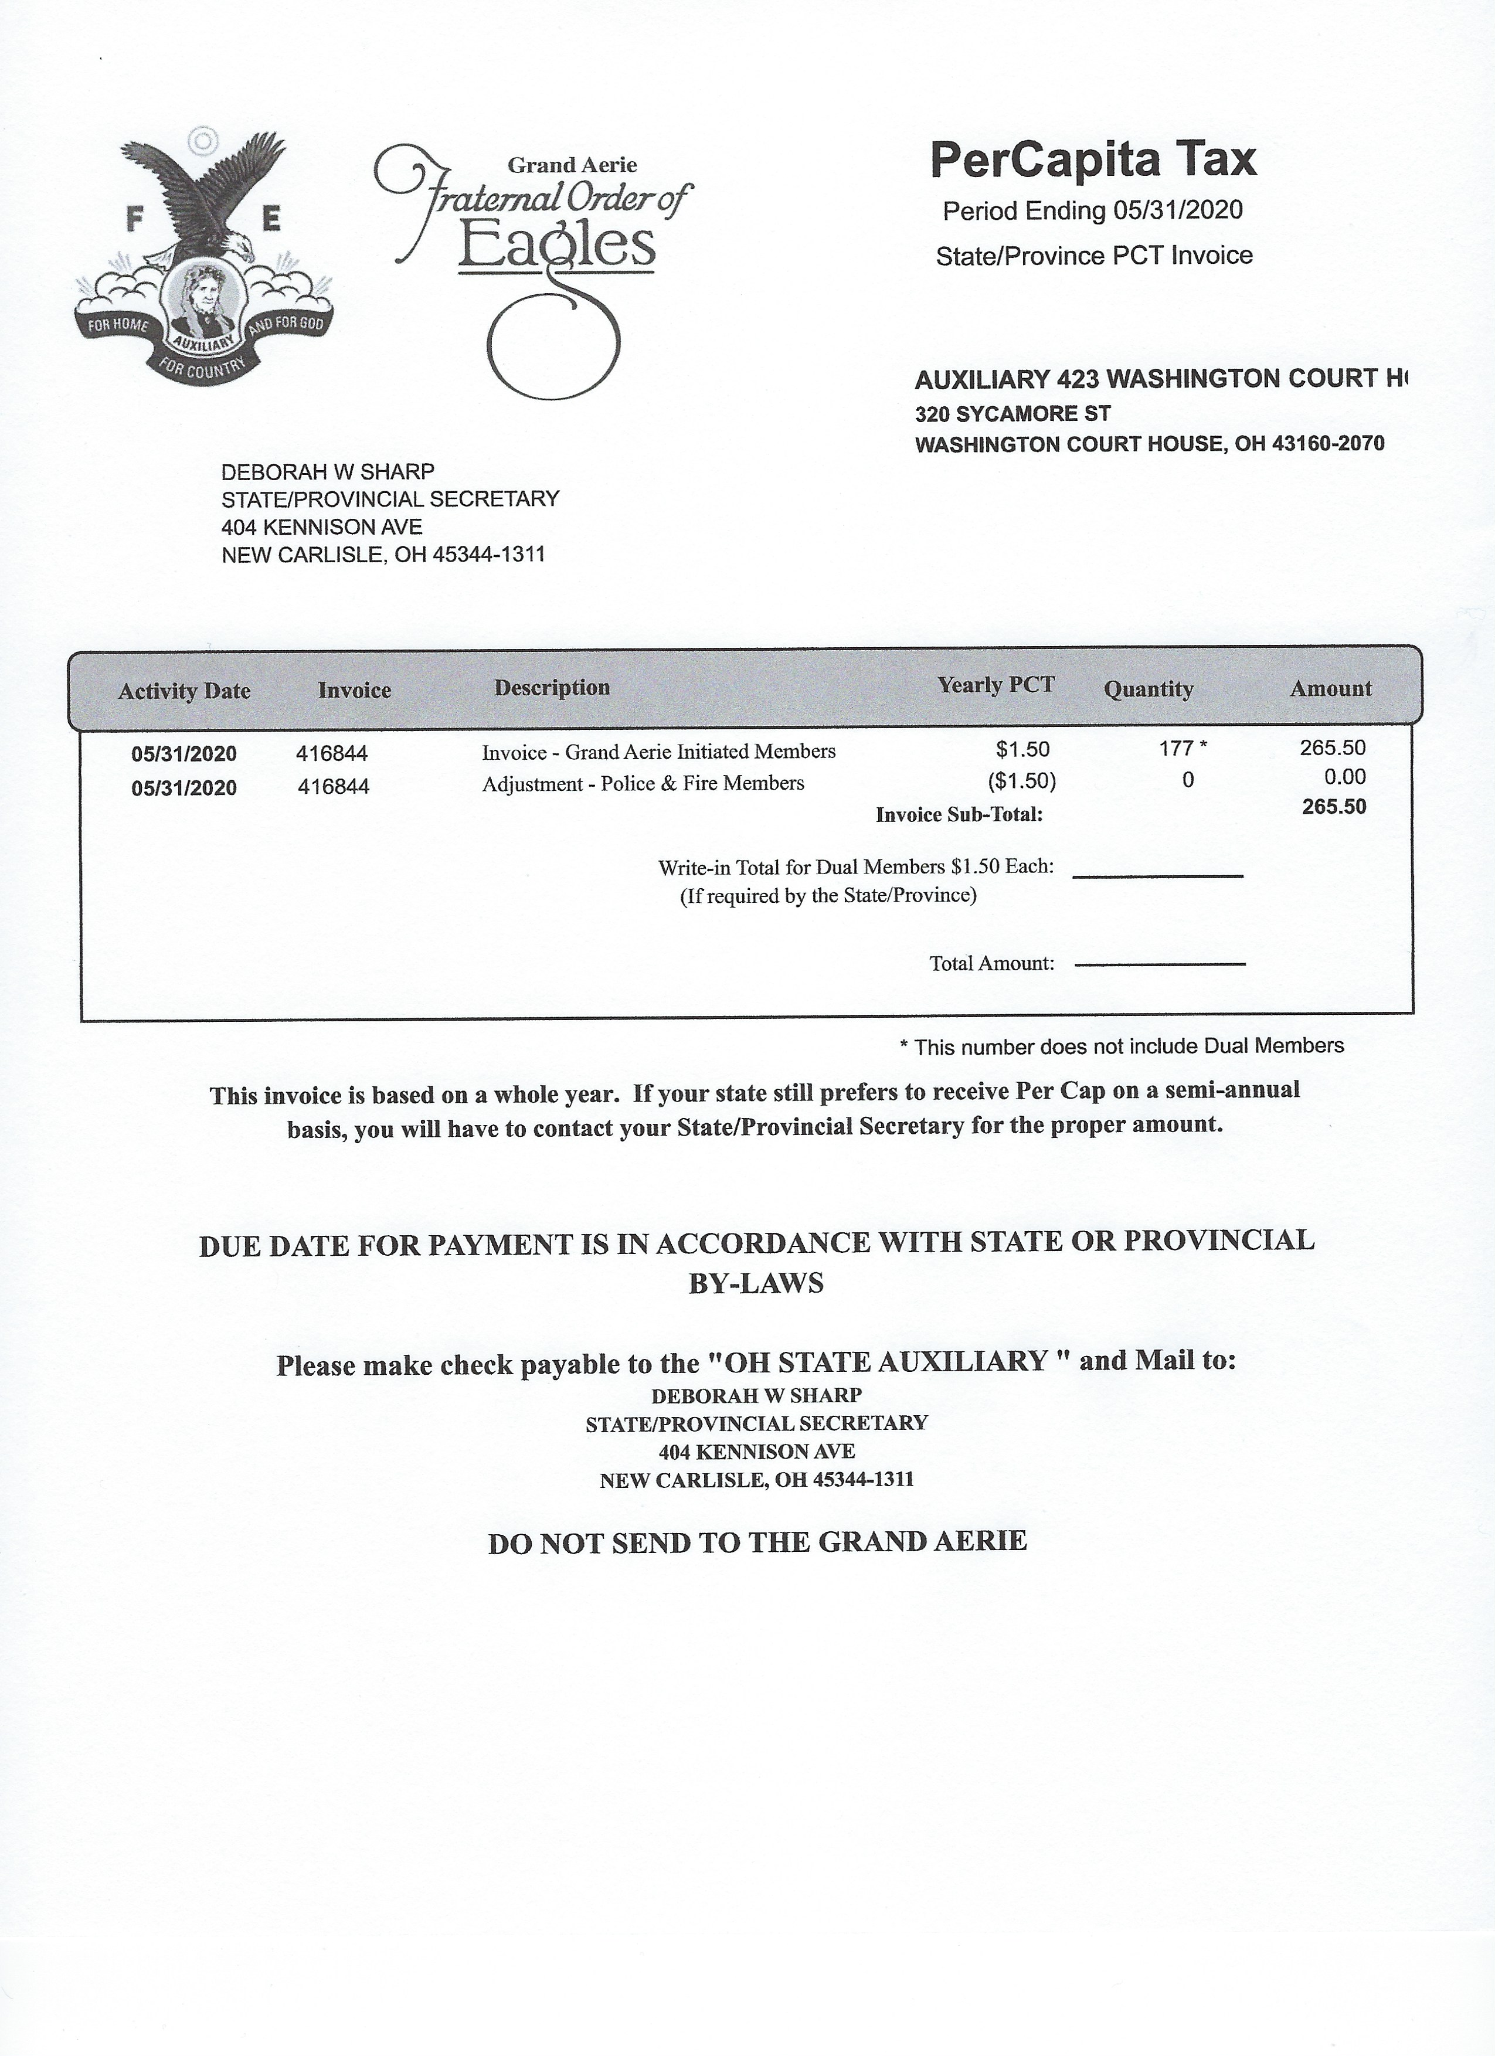
24. Sample of State Auxiliary Per Capita Tax Statement

Slide 16
25. Delinquent Members and Dues Reminders
Members are considered delinquent as of June 1st.
A Delinquent Member Report is available in the Membership Management System.
Dues Reminders will be sent by the Grand Aerie.
26. Report of Applications
Applications for membership shall be entered into the MMS System before the next regularly scheduled meeting.
An Initiation/Re-enrollment Report is available in the MMS System.
27. Notice of Election to Membership
Must appear for interview within 60 day of notice
Has a period of six (6) months to appear for Initiation
If they do not appear, they forfeit all fees paid.
Application for membership is cancelled.
28. Report of Officers to the Grand Aerie
The Secretary is required to enter all Officers and required Committees in the Membership Management System.

Slide 17
29. MEMBERSHIP MANAGEMENT SYSTEM (MMS)
The Membership Management System is used to assist the Local Secretaries with their day to day duties. With MMS, the Secretary has the ability to maintain membership records, print dues receipts, run specific reports pertaining to membership, finances, etc., print Accounting statements, check their status with the Compliance Department, create postcards, send mass e-mails to their membership, update the Officer List and much more.
The link to access the Membership Management System (MMS) is https://mms.foe.com
In order to access the system, you will need to have a username and password which can be obtained by sending an e-mail to mmshelp@foe.com.

Slide 18
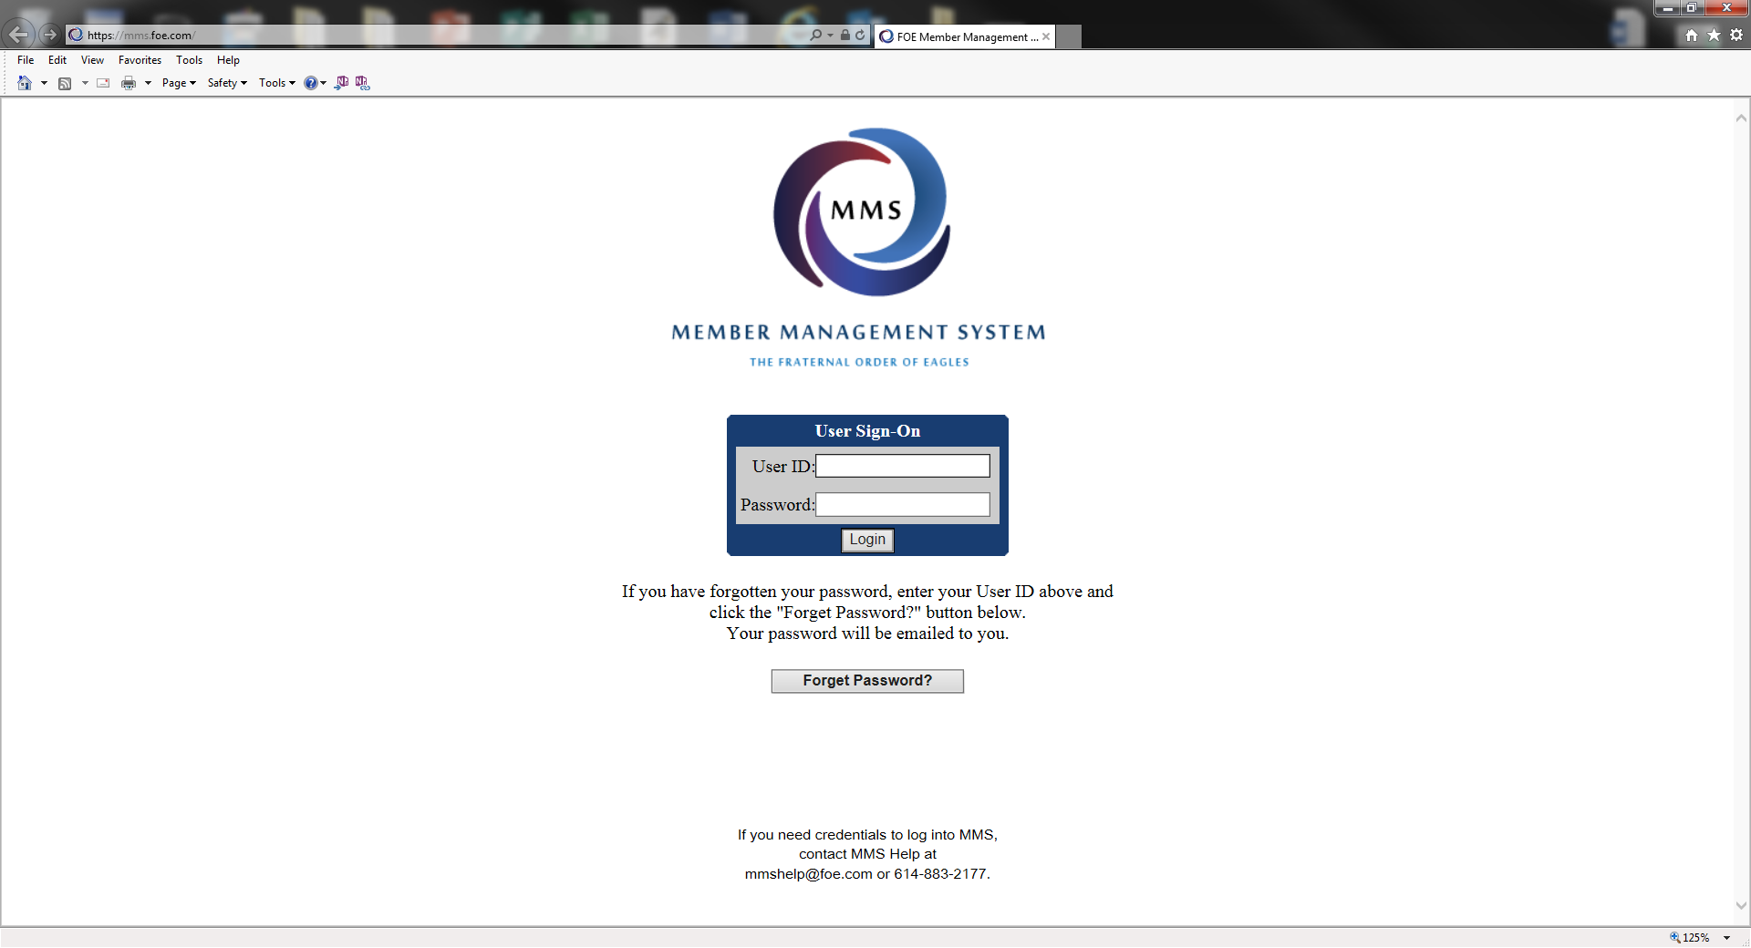
30.

Slide 19
31. New and Re-enrolled Membership Applications
Every application for membership shall be recommended by two (2) members in good standing.
Initiation/Re-enrollment Fee is to be determined by the By-Laws.
$10.00 of the Application Fee is to be sent to the Grand Aerie.
The Grand Aerie will keep $6.00. $4.00 will be forwarded to the State.
Dues shall be determined by the By-Laws but can be no less than the amount equal to the Grand Aerie Per Capita Tax plus State Per Capita Tax and any fees and/or assessments.
All applicants must be interviewed, voted upon and Initiated with the exception of re-enrollments as they are not required to go through the Initiation process again.

Slide 20
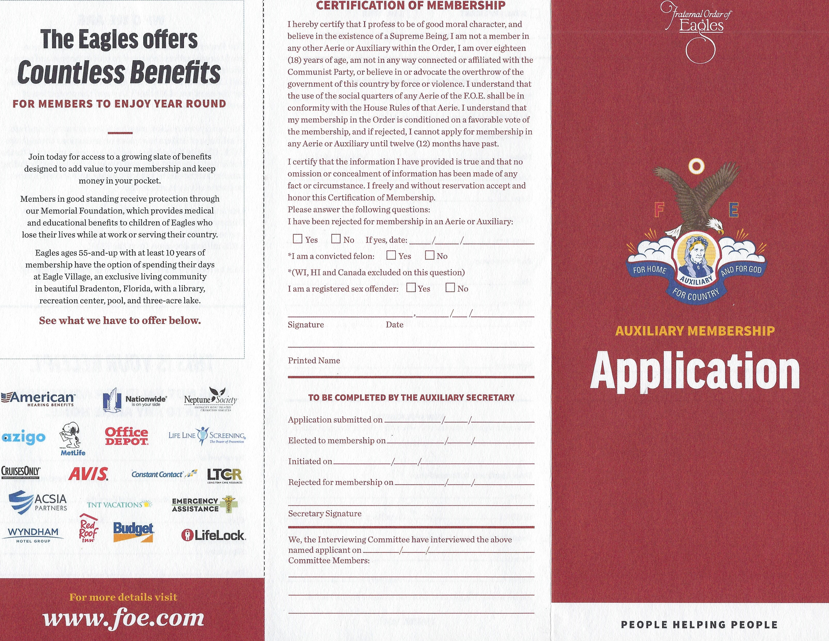
32.

Slide 21
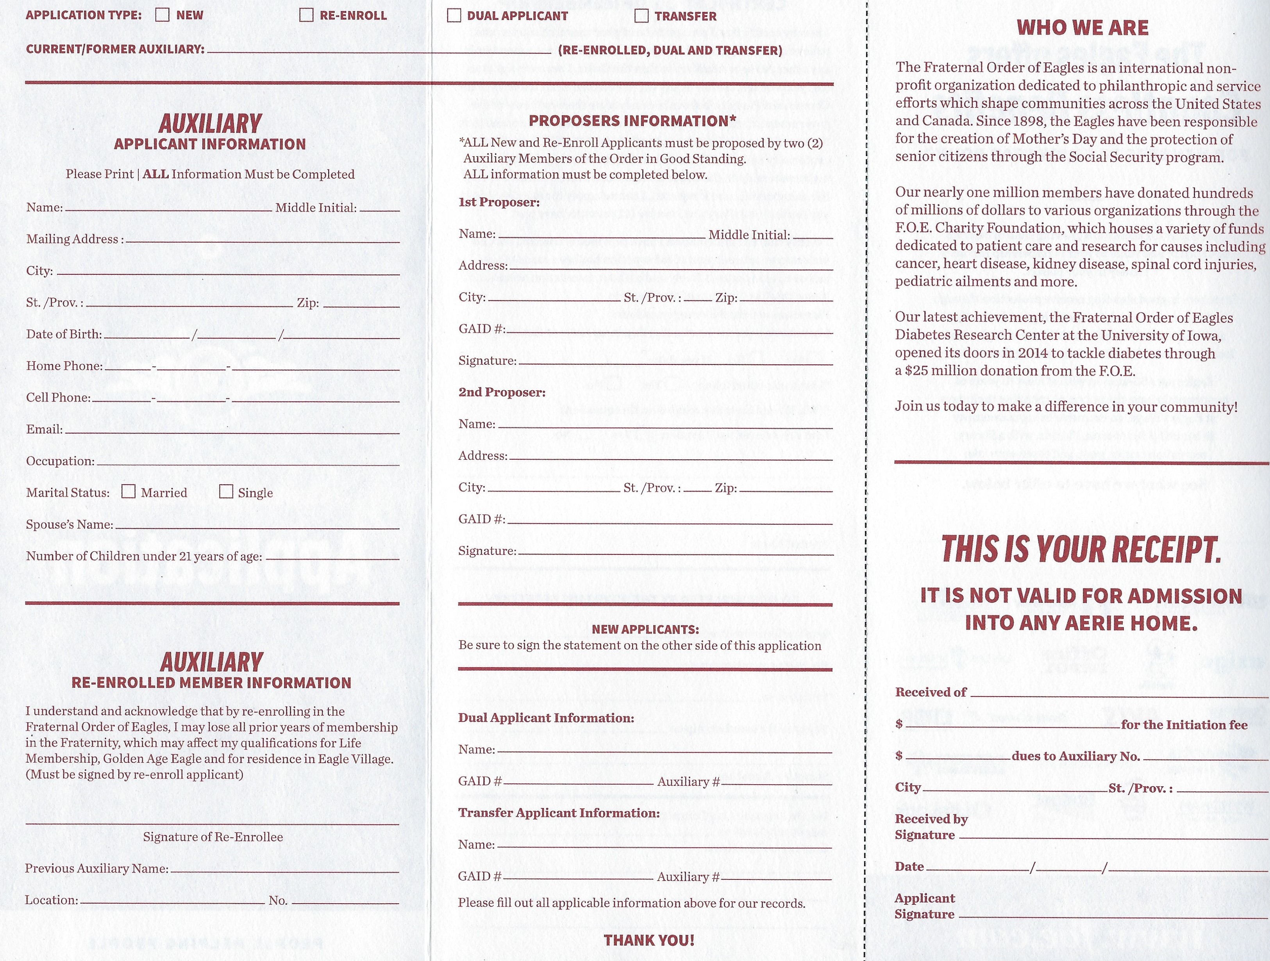
32. a

Slide 22
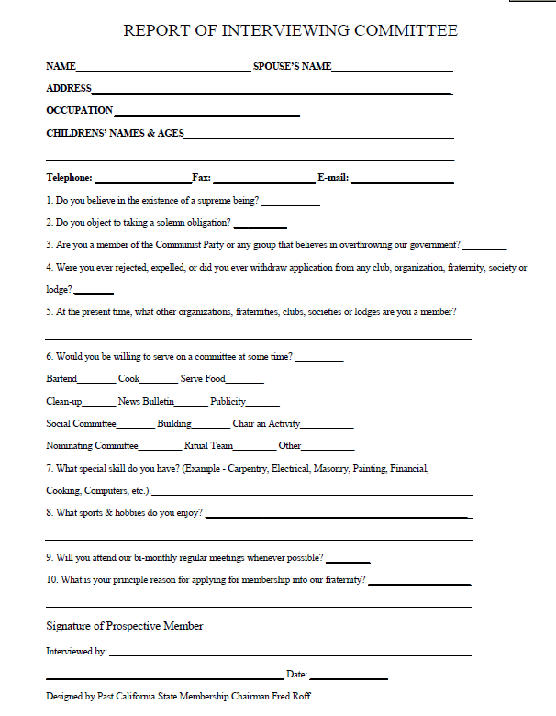
33. Suggested Interview Worksheet

Slide 23
34. Dual Membership Applications
No initiation fee is required.
Must provide proof that their dues have been paid in advance at their Home Auxiliary.
Must be interviewed and voted upon.
Dues shall be determined by the By-Laws but can be no less than $10.00 nor more than the regular non-benefit member dues.
No Per Capita Tax is paid to the Grand Aerie.
Dual Members should NOT be added through Batch Entry.

Slide 24
35. TRANSFERS
Must be interviewed and voted upon.
Must be a member in good standing with no charges pending. To be in good standing, the dues of the member requesting a transfer must be paid in advance at the time the application for transfer is made.
A Home Auxiliary cannot refuse to transfer a member in good standing with no charges pending. A member requesting a transfer shall remain a member of the transferring Auxiliary until she has been accepted by the transferee Auxiliary, provided her dues are paid as required by law. Upon issuance of a new receipt, she shall surrender her original receipt to the new Auxiliary Secretary.
Member forfeit any dues paid to the Auxiliary which they belong and are required to pay dues to the Auxiliary in which they are transferring to.
Transfers should NOT be added through Batch Entry.

Slide 25
36. Official Receipts
Official Dues Receipts MUST be printed directly from the MMS System in color. This is the ONLY acceptable receipt to show as evidence of membership.
The Official Receipt must include the highest office the member has attained, if any.
Under 21 Years of Age must be endorsed on the receipt if the By-Laws so allow.
You can account for monies collected for dues and application fees within the MMS System.

Slide 26
37.
RECORDS TO BE KEPT PERMANENTLY
Secretary’s Cash Books Secretary’s Minute Books Deeds, mortgages, notes, leases and contracts Authorizations from Grand Aerie Departments By-Laws (current) All Tax Records Transfer Applications Applications for Membership (Applications: Permanently or until the member has passed, resigned or transferred to another Auxiliary.)
RECORDS TO BE KEPT FOR SEVEN (7) YEARS, THEN DESTROYED
Secretary’s Semi-Annual and Annual Reports Treasurer’s Cash Books Treasurer’s Annual Reports. Miscellaneous Receipts Individual ledger sheets and/or cards of deceased or former members Canceled checks, except those where the liens have not been canceled Check Stubs Auditor’s Monthly and Annual Statements Bank Statements
RECORDS TO BE KEPT FOR THREE (3) YEARS, THEN DESTROYED Bills, invoices, etc. Temporary dues receipts Official Government and Grand Aerie/Auxiliary Correspondence
NOTE: Official Correspondence should be carefully screened before destroying. Some correspondence could be destroyed in less than three (3) years, while some should be kept much longer. Correspondence that may be needed for any audit should be kept for at least seven (7) years.

Slide 27
38. Checklist of Financial and Reporting Responsibilities for Aeries and Auxiliaries
JUNE
1st - Per Capita Tax Due to Grand and State/Province
JULY
1st - Per Capita Tax LATE
31st - IRS Payroll Tax Form 941 Due for June 30
31st - Qtr. Ends
OCTOBER
15th - IRS Form 990 Due
15th - IRS Form 990 Extension Due if unable to file
15th - Treasurer’s Report and 990 Copy Due to Grand Aerie
15th - Auditor Report due for all postcard filers and Canada
31st - IRS Payroll Tax Form 941 Due for Sept 30
31st - Qtr. Ends
JANUARY
31st - IRS Payroll Tax Form 941 Due for September 30 Qtr. end
31st - IRS Payroll Tax Form 941 Due for December 31 Qtr. end
31st - IRS Payroll Tax Form 940 Due for December 31 year end
JANUARY
31st - Forms 1099 and W2 due to recipient
28th - Form 1096 (1099 Summary Report) due to IRS
APRIL
15th - IRS Form 990 due – if extension was filed
30th - IRS Payroll tax form 941 due for March 31 Qtr. end
MAY
31st - Contributions must be received in Grand Aerie for fiscal year
31st - Credit on Convention Reports
31st - Grand Aerie Books Closed
31st - Last POST Date
Assistance: IRS – www.irs.gov website, choose Non-Profit and Charity tab or call 1-877-829-5500
Grand Aerie – accounting@foe.com or charities@foe.com

Slide 28
39.
REPORTING WHERE DUE DATE IS DEPENDENT UPON STATE LAW REQUIREMENTS OR RENEWAL DATES:
Monthly:
- State Sales Tax Reports
- Gaming Reporting
Annually:
- Insurance Documents with Declaration Pages naming Grand Aerie as additionally insured
- State Registration or Incorporation Renewal (usually has a filing fee).

Slide 29
OTHER TIMEFRAMES OF NOTE
40. CONTRIBUTIONS:
The Grand Aerie Accounting Department closes the fiscal year on MAY 31. There are no exceptions to this date and late receipts cannot be accommodated.
If you wish to ensure credit for your charity work during the annual convention, all contributions must reach the Grand Aerie PRIOR to May 31. If May 31 falls on a weekend, please adjust mailing dates accordingly to the prior Friday.
GRANTS:
If you are requesting a grant to be presented to a recipient or to be presented at a convention, please request your grant at a minimum of one month prior to date needed.
The grant is processed through your State Secretary’s office, the International Charity Director (if over $5,000), through the Grand Aerie Board of Directors (if over $10,000) and then can be processed by the GA Accounting Department.
REGIONAL GRANTS:
The hosting State requests the Grant for $5,000 and must be submitted one month in advance of the Regional Conference

