Slide 1

Auxiliary
Officer Training
December 2024

Slide 2
General Duties & Responsibilities of ALL Auxiliary Officers

Slide 3
GENERAL DUTIES AND RESPONSIBILITIES OF ALL AUXILIARY OFFICERS
Members are elected to serve in the respective offices of the Auxiliary because the membership has confidence in these individuals – confidence in their ability to direct the various activities – and confidence in their integrity. If you are an offi­cer, you are most anxious to fulfill the trust that has been placed in you.
The Rules and Regulations for the Government of Ladies Auxiliaries, the Ritual, and the operating By­-Laws of the Auxiliary are the “guide post” by which the offi­cers should be directed in the conduct of their various duties.
Each officer has her own specific duties and if these are performed as they should be, and in cooperation with the efforts of every other officer, the Auxiliary will have every right to be proud and pleased with the officers elected.
First, the officers meetings are designed to lay plans for future programs. The officers do not transact any business, nor spend any of the funds of the Auxiliary. All officers are expected to attend the officers meetings and be prepared to active­ly participate in a discussion of the suggested programs and present constructive ideas for advancing the welfare of the Auxiliary. By “pooling” these suggestions, the officers can then recommend projects to the Auxiliary for consideration and final action.

Slide 4
GENERAL DUTIES AND RESPONSIBILITIES OF ALL AUXILIARY OFFICERS
It is the duty of each officer to attend all meetings, regular, special and officers meetings. She should not be absent unless she has a good excuse, and if an offi­cer finds she cannot be present for a particular meeting, she should promptly noti­fy the Madam President and/or Madam Secretary.
The Ritual is to be spoken, not read. Therefore, each officer should memorize her part as soon after installation as possible. She should be thoroughly acquainted with the duties of her office, but should be careful not to infringe upon the duties of any other officer.
Each officer should be well informed on all programs of the Auxiliary and the manner in which they are to be conducted so that she can intelligently discuss them with anyone who requests information. It is the responsibility of the officers to direct the activities in such a manner that a spirit of harmony and cooperation prevails.
Well­-organized business meetings will do much to encourage attendance at the regular meetings. Meetings should always open promptly at the designated hour. It is the responsibility of the Madam President to conduct the meetings; however, it is the duty of every officer to be prompt and be present when the meeting opens. It is also the duty of each one to do her part to assist in the conduct of a well­-organ­ized business session.
Last the officers are the leaders of the Auxiliary. They represent the membership and should conduct themselves at all times with dignity. They should also be friendly in manner, treating all members alike.
If for any reason an officer does not complete her term, she does not receive cred­it for that office.

Slide 5
Jr. Past Madam President

Slide 6
JUNIOR PAST MADAM PRESIDENT
The retiring Madam President serves as the Jr. Past Madam President by virtue of serving as Madam President.
You shall aid the Madam President and share your knowledge; please remember you are there to help by virtue of your experience.
The Jr. Past Madam President shall not hold any other office in the Auxiliary but may resign from office if elected to another office in the Auxiliary.
In the absence of the Madam President and the Madam Vice-President, the Junior Past Madam President shall preside.
The serving Junior Past Madam President, is not included among the officers who are required to hold and attend officers’ meetings.
May attend the officers’ meeting, but shall have no voice or vote in such meeting unless called upon by the Madam President who is authorized to preside at the officers’ meeting.

Slide 7
Madam President

Slide 8
MADAM PRESIDENT
PRIOR TO INSTALLATION
1. Choose your installing officers Madam President, who must be a Past President or a 10 year Secretary, Madam Conductor, Madam Inside Guard/Chairman and a Madam Secretary.
2. Make a list of committees and the persons you intend to appoint. Check with each individual to be sure they will accept the appointment.
3. Meet with the current Madam President, Madam Secretary, Madam Treasurer and Auditor to make sure the books and funds are in order before you take office. You should have a working knowledge of the books and all that goes on in the Auxiliary.
4. Choose your Auditor
5. Announce your committees to the meeting attendees under new business.
6. Read the Ladies Auxiliary Rules & Regulations, Auxiliary Officer Handbook & Ritual

Slide 9
MADAM PRESIDENT CONTINUED
DUTIES
Presides at all regular, special & Officers meetings.
2. Enforce all the Laws of the Order
3. Maintain harmony in the Auxiliary.
4. General Supervision over all the affairs of the Auxiliary, except where vested elsewhere.
a. Secretary, Trustees, & Treasurer
5. Appoint all Officers pro – tem in the places of absentees.
a. Fill all vacancies in accordance with the Rules & Regulations
b. Check Auxiliary By-Laws to see which Officers are elected or appointed.
6. Shall see that all Officers required to be bonded by the Laws of the Order are so bonded.
7. Shall see that the Auxiliary Auditor audits the records.
8. Shall see that all Auxiliary funds are properly deposited and credited to the funds prescribed by the Laws of the Order.

Slide 10
MADAM PRESIDENT CONTINUED
9. Sign all checks drawn by the Madam Secretary which have been voted by the Auxiliary, and all other papers and documents that may require her signature.
10. Shall see to it that a properly signed affiliation agreement is filed with the Local and Grand Aerie.
11. Must sign the minutes of all Official Auxiliary meetings.
12. Ensure that a minimum of two (2) meetings are held each month.
a. By-Laws dictate time and place.
b. Cannot cancel a meeting, must reschedule it.
c. Each Aerie/Auxiliary shall conduct a joint officers meeting at least quarterly.
d. Special meetings:
(1) President may call
(2) At least 10 members may request one, in writing
(3) No business may be transacted except as stated in the notice of the meeting.
(4) At least five (5) days notice shall be given to the members.
(5) Voting may only take place if it is stated in the notice that voting will take place and only on the business stated in the notice.

Slide 11
MADAM PRESIDENT CONTINUED
13. Ensure that an officers’ meeting be held at least two (2) times a month. No formal actions can be taken or expenditures of Aerie/Auxiliary funds.
14. Appoints for such purposes and on such occasions as deemed necessary or advisable all committees of the Auxiliary together with such other committees that shall be required by the Laws of the Order or the By- Laws of the Auxiliary.
a. you do not serve as a member “Ex-officio” of any committee of the Auxiliary. “Ex-Officio” means by virtue of your office, you do not automatically serve on a committee.
b. You have the authority to change any committee appointment during your term unless otherwise stated in the Rules & Regulations.
15. Committee Appointments required by the Rules & Regulations
a. VISITING COMMITTEE
1. You may appoint as many members as you see fit. It will be their responsibility to visit the sick and bereaved and report to the Auxiliary at the next regular meeting.

Slide 12
MADAM PRESIDENT CONTINUED
Committee Appointments required by the Rules & Regulations Continued
b. MEMBERSHIP COMMITTEE
1. Shall consist of four or more members.
2. You will need a Membership Chairman, Reenrollment Chairman, no Goose Egg Chairman and
a Net Gain Chairman.
3. The Membership Chairman shall be the committee coordinator.
4. The Committee will serve for a term of one year or until successors are appointed.
5. The duties of the committee are to develop programs to vitalize, strengthen, and improve membership.

Slide 13
MADAM PRESIDENT CONTINUED
Committee Appointments required by the Rules & Regulations Continued
c. MEMBERSHIP SECURITY COMMITTEE
1. Shall consist of three or more members
2. Shall serve for a term of one year or until their successors are appointed
3. Shall secure a list of delinquent members from the Madam Secretary.
d. CONCILIATION COMMITTEE
1. Shall consist of five members, all of who shall be Past Madam Presidents of the Auxiliary, If available and will serve during your term of Office.
2. The purpose of the committee is to provide a means for resolving disputes between members of the Auxiliary.

Slide 14
RECOMMENDED FORM
REPORT OF DISPUTE TO THE CONCILIATION COMMITTEE (Section 20.5)
This form should be used to refer a dispute to the Madam President
I,_______________________________, a member in good standing of Auxiliary No. __________, ______________________________, _________________________,
City State/Province
Fraternal Order of Eagles, am filing this report against ______________________________, who is a member of the Fraternal Order of Eagles, Auxiliary No. _________, for the
following matter, which occurred on _____________, 20____, at approximately ____________AM/PM.
The nature of the dispute is:______________________________________________________________________________________________________________________________
______________________________________________________________________________________________________________________________________________________________________________________________________________________________________________________________________________________________________________
______________________________________________________________________________________________________________________________________________________________________________________________________________________________________________________________________________________________________________
Section 20.5 After a dispute is referred to the Madam President, she shall refer the matter to the Conciliation Committee, who shall set a date for the parties to informally meet with the Committee to attempt to resolve the dispute. If no resolution is reached, and if a formal written Complaint has been filed, then, that Complaint shall be given directly to the Aerie Secretary for the processing under Section 63.1 – 63.11 of the Statutes of the FOE. The accuser then become responsible for the payment of the filing fee, per Section 63.1 (b), Statutes.
Date: _________________________, 20_______. __________________________________________
Auxiliary Member
__________________________________________
Witness (optional) Aerie/Auxiliary No.
__________________________________________
Witness (optional) Aerie/Auxiliary No.

Slide 15
RECOMMENDED FORM
CONCILIATION DISPUTE RESOLUTION
Under Section 20.5, Ladies Auxiliary Rules and Regulations, the Madam President referred the dispute to the Conciliation Committee on , 20 .
The Committee met informally with both parties on , 20 .
CONCILIATION RESULTS
Contact(s) with_________________________________________________________Date(s): ____________________________________________ (Party One)
Comments________________________________________________________________________________________________________________________________________________
Contact(s) with_________________________________________________________Date(s): ____________________________________________ (Party Two)
Comments________________________________________________________________________________________________________________________________________________
As a result of the conciliation, the parties have agreed to:
1. Settle the dispute, as follows:
2. Dismiss the dispute.
3. No resolution reached. A formal written Complaint has been filed directly with the Aerie Secretary for processing under Section 63.1 – 63.11 of the Statutes of the F.O.E. The Accuser is responsible for the payment of the filing fee, per Section 63.1 (b), Statutes.
__________________________________________ Dated: , 20
Signature (Party One) Signature (Party Two)
CONCILIATION COMMITTEE:
_____________________________ _____________________________ _____________________________ _____________________________
Member Member Member Member

Slide 16
MADAM PRESIDENT CONTINUED
Committee Appointments required by the Rules & Regulations Continued
e. FINANCE COMMITTEE
1. Shall be made up of three members.
2. Shall serve for one year or until their successors are appointed
3. Prior to each meeting they must examine all bills, pass on their validity and correctness, and recommend to the Auxiliary for their payment or rejection.
4. Bills are to be given to the Madam Secretary to bring to the Auxiliary floor for final action.
f. PUBLICITY COMMITTEE
1. Shall have up to three members
2. shall serve for one year
3. Assure that favorable publicity regarding functions and activities is provided to the community through whatever means of communication are available.

Slide 17
MADAM PRESIDENT CONTINUED
Committee Appointments required by the Rules & Regulations Continued
g. INTERVIEWING COMMITTEE
1. Shall consist of three members
2. Shall serve for the fraternal year in which they are appointed and or until their successors are appointed
3. A majority of the members of the committee will constitute a quorum for a report.
4. It shall be their duty to personally interview all applicants for membership within 60 days after her application has first been read at a meeting of the Auxiliary to determine their eligibility and qualifications for membership.

Slide 18
MADAM PRESIDENT CONTINUED
Committee Appointments required by the Rules & Regulations Continued
h. MEETING ATTENDANCE COMMITTEE
1. There are no set number of members to serve on this committee.
2. Committee should develop programs to encourage greater attendance at Auxiliary meetings. All programs must be reported & approved by the Auxiliary.
i. AUDITOR
1. Appoint your Auditor immediately after installation.
2. May be a qualified member of any Auxiliary or Aerie
3. No bonded Officer of the Auxiliary may be appointed as the Auditor.

Slide 19
Madam Vice-President

Slide 20
MADAM VICE PRESIDENT
DUTIES
1. Shall assist the Madam President in preserving order and decorum in the Auxiliary.
2. Shall in conjunction with the Madam President, inspect all ballots on applications and report to the Auxiliary.
3. She shall preside in the absence of the Madam President and perform all other duties required of her by the Laws of the Order. In the absence of the Madam President and the Madam Vice-President, the Junior Past Madam President shall preside and, in the absence of all of the above named, Past Madam Presidents in good standing and who are in attendance at such meeting shall preside according to the order of the most recent term of service. In the absence of the above mentioned, the highest-ranking officer shall preside.
4. The Madam Vice-President shall have her name on the bank accounts to sign checks in the absence or inability of any of the prescribed officers.
5. If a vacancy occurs in the Office of the Madam President, the Madam Vice President must succeed to the office of Madam President and the office of Madam Vice President shall be declared vacant.
6. The office of Madam Vice President must always be filled by election.
7. When a vacancy occurs in the office of Madam President the Madam Vice President, must succeed to that office. If she refuses to do so, then she must give up her office of Madam Vice President and both offices are declared vacant.

Slide 21
Madam Chaplain

Slide 22
MADAM CHAPLAIN
DUTIES
1. Shall have charge of the devotional exercises of the Auxiliary in accordance with the Ritual.
2. Shall assists the Madam Conductor with inspecting the official receipts and make sure they are up to date and signed.

Slide 23
Madam Conductor

Slide 24
CONDUCTOR
1. Sets up the Meeting Room per the Ritual.
2. Shall ensure all those present in the meeting are members in good standing. Official receipts must be up to date and signed.
3. Prepares the ballot box for election of candidates and supervises the voting.
4. Introduces all visitors and conducts them to their seats.
5. Has custody of all Ritual paraphernalia.
6. Shall perform such other duties as required of her by the President and/or by the Laws of the Order.
7. Assist in the initiation of the candidates.

Slide 25
Madam Secretary

Slide 26
SECRETARY
DUTIES
1. Keep a full and complete record of the proceedings of the Auxiliary in a book provided for that purpose by the Grand Aerie or if the records are kept electronically, they shall be printed and read at each meeting and, once approved by the membership and signed by the Madam President and Secretary, copies shall be kept and protected in a three (3) ring binder or book for that purpose.
2. Shall read in the meetings all Auxiliary communications. All official communications received from the Grand Aerie, shall be read in their entirety unless otherwise specifically directed.
3. Shall write all communications, fill out all certificates and cards granted by the Auxiliary.
4. Shall maintain at all times a full, complete and up-to-date roster of the Membership, Committees and Officers of the Auxiliary, as required by the Membership Management System (MMS) with the latest up-to-date residence, mailing address, phone or cell numbers and email address.
5. Shall notify the Grand Secretary forthwith of the expulsion by the Trial Committee of any member or Officer removed from office.

Slide 27
6. Shall maintain such systems of records, books and accounts, and shall issue such notices and make such reports as the Grand Aerie shall prescribe.
7. Provide a delinquent list of members to the Membership Security Committee Board, dues expire on May 31st.
8. The mailing list or roster is an official record of the Local Auxiliary for which the Madam Secretary is responsible. Every member whose name is on the roster list of the Local Auxiliary is entitled to full protection from any misuse of such roster list. Neither the Madam Secretary nor any other officer of the Local Auxiliary may use or authorize the use of the Auxiliary roster list. NAMES ONLY may be given for official Auxiliary business.
9. If the Auxiliary has an office in the Aerie Home and it is an office shared by the Auxiliary officers, the Auxiliary membership controls who is to have a key to that office.
If the office is under the control of the Secretary, she controls who has keys to the office, with the exception that a key must be given to the Aerie Trustees for security and emergency purposes only.
10. The Local Auxiliary’s current By-Laws shall be posted at all times on the Auxiliary Bulletin Board, so they are available to all members of the Auxiliary to read.

Slide 28
11. The Madam Secretary shall segregate and enter amounts of all monies received upon her records to the credit of the respective funds of the Auxiliary, as required by the Laws of the Order, and shall pay such money to the Madam Treasurer at the close of each meeting, or on the succeeding day and demand the signature of the Madam Treasurer in the Secretary’s Cash Book, for money received by the Madam Treasurer.
12. The Madam Secretary shall demand, receive and immediately receipt for all money and/or property belonging to the Auxiliary and receive from every source, including any committee, Marching Club, Degree or Drill Team or other Internal Unit.
13. May appoint an assistant to efficiently carry on the duties of her office. The assistants so appointed shall give bond for the faithful performance of such duties, the premiums to be paid for by the Auxiliary. The Secretary shall also be responsible for her bond, for the faithful performance of the duties assigned to such assistants. The assistants’ compensation shall be paid by regular Auxiliary check from the treasury of the Auxiliary if compensation is provided for in the By-Laws of the Local Auxiliary, and in that event, the compensation to the assistant shall not be charged against, and regularly deducted from, the compensation of the Secretary. No compensation shall be paid to the assistant unless specifically stated in the Auxiliary By-Laws.
14. Shall read at every meeting:
  An itemized account of the receipts to and the disbursements from each fund of the Auxiliary since the last regular meeting.
  At the last regular meeting of each month she shall read an itemized list of all, approved unpaid bills of the Auxiliary on hand, and the date such bills were due and payable.

Slide 29
15. Shall, on request, deliver all books, papers and property of the Auxiliary to the Auditor or to such officer or officers as the Grand Worthy President or the Grand Secretary shall direct.
16. Shall receive compensation for the performance of her duties as may be prescribed by the By-Laws of the Auxiliary.
Such compensation shall be a per-capita compensation
Shall be based upon the number of members who are in good standing or who are not more than (1) month in arrears.
Shall not be paid until all required reports have been completed and transmitted.

Slide 30
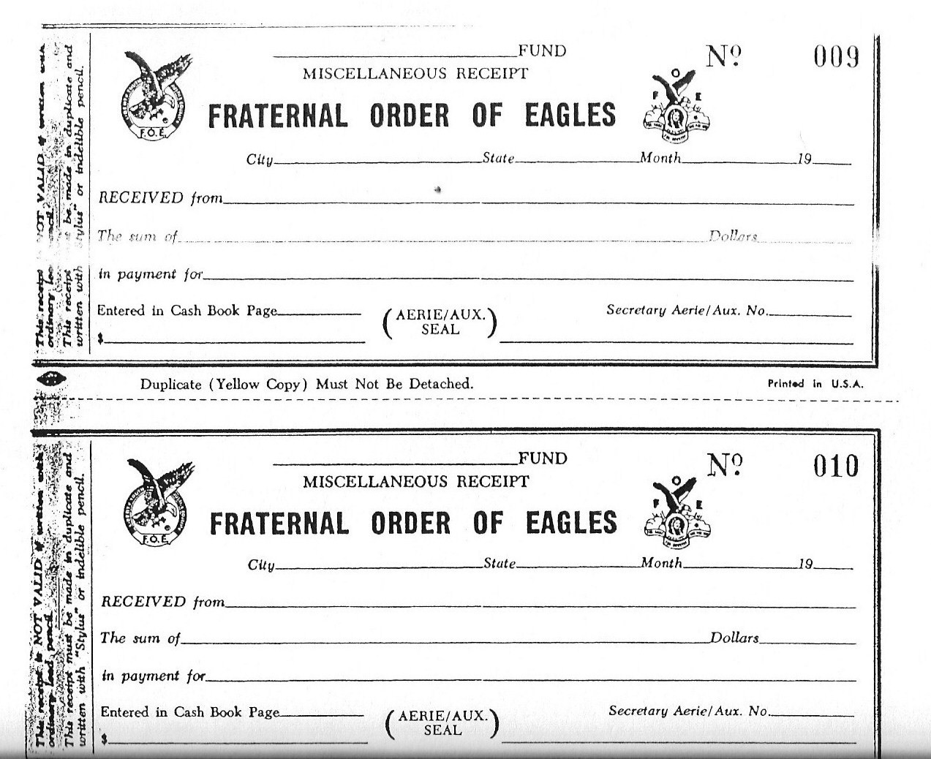
17. Temporary Receipts - to immediately acknowledge receipt of dues and application fees.
Miscellaneous Receipts - a duplicate carbon receipt for all other monies received
- original to be given to the person you received money from
- Receipts are in numerical order.
Both receipts provided by the Grand Aerie.

Slide 31
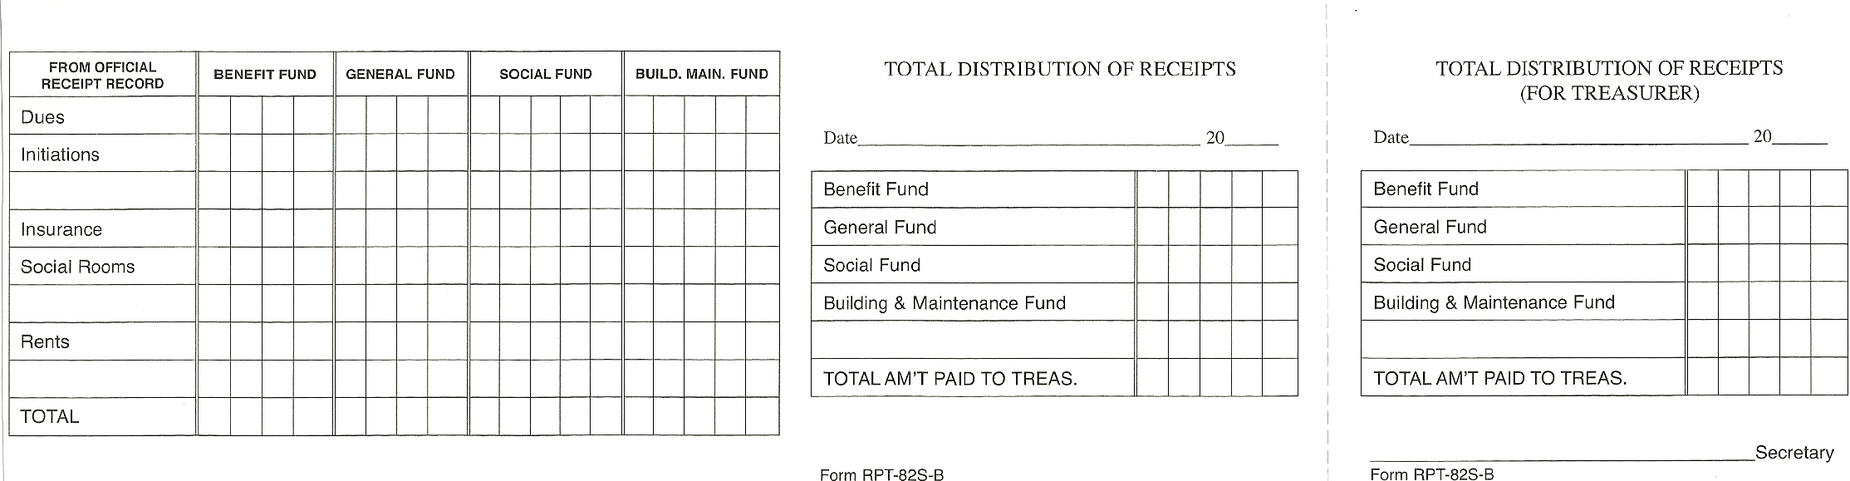
18. DISTRIBUTION OF RECEIPT FORMS
Can be obtained from the Grand Aerie Supply Department.
A valuable tool for making the turnover of money to the Treasurer and making your report to the membership.
Not to be used as a receipt from the Treasurer.
Indicates how your deposits are made to the different funds.
Perforated for tearing off part for the Treasurer.

Slide 32
19. SECRETARY’S MINUTE BOOK
Secretary’s must keep a complete and full record of the proceedings of the Auxiliary.
DO NOT attempt to write out completed minutes of the meeting during the meeting. Take notes and/or record the meeting.
A Local Auxiliary may, by a proper By-Law, prohibit the tape recording of any of its meetings other than that done by the Secretary or designated recorder for those proceedings or meetings. Opinion No. 703.
Create an outline of standard minutes required so you have it available for each meeting:
  Roll Call of Officers
  Reading of the Minutes of the previous meeting
  Treasurer’s Report
  Old Business
  New Business
  Reading of new applicants
  Reading of re-enrolled applicants
  Etc.

Slide 33
5. Minutes can be typed and glued to the Secretary’s minute book pages or maintained in a Applicant's binder.
6. It is VERY important to include the following in the Minutes book:
  Visiting Members
  Officers absent and if they were excused
  Applications received for New/Reenrolls/Dual/Transfer
  Applicant’s names voted upon
  Applicant’s names that were rejected
  Applicant’s names who were initiated
  Members on the sick list
  Short resume on all communications received and read
  Action taken on reports of all committees
  Excuses of absentees
  Old Business – Motions, etc.
  New Business – Motions, etc.
  Good of the Order

Slide 34
20. SECRETARY’S MINUTE BOOK PART 2
Part two of the minute books is a record of all Special Committees.
Part three is for a record of all Standing Committees.
Part four is for recording attendance of all Officers.
Fraternal and Fiscal Year – June 1st to May 31st.
There are 2 authorized funds:
General Fund
Benefit Fund
Local Auxiliaries may, by their By-Laws, provide for special funds for any purpose not prohibited by the Laws of the Order, upon obtaining the approval of the Grand Aerie Financial Advisor.
The Secretary Cash Book is available through the Grand Aerie Supply Department or you may use the Quicken Quickbooks or similar program.

Slide 35
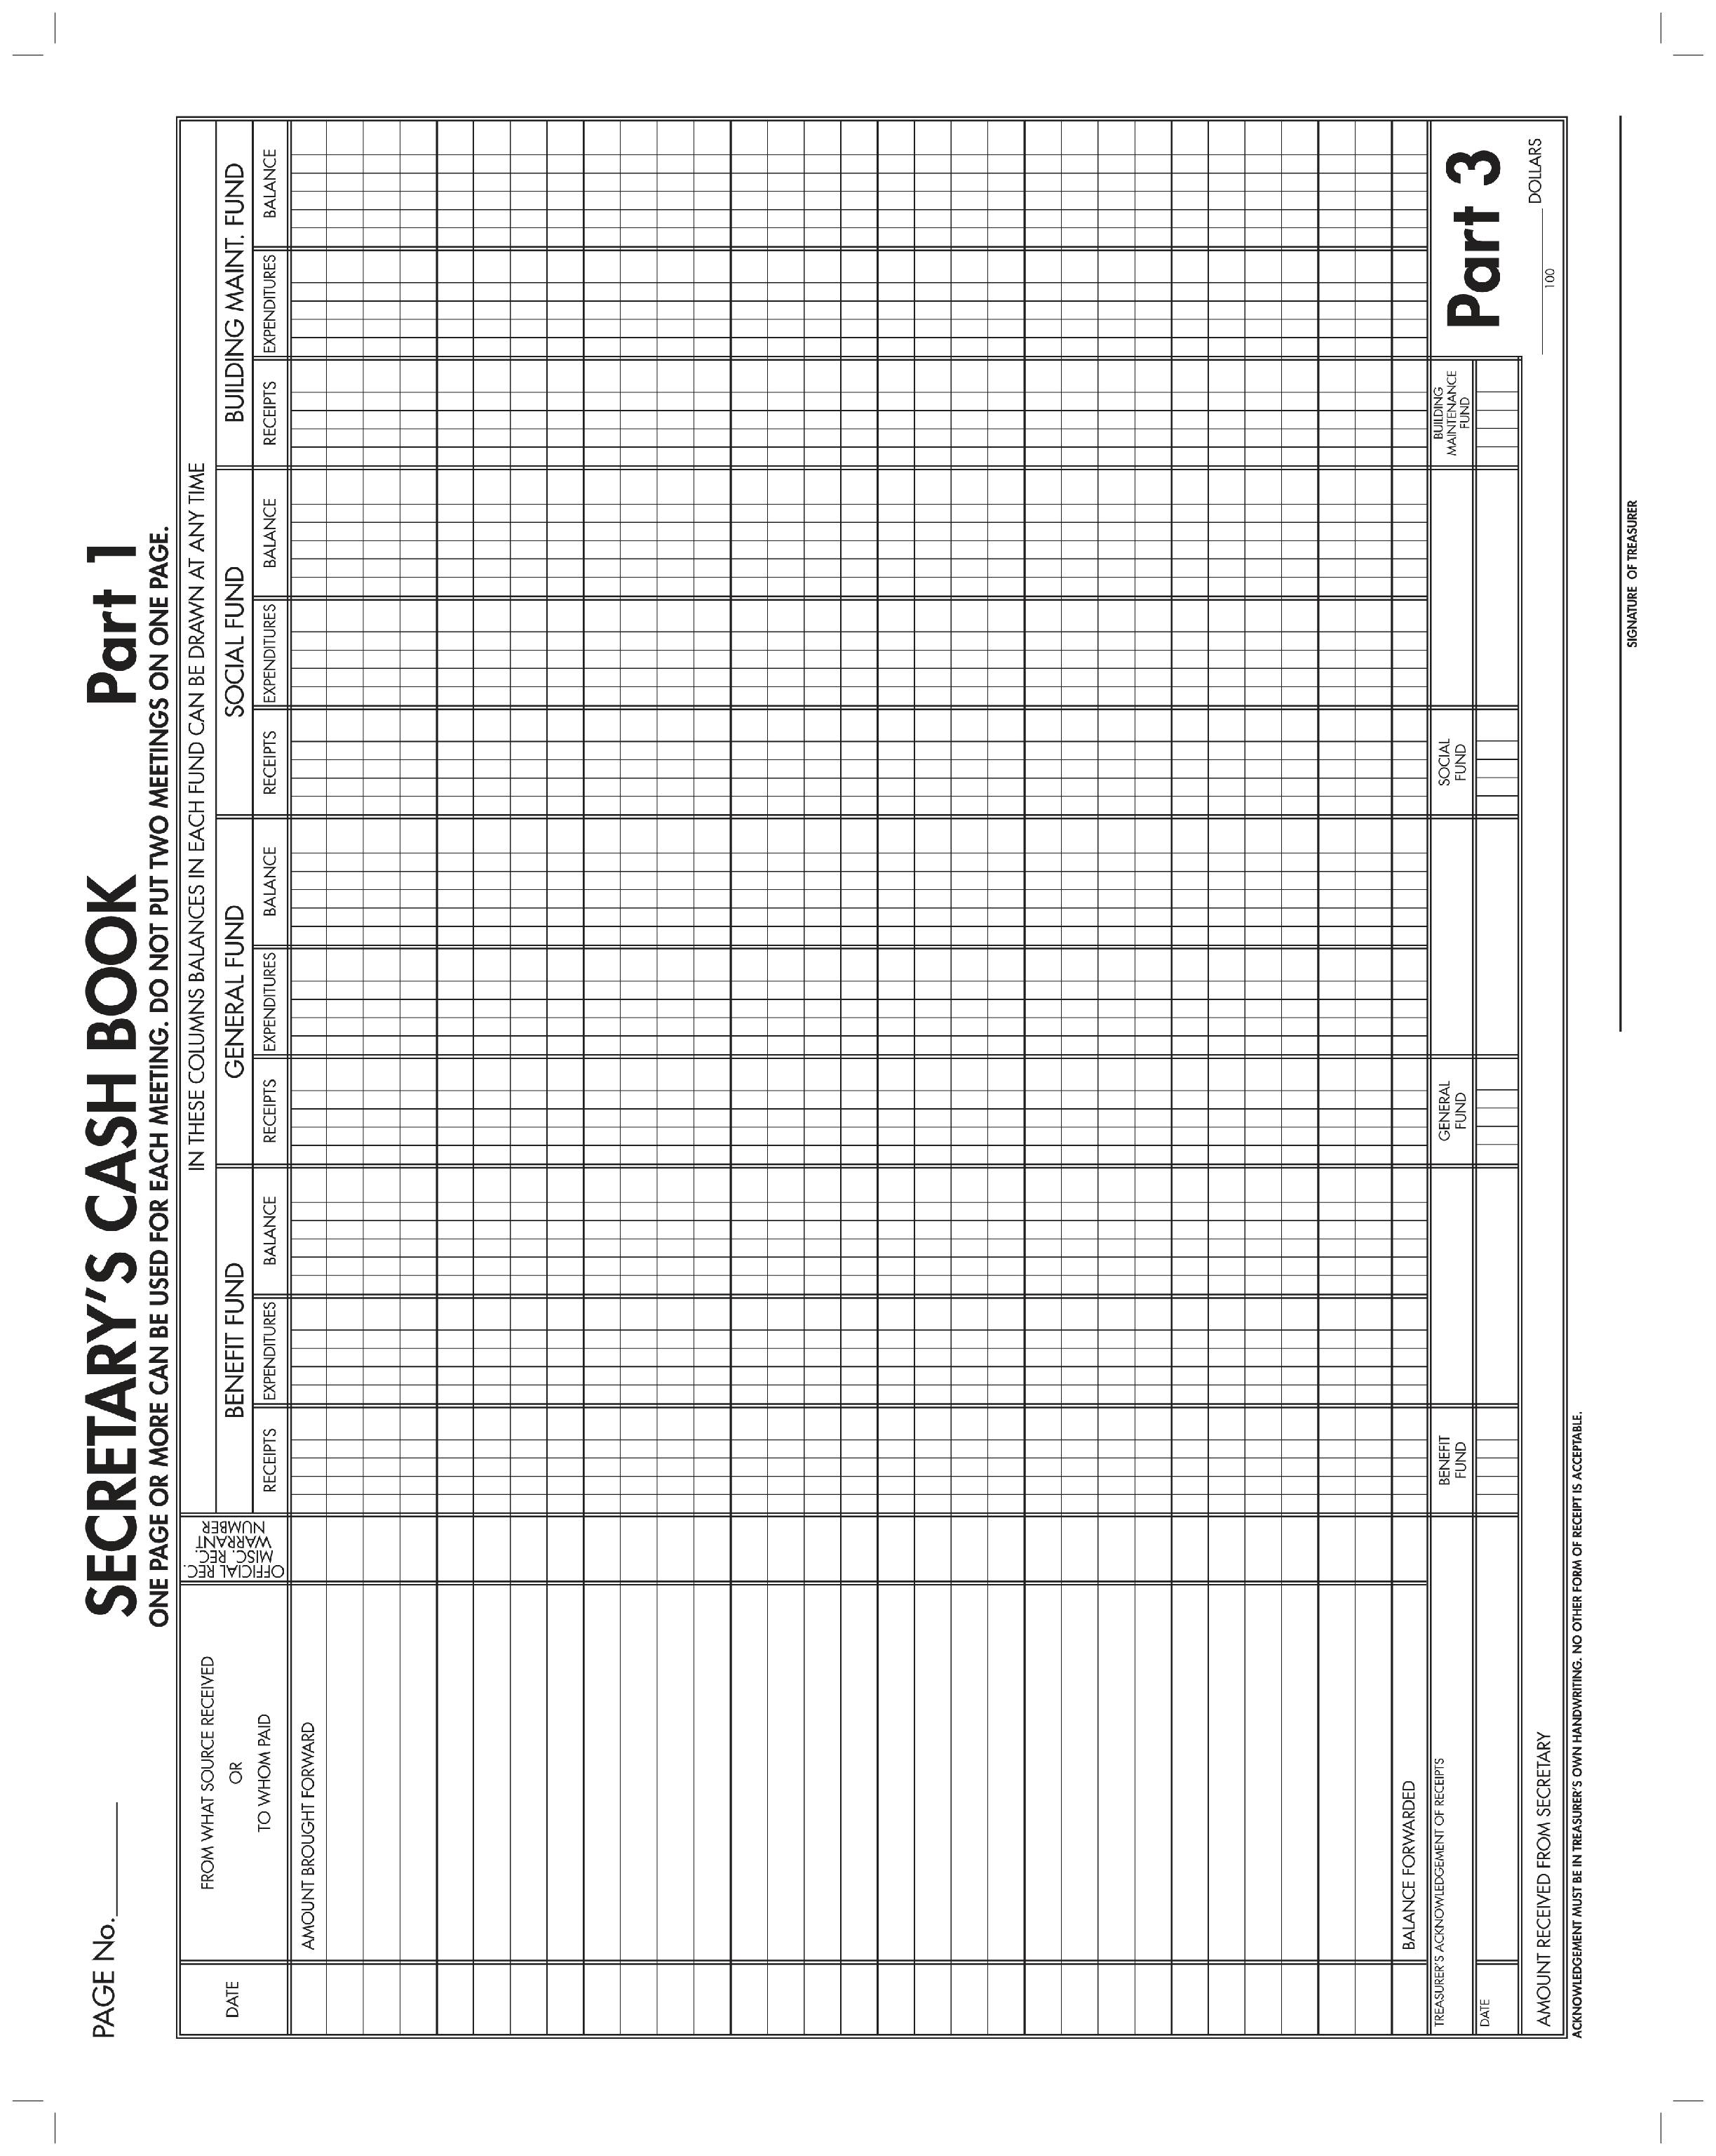
21.

Slide 36
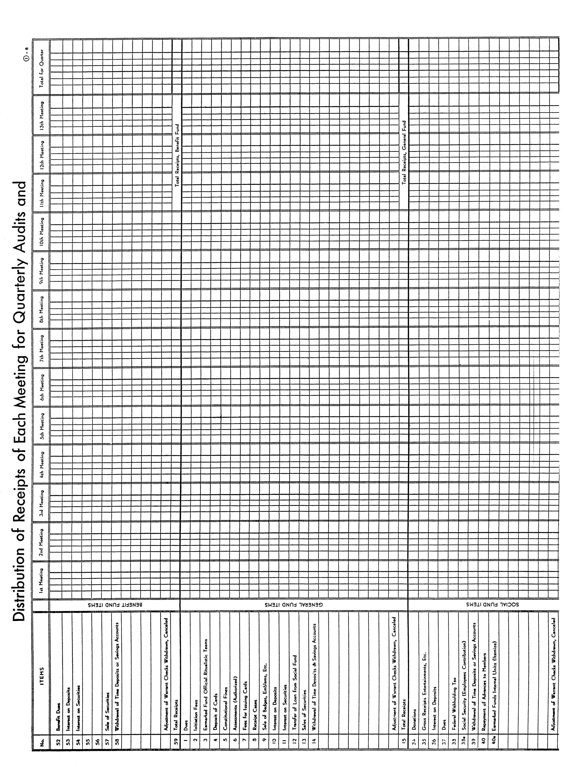
21. a

Slide 37
22. Secretary’s Annual Report – Per Capita Tax
  Each Local Auxiliary shall pay to the Grand Aerie an annual Per Capita Tax of twenty ($20.00).
  Invoice will appear on the Membership Management System home page
  Paid from the Benefit Fund
  Due and payable by June 1st. It becomes delinquent on July 1st.

Slide 38
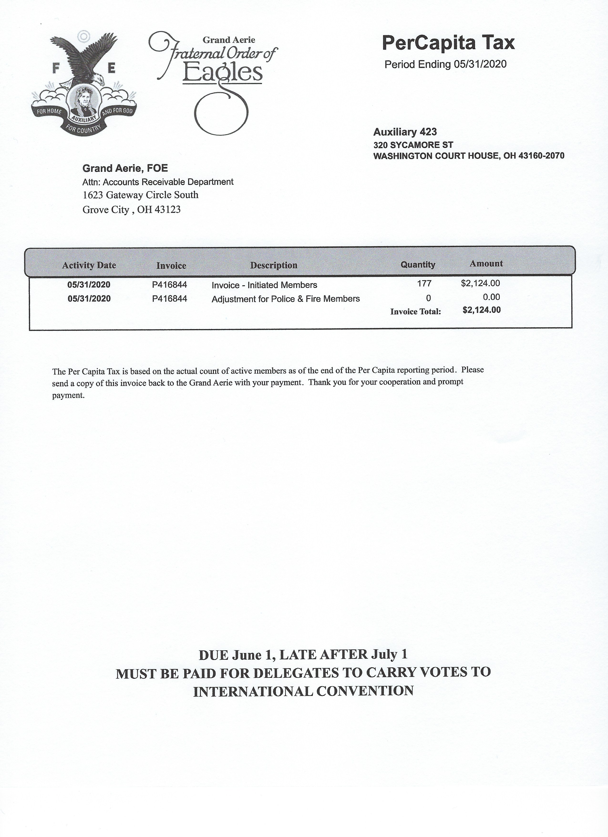
23. Sample of Local Auxiliary Per-Capita Tax Statement

Slide 39
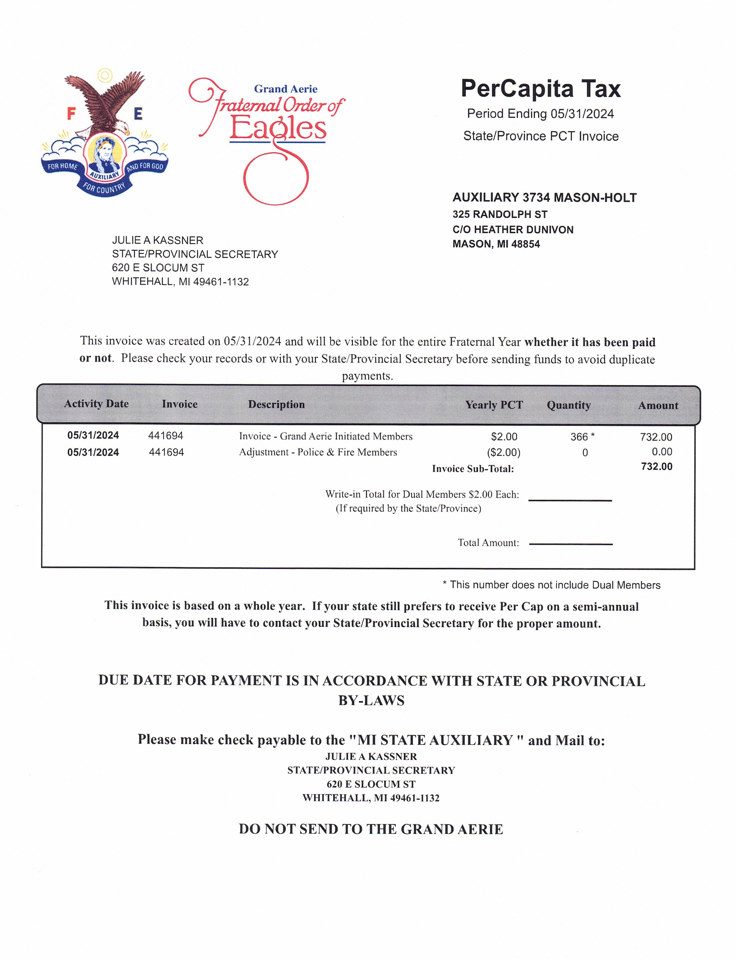
24. Sample of State Auxiliary Per-Capita Tax Statement

Slide 40
25. Delinquent Members and Dues Reminders
  Members are considered delinquent as of June 1st.
  A Delinquent Member Report is available in the Membership Management System.
  Dues Reminders will be sent by the Grand Aerie.
26. Report of Applications
  Applications for membership shall be entered into the MMS System before the next regularly scheduled meeting.
  An Initiation/Re-enrollment Report is available in the MMS System.
27. Notice of Election to Membership
  Must appear for interview within 60 day of notice
  Has a period of six (6) months to appear for Initiation
    If they do not appear, they forfeit all fees paid.
    Application for membership is cancelled.
28. Report of Officers to the Grand Aerie
  The Secretary is required to enter all Officers and required Committees in the Membership Management System.

Slide 41
29. MEMBERSHIP MANAGEMENT SYSTEM (MMS)
The Membership Management System is used to assist the Local Secretaries with their day-to-day duties. With MMS, the Secretary has the ability to maintain membership records, print dues receipts, run specific reports pertaining to membership, finances, etc., print Accounting statements, check their status with the Compliance Department, create postcards, send mass e-mails to their membership, update the Officer List and much more.
The link to access the Membership Management System (MMS) is https://mms.foe.com
In order to access the system, you will need to have a username and password which can be obtained by sending an e-mail to mmshelp@foe.com.

Slide 42
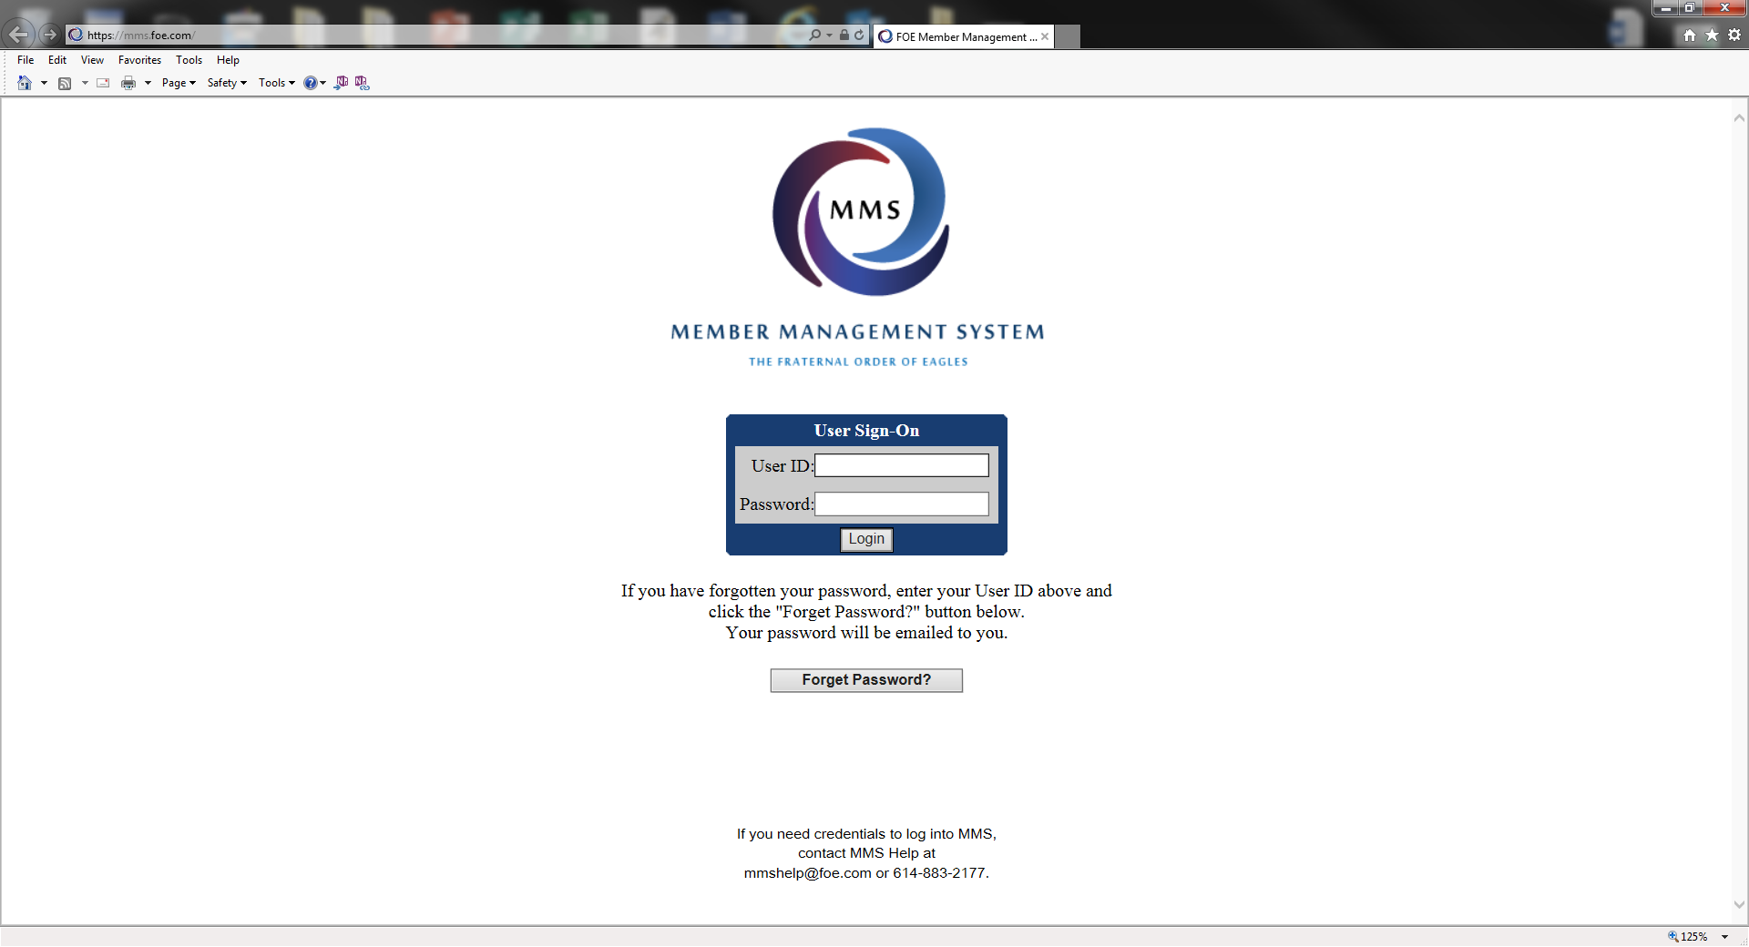
30.

Slide 43
31. New and Re-enrolled Membership Applications
Every application for membership shall be recommended by two (2) members in good standing.
Initiation/Re-enrollment Fee is to be determined by the By-Laws.
$10.00 of the Application Fee is to be sent to the Grand Aerie.
  The Grand Aerie will keep $6.00. $4.00 will be forwarded to the State.
Dues shall be determined by the By-Laws but can be no less than the amount equal to the Grand Aerie Per Capita Tax plus State Per Capita Tax and any fees and/or assessments.
All applicants must be interviewed, voted upon and Initiated with the exception of re-enrollments as they are not required to go through the Initiation process again.

Slide 44
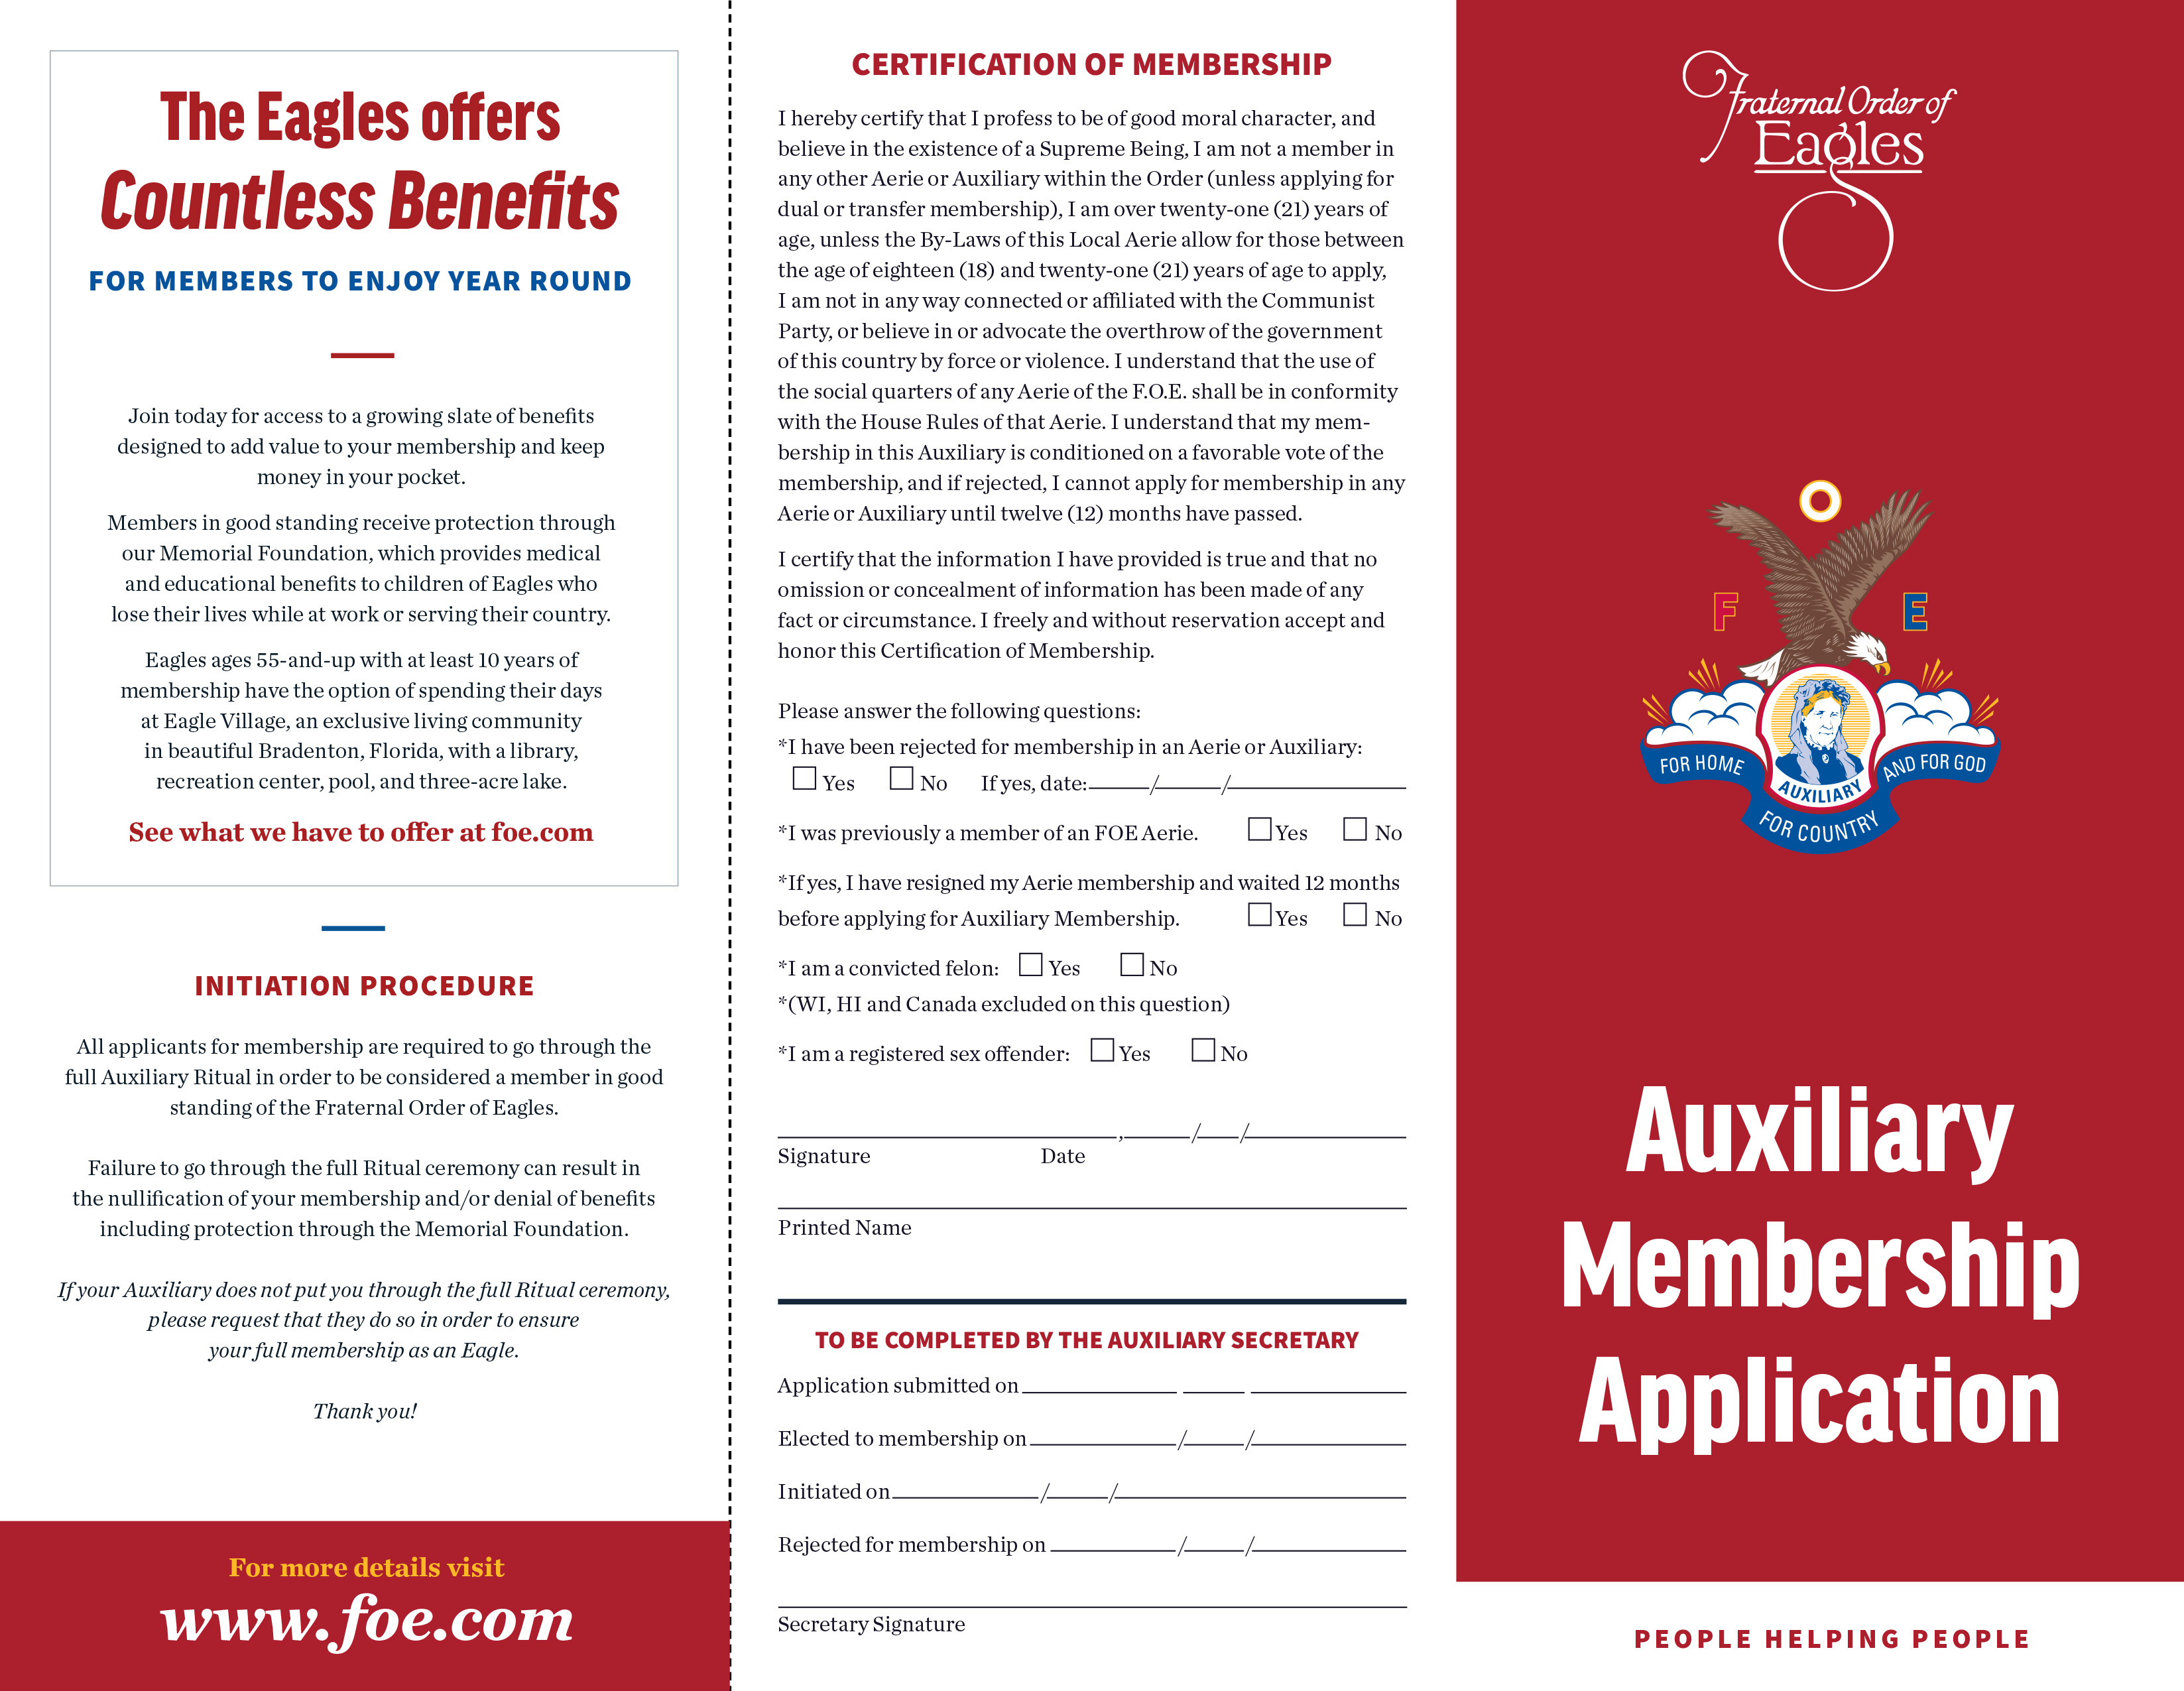
32.

Slide 45
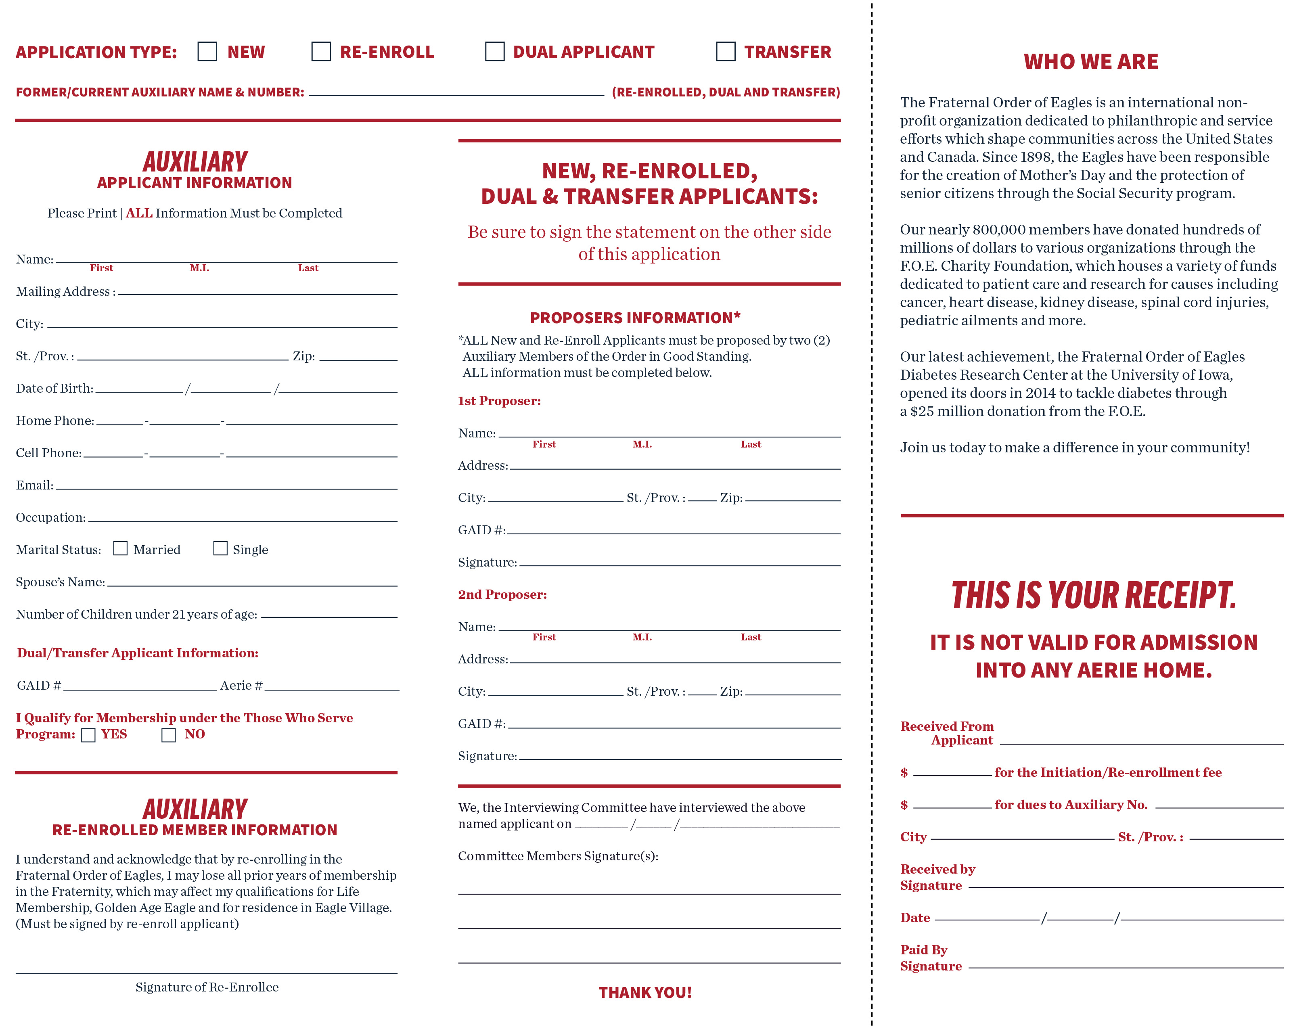
32. a

Slide 46
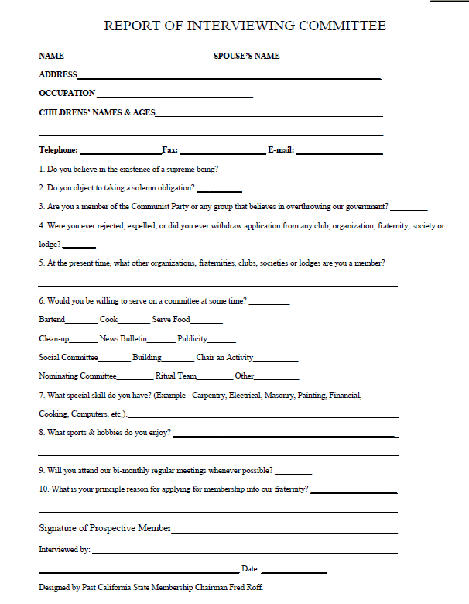
33. Suggested Interview Worksheet

Slide 47
34. Dual Membership Applications
No initiation fee is required.
Must provide proof that their dues have been paid in advance at their Home Auxiliary.
Must be interviewed and voted upon.
Dues shall be determined by the By-Laws but can be no less than $10.00 nor more than the regular non-benefit member dues.
No Per Capita Tax is paid to the Grand Aerie.
Dual Members should NOT be added through Batch Entry.

Slide 48
35. TRANSFERS
Must be interviewed and voted upon.
Must be a member in good standing with no charges pending.
A Home Auxiliary cannot refuse to transfer a member in good standing with no charges pending.
Member forfeit any dues paid to the Auxiliary which they belong and are required to pay dues to the Auxiliary in which they are transferring to.
Transfers should NOT be added through Batch Entry.

Slide 49
36. Official Receipts
Official Dues Receipts MUST be printed directly from the MMS System in color. This is the ONLY acceptable receipt to show as evidence of membership.
The Official Receipt must include the highest office the member has attained, if any.
Under 21 Years of Age must be endorsed on the receipt if the By-Laws so allow.
You can account for monies collected for dues and application fees within the MMS System.

Slide 50
37.
RECORDS TO BE KEPT PERMANENTLY
Secretary’s Cash Books
Secretary’s Minute Books
Deeds, mortgages, notes, leases and contracts
Authorizations from Grand Aerie Departments
By-Laws (current)
All Tax Records
Transfer Applications
Applications for Membership
(Applications: Permanently or until the member has passed, resigned or transferred to another Auxiliary.)
RECORDS TO BE KEPT FOR SEVEN (7) YEARS, THEN DESTROYED
Secretary’s Semi-Annual and Annual Reports
Treasurer’s Cash Books
Treasurer’s Annual Reports.
Miscellaneous Receipts
Individual ledger sheets and/or cards of deceased or former members
Canceled checks, except those where the liens have not been canceled
Check Stubs
Auditor’s Monthly and Annual Statements
Bank Statements
RECORDS TO BE KEPT FOR THREE (3) YEARS, THEN DESTROYED Bills, invoices, etc.
Temporary dues receipts
Official Government and Grand Aerie/Auxiliary Correspondence
NOTE: Official Correspondence should be carefully screened before destroying. Some correspondence could be destroyed in less than three (3) years, while some should be kept much longer. Correspondence that may be needed for any audit should be kept for at least seven (7) years.

Slide 51
38. Checklist of Financial and Reporting Responsibilities for Aeries and Auxiliaries
JUNE
1st - Per Capita Tax Due to Grand and State/Province
JULY
1st - Per Capita Tax LATE
31st - IRS Payroll Tax Form 941 Due for June 30
31st - Qtr. Ends
OCTOBER
15th - IRS Form 990 Due
15th - IRS Form 990 Extension Due if unable to file
15th - Treasurer’s Report and 990 Copy Due to Grand Aerie
15th - Auditor Report due for all postcard filers and Canada
31st - IRS Payroll Tax Form 941 Due for Sept 30
31st - Qtr. Ends
JANUARY
31st - IRS Payroll Tax Form 941 Due for September 30 Qtr. end
31st - IRS Payroll Tax Form 941 Due for December 31 Qtr. end
31st - IRS Payroll Tax Form 940 Due for December 31 year end
JANUARY
31st - Forms 1099 and W2 due to recipient
28th - Form 1096 (1099 Summary Report) due to IRS
APRIL
15th - IRS Form 990 due – if extension was filed
30th - IRS Payroll tax form 941 due for March 31 Qtr. end
MAY
31st - Contributions must be received in Grand Aerie for fiscal year
31st - Credit on Convention Reports
31st - Grand Aerie Books Closed
31st - Last POST Date
Assistance: IRS – www.irs.gov website, choose Non-Profit and Charity tab or call 1-877-829-5500
Grand Aerie – accounting@foe.com or charities@foe.com

Slide 52
39.
REPORTING WHERE DUE DATE IS DEPENDENT UPON STATE LAW REQUIREMENTS OR RENEWAL DATES:
Monthly:
- State Sales Tax Reports
- Gaming Reporting
Annually:
- Insurance Documents with Declaration Pages naming Grand Aerie as additionally insured
- Affiliation Agreement
State Registration or Incorporation Renewal (usually has a filing fee).

Slide 53
OTHER TIMEFRAMES OF NOTE
40. CONTRIBUTIONS:
The Grand Aerie Accounting Department closes the fiscal year on MAY 31. There are no exceptions to this date and late receipts cannot be accommodated.
If you wish to ensure credit for your charity work during the annual convention, all contributions must reach the Grand Aerie PRIOR to May 31. If May 31 falls on a weekend, please adjust mailing dates accordingly to the prior Friday.
GRANTS:
If you are requesting a grant to be presented to a recipient or to be presented at a convention, please request your grant at a minimum of one month prior to date needed.
The grant is processed through your State Secretary’s office, the International Charity Director (if over $5,000), through the Grand Aerie Board of Directors (if over $10,000) and then can be processed by the GA Accounting Department.
REGIONAL GRANTS:
The hosting State requests the Grant for $5,000 and must be submitted one month in advance of the Regional Conference

Slide 54
Madam Treasurer

Slide 55
TREASURER
1. Demand and Receive from Secretary all money belonging to the Auxiliary.
2. Give Secretary receipt and deposit money in the proper accounts within 48 hours of receipt of the money.
3. Sign all checks, if authorized by the Auxiliary, signed by President, attested to by the Auxiliary Secretary, and drawn from the proper fund.
4. Keep records, books and accounts and make reports as required by the Grand Aerie/Auxiliary
a. The accounts shall be recorded in the book provided for that purpose by the Grand Aerie. The accounts may be maintained in this book or if the records are kept electronically, they shall be printed, copies shall be kept and protected in a three (3) ring binder or cash book for that purpose. This cannot be a copy of the Secretary’s Cash Book.
5. Hold in trust all securities belonging to the Auxiliary in a Safe Deposit Box. Must be Accessible to Treasurer but only when accompanied by the Secretary or President.
6. Provide books for audit each month and quarter and when requested by the President or Auditor.
7. Work with Secretary to ensure your books and the Secretary's are in balance, but not copied.
8. Compensation fixed by the By-Laws

Slide 56
TREASURER CONTINUED
Records & Reports
Treasurer's cash book.
a. It is similar to the Secretary's cash book.
b. At the end of the month you should reconcile the bank statements with your cash book.
C. Reconcile yours with the Secretary’s cash book.

Slide 58
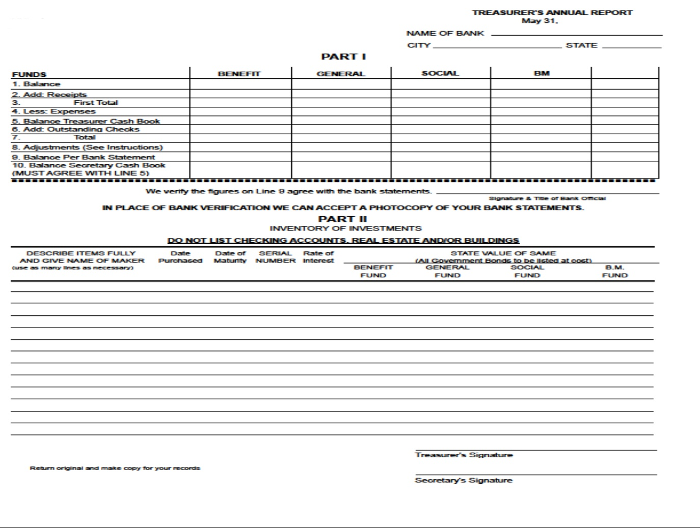
TREASURER CONTINUED
RECORDS/REPORTS:
2. Treasurer's Annual Report .
a. 12 month report ending May 31 each year.
b. Due by the 15th of October each year.
c. Coincides with Secretary's filing of the 990 and/or 990EZ.

Slide 59
Madam Inside Guard
&
Madam Outside Guard

Slide 60
Inside Guard & Outside Guard
Inside Guard
a. Maintain a position at the Inner Door of the Auxiliary meeting room.
b. Examine the official receipt of every member desiring admission to the Auxiliary meeting.
c. If dues are paid, admit the member to the Auxiliary room.
d. Assist in the initiation of candidates.
2. Outside Guard
a. May provide in the By-Laws that the office of Outside Guard be abolished.
b. Shall have charge of the outer room and during the meeting of the Auxiliary shall permit only members in good standing to enter the room.

Slide 61
Madam Trustees

Slide 62
TRUSTEES
Duties
1. The duties of the Madam Trustees shall be as hereafter set out, and the Madam Trustees shall at all times be under the direction and control of the Auxiliary.
2. Immediately after the election and installation of officers each year, the Madam Trustees shall organize by electing a Chairman and a Secretary, each to serve in her respective capacity for one (1) year.
a. The Madam Trustees shall hold such meetings as deemed necessary by the Auxiliary, except that the Chairman may call meetings of the Madam Trustees when, in her judgment, same are necessary, and she shall call a meeting when requested to do so by two (2) members of the Madam Trustees. The Madam Trustees shall keep such records as may be required for an official recording and reporting of their activities to the Auxiliary.
b. A majority of the Madam Trustees shall at all times constitute a quorum.
c. No one (1) of the Madam Trustees, including the Chairman, shall have greater powers than those vested in her while acting jointly and collectively with her associates holding the office of Madam Trustee.

Slide 63
TRUSTEES CONTINUED
3. The Madam Trustees are under the supervision and instruction of the Auxiliary.
a. Shall generally be the medium of contact between the officers and members of the Auxiliary and the officers and members of the Aerie to which it is ancillary.
b. They shall consult with the Trustees of the Aerie with relation to the use of the Aerie premises for Auxiliary meetings, social functions, entertainments and charitable undertakings of a local nature; they shall use their offices to coordinate the undertakings of the Aerie and the Auxiliary in such functions and enterprises to the end that conflicting dates, activities and the like shall be avoided, thereby bringing about a practical and harmonious cooperation between the two.
4. The Madam Trustees shall be responsible for recommending to the Auxiliary the investment of the funds of the Auxiliary in excess of those amounts necessary to defray the current expenses of the Auxiliary. The investments so recommended shall be in such bonds or other securities as shall be approved by the Financial Advisor of the Grand Aerie; or such funds may be deposited, as an interest bearing deposit in a bank designated by the Auxiliary and approved by the Financial Advisor of the Grand Aerie.

Slide 64
TRUSTEES CONTINUED
4. At the close of each semi-annual period or at any other time when requested to do so by the Auxiliary, the Madam Trustees shall make a full report to the Auxiliary of all activities and business transacted by them during such period, including all detailed recommendations made regarding investment of Auxiliary funds.
5. The Madam Trustees shall hold in trust for the Auxiliary all properties belonging to the Auxiliary not otherwise entrusted to a specific officer or group such as those entrusted to the Madam Treasurer pursuant to the provisions of the Rules and Regulations.
6. The Madam Trustees shall see to it that the Auxiliary shall be named as an owner on the Aerie’s policy at no expense to the Auxiliary, unless otherwise dictated by State Law.
7. Upon demand of the Auxiliary Auditor or instructions of the Auxiliary, the Madam Trustees shall, at any time, deliver any and all books, papers or other property which they may have in their possession for examination or audit.
8. Upon the expiration of their term of office, or upon their removal there from, the Madam Trustee shall deliver to their successors in office all books, papers or other property which may be in their possession, and which belongs to the Auxiliary.

Slide 65
Auditor

Slide 66
  Auditor
  Duties
Procure a copy of the Rules and Regulations and By-Laws upon assuming office from the Auxiliary Secretary.
Do not write in the books.
Examine and audit the books of the financial officers and/or committees of the Auxiliary, at the close of business at the last meeting of each month.
Include records kept by the Secretary, Treasurer, Special Committees, or any person bonded and keep­ing records that reflect the financial status of the Auxiliary.
Determine whether books and records are posted currently and correctly and are in balance.
Audit should be done immediately after the close of business at the last meeting of each month.
Report of findings shall be submitted to the Auxiliary in writing and read on the floor at the first meeting of the next month and entered in the minutes.

Slide 67
Duties continued
Complete the Financial Statement, which encompasses the financial transactions for the fiscal year June 1st through May
31st
Immediately report, in writing, to the President with a copy to the General Auditor of the Grand Aerie, any delinquency in books, reports and accounts of the financial officers of the Auxiliary and any misappropriation of funds.
Make a written report to the Auxiliary of the audit findings at the first meeting following the last audit.
The Local Auxiliary By­-Laws contain specific laws governing local conditions, such as the hour and day, also the place
of the Auxiliary’s regular meetings, dis­tribution of the annual dues into the Auxiliary’s various funds, the amount of
the initiation fee charged, the amount of Sick and Funeral Benefits paid by the Auxiliary, the salaries of the various officers, etc., all of the information needed by you each month as you make the monthly Audit of the Auxiliary’s books and records.
It is also your duty to review the Auxiliary Bond to verify that the Auxiliary Officers are properly bonded.
Compensation as defined in the By-Laws and not payable until all reports are completed and transmitted.

Slide 68

Resignation and Reaffiliation

Slide 69
Section 6.1 Any member of any Auxiliary who is in good standing and against whom no charges are pending may, without the payment of any fee, resign her membership in the Auxiliary in writing and her membership in the Auxiliary shall forthwith cease upon presentation of such resignation to any regular meeting of the Auxiliary without the formality of acceptance by the Auxiliary. Upon her resignation, she must return her Official Receipt to the Secretary.
Section 6.2 Any member of an Aerie or Auxiliary who has resigned her membership and who desires to re-affiliate in any Aerie or Auxiliary may not do so for twelve (12) months and must do so as a new member.
Section 6.3 No expelled member of an Aerie or Auxiliary shall be accepted as a member or be employed by an Aerie or Auxiliary unless such expulsion had been appealed and reversed by the Grand Tribunal or pardoned by the Grand Worthy President under the Laws of the Order.

Slide 70
Section 6.4 If any Past Madam President of any Auxiliary shall affiliate with another Auxiliary, or re-affiliate with her own Auxiliary after having ceased to be a member in good standing of the Ladies Auxiliary because of non-payment of dues, she shall upon such affiliation or re-affiliation be restored to her former status of Past Madam President and the Auxiliary shall enter her name on the list of its Past Madam Presidents and shall be recognized as such. However, any Past Madam President who has resigned from the Ladies Auxiliary shall not, upon re-affiliation, be restored to her former status of Past Madam President. Any Past Madam President who resigns from the Order shall rejoin as a new member and shall not regain her status as a Past Madam President.
There are only two (2) prohibitions enumerated in the Rules against restoration of a Past Madam President’s status upon re-affiliation. They are where a Past Madam President of an Auxiliary has been expelled or where she has resigned from the Order.
Section 6.5 A Charter member of a Ladies Auxiliary dropped from the rolls of the Auxiliary for any reason, regains recognition as such Charter member upon re-affiliation with the Auxiliary of which she was one of the original members, but of no other Auxiliary with which she might affiliate unless such affiliation is as a Charter member.

