Slide 1


Aerie and Auxiliary Compliance Survey Training
Revised 3/25

Slide 2
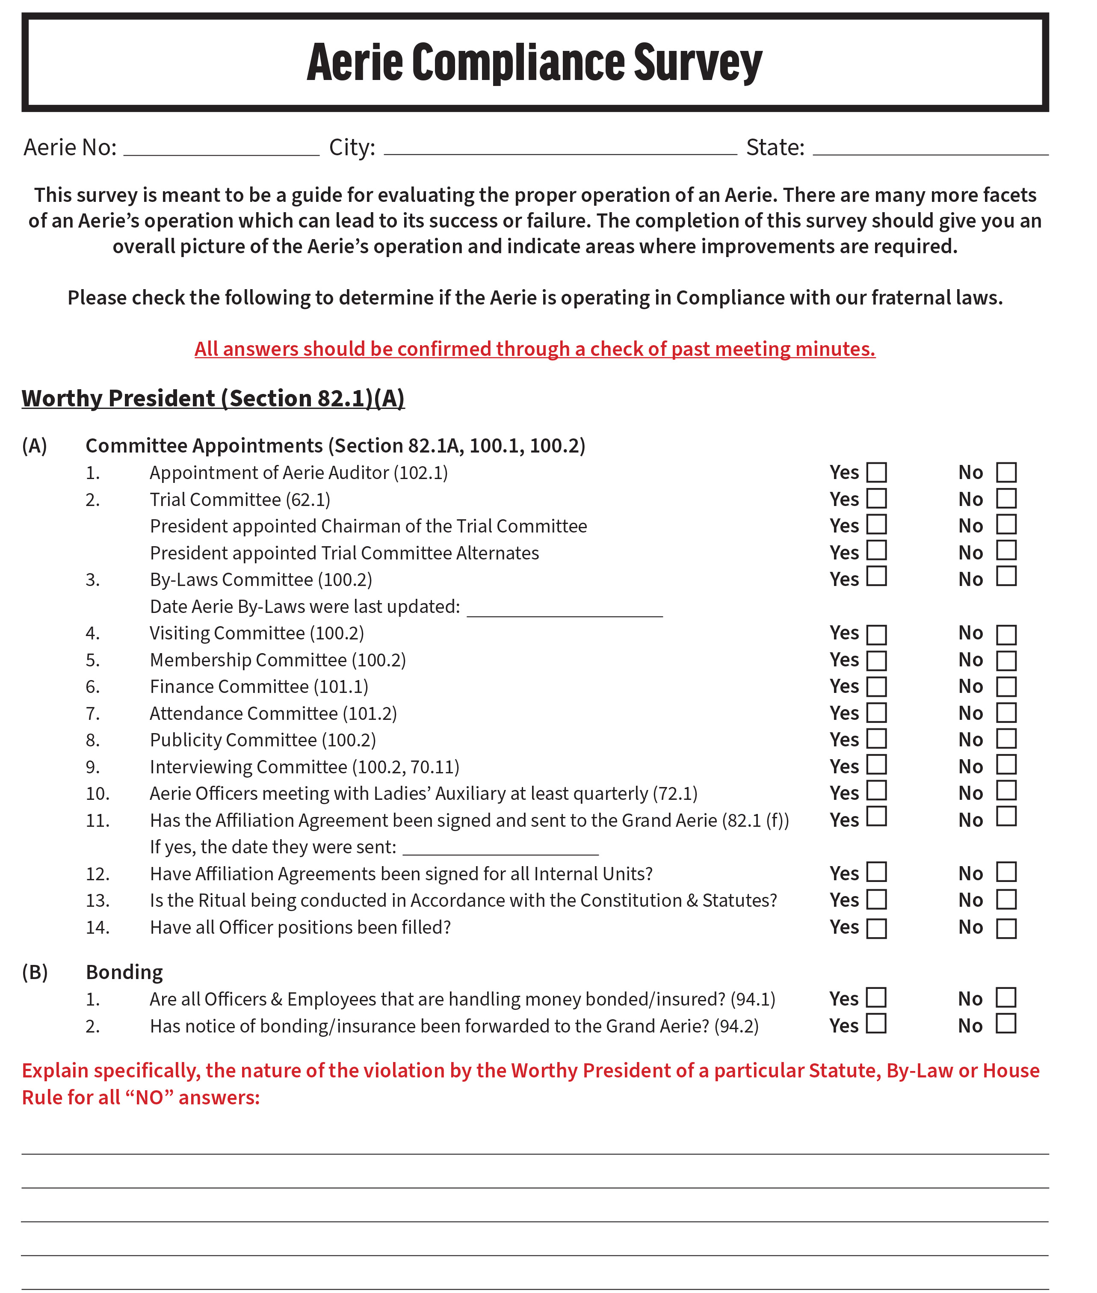
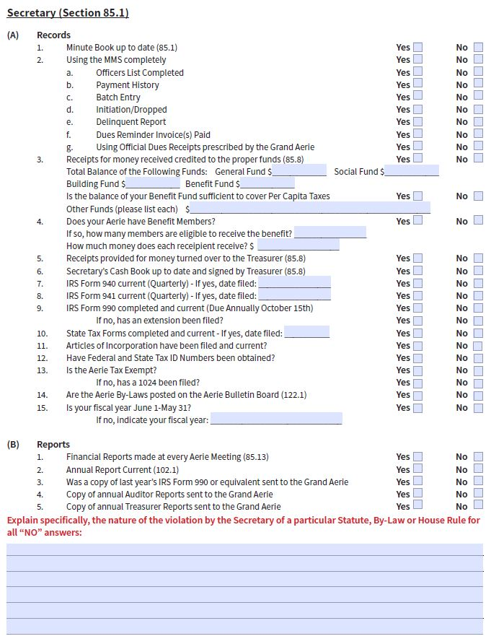
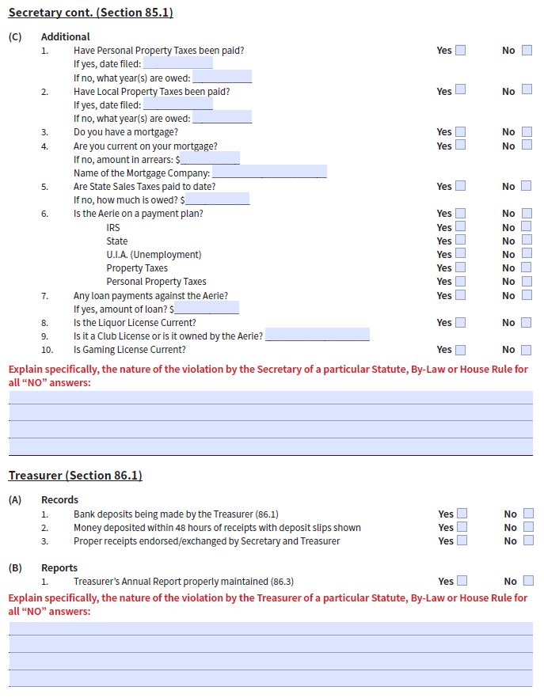
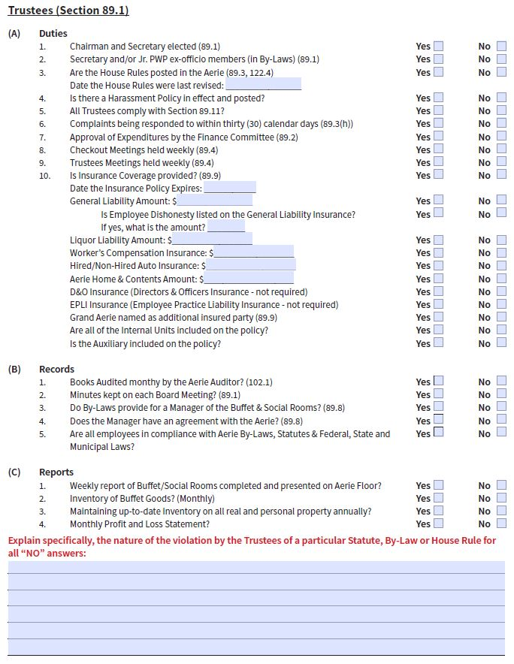
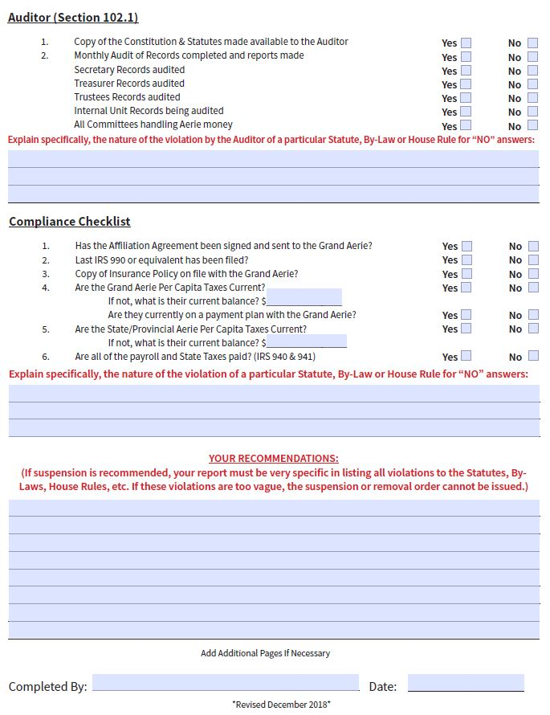
Grand Aerie Survey

Slide 3
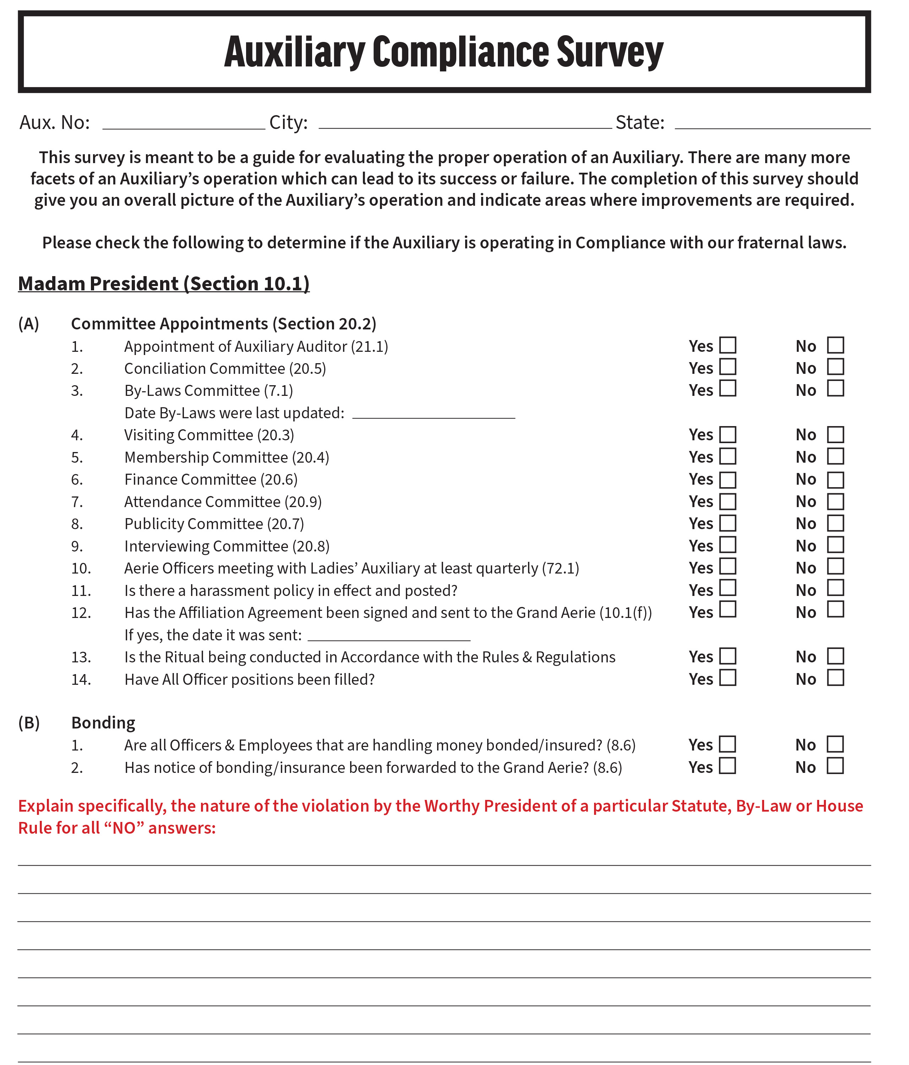
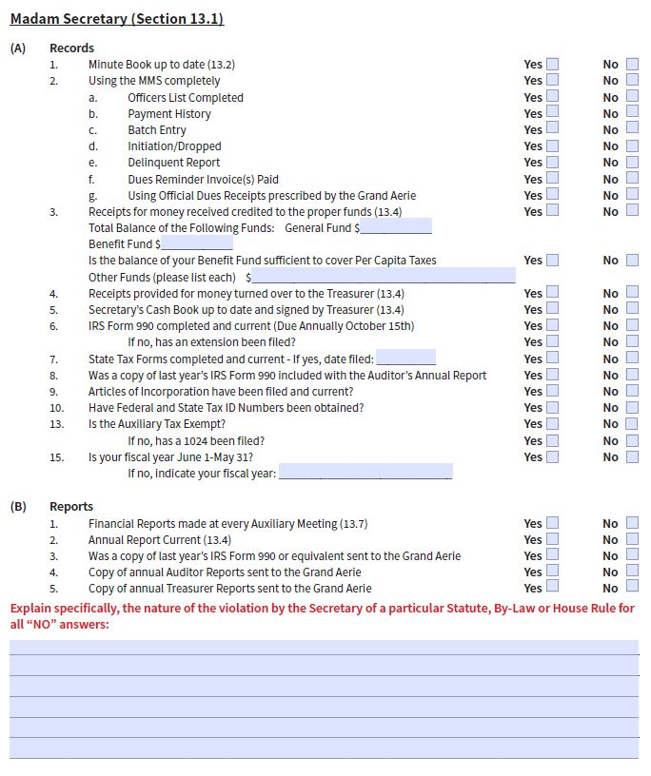
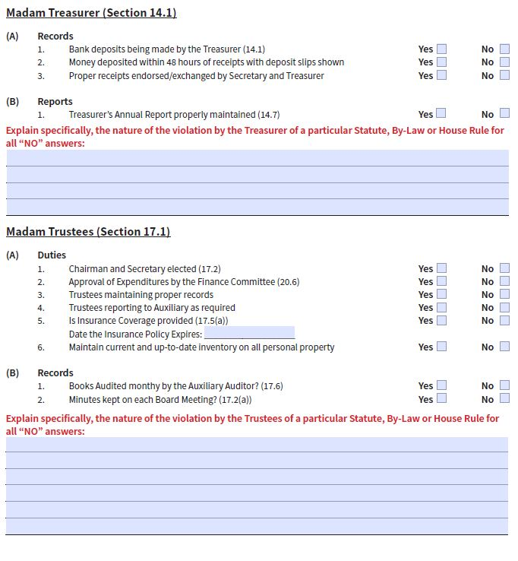
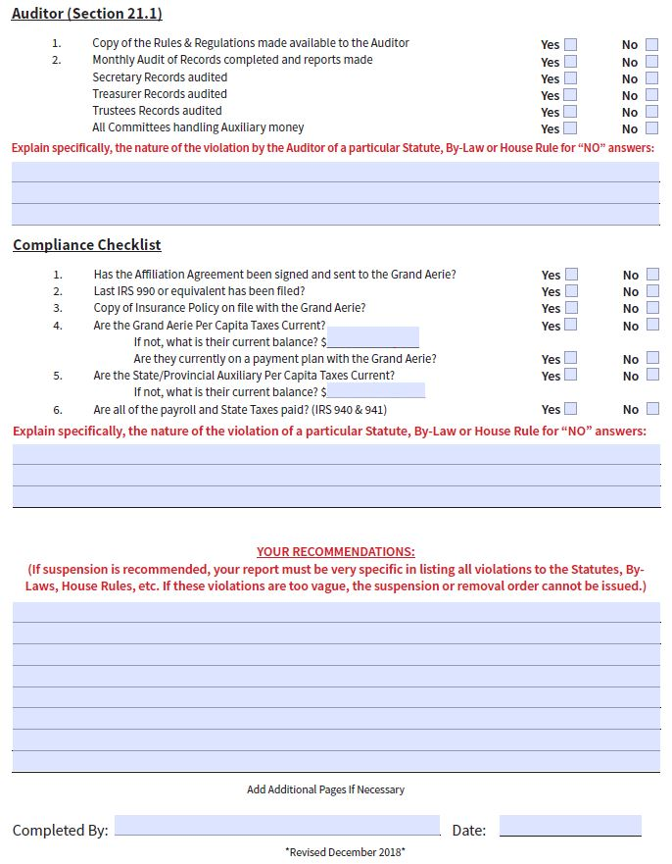
Grand Auxiliary Survey

Slide 4
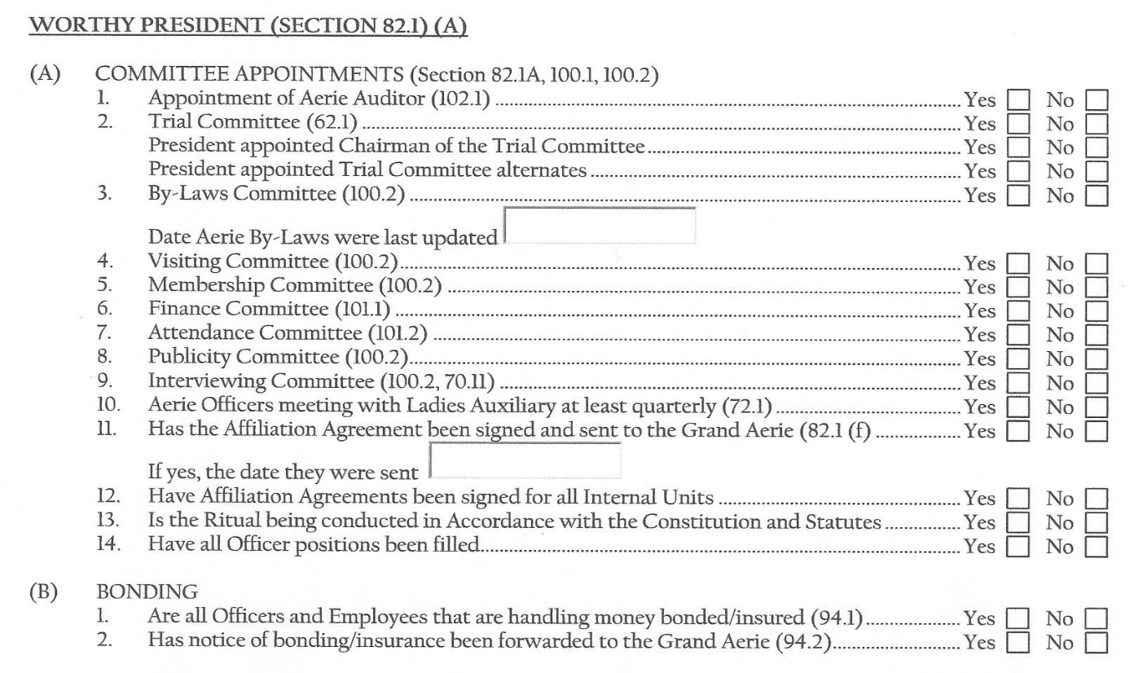
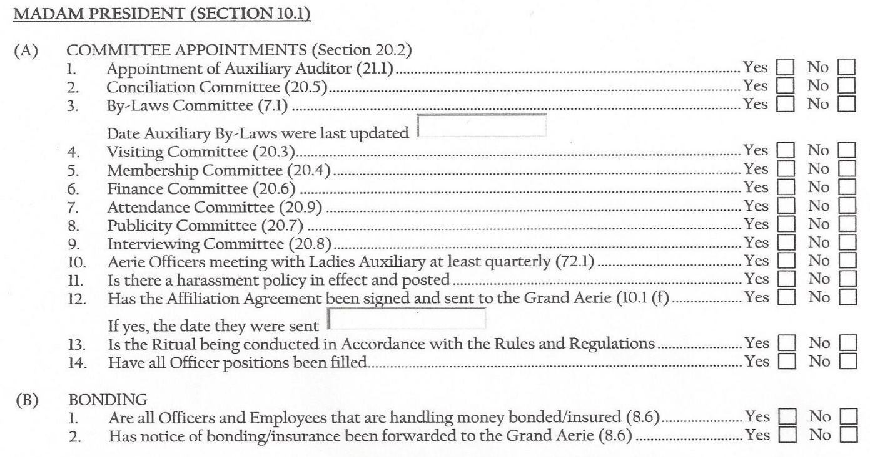
Aerie and Auxiliary Presidents

Slide 5
Aerie Auditor
Section 102.1, pg. 112 Immediately upon his installation in office, the Worthy Presi­dent shall appoint, preferably from among the members of the Order, an experi­enced and competent Aerie Auditor, which shall not be a bonded Aerie officer as listed in Section 94.1, Statutes.
Auxiliary Auditor
Section 21.1, pg. 40 Immediately upon her installation in office, the Madam President shall appoint an Auditor, who may be a qualified member of either the Aerie or Auxiliary.
(a) None of the bonded officers of the Auxiliary may be appointed as Auditor.

Slide 6
Trial Committee
Section 62.1, pg. 55 Immediately after his installation, the Worthy President of each Local Aerie shall appoint a Local Tribunal, which shall be known as the '"Trial Committee". The Worthy President shall appoint one (1) member of which shall be designated as “Chairman”. Such Trial Committee shall consist of five (5) members, and two (2) alternates, all of whom shall be Past Worthy Presidents of the Aerie or Ten-Year Secretaries (retired), if they are available, and who shall serve during the Worthy President's term of office.
The Worthy President, who does appoint the Local Trial Com­mittee, is not authorized to change the membership thereof ex­cept to appoint new members to such Trial Committee when a vacancy properly occurs thereon. (Opinion No.276)

Slide 7
Conciliation Committee
Section 20.5, pg.37, Immediately after her installation, the Madam President of each Local Auxiliary shall appoint a Conciliation Committee, which shall consist of five (5) members, all of whom shall be Past Madam Presidents of the Auxiliary, if Past Madam Presidents are available, and who shall serve during the Madam President’s term of office.
The purpose of the Conciliation Committee is to provide a means for resolving disputes between members of the Auxiliary. Said dispute must have occurred within the past thirty (30) days.

Slide 8
Aerie By-Laws Committee
Section 101.3, pg. 112 Immediately upon his installation in office, the Worthy Presi­dent shall appoint a By-Laws Committee consisting of not less than three (3) members in good standing. The By-Laws Committee shall review the current By-Laws in effect and make such recommendation for amendment as they deem necessary and proper. Such suggested amendments shall be proposed and, if adopted, shall be done in compliance with Sections 122.1, 122.2 and 122.3, Stat­utes Annotated.
Auxiliary By-Laws Committee
Section 7.1, pg. 18 Each Auxiliary shall make such By-Laws as its needs require and are not inconsistent or in conflict with the Laws of the Order. Such By-Laws shall not become effective until they have submitted in duplicate to the Grand Secretary and approved in writing.

Slide 9
Appointment of Aerie Committees
Section 100.1, pg. 111 The Worthy President of each Aerie shall appoint for such purposes and on such occasions as he or the Aerie shall deem necessary or advis­able all committees of the Aerie, together with such other committees as shall be required by the Laws of the Order or the By-Laws of the Aerie.
The Worthy President is the sole appointing power of all com­mittees. Such power of appointment carries with it the power of removal with the exception of the Trial Committee and Finance Committee. The Worthy President therefore is authorized to change the membership of his committees with or without cause at any time during his tenure of office with the exception of the Trial Committee and Finance Committee. (Opinion No. 180) (Refer to Sec­tion 62.3 and Opinion No. 581 under Finance Committee, Section 101.1)
Section 100.2, pg. 111 Each Aerie shall include among the committees thereof a By-Laws Committee, a Visiting Committee, a Membership Committee, a Mem­bership Security Committee, a Trial Committee, a Finance Committee, a Meet­ings Attendance Committee, a Publicity Committee and an Interviewing Com­mittee. The duties of each Committee shall be as set forth in the Aerie By-Laws, or in the Laws of the Order

Slide 10
Appointment of Auxiliary Committees
Section 20.1, pg. 36 The Madam President of each Auxiliary shall appoint for such purpose and on such occasions as she or the Auxiliary shall deem necessary or advisable, all Committees of the Auxiliary together with such other Committees as shall be required by the Laws of the Order or the By-Laws of the Auxiliary.
Section 20.2, pg. 36 Each Auxiliary shall include among the Committees a Visiting Committee, a Membership Committee, a Membership Security Committee, a Conciliation Committee, a Finance Committee, a Meeting Attendance Committee, a Publicity Committee, an Interviewing Committee and a By-Laws Committee. The duties of each Committee shall be as set forth in the Auxiliary By-Laws or in the Rules and Regulations or in the Laws of the Order.

Slide 11
Joint Officers Meeting
Section 72.1(b), pg. 85 Each Aerie that has a Ladies’ Auxiliary shall conduct a joint officers meeting on no less than a quarterly basis.
Section 3.4(c), pg. 13 The Aerie and Auxiliary shall conduct a joint officers’ meeting on no less than a quarterly basis.

Slide 12
Aerie affiliation
agreement

Slide 13
Auxiliary affiliation agreement

Slide 14
Bonding of Officers and Employees
Section 94.1, pg. 110 The Worthy President, Worthy Vice-President, Secretary, Trea­surer, and Trustees of each Aerie, and other employees of the Aerie who handle moneys of the Aerie, shall each give a surety bond conditioned for the faithful performance of their duties, the amount of the bond to be set forth in the Aerie By-Laws. The premiums for such bonds shall be paid by the Aerie.
Section 94.2, pg. 110 No officer or employee of the Local Aerie who shall be required by the Laws of the Order, or by Local Aerie By-Laws, to be bonded shall be permitted to assume or discharge the duties of such office or employment until so bonded, and notification thereof forwarded to the office of the Grand Worthy President and shall be enforced under Section 82.1(b).

Slide 15
Bonding Continued
Section 8.6, pg. 20 The Madam President, Madam Vice-President, Madam Secretary, Madam Treasurer and Madam Trustees of each Auxiliary and other members of the Auxiliary who handle monies of the Auxiliary, shall each give a surety bond condition for the faithful performance of her duties, the amount of the bond to be set forth in the Auxiliary By-Laws. No officer or employee of the Local Auxiliary who shall be re­quired by the Laws of the Order, or by Local Auxiliary By-Laws, to be bonded shall be permitted to assume or discharge the duties of such office or employment until so bonded, and notification thereof forwarded to the office of the Grand Worthy President and shall be enforced under Ladies Auxiliary Rules and Regulations Section 10.1(b).
(a) The premiums for such bonds shall be paid by the Auxiliary.

Slide 16
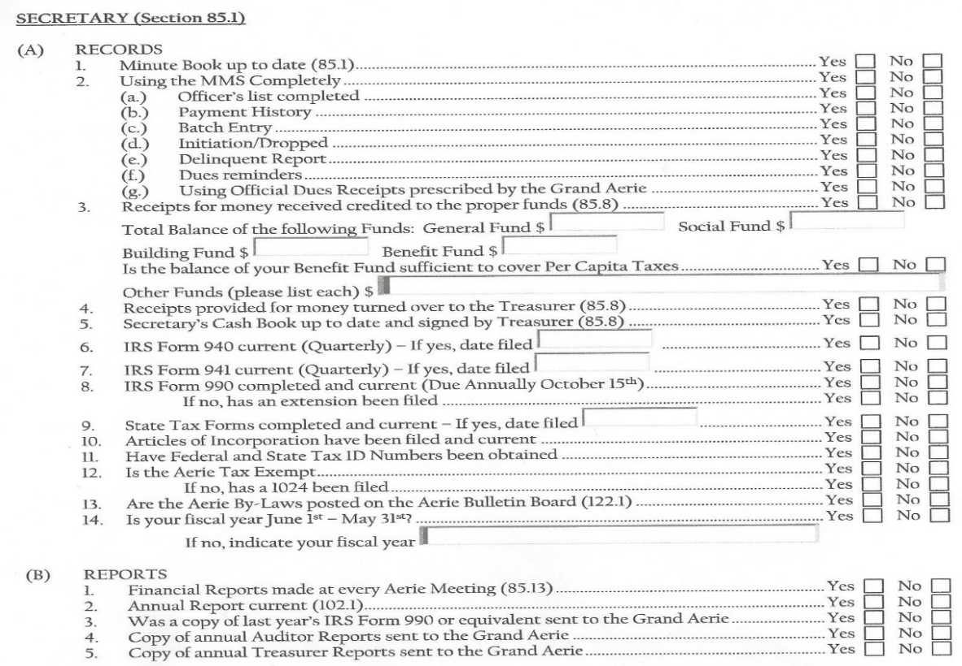
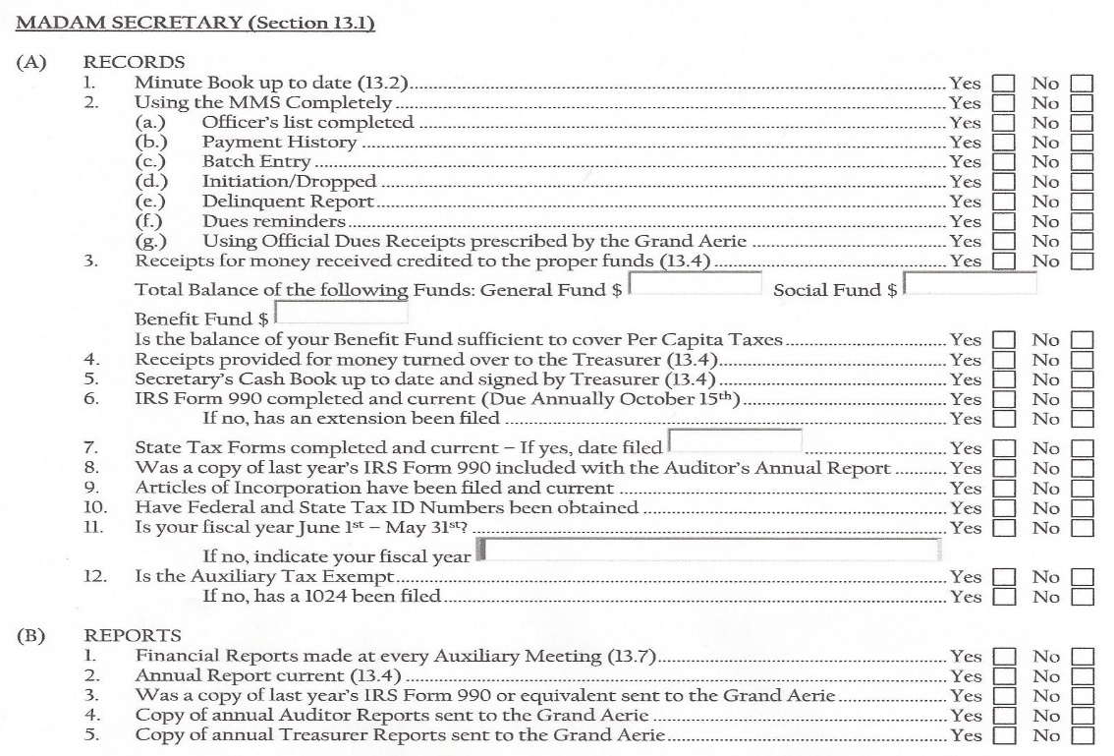
secretary

Slide 17
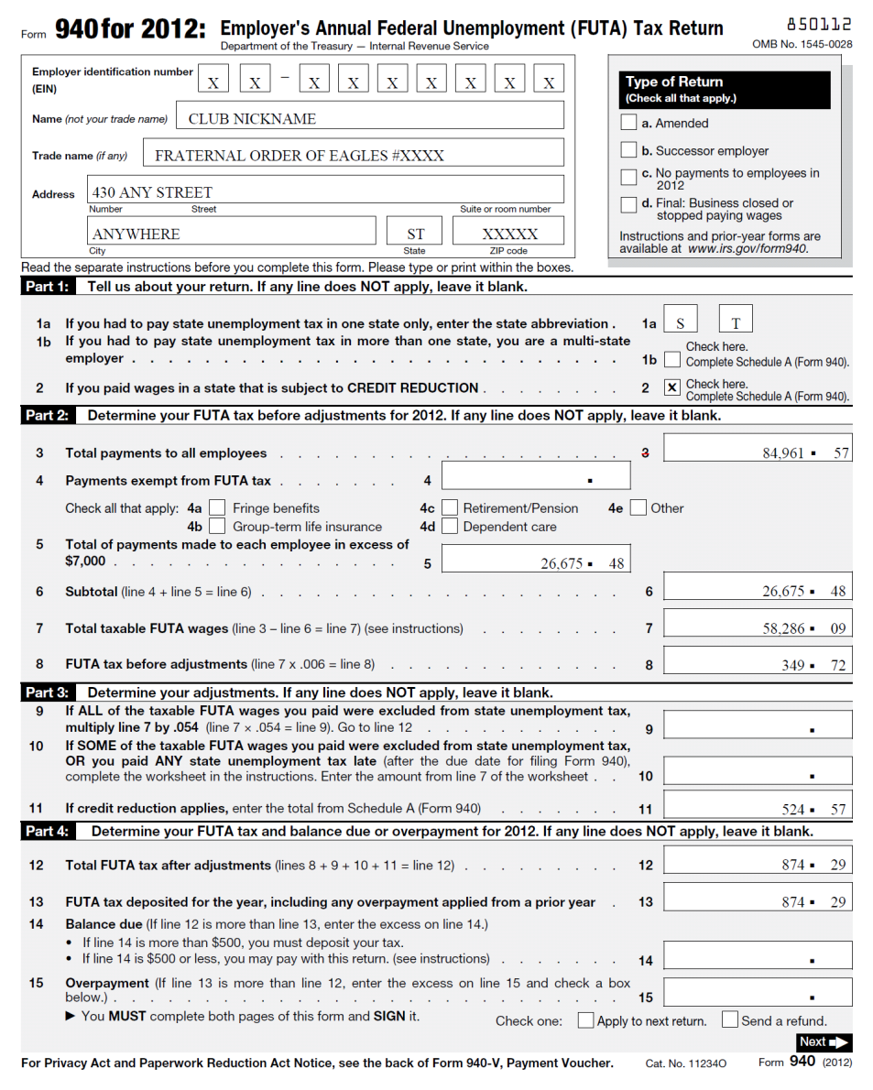
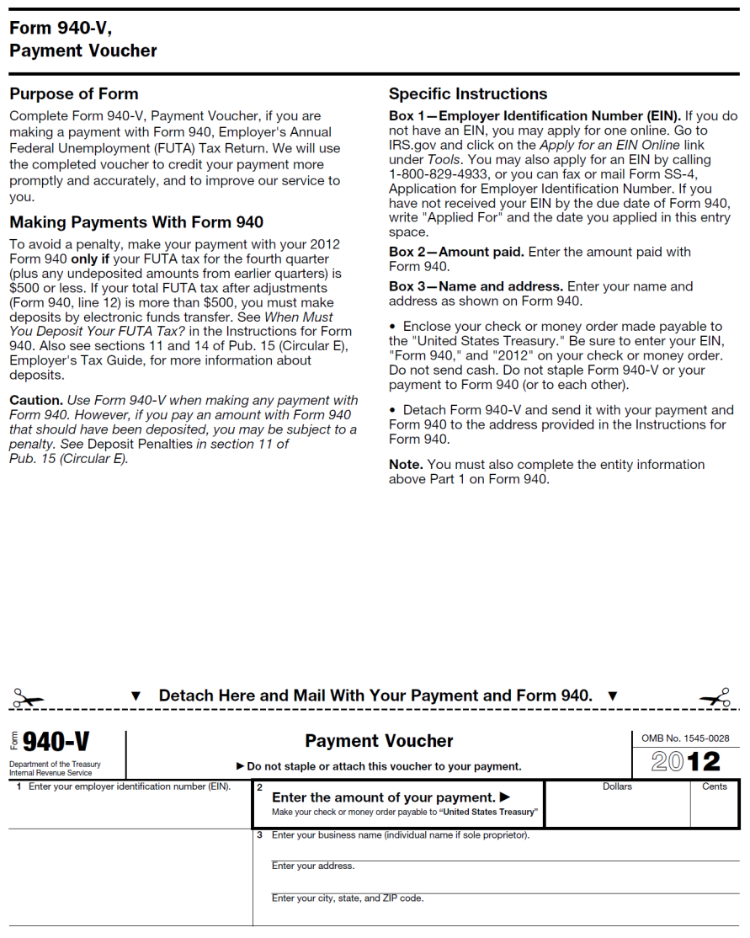
Irs form 940

Slide 18
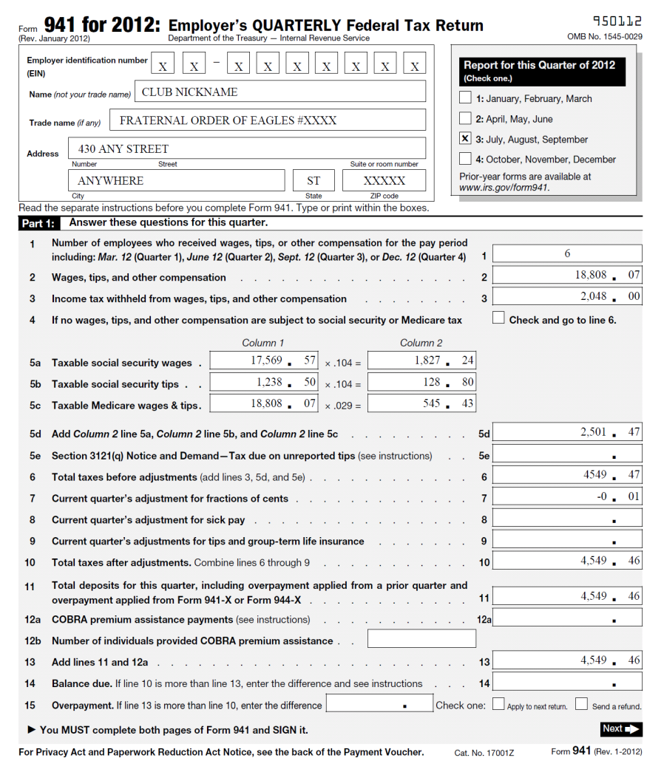
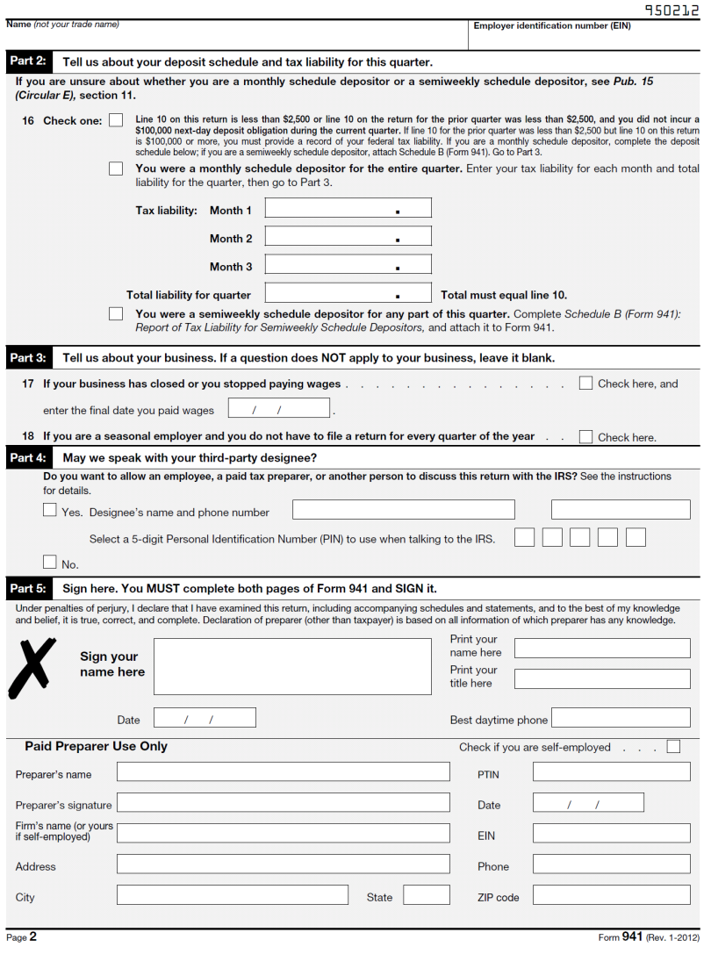
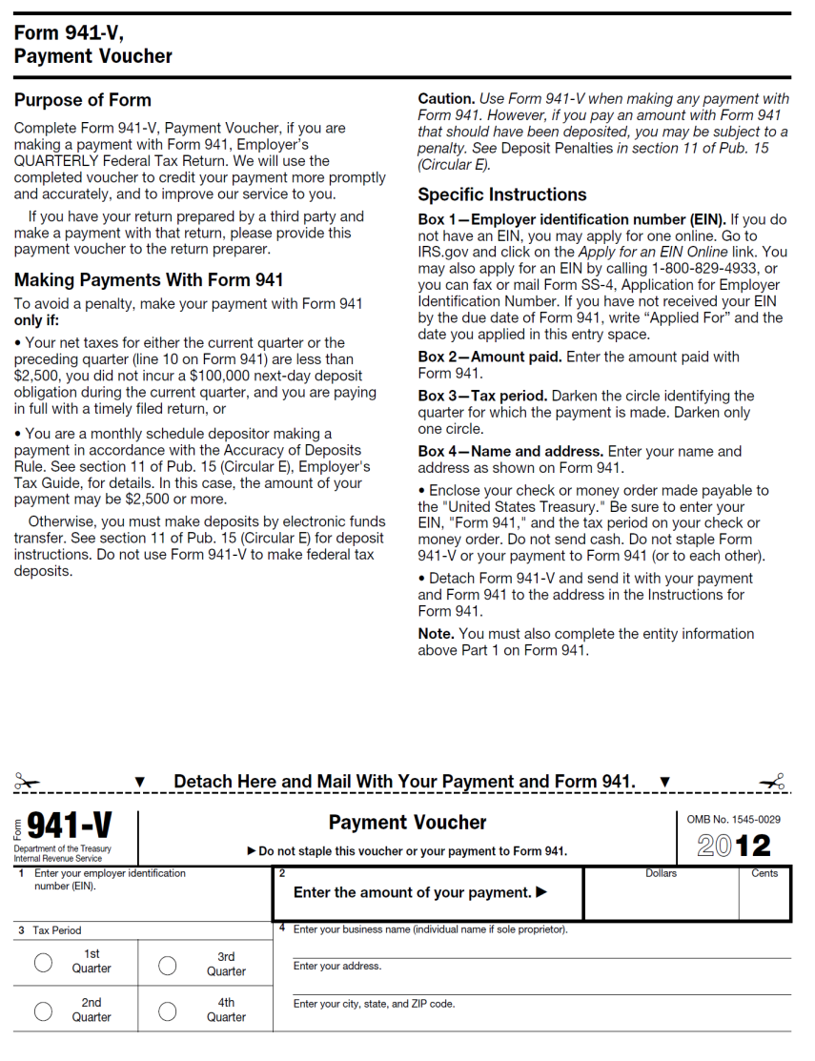
Irs form 941

Slide 19
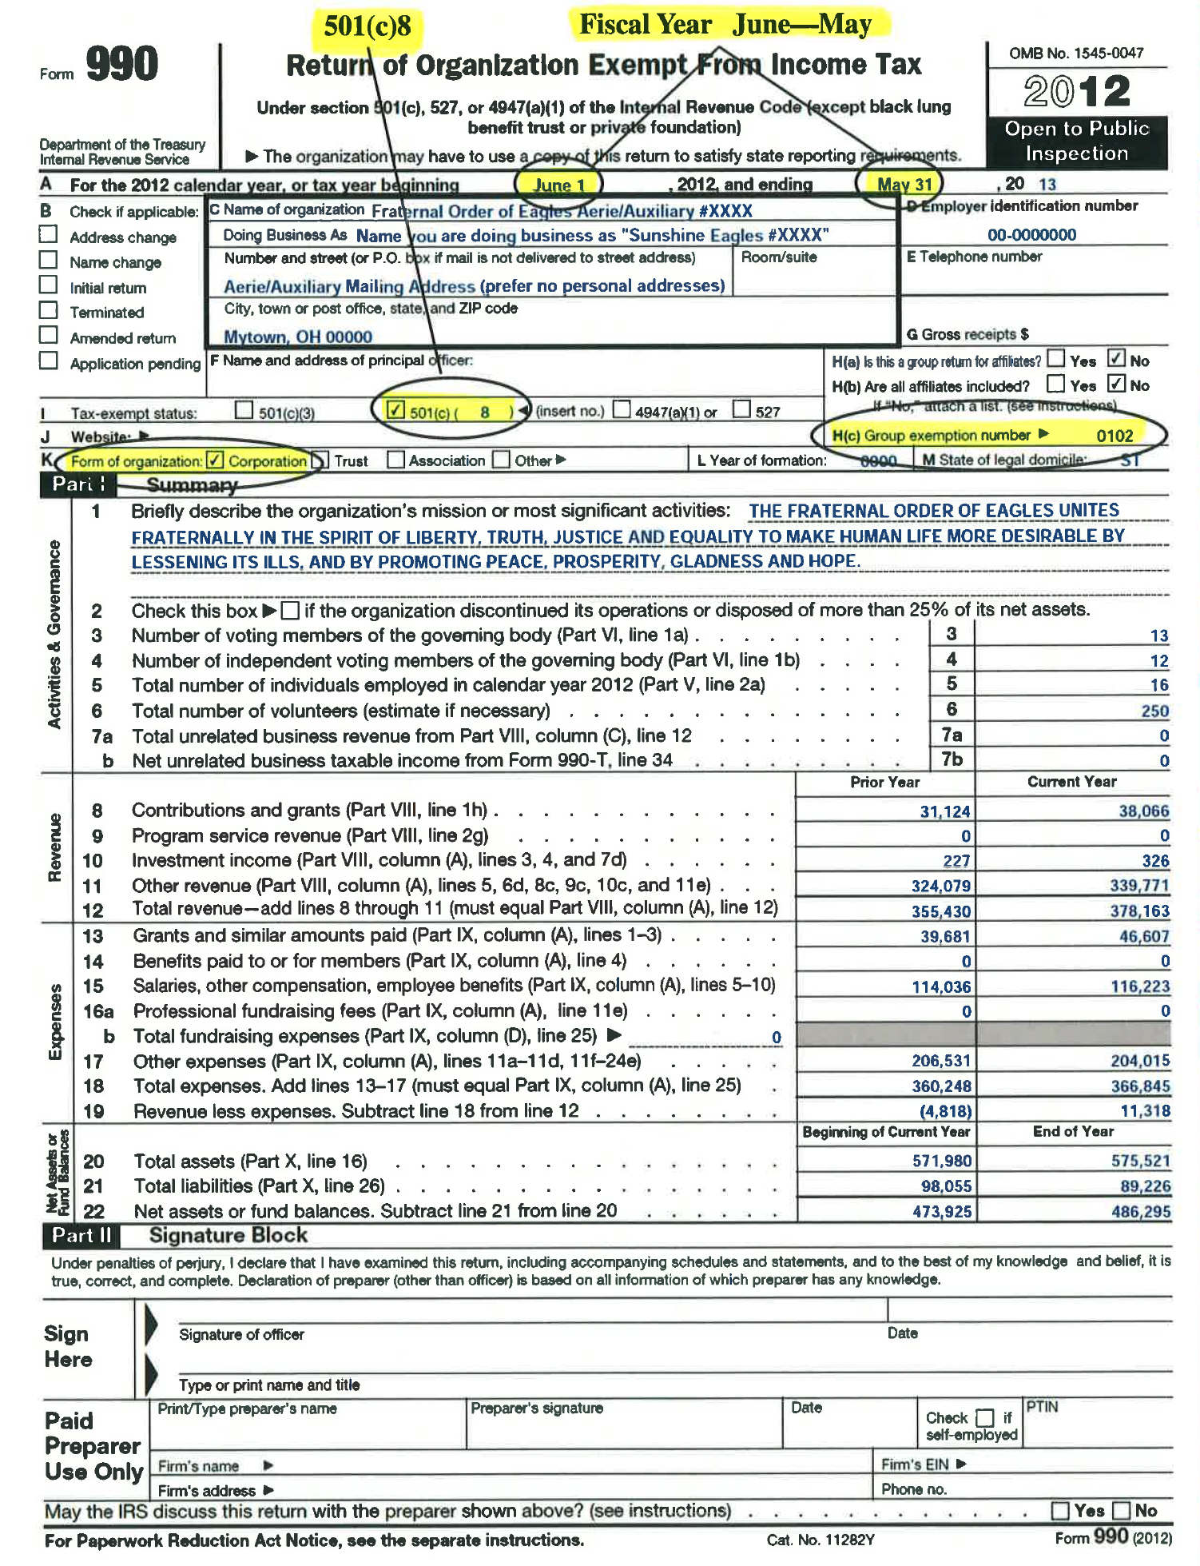
Irs form 990

Slide 20
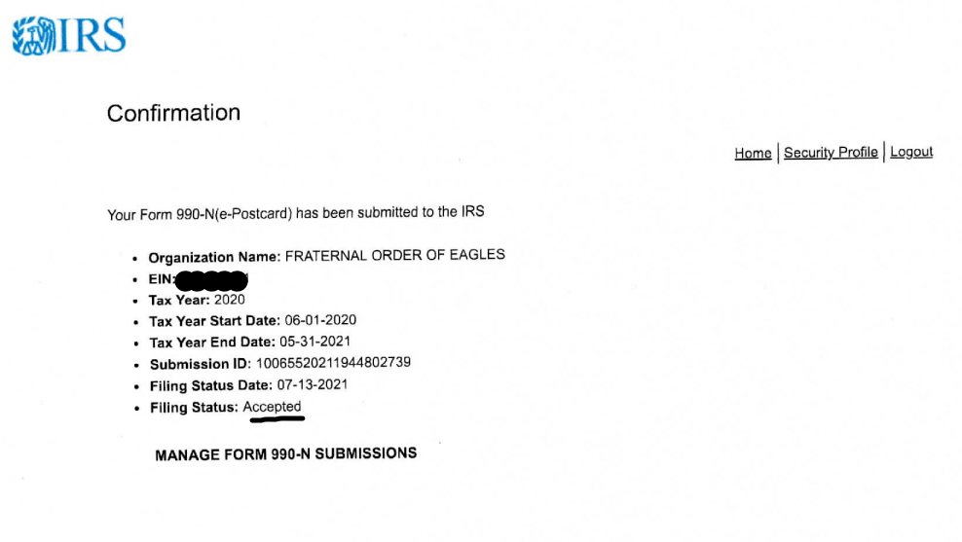
Irs 990-N (e-PostCard)

Slide 21
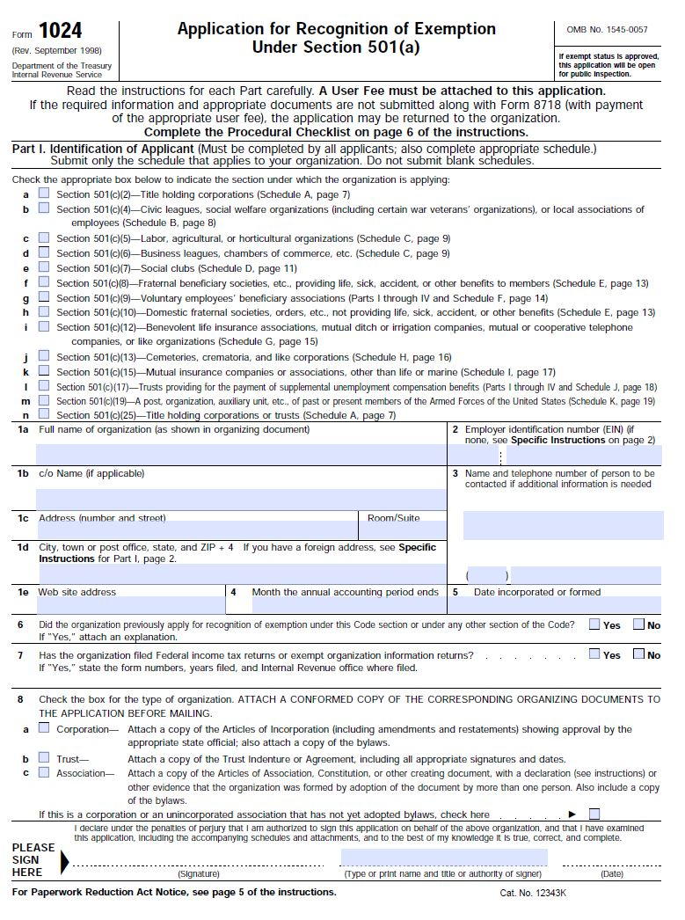
IRS FORM 1024

Slide 22
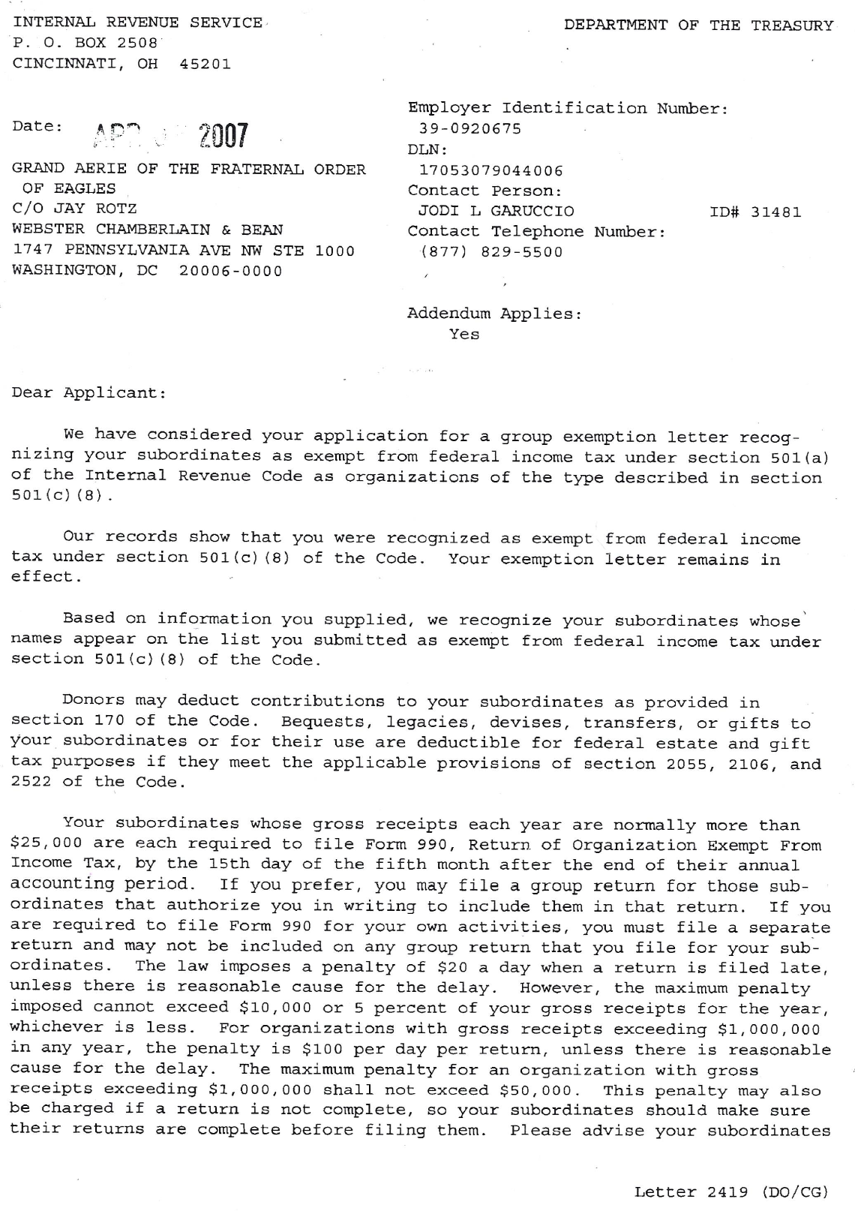
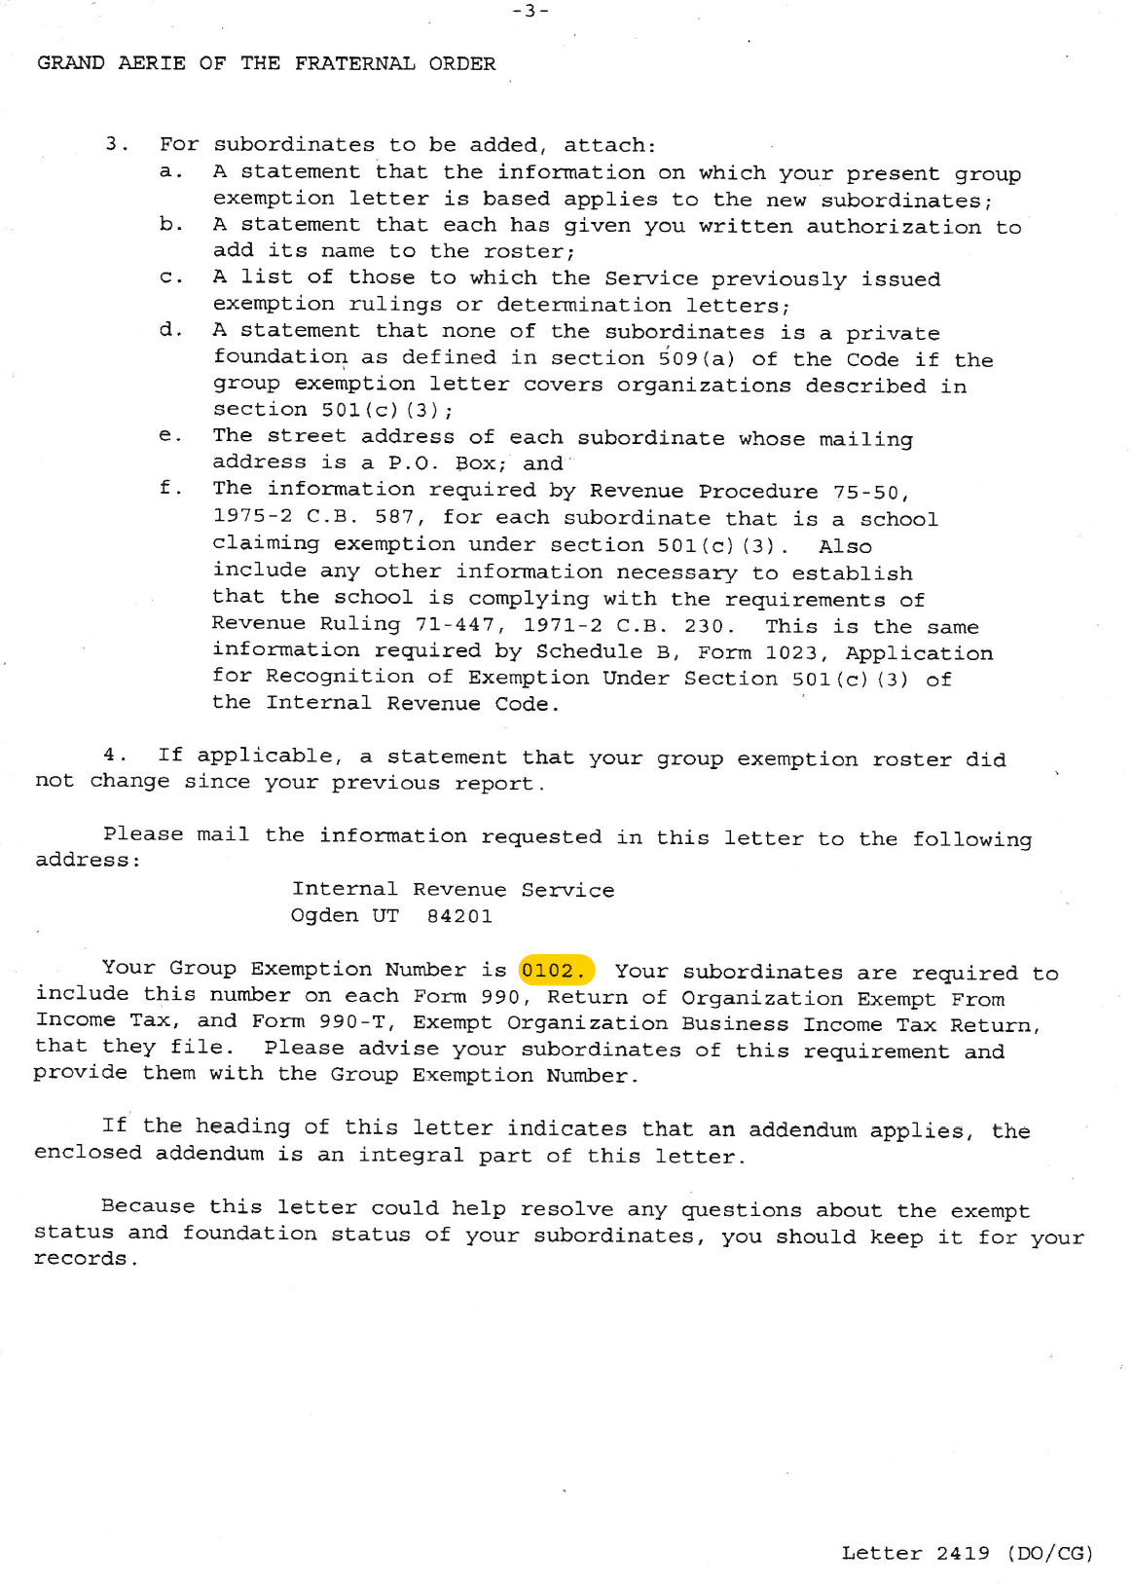

Slide 23
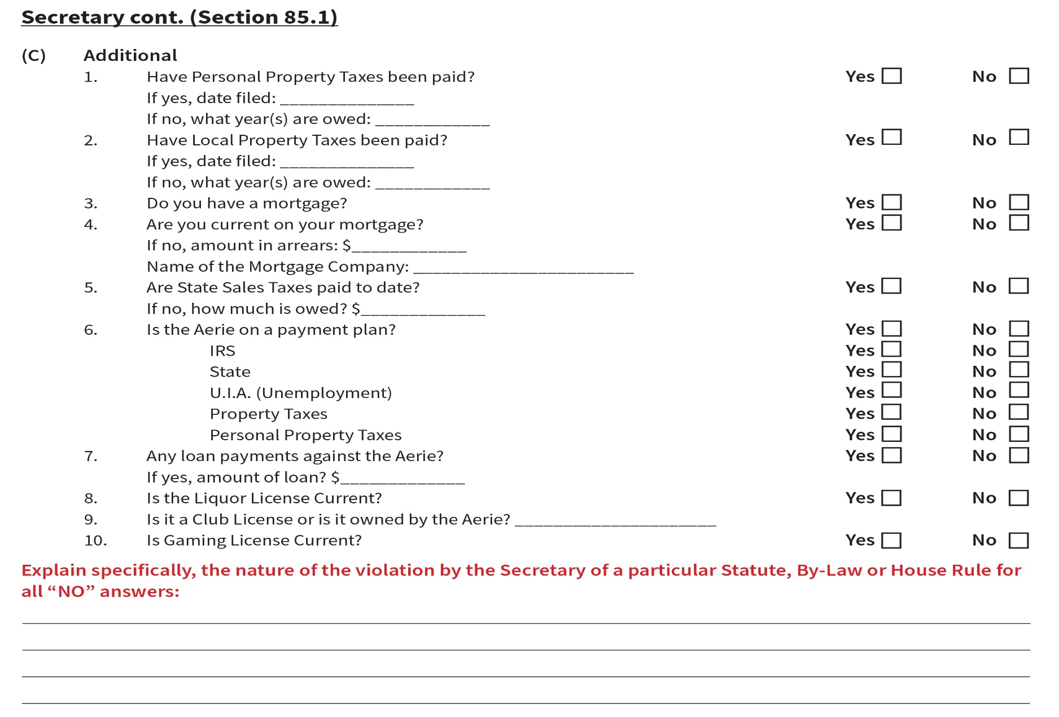
Secretary Continued

Slide 24
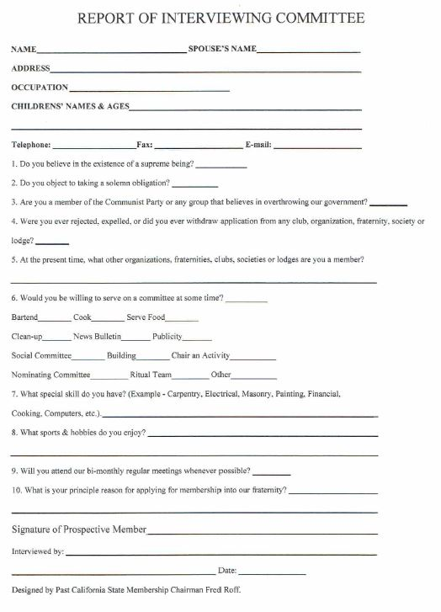

Slide 25
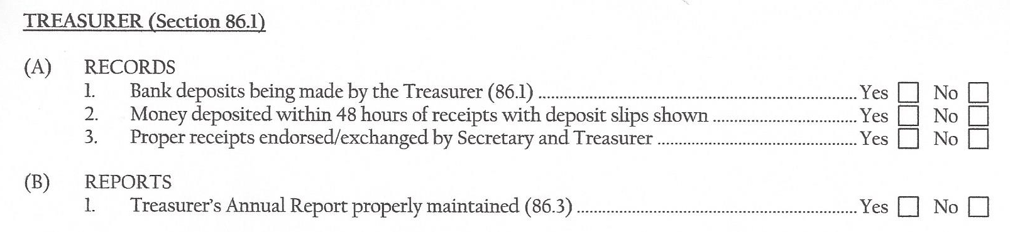
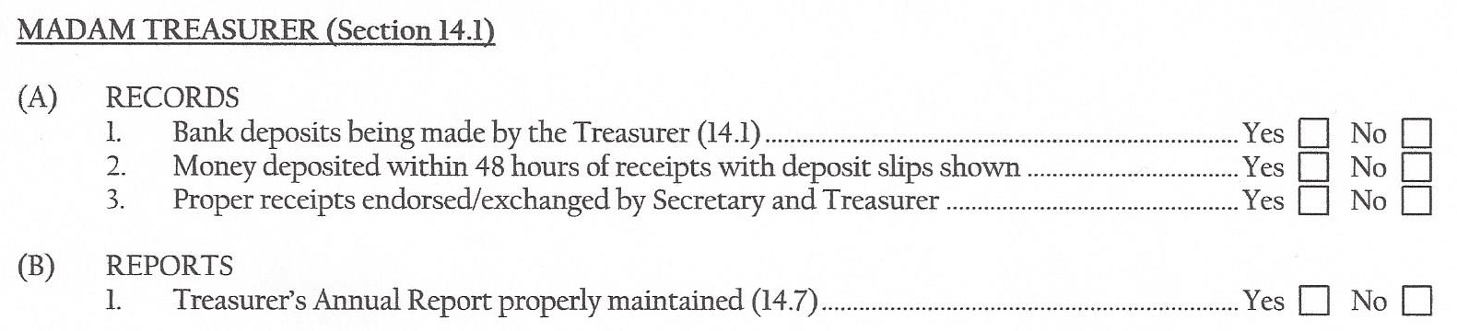
treasurer

Slide 26
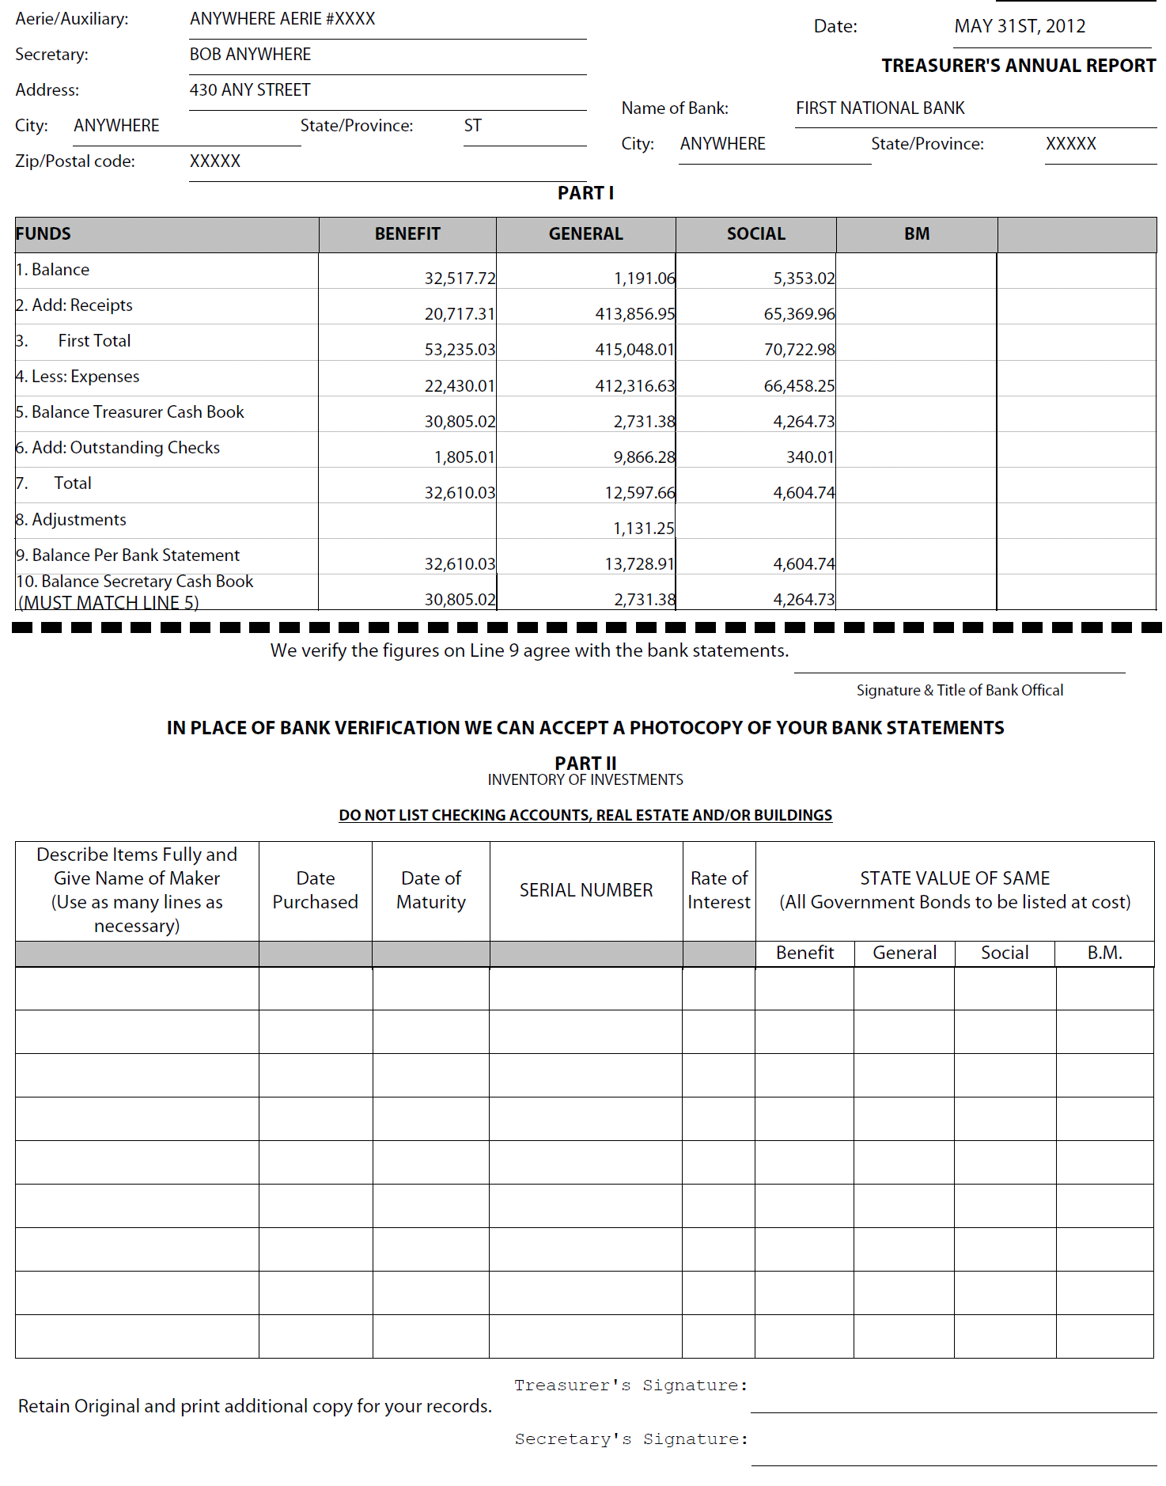
Annual
Treasurer’s
report

Slide 27
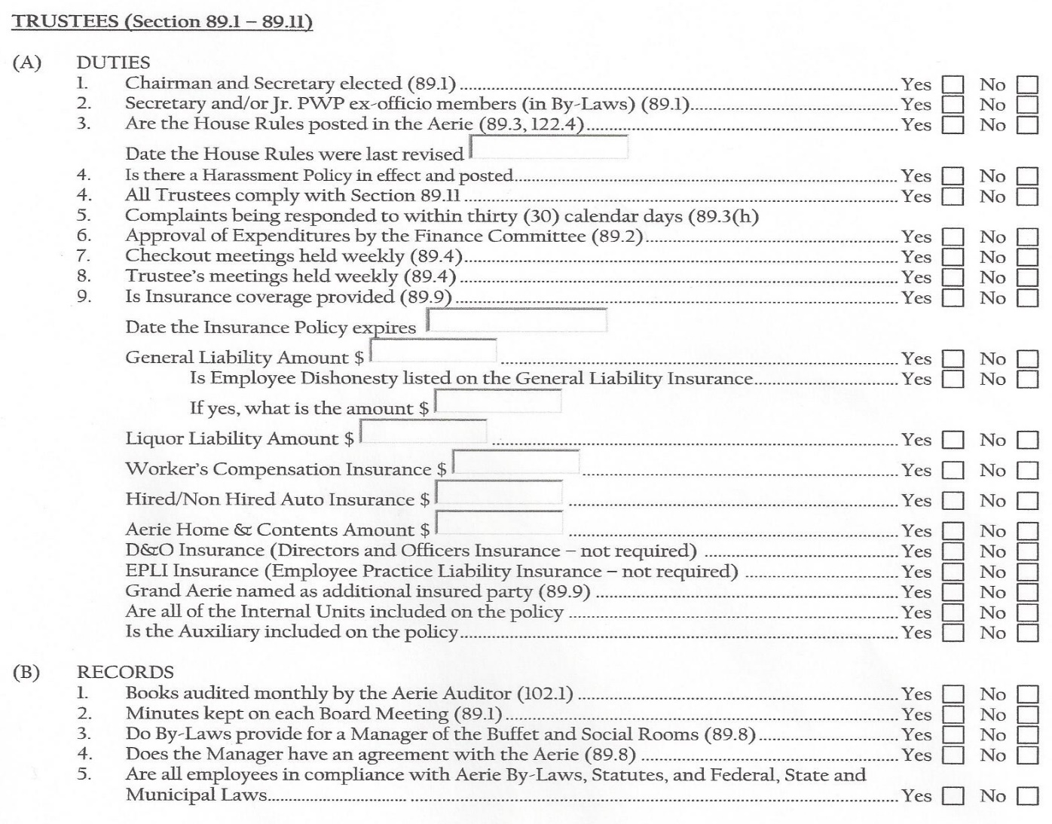
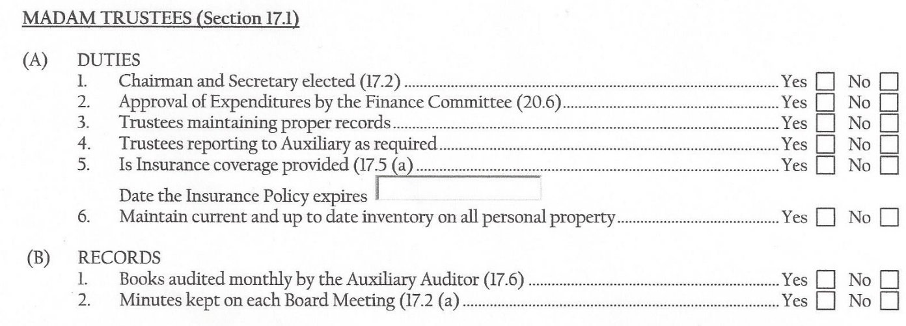
trustees

Slide 28
House Rules
Section 122.4, pg. 124 The House Rules of the Aerie are to be adopted or amended in the same manner as the adoption or an amendment to the Aerie By-Laws and in accordance with Section 122.1 and 122.2 of the Statutes. House Rules require Grand Secretary approval. No House Rule may be adopted by the Aerie which conflicts with the Constitution and Statutes of the Fraternal Order of Eagles. All House Rules must be updated and sent into the Grand Secretaries office to ensure that they are not in conflict with the Constitution and Statutes, due to this change, by May 31, 2018.

Slide 29
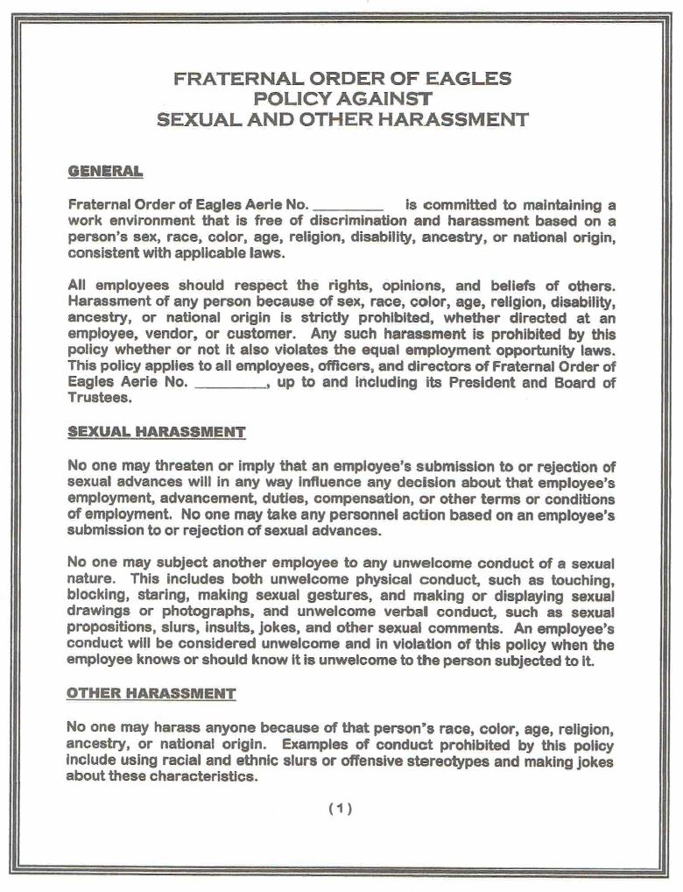
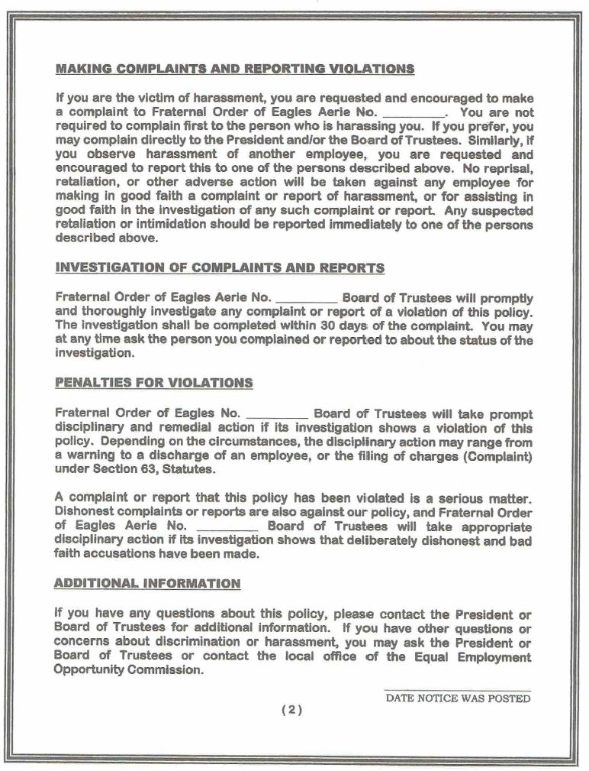

Slide 30
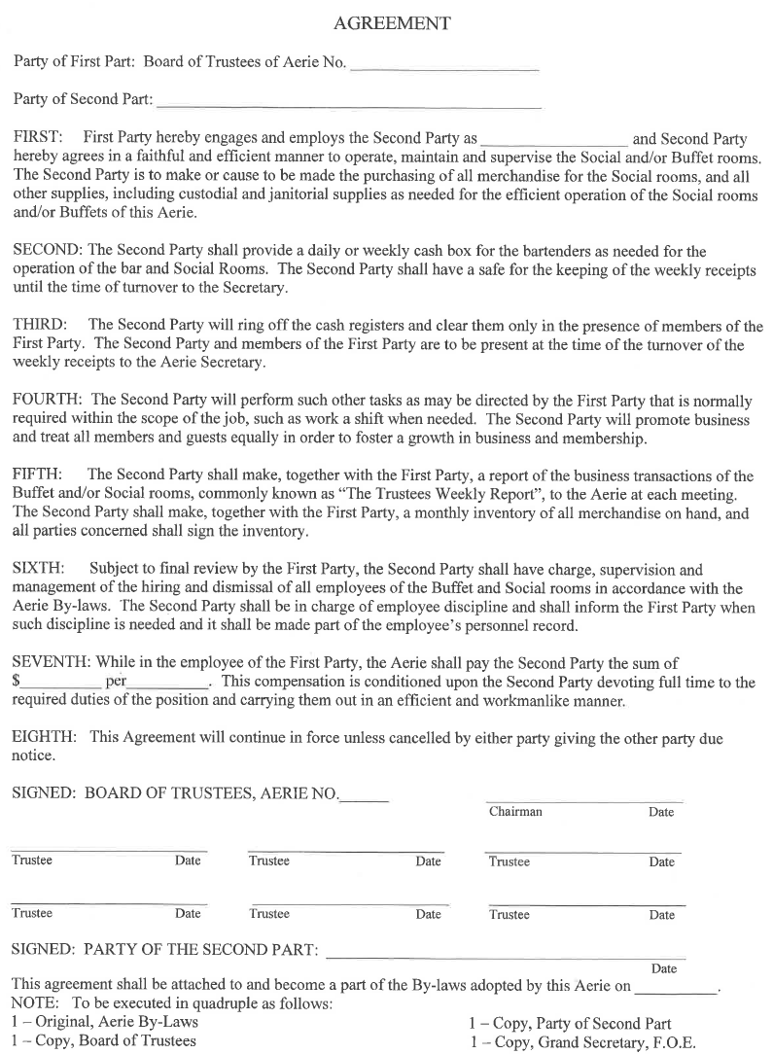

Slide 31
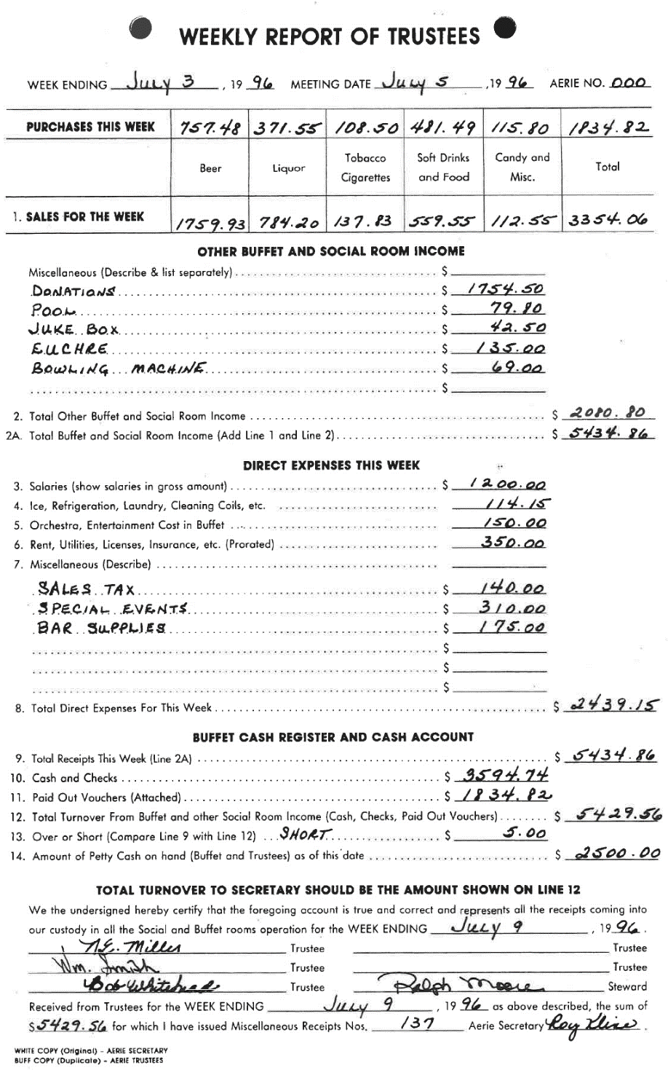

Slide 32
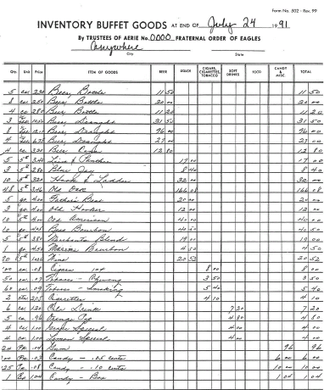

Slide 33
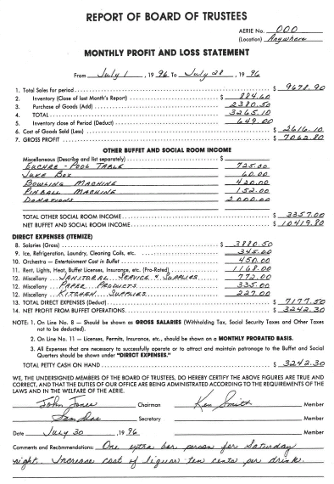

Slide 34
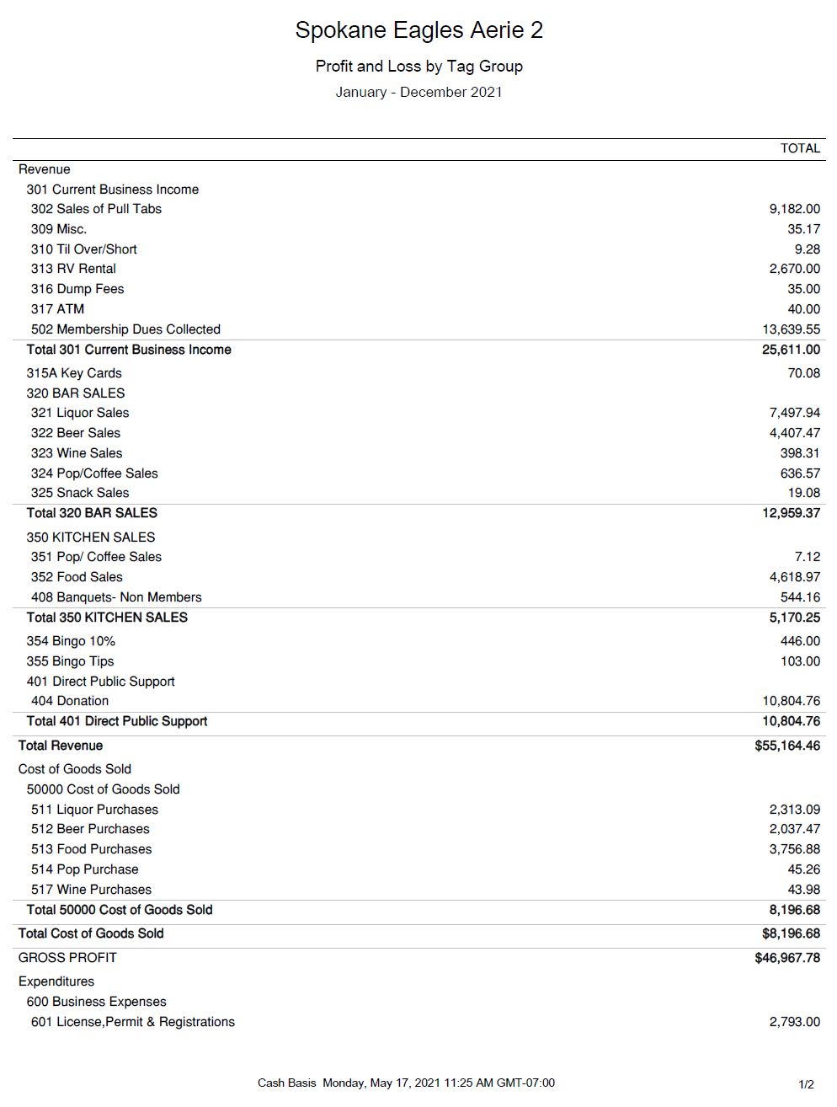

Slide 35
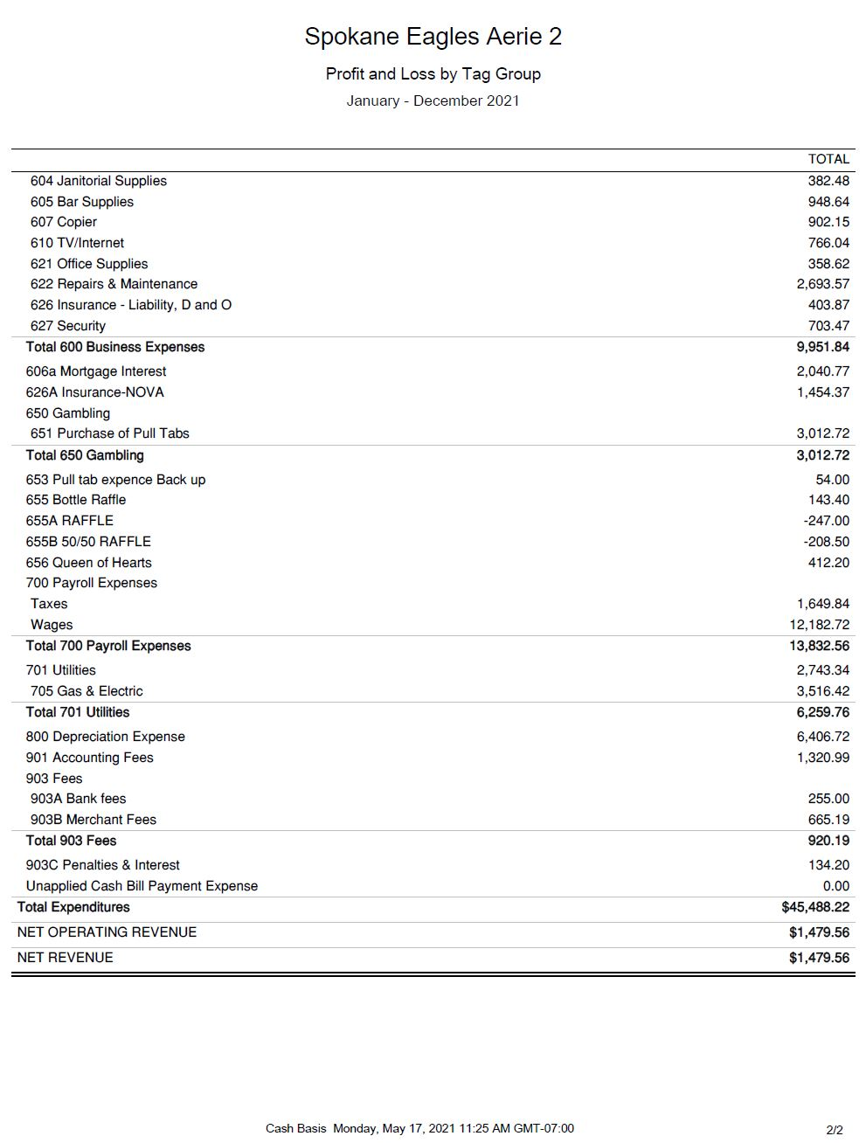

Slide 36
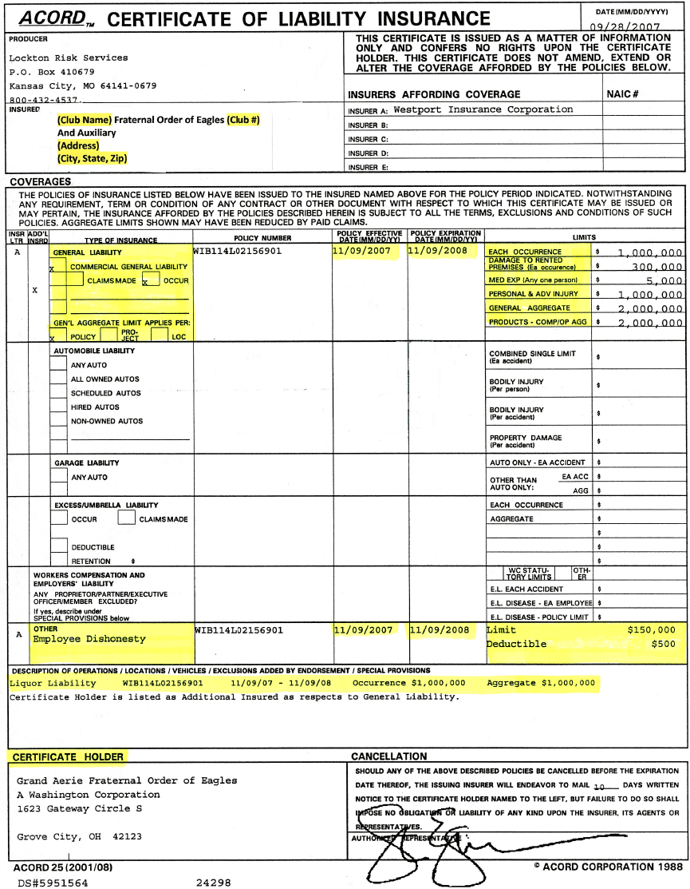
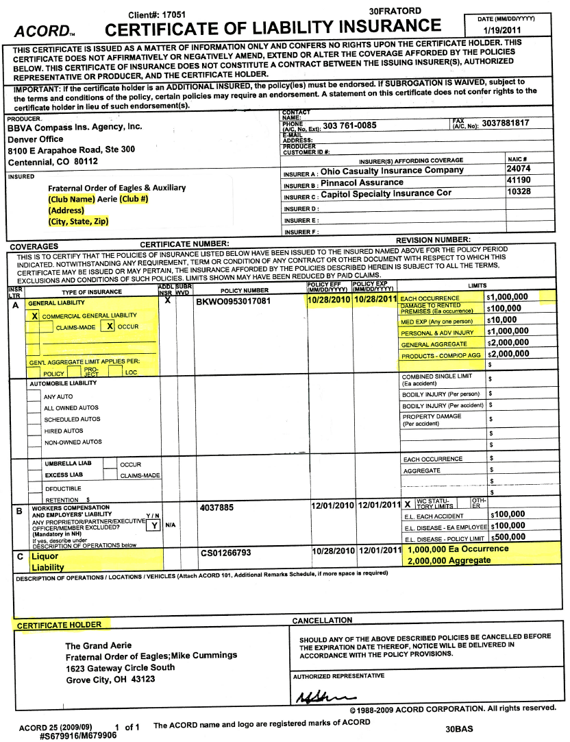

Slide 37
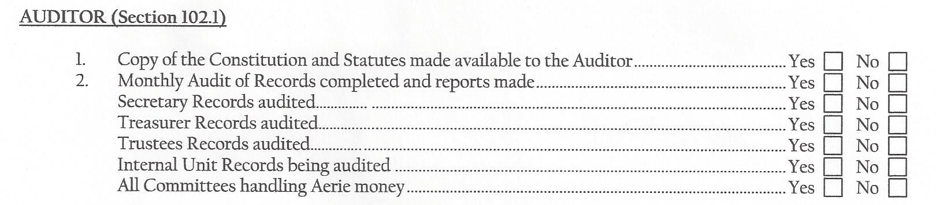
auditor

Slide 38
