Slide 1

2020-2021 SECRETARY TRAINING
Revised 8/17/20

Slide 2
SECRETARY
DUTIES
To keep a full and com­plete record of the proceedings of the Aerie in a book provided for that purpose by the Grand Aerie or if the records are kept electronically, they shall be printed and read at each meeting.
Responsible for opening all Aerie mail, except that addressed to other members or officers or the Auxiliary and to read to the Aerie all reports, bills and communications which may be presented.
To assist in the transaction of the business of the Aerie.
To write all communications.

Slide 3
SECRETARY
DUTIES CONT’D
To fill out all certificates and cards granted by the Aerie.
To keep and maintain at all times a full, complete and up-to-date roster of the membership, committees as required by MMS and officers of the Aerie, with the latest and up-to-date residence, email address and mailing address of each member and officer.
To notify the Grand Secretary forthwith of the expul­sion of any member and the cause thereof by forwarding the Trial Committee Decision Form.

Slide 4
SECRETARY
DUTIES CONT’D
Shall maintain such systems of records, books and accounts, and shall issue such notices and make such reports as the Grand Aerie shall prescribe.
Shall issue receipts for dues, fines and assessments using receipt forms which shall be prescribed by the Grand Aerie.
Shall, on a form or method to be provided by the Grand Secretary, on or before the fifth (5th) day of April, May and June, notify by mail, to his last known address or email address that has been supplied to the Secretary, each and every member of the Aerie who will be delinquent on the first (1st) day of June. (A copy of the delinquent list is to be provided for the Membership Security Committee and a copy posted in the Aerie Home after the last meeting in May)

Slide 5
SECRETARY
DUTIES CONT’D
When, and as directed so to do by the Aerie, the Secretary shall issue checks on the Treasurer against the proper funds of the Aerie.
Shall receive all moneys due the Aerie and shall enter such receipts upon his records to the credit of the respective funds of the Aerie.
In the event of the absence of the Treasurer, the Secretary shall deposit all collections in the proper Aerie account.

Slide 6
SECRETARY
DUTIES CONT’D
Shall demand, receive and receipt for all money and/or property received or coming into the possession or under the control of any committee, club, etc., except those authorized by the Aerie By-Laws to maintain their own accounts per Section 116.1, Statutes.
Shall receipt for all money received from ev­ery source on the receipt forms provided by the Grand Aerie.

Slide 7
SECRETARY
DUTIES CONT’D
Shall have the power to appoint assistants to efficiently carry on the duties of their office.
Must be bonded – Aerie pays for bond.
Paid by the Secretary or paid by the Aerie, if provided for in the By-Laws of the Aerie.
They are considered employees of the Aerie, IF compensated by the Aerie.
The assistant so appointed shall be under the supervision of the Aerie Secretary only.
Can be anyone the Secretary wishes to appoint, with the exception that they cannot be the spouse of a Trustee or Auditor.

Slide 8
SECRETARY
DUTIES CONT’D
Shall read at every meeting:
An itemized account of the receipts to and the disbursements from each fund of the Aerie since the last regular meeting.
At the last regular meeting of each month he shall read an itemized list of all, approved unpaid bills of the Aerie on hand, and the date such bills were due and payable.
Shall, on request, deliver all books, papers and property of the Aerie to the Auditor or to such officer or officers as the Grand Worthy President or the Grand Secretary shall direct.

Slide 9
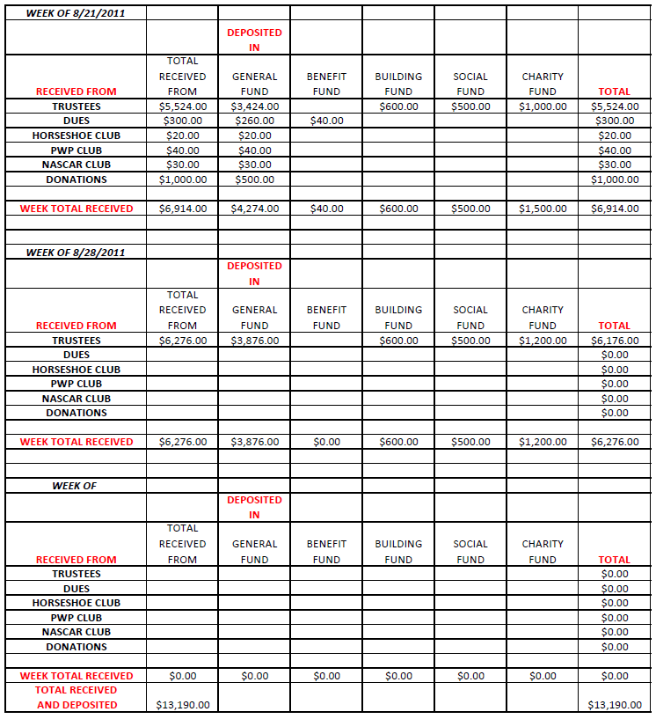

Slide 10
SECRETARY
DUTIES CONT’D
Shall receive compensation as prescribed by the By-Laws of the Aerie.
Such compensation shall be a per capita compensation.
Shall be based upon the number of members who are in good standing or who are no more than one (1) month in arrears.
Such compensation shall not be paid to the Secretary however, until all required reports have been completed and transmitted.

Slide 11
SECRETARY
MISCELLANEOUS RECEIPTS
Required for all monies received except for dues when you use the Temporary Receipt Form.
The receipts are in numerical order.
Original given to the person you received the money from.

Slide 12
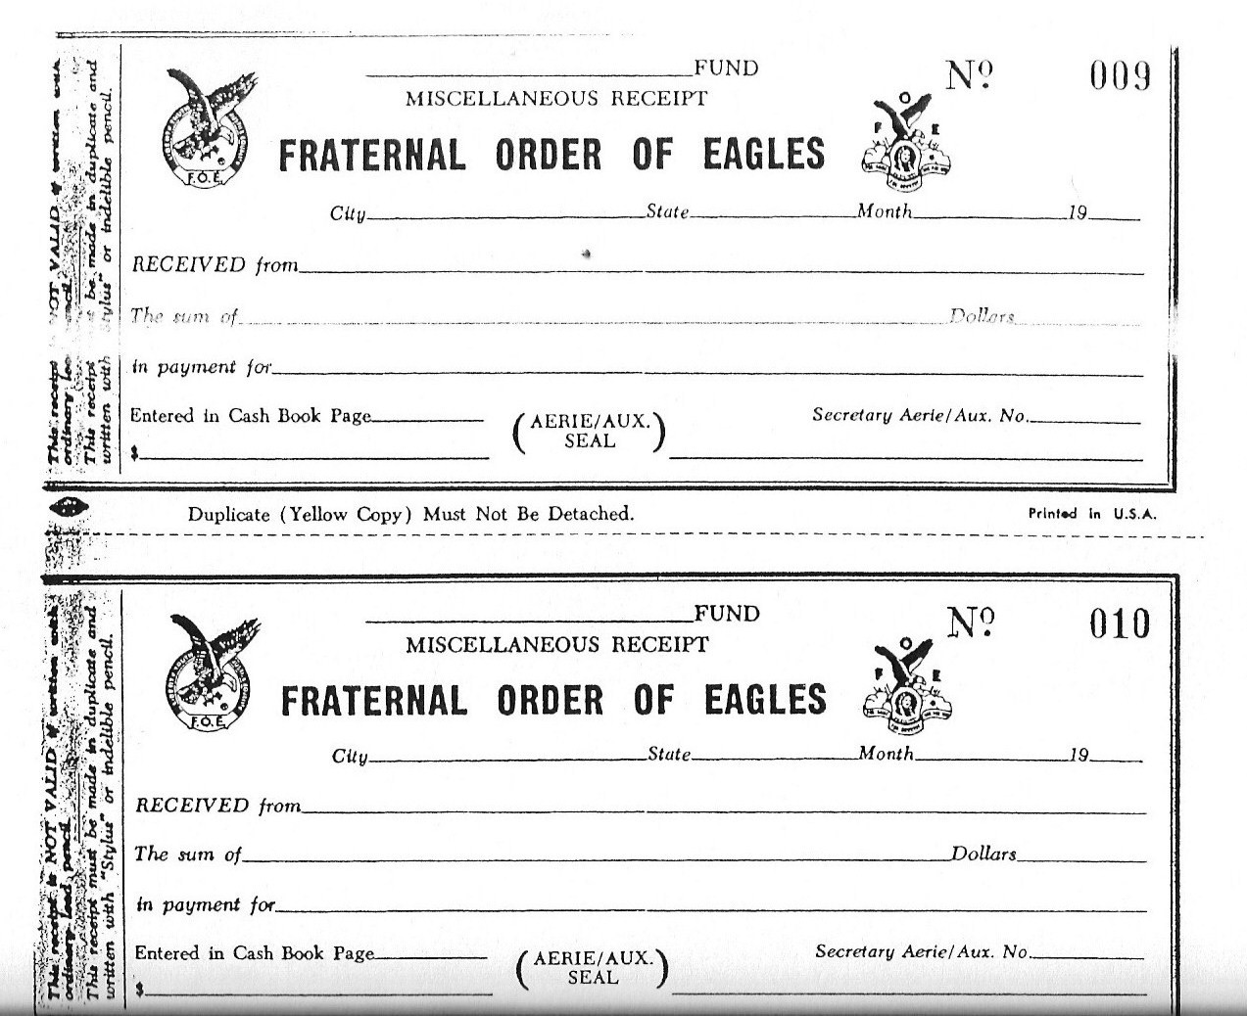

Slide 13
SECRETARY
DISTRIBUTION OF RECEIPT FORMS
Can be obtained from the Grand Aerie Supply Department.
A valuable tool for making the turnover of money to the Treasurer and making your report to the membership.
Not to be used as a receipt from the Treasurer.
Indicates how your deposits are made to the different funds.
Perforated for tearing off part for the Treasurer.

Slide 14
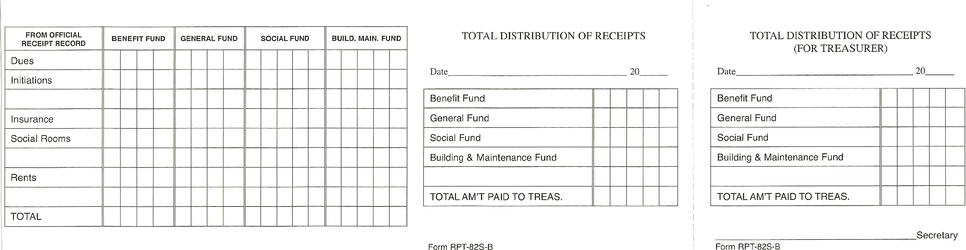

Slide 15
SECRETARY
SECRETARY’S MINUTE BOOK
Secretary’s must keep a complete and full record of the proceedings of the Aerie.
DO NOT attempt to write out completed minutes of the meeting during the meeting. Take notes and/or record the meeting.
(A Local Aerie may, by a proper By-Law, prohibit the tape recording of any of its meetings other than that done by the Secretary or designated recorder for those proceedings or meetings. Opinion No. 703.)

Slide 16
SECRETARY
SECRETARY’S MINUTE BOOK CONT’D
Create an outline of standard minutes required so you have it available for each meeting:
Roll Call of Officers
Reading of the Minutes of the previous meeting
Treasurer’s Report
Old Business
New Business
Reading of new applicants
Reading of re-enrolled applicants
Etc.

Slide 17
SECRETARY
SECRETARY’S MINUTE BOOK CONT’D
Minutes can be typed on stationary and glued to the Secretary’s minute book pages or maintained in a three ring binder.
It is VERY important to include the following in the Minutes book:
Visiting Members
Officers absent and if they were excused
Applications received for New/Reenrolls/Dual/Transfer
Applications voted upon
Applications that were rejected
Applicants who were initiated

Slide 18
SECRETARY
SECRETARY’S MINUTE BOOK CONT’D
Members on the sick list
Short resume on all communications received and read
Action taken on reports of all committees
Excuses of absentees
Old Business – Motions, etc.
New Business – Motions, etc.
Good of the Order

Slide 19
SECRETARY
SECRETARY’S MINUTE BOOK CONT’D
Part two of the minute books is a record of all Special Committees.
Part three is for a record of all Standing Committees.
Part four is for recording attendance of all Officers.
Fraternal and Fiscal Year – June 1st to May 31st.

Slide 20
SECRETARY
SECRETARY CASH BOOK
There are four authorized funds:
General Fund – Section 112.1 Statutes
Social Fund – Section 113.1 Statutes
Benefit Fund – Section 111.1 Statutes
Building Fund – Section 114.1 Statutes
The Secretary Cash Book is available through the Grand Aerie Supply Department or you may use the Quicken Quickbooks or similar program.

Slide 21
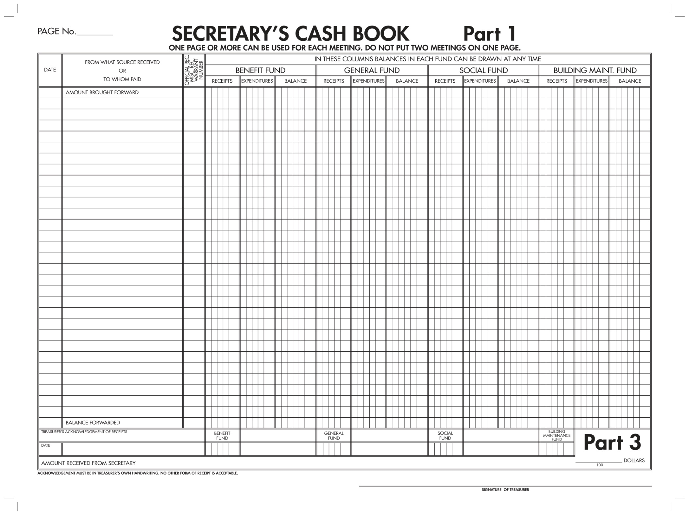

Slide 22
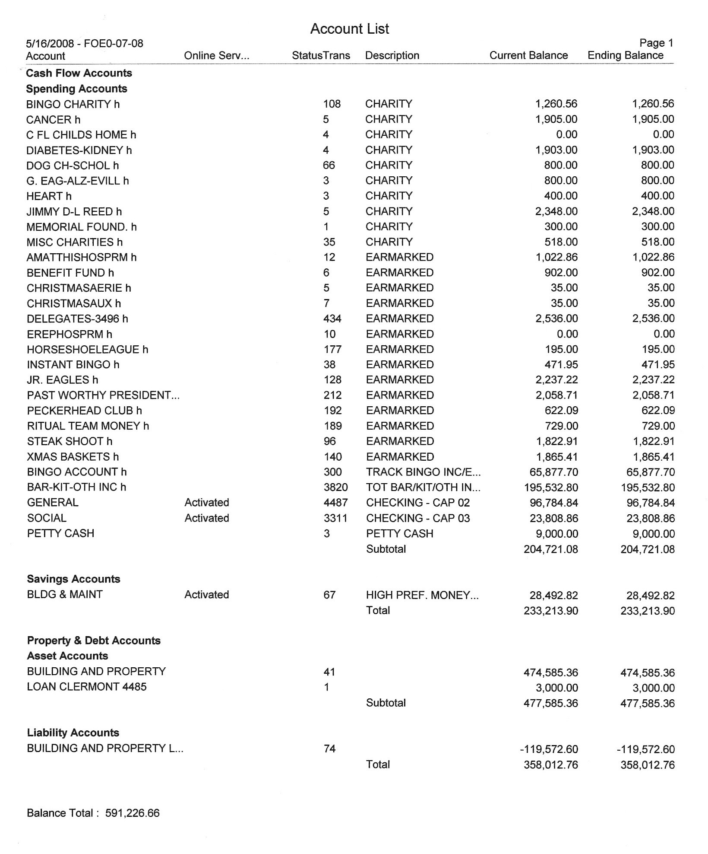

Slide 23
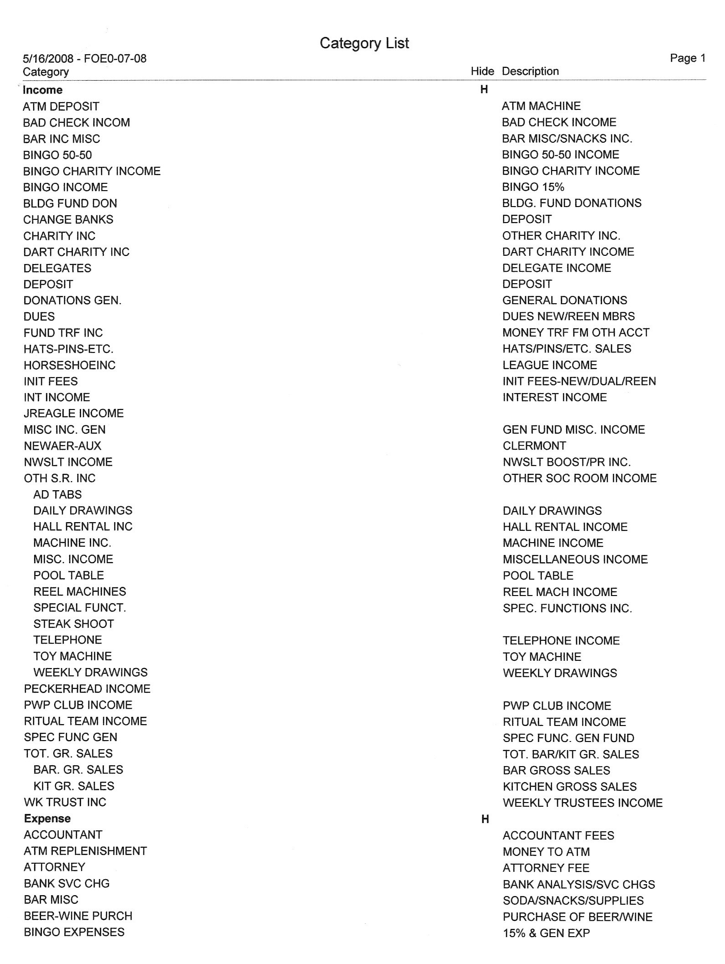

Slide 24
SECRETARY
SOCIAL SECURITY/WITHOLDING TAXES
Trust Funds – Deposited in to the Benefit Fund.
Paid at the end of each quarter. (July 21st – October 31st, January 31st, April 30th)
Large payrolls require deposits of withholding taxes to a local bank depository. Be sure to check with the IRS.
It is strongly recommended that Aeries hire an accountant because Secretary turnover can be an issue when quarterly reports are due.
Record as a liability on the Semi-Annual Report.

Slide 25
SECRETARY
REPORTS AND NOTIFICATIONS
Secretary’s Annual Report – Per Capita Tax
Each Local Aerie shall pay to the Grand Aerie an annual Per Capita Tax of twelve ($12.00).
Invoice will appear on the Membership Management System home page
Paid from the Benefit Fund
Due and payable by June 30th
State Per Capita Tax may be billed annually or semi-annually depending on the State

Slide 28
SECRETARY
REPORTS AND NOTIFICATIONS
Financial Report
In accordance with the Blue Hardbound Ritual Book – Pages 21 – 23
At each meeting, the Secretary is required to report on the finances of the Aerie.
An excel spreadsheet can be created to track finances
An Accounting Statement is available in MMS that will provide balances for Per Capita Tax, Membership Application Fees, Supplies and Dues Reminders.

Slide 30
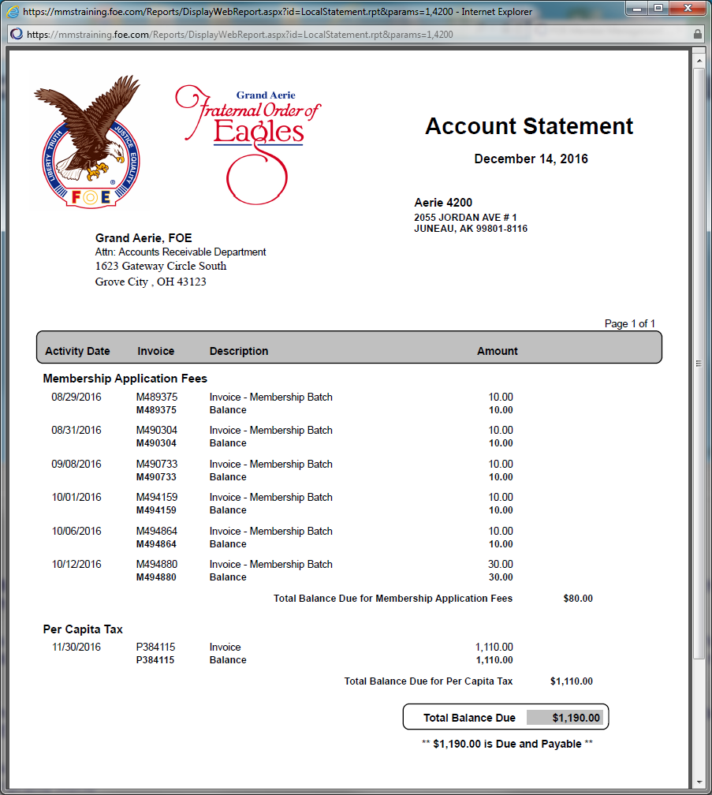

Slide 31
SECRETARY
REPORTS AND NOTIFICATIONS CON’TD
Delinquent Members and Dues Reminders
Members are considered delinquent as of June 1st.
A Delinquent Member Report is available in the Membership Management System.
Dues Reminders will be sent by the Grand Aerie.
Report of Applications
Applications for membership shall be entered into the MMS System before the next regularly scheduled meeting.
An Initiation/Re-enrollment Report is available in the MMS System.

Slide 33
SECRETARY
REPORTS AND NOTIFICATIONS CON’TD
Notice of Election to Membership
Must appear for interview within 60 day of notice
Has a period of six (6) months to appear for Initiation
If they do not appear, they forfeit all fees paid.
Application for membership is cancelled.
Report of Officers to the Grand Aerie
The Secretary is required to enter all Officers and required Committees in the Membership Management System.

Slide 34
SECRETARY
REPORTS AND NOTIFICATIONS CON’TD
Sales Taxes – Monthly
State is a percentage of Gross Sales. Some counties add to the State Tax for County revenue.
State and other Sales Tax is filed and paid online.
Determine your Gross Sales from Trustees Monthly Report.

Slide 35
Checklist of Financial and Reporting Responsibilities for Aeries and Auxiliaries
JUNE
1st - Per Capita Tax Due to Grand and State/Province
JULY
1st - Per Capita Tax LATE
31st - IRS Payroll Tax Form 941 Due for June 30
31st - Qtr. Ends
OCTOBER
15th - IRS Form 990 Due
15th - IRS Form 990 Extension Due if unable to file
15th - Treasurer’s Report and 990 Copy Due to Grand Aerie
15th - Auditor Report due for all postcard filers and Canada
31st - IRS Payroll Tax Form 941 Due for Sept 30
31st - Qtr. Ends
JANUARY
31st - IRS Payroll Tax Form 941 Due for September 30 Qtr. end
31st - IRS Payroll Tax Form 941 Due for December 31 Qtr. end
31st - IRS Payroll Tax Form 940 Due for December 31 year end
JANUARY
31st - Forms 1099 and W2 due to recipient
28th - Form 1096 (1099 Summary Report) due to IRS
APRIL
15th - IRS Form 990 due – if extension was filed
30th - IRS Payroll tax form 941 due for March 31 Qtr. end
MAY
31st - Contributions must be received in Grand Aerie for fiscal year
31st - Credit on Convention Reports
31st - Grand Aerie Books Closed
31st - Last POST Date
Assistance: IRS – www.irs.gov website, choose Non-Profit and Charity tab or call 1-877-829-5500
Grand Aerie – accounting@foe.com or charities@foe.com

Slide 36
REPORTING WHERE DUE DATE IS DEPENDENT UPON STATE LAW REQUIREMENTS OR RENEWAL DATES:
Monthly:
- State Sales Tax Reports
- Gaming Reporting
Annually:
- Insurance Documents with Declaration Pages naming Grand Aerie as additionally insured
- Affiliation Agreement
State Registration or Incorporation Renewal (usually has a filing fee).

Slide 37
OTHER TIMEFRAMES OF NOTE
CONTRIBUTIONS:
The Grand Aerie Accounting Department closes the fiscal year on MAY 31. There are no exceptions to this date and late receipts cannot be accommodated.
If you wish to ensure credit for your charity work during the annual convention, all contributions must reach the Grand Aerie PRIOR to May 31. If May 31 falls on a weekend, please adjust mailing dates accordingly to the prior Friday.
GRANTS:
If you are requesting a grant to be presented to a recipient or to be presented at a convention, please request your grant at a minimum of one month prior to date needed.
The grant is processed through your State Secretary’s office, the International Charity Director (if over $5,000), through the Grand Aerie Board of Directors (if over $10,000) and then can be processed by the GA Accounting Department.
REGIONAL GRANTS:
The hosting State requests the Grant for $5,000 and must be submitted one month in advance of the Regional Conference

Slide 38
MEMBERSHIP MANAGEMENT SYSTEM (MMS)
The Membership Management System is used to assist the Local Secretaries with their day to day duties. With MMS, the Secretary has the ability to maintain membership records, print dues receipts, run specific reports pertaining to membership, finances, etc., print Accounting statements, check their status with the Compliance Department, create postcards, send mass e-mails to their membership, update the Officer List and much more.
The link to access the Membership Management System (MMS) is https://mms.foe.com
In order to access the system, you will need to have a username and password which can be obtained by sending an e-mail to mmshelp@foe.com.

Slide 39
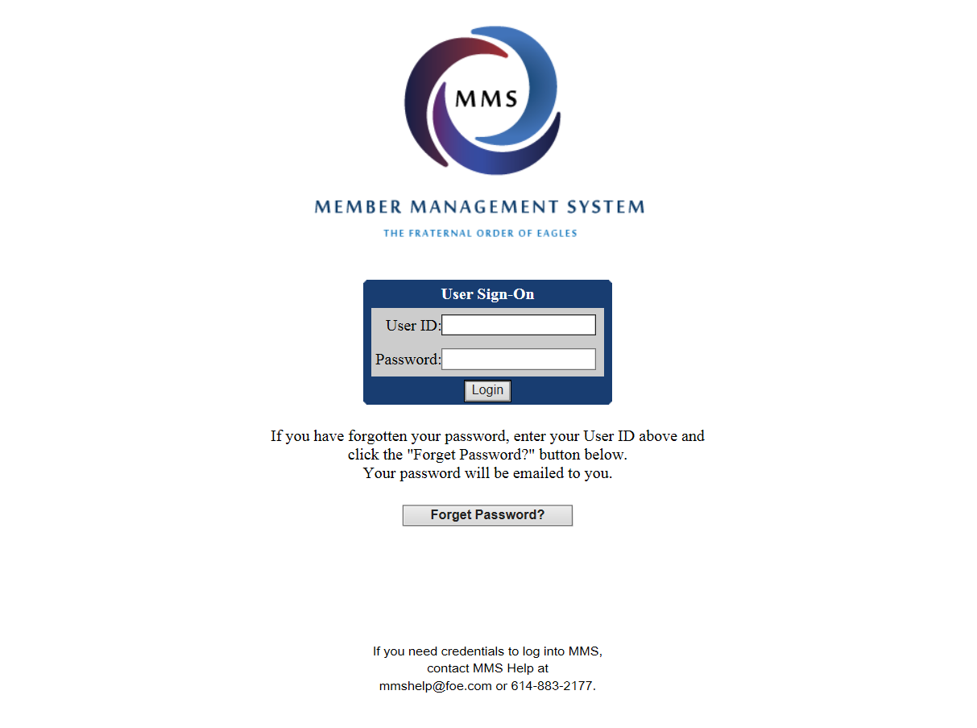

Slide 40
MEMBERSHIP & APPLICATIONS
New and Re-enrolled Membership Applications
Every application for membership shall be recommended by two (2) members in good standing.
Initiation/Re-enrollment Fee is to be determined by the By-Laws.
$10.00 of the Application Fee is to be sent to the Grand Aerie.
The Grand Aerie will keep $6.00. $4.00 will be forwarded to the State.
Dues shall be determined by the By-Laws but can be no less than the amount equal to the Grand Aerie Per Capita Tax plus State Per Capita Tax and any fees and/or assessments.
All applicants must be interviewed, voted upon and Initiated with the exception of re-enrollments as they are not required to go through the Initiation process again.

Slide 43
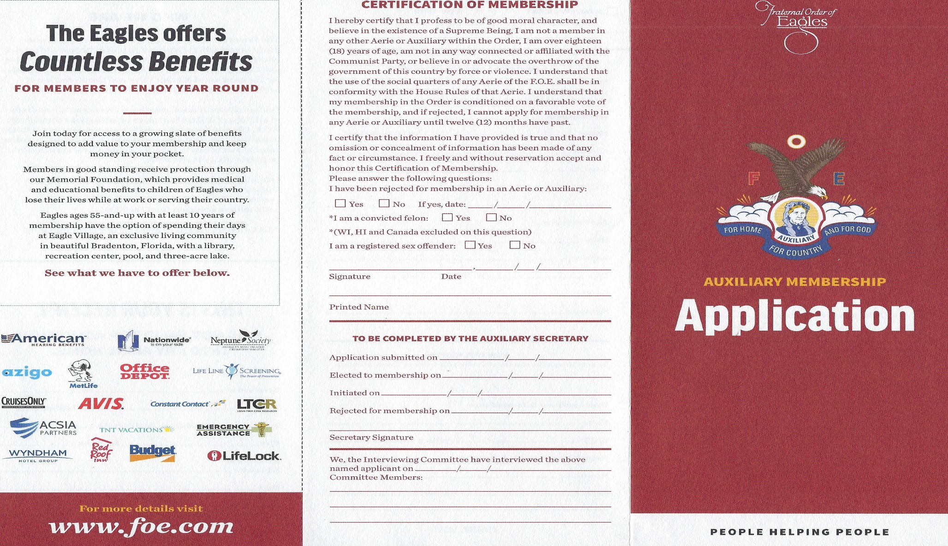

Slide 44
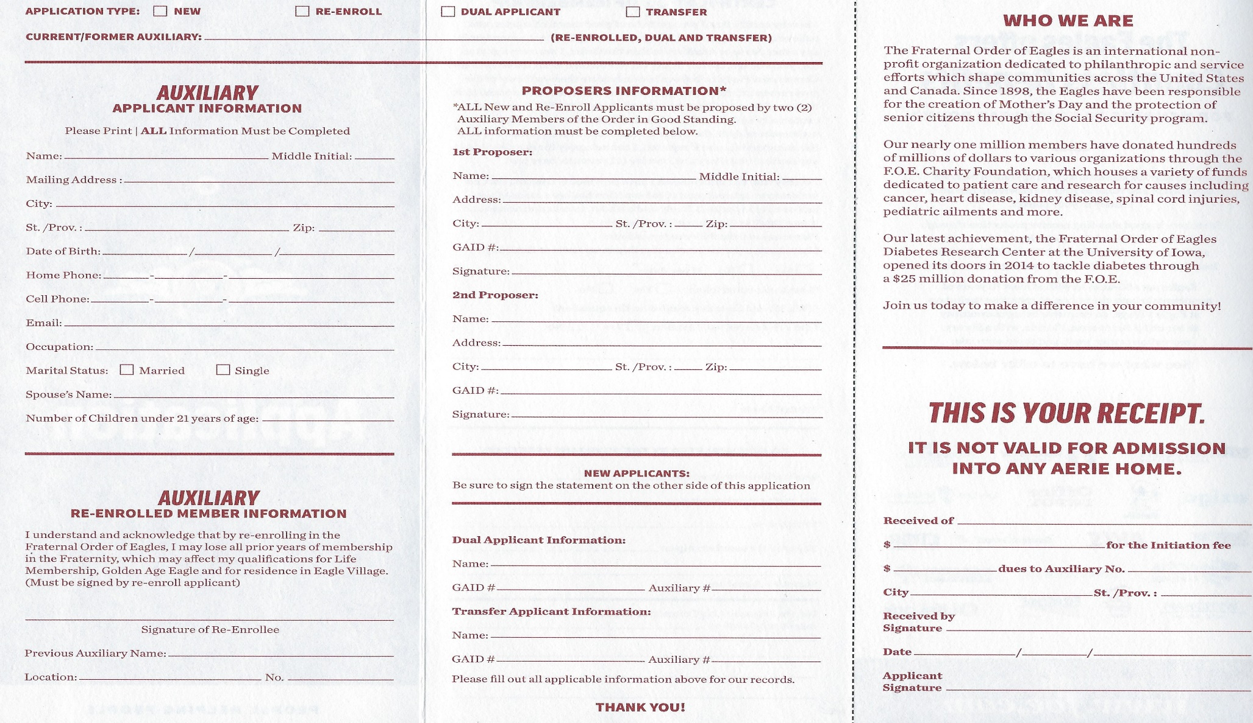

Slide 45
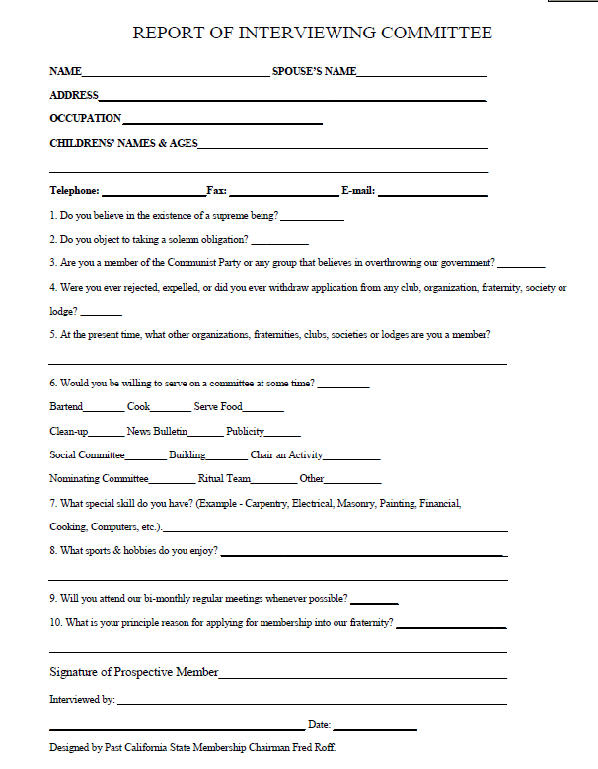

Slide 46
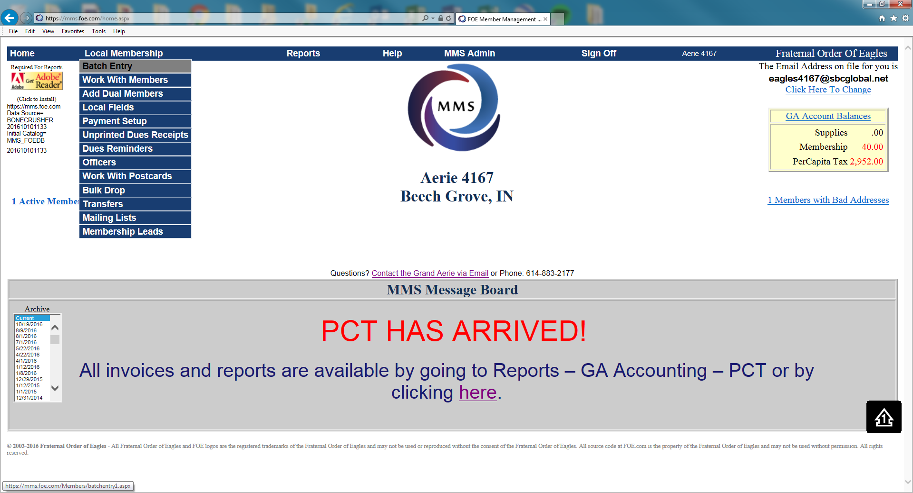

Slide 47
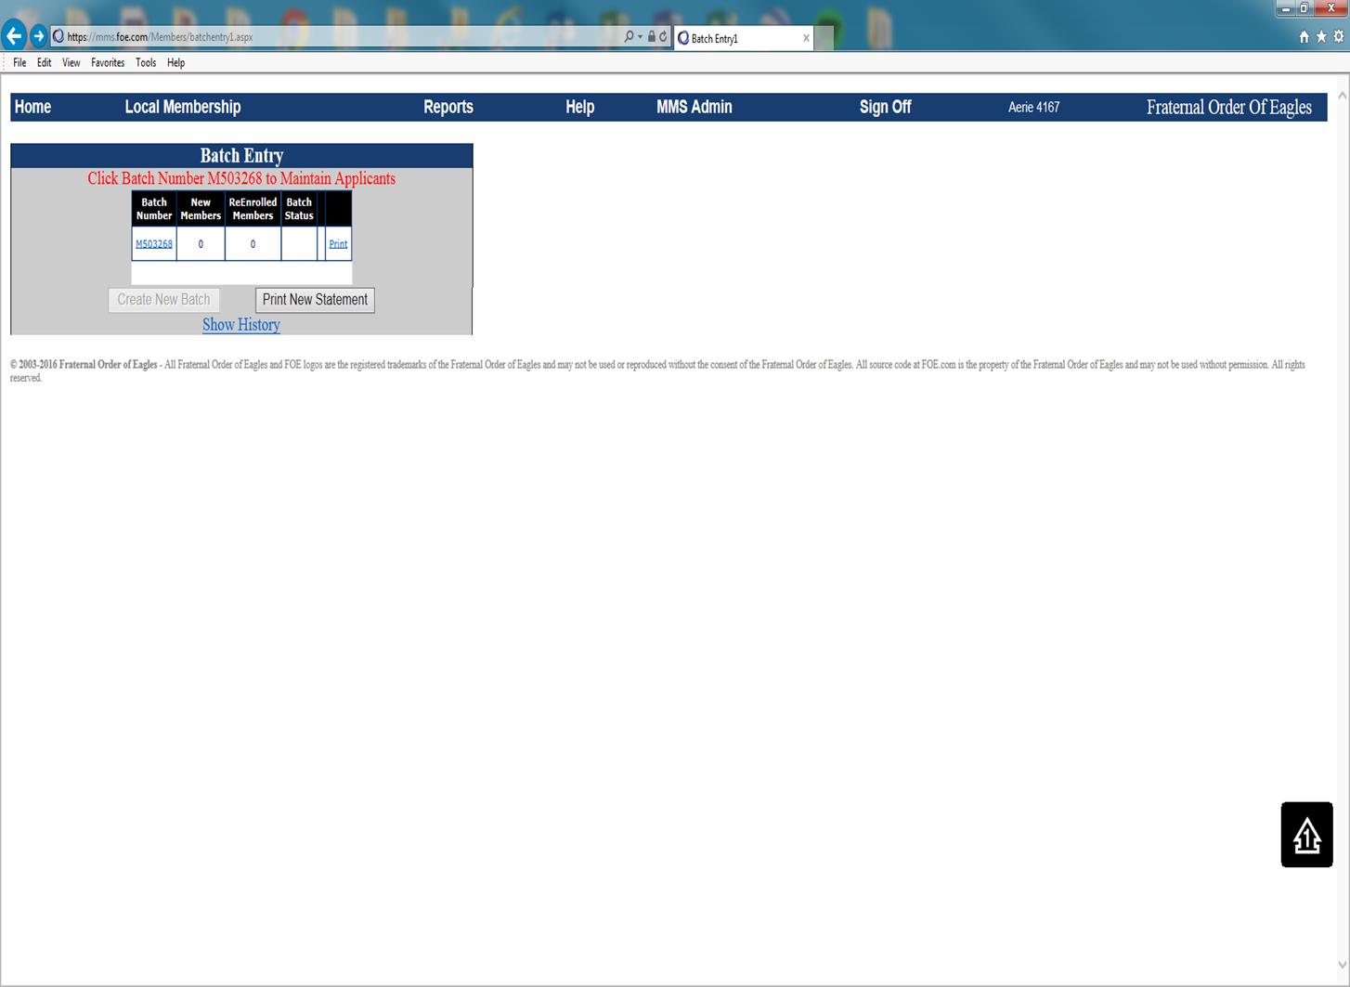

Slide 48
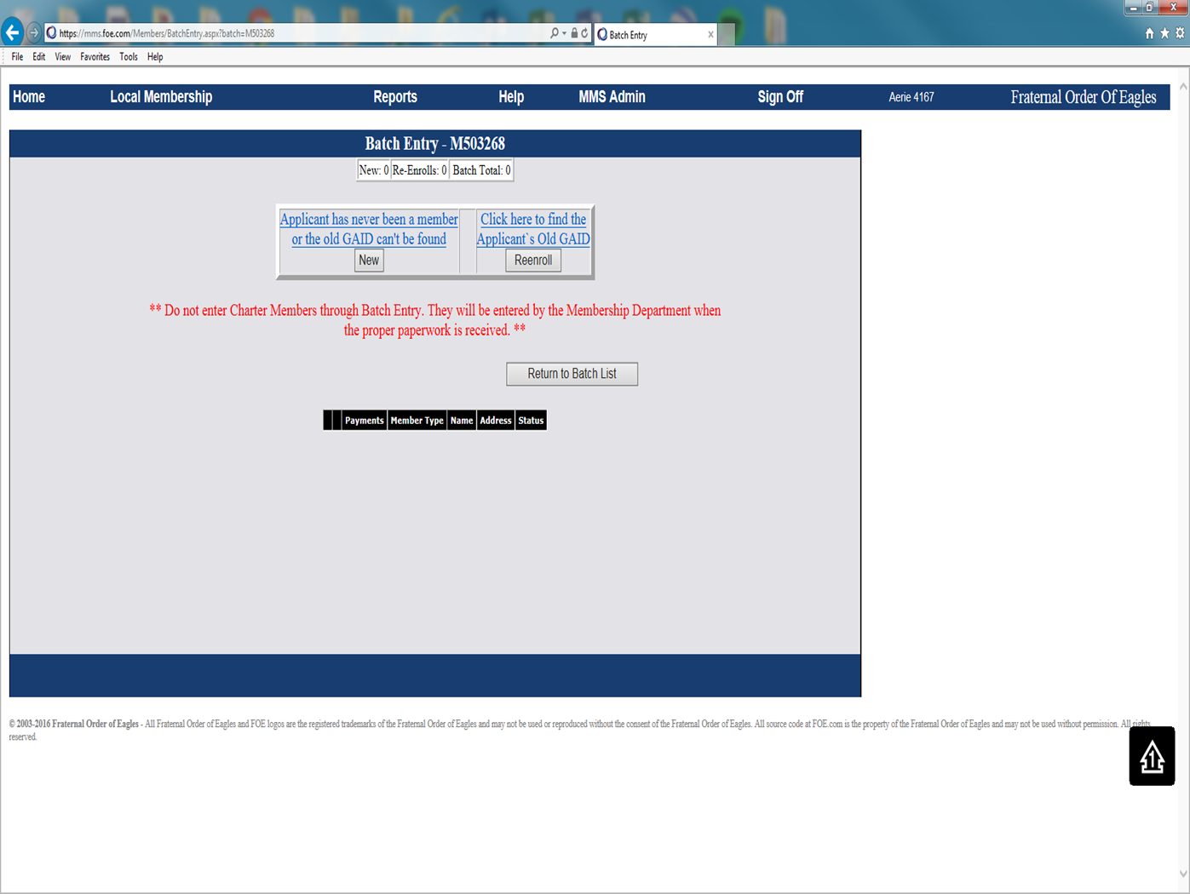

Slide 49
MEMBERSHIP & APPLICATIONS CONT’D
Dual Membership Applications
No initiation fee is required.
Must provide proof that their dues have been paid in advance at their Home Aerie.
Must be interviewed and voted upon.
Dues shall be determined by the By-Laws but can be no less than $10.00 nor more than the regular non-benefit member dues.
No Per Capita Tax is paid to the Grand Aerie.
Dual Members should NOT be added through Batch Entry.

Slide 50
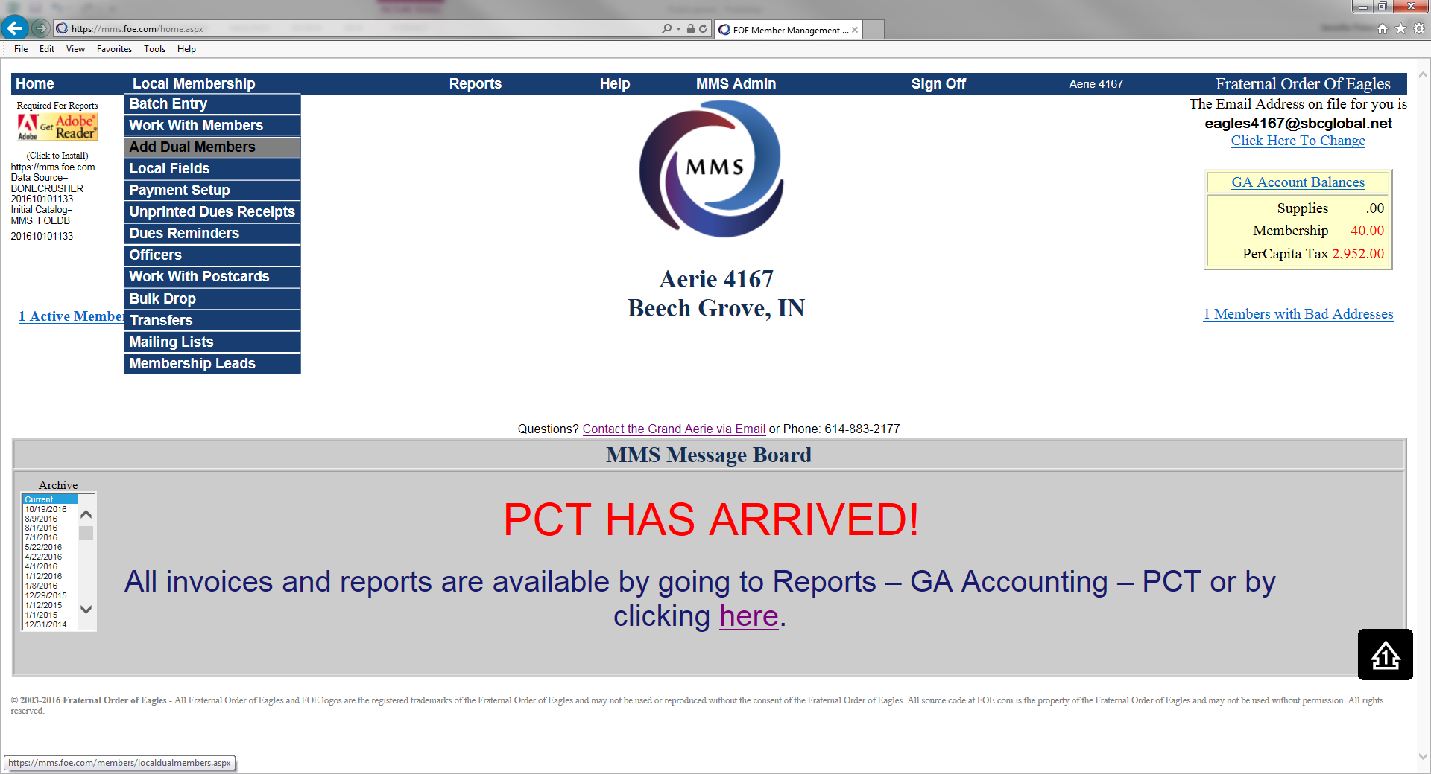

Slide 51
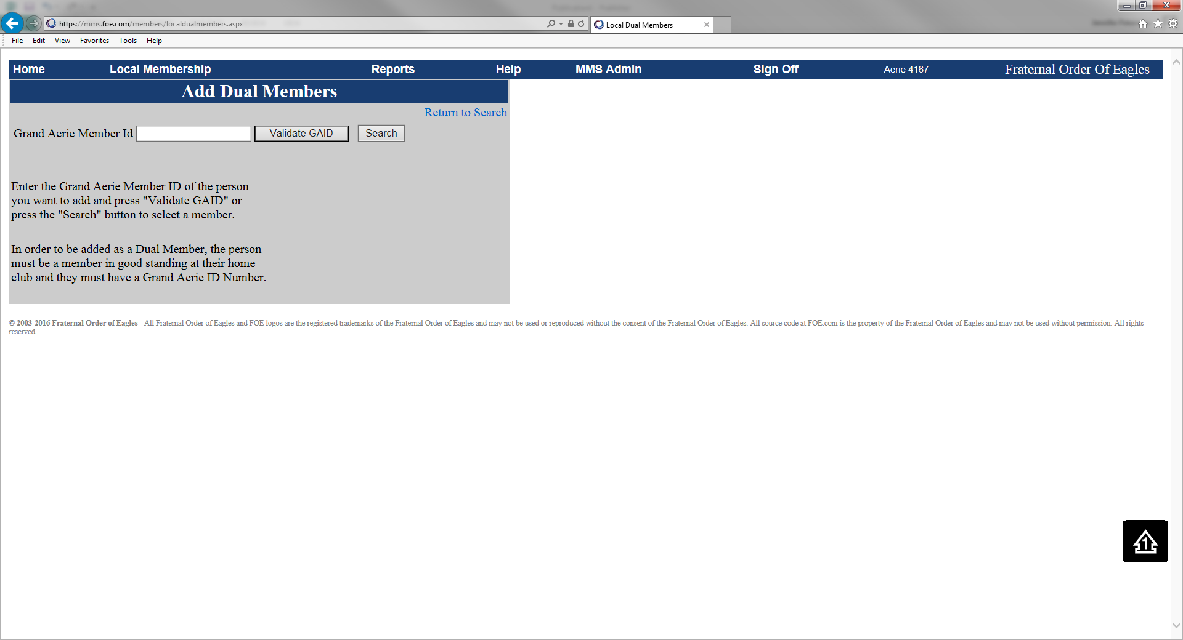

Slide 52
MEMBERSHIP & APPLICATIONS CONT’D
TRANSFERS
Must be interviewed and voted upon.
Must be a member in good standing with no charges pending.
A Home Aerie cannot refuse to transfer a member in good standing with no charges pending.
Member forfeit any dues paid to the Aerie which they belong and are required to pay dues to the Aerie in which they are transferring to.
Transfers should NOT be added through Batch Entry.

Slide 53
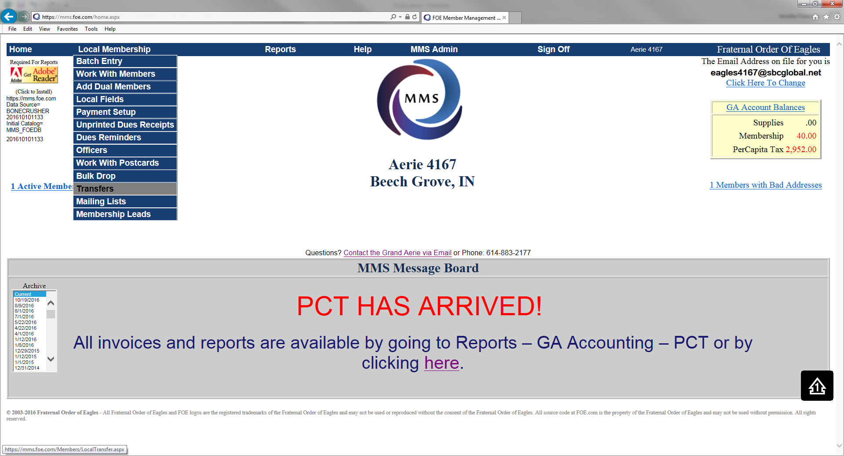

Slide 54
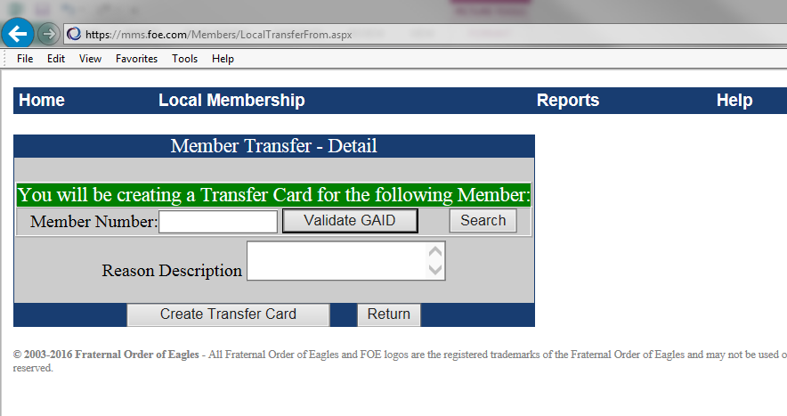

Slide 55
OFFICIAL RECEIPTS
Official Dues Receipts MUST be printed directly from the MMS System in color. This is the ONLY acceptable receipt to show as evidence of membership.
The Official Receipt must include the highest office the member has attained, if any.
Under 21 Years of Age must be endorsed on the receipt if the By-Laws so allow.
You can account for monies collected for dues and application fees within the MMS System.

Slide 56
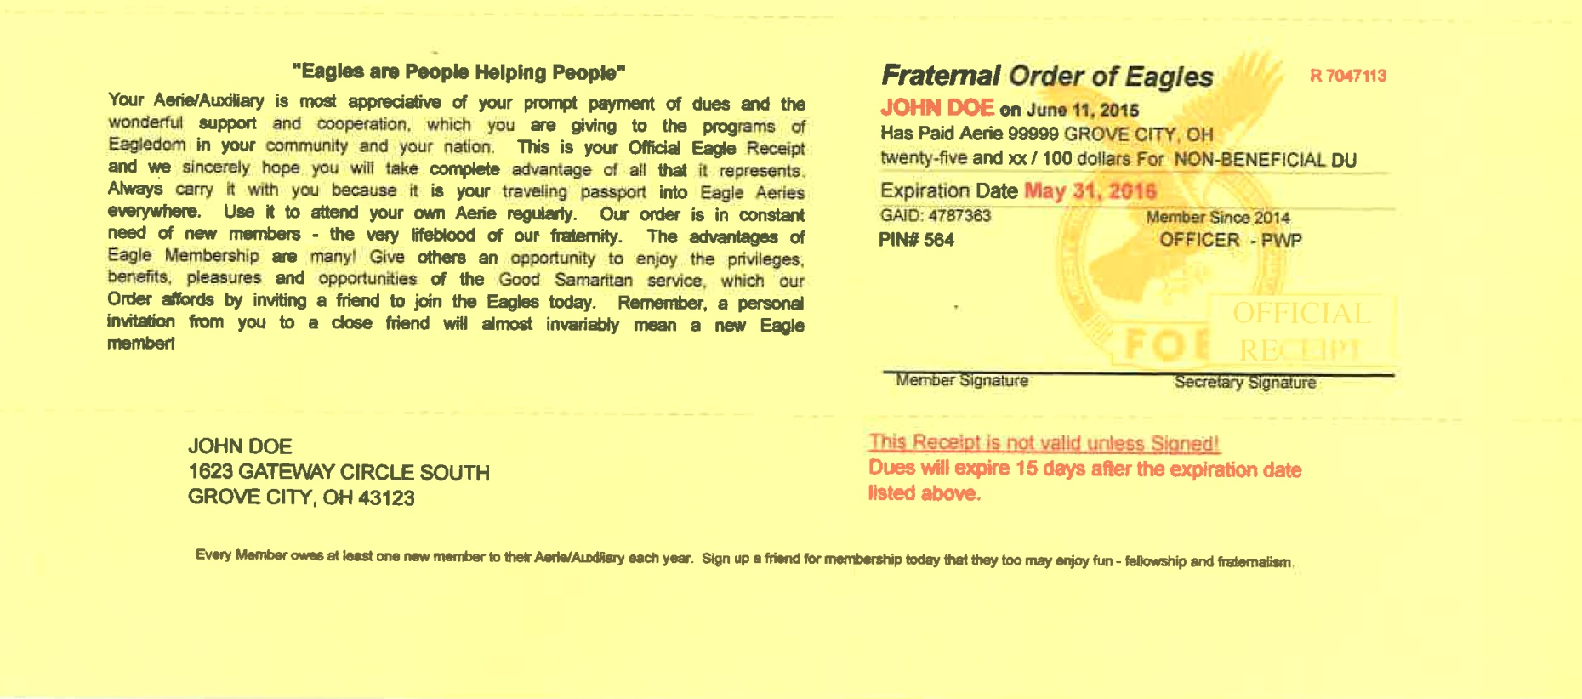

Slide 57
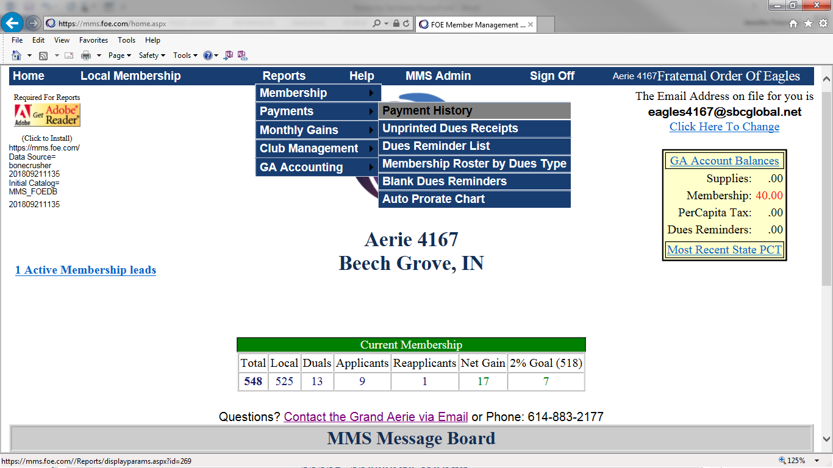

Slide 59
MEMBERSHIP RECORDS
You can still use the Membership Ledger Card; however, you have the capability in the MMS System to print out membership reports or individual records.
The MMS System will also keep records of those members who have been dropped for non-payment of dues, etc.

Slide 60
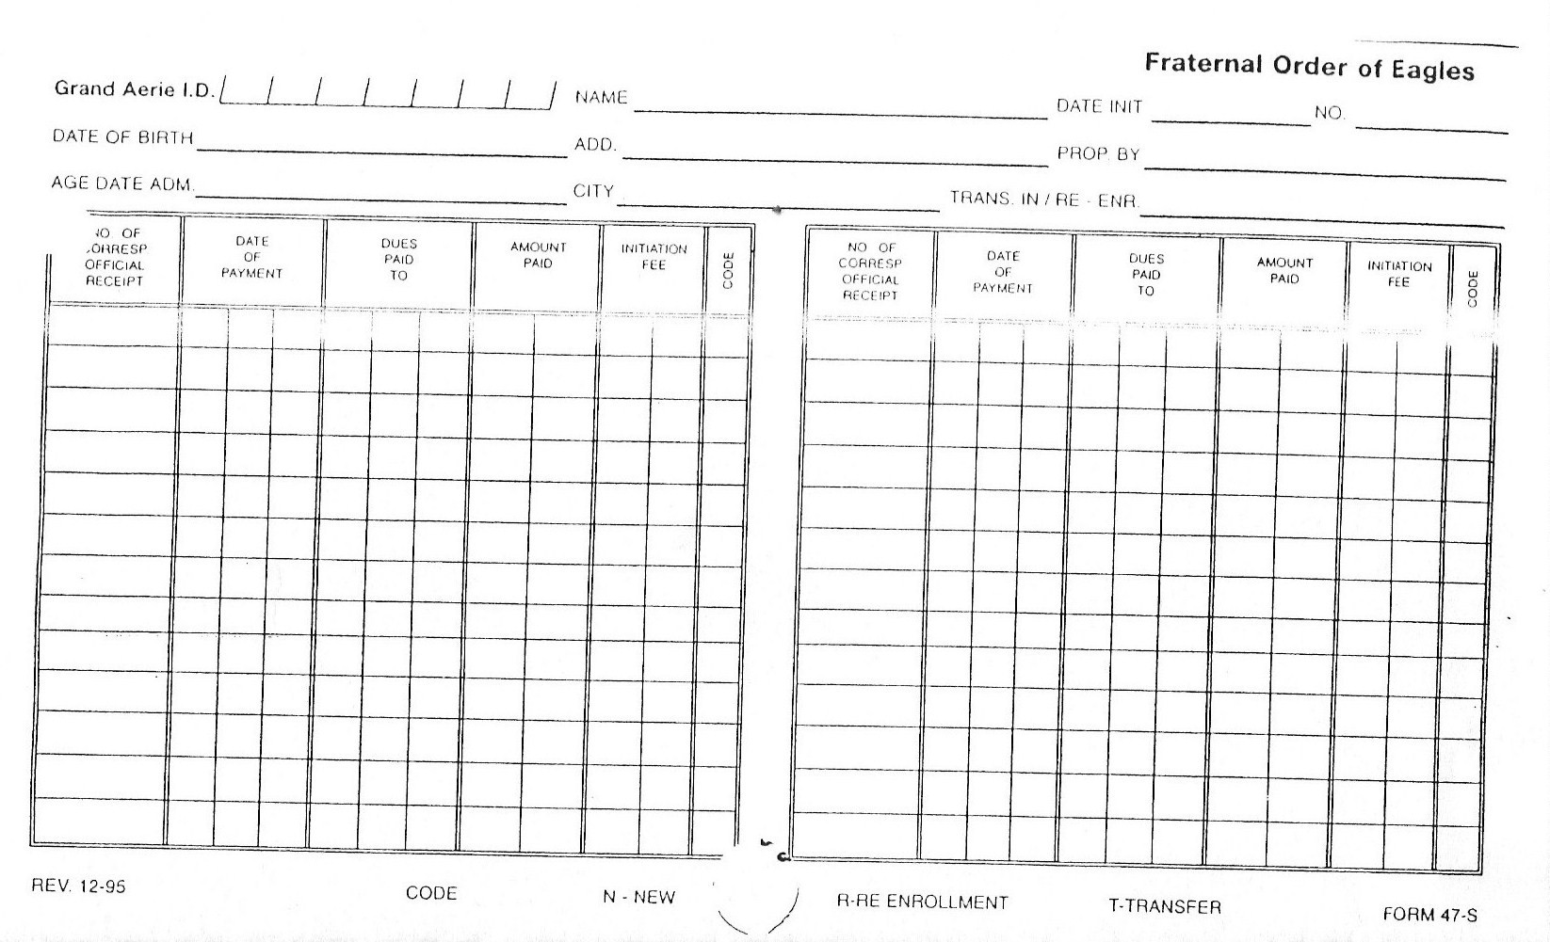
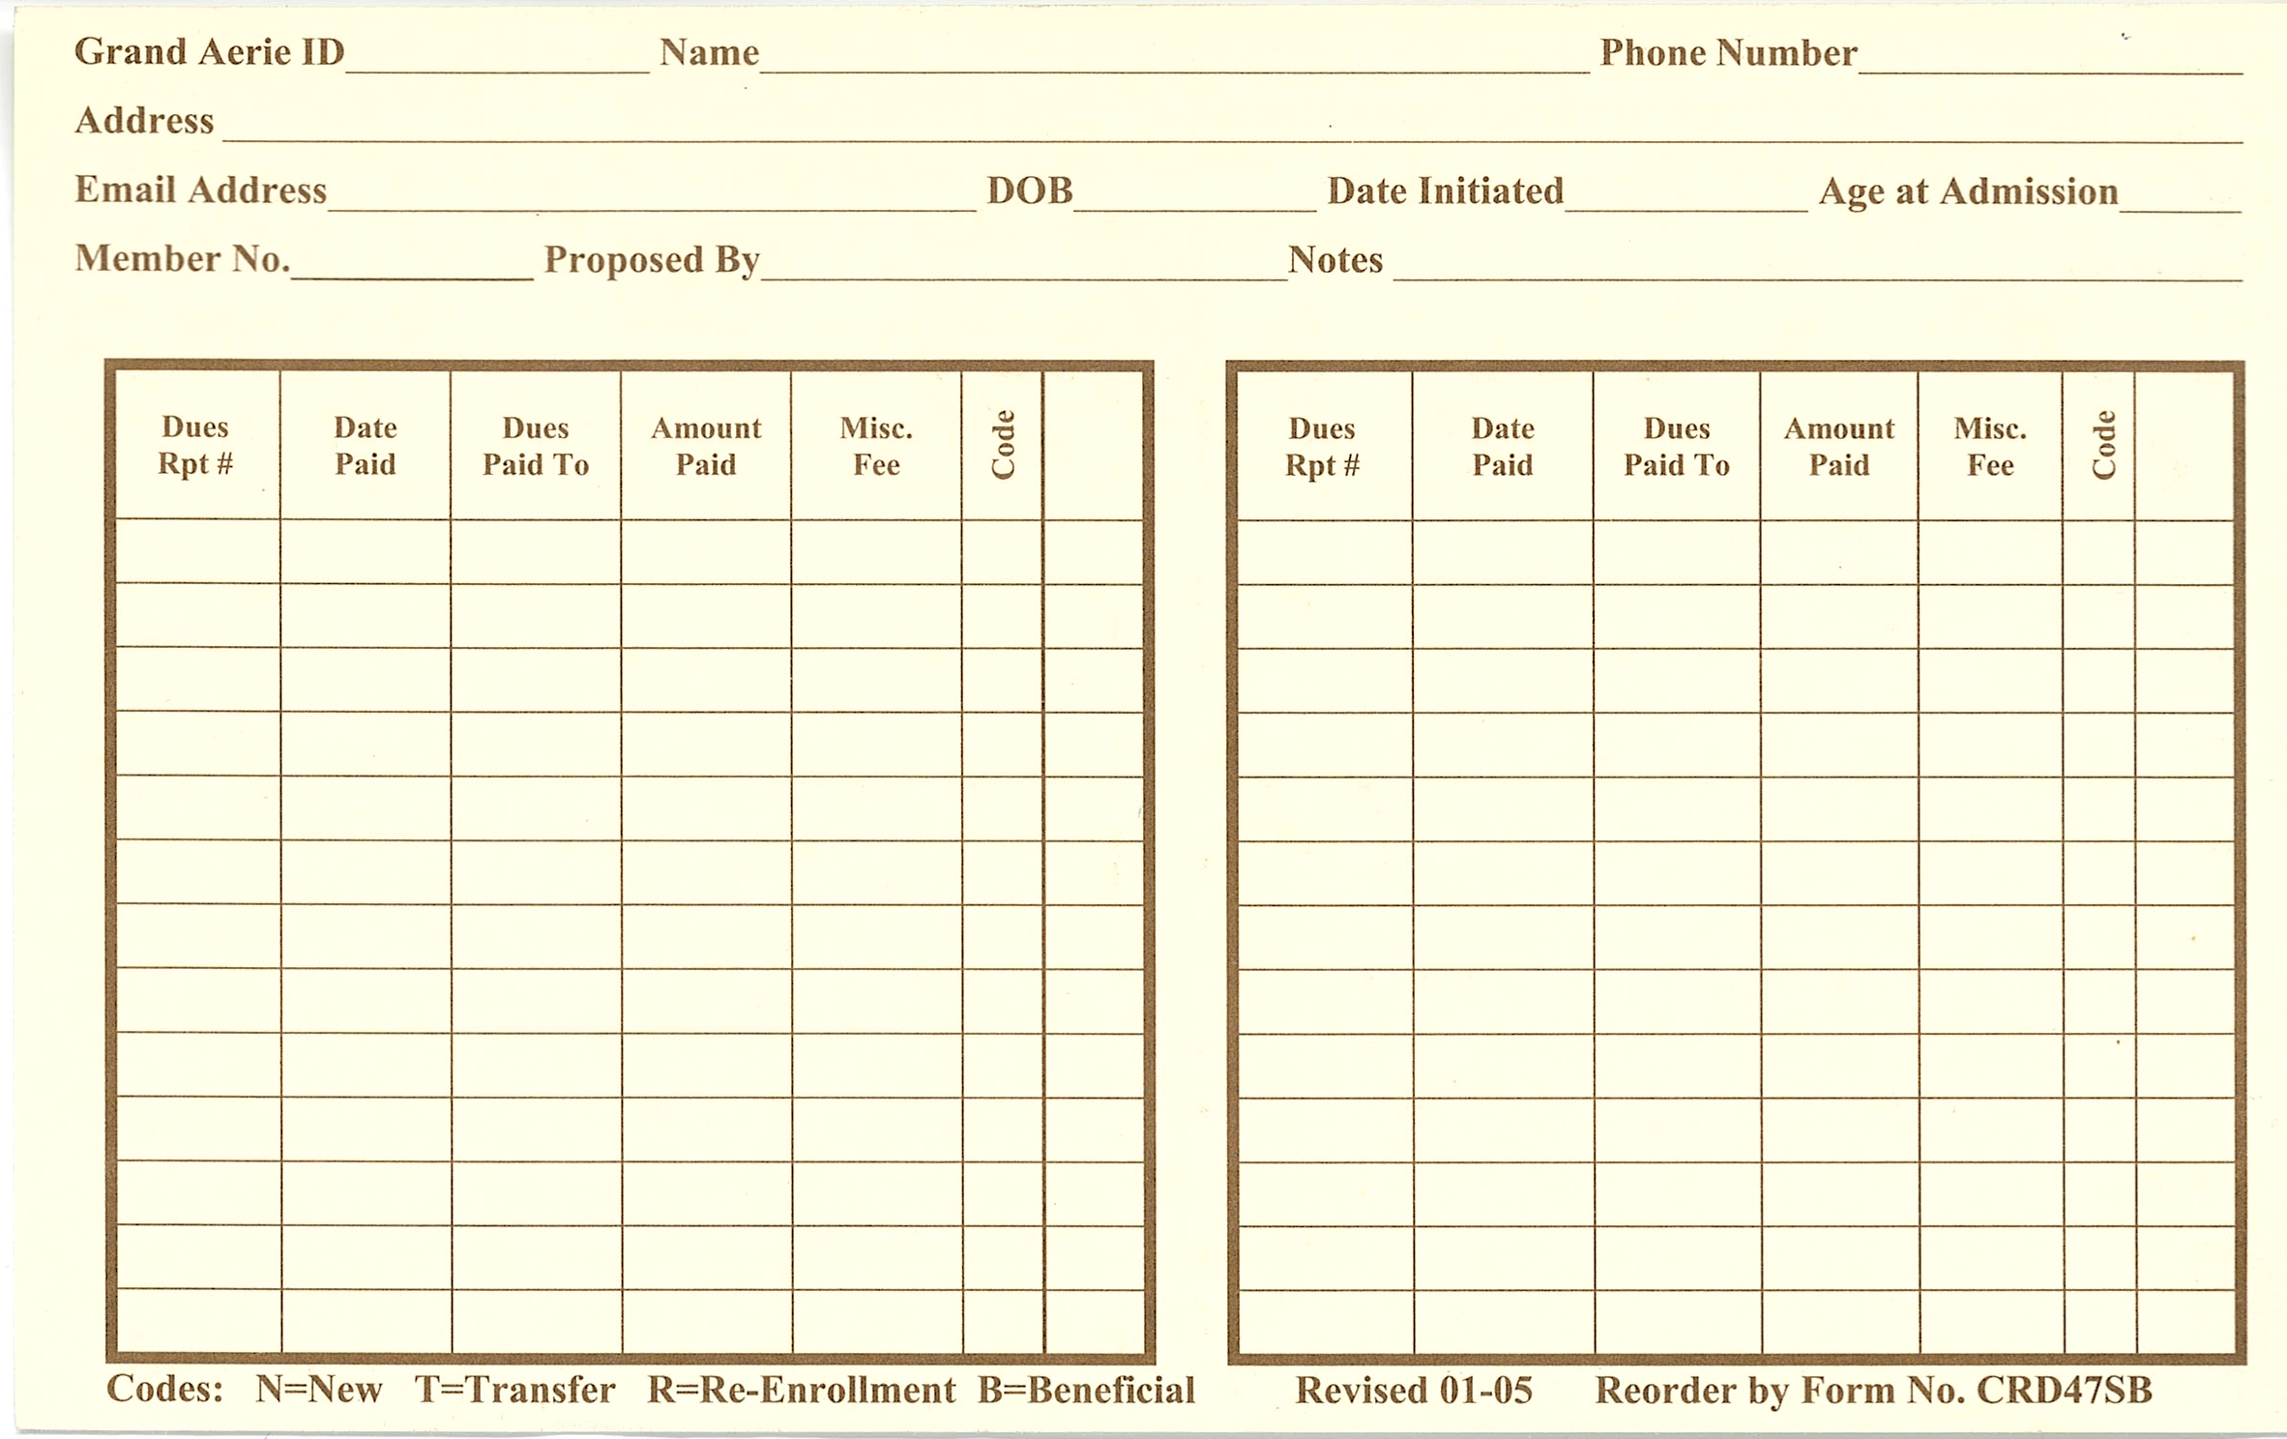

Slide 61


Slide 62
